Slide 1
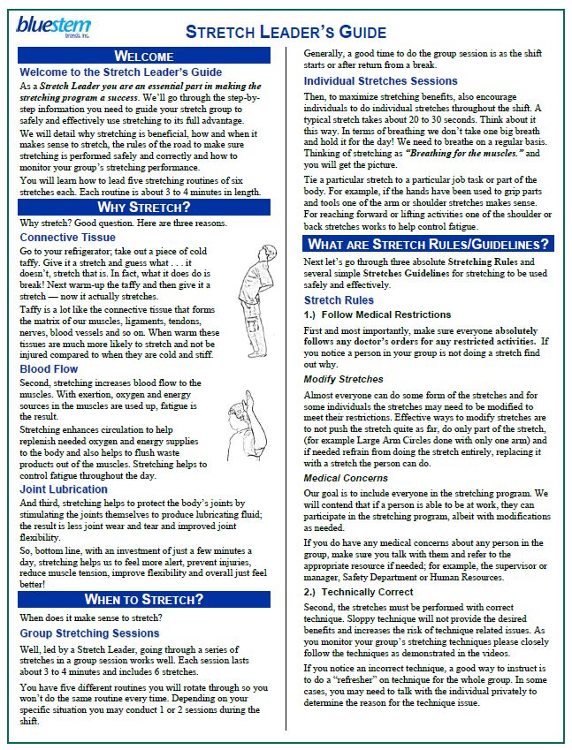
Bluestem Brands Stretching Program Menu
Welcome to Bluestem Brands Stretching Program. Click on the links below to access the training materials for the stretching program.
Leader’s Guide
Manual Written manual detailing how to lead groups in the stretching program
Video Video that complements the Leader’s Guide and includes Routines 1 to 5
Stretches
Poster – 11” by 17” laminated poster
Video Clips | Audio Clips
Routine 1 | Routine 1
Routine 2 | Routine 2
Routine 3 | Routine 3
Routine 4 | Routine 4
Routine 5 | Routine 5
Audio CD – The routines are also available on the accompanying Audio CD.
Produced for Bluestem Brands, Inc. by ErgoSystems Consulting Group, Inc. www.ergosystemsconsulting.com

