Slide 1
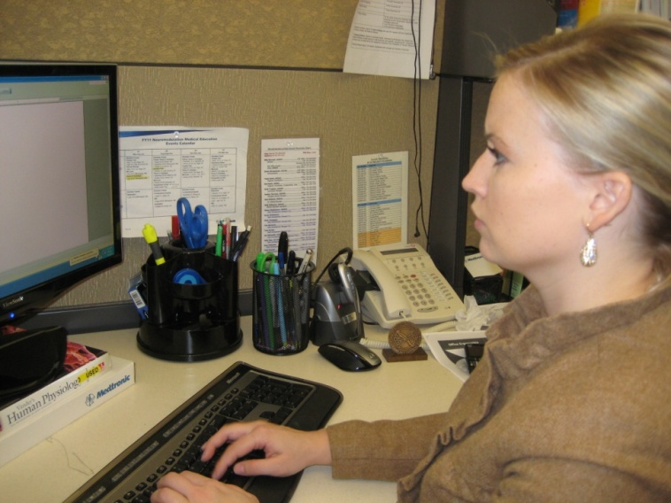
ErgoSystems presents . . .
A Practical Approach to Office Ergonomics
Mark Anderson, MA, PT, CPE
Ergonomist and Physical Therapist
ErgoSystems Consulting Group, Inc.

Slide 2
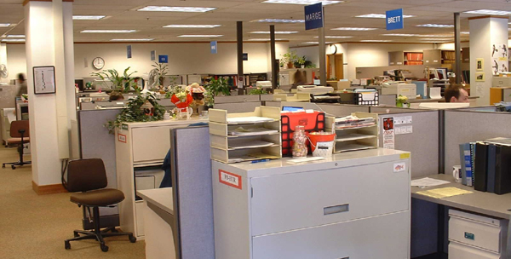
What do you want to accomplish?
Describe successful office workspace . . .

Slide 3
A careful examination
Look carefully at the words
Do you see any pattern or trend?
Is there a predominant theme?

Slide 4
In other words . . .
Words like comfort or comfortable mixed in with:
  Productive
  Efficient
  Satisfying
  Effective
  Safe and so on
Comfort . . . direct positive relationship to other descriptors

Slide 5
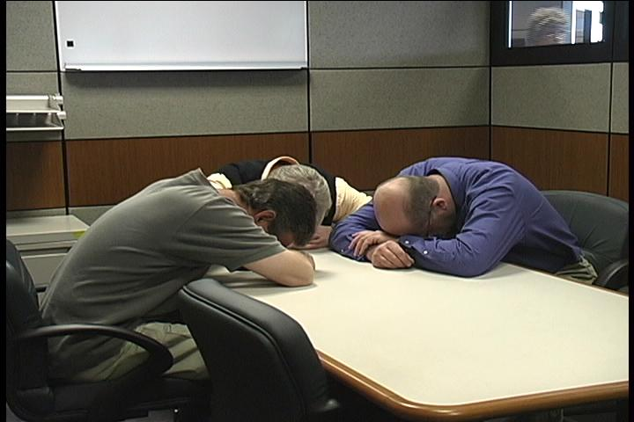
Maximize comfort?
The answer is NO!
Maximizing comfort can be very dangerous thing to do . . .
Optimize comfort in workplace!

Slide 6
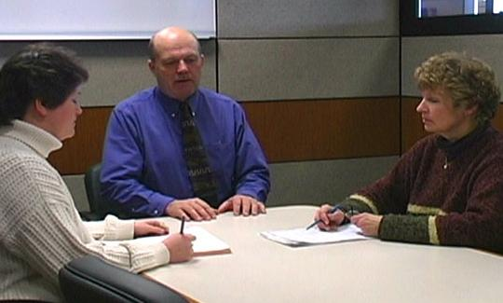
It’s all about relationships!
The relationships we form are one very important part of life
In office ergonomics, relationships between the user and the chair, workstation and equipment are also a critical component

Slide 7
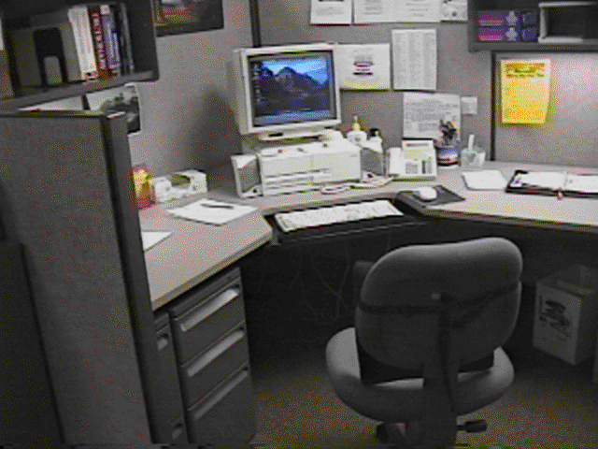
Relationships
What do you see as potentials problems in this example?

Slide 8
Discovery
You already know a good deal about office ergonomics!
You really can’t tell a whole lot until you see the workspace in use!

Slide 9
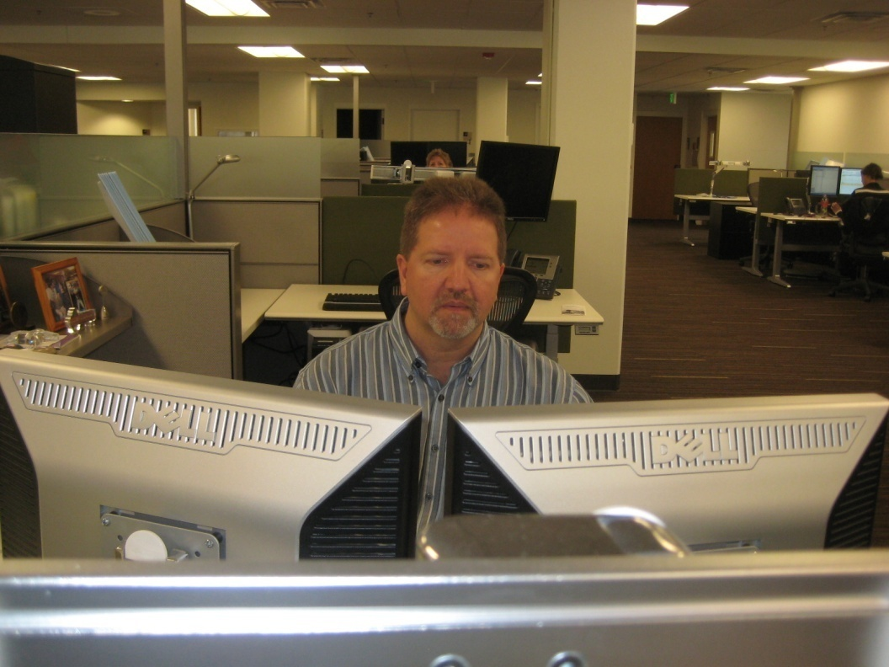
Workshop Objectives
Objectives
Discover what Office Ergonomics is all about
Identify components that make up the successful office workspace
Learn how to analyze and setup the office workplace
Acquire confidence in using system through practice

Slide 10
Workshop Guidelines
Follow along with demonstrations unless you think they may cause you a problem
Do not go against doctor's orders or do anything that you feel you should not
If you are uncomfortable sitting during workshop, move to side or rear of classroom
Use your good judgment when trying new techniques or exercises after you leave workshop

Slide 11

Course Logistics
Manual/handouts
Course Schedule
  Starting/ending times
  Rest breaks
Rest rooms
Fire exits
Telephones
Messages
Group Introductions

Slide 12
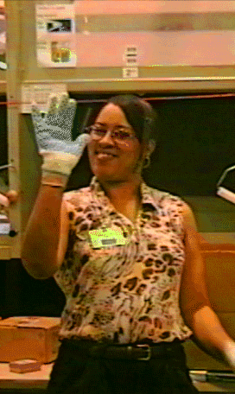
Please take a moment for:
Name
Background
Expectations

Slide 13
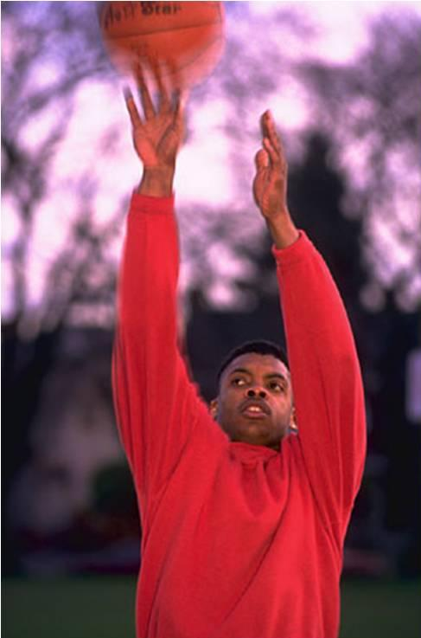
First of all . . . What is Ergonomics?
Ergonomics is like throwing a ball into the air
What happens?
Correct! The ball comes back down
Why? Because GRAVITY works!

Slide 14
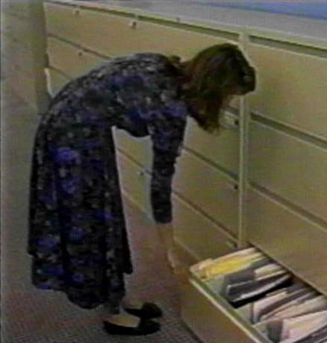

Applied to work

Slide 15
So, in our workspace, given a certain set of circumstances we will respond in a fairly predictable way

Slide 16
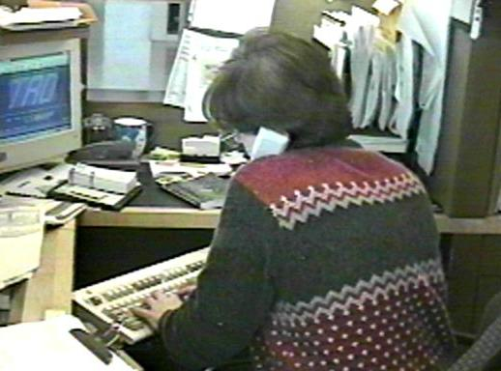
Definition of Ergonomics
The word “ergonomics” comes to us from the Greek
Ergon means work and nomos means the laws or study of
So, ergonomics is literally the “study of work”

Slide 17
Ergonomics . . .
The enhancement of all aspects of job performance – safety, quality and productivity – accomplished through the appropriate design and use of workstations, work processes and the overall organization of work

Slide 18
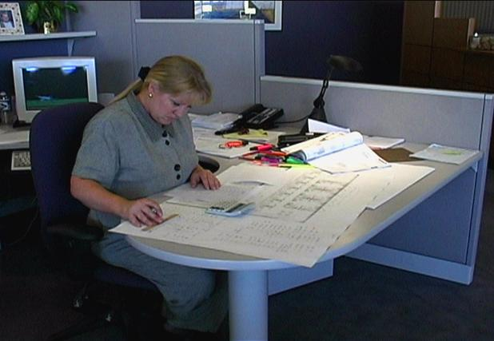
Ergonomics Principles

Slide 19
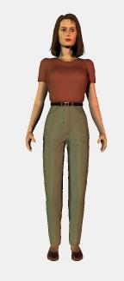
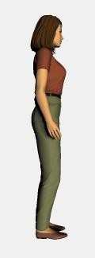
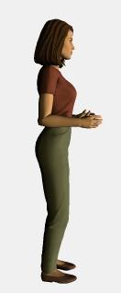
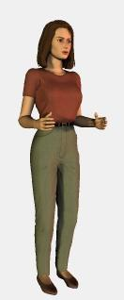
Position and support in neutral
Body neutral
Arm/Hand neutral

Slide 20
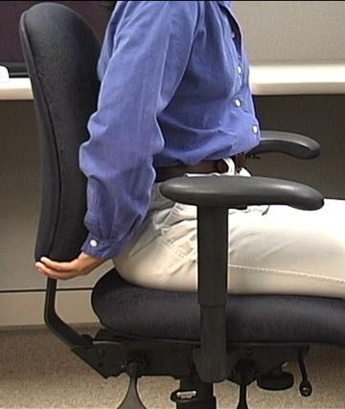
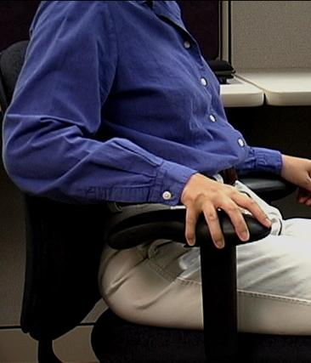
Provide support for body/limbs
Seated
  Compression of soft tissues
  Decrease in blood flow and circulation
  Proper seated support is critical
Limbs
  Proper support for limbs
  Removes strain of weight bearing
  Unloads neck, shoulders and back

Slide 21
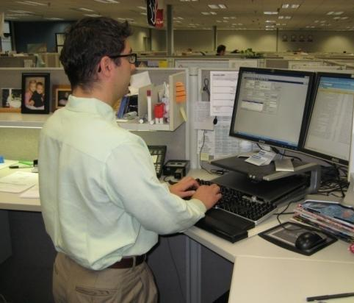
Provide support for body/limbs
Standing – sustained
  Unsupported standing for extended periods is not desired
  Joint compression occurs decreasing joint space
  Inadequate joint lubrication
  Fluid tends to pool in lower extremities
The bottom line . . . tiring!

Slide 22
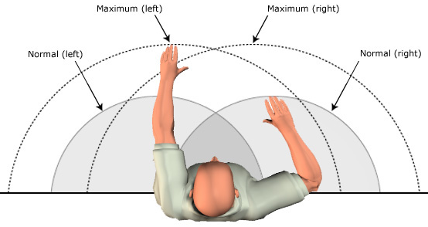
Work in reach zone
Stature and arm’s length determine reach zone
Determine individual reach zone and set up workstation to promote reach in that zone

Slide 23
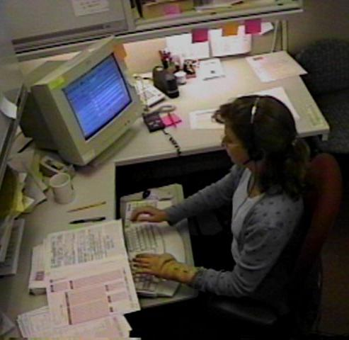
Promote effective work processes
Take step back and really examine why something is done as it is
If answer is, ‘Because it has always been done that way!’
Take fresh look
Is there better way to get it done?

Slide 24
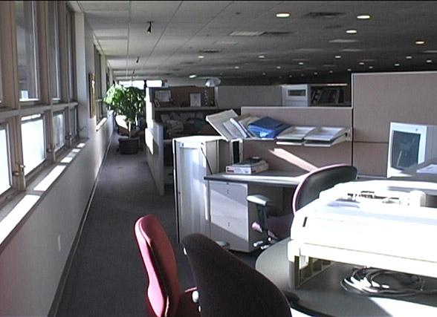
Moderate Environment
Light
Noise
Temperature
Ventilation

Slide 25

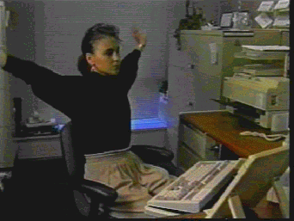
Movement, Movement, Movement!
Directly addresses our need to move to stay healthy
Provide workplace where regular movement is built into course of doing business
Movement helps to control fatigue by:
  Relieving awkward and sustained positions
  Promoting circulation to body's tissues

Slide 26
Ergonomics Principles
Position and support body in neutral
Provide support for body/limbs
Work in reach zone
Promote effective work processes
Provide moderate environment
Promote physical movement

Slide 27
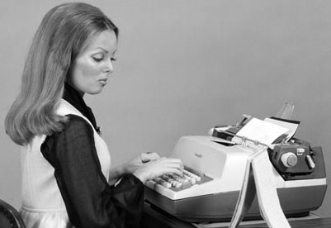
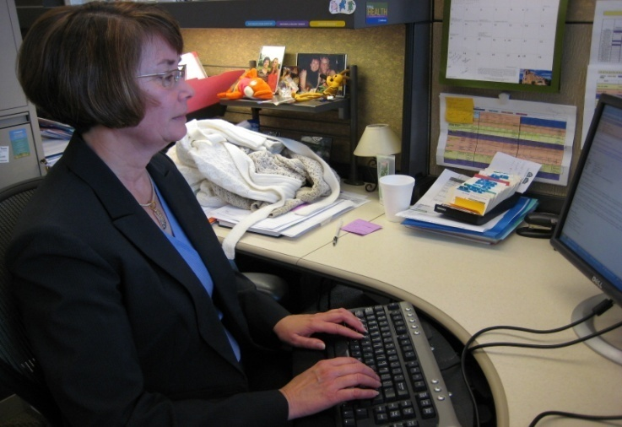
Office Ergonomics Applications
Typewriters to computers!
Where do we use computers?
EVERYWHERE!

Slide 28
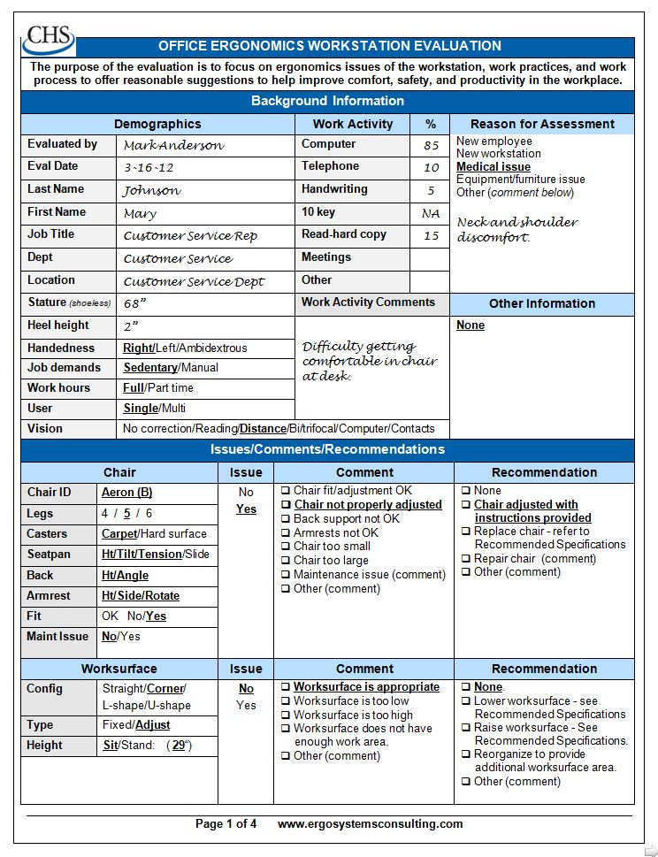
Office Ergonomics
Workstation Evaluation Form

Slide 29
Typical office components
User population profile
User – Single/Multi
Tasks – Single /Multi
Floor space
Seating system
Worksurface
Floor surface
Computer equipment
Telephone
Office equipment
Storage
Conference tables/chairs
Light
Noise
Temperature

Slide 30
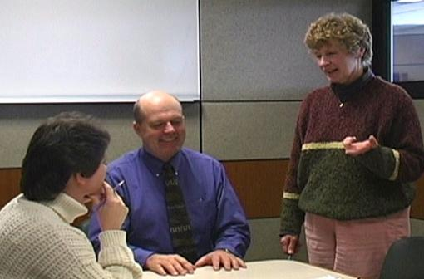
User population profile
Very important first step - accurately define user population
  Age
  Gender
  Stature
  Vision
  Hand dominance
  Other
Defining user profile lays the foundation for remainder of process

Slide 31
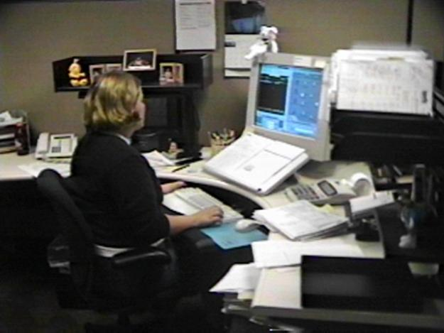
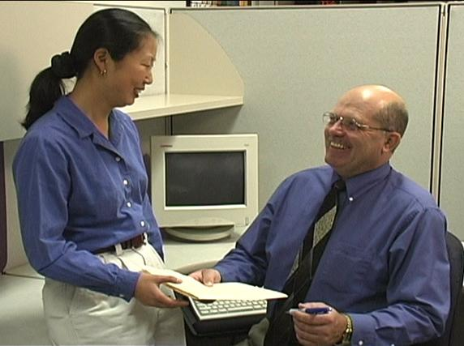
User: Single/Multi

Slide 32
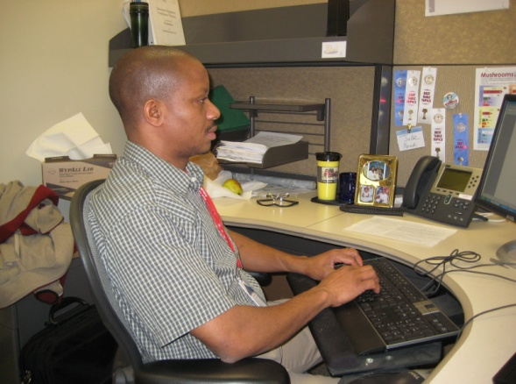
Single user
Less influenced by need for adjustability of workstation itself
Once determine proper height of worksurface
  Use fixed height or adjustable/fixed worksurface
  Worksurface can be height adjusted but once adjusted is not readily changed

Slide 33
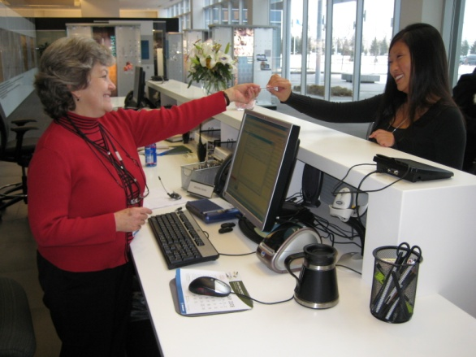
Multi user
Multi-user workstations require significantly greater degree of adjustability
Critical that changeover from one user to next accomplished quickly and easily
Adjustable/adjustable worksurface
  Through spring balanced manual system/powered system worksurface height readjusted within seconds

Slide 34
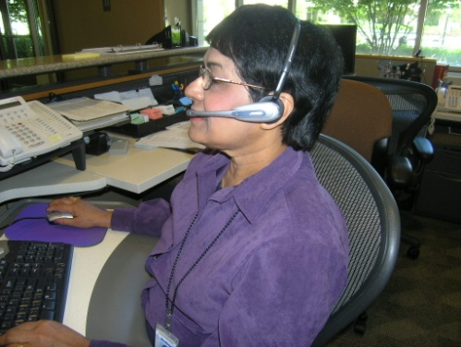
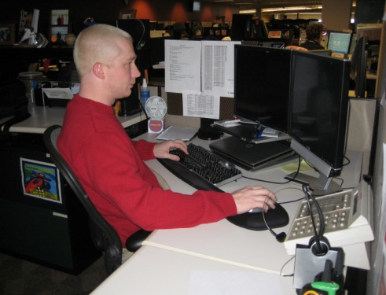
Tasks: Single-task or Multi-task

Slide 35
Single-task
Majority of work time accomplishing specific focused task
For example, customer service representative majority of day on computer and telephone performing computer lookup activities
Physically job demands are concentrated in single area
Efficient set up is critical because user tends to maintain sustained position to perform activities

Slide 36
Multi-task
Number of different tasks need to be accomplished
  Computer
  Telephone
  Writing workstation
  Attending meetings
  And so on

Slide 37

Work Activity
(percentage breakdown)
Computer
Telephone
Read
Write
Meetings
Misc
Other

Slide 38
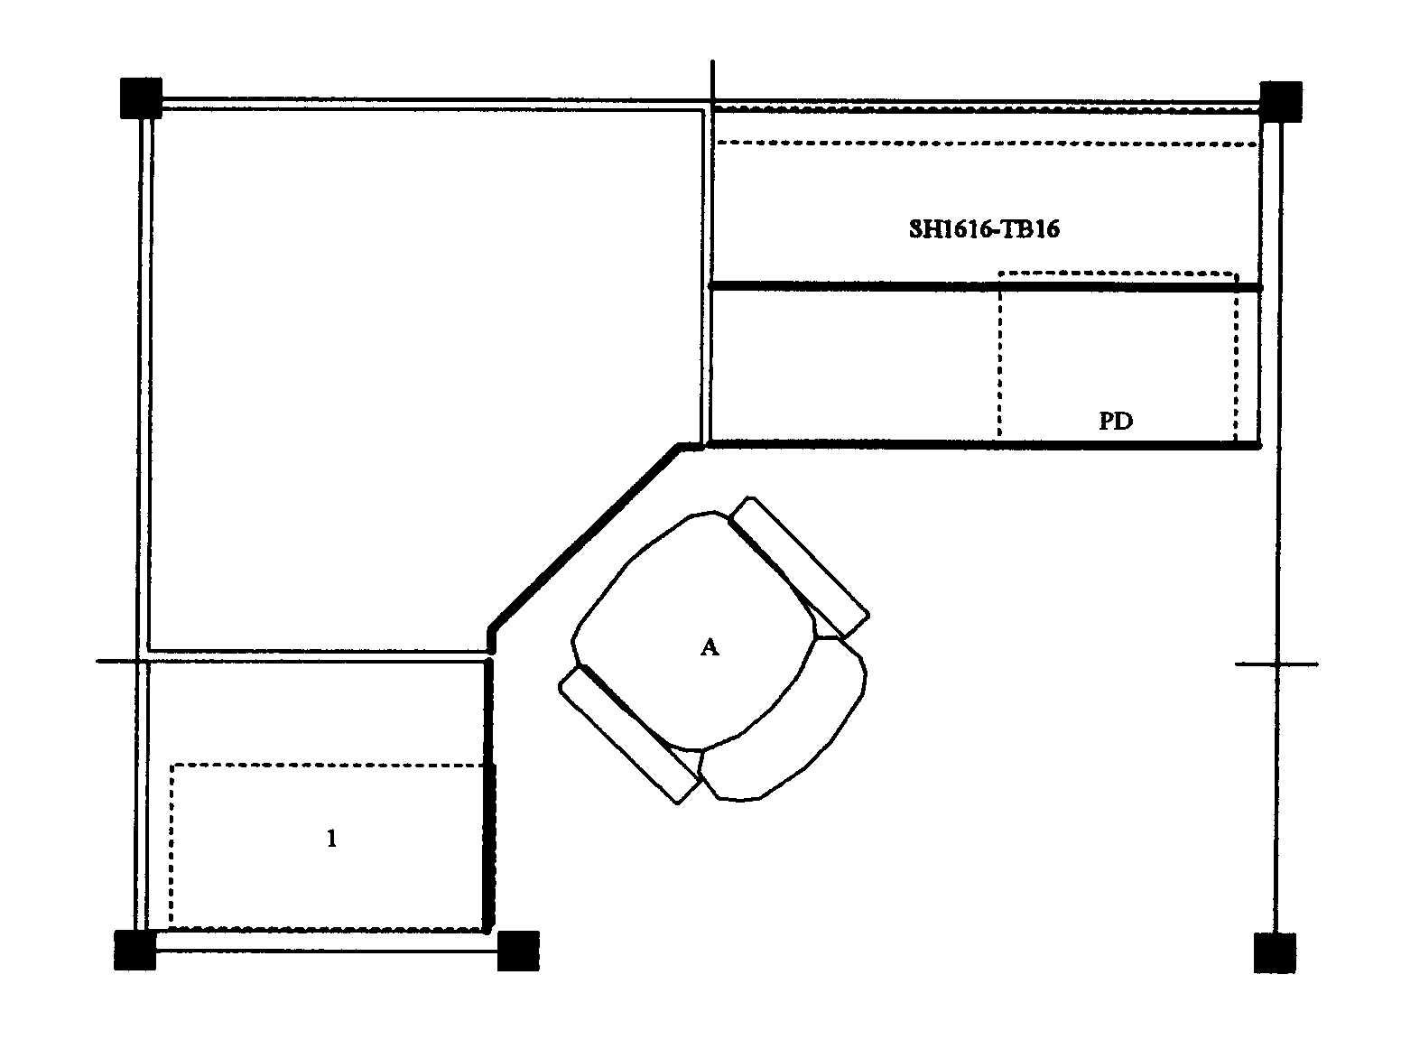
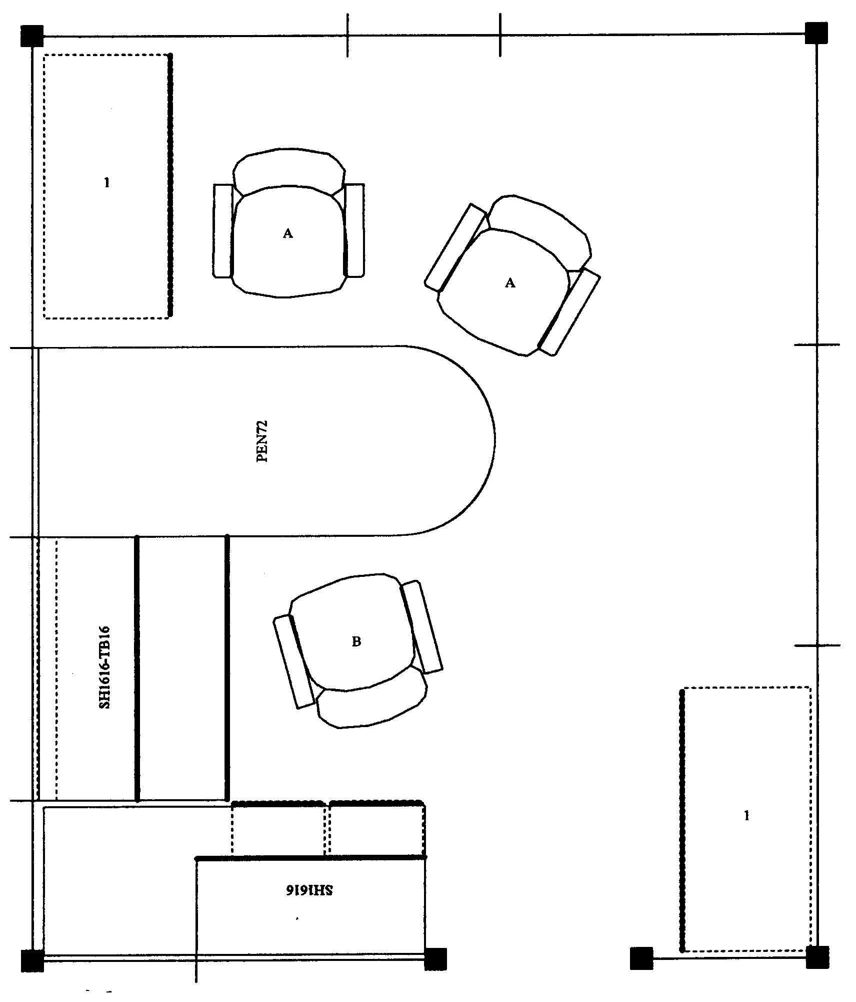
Floor space
In ideal world, dimensions of office workstation are determined exclusively by job tasks
  Some very focused single-task workstations 48 sq ft
  Multitask workstation 120 sq ft or even more

Slide 39
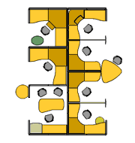
We do not live in an ideal world
Floor space may be determined by host of factors not relative to job task
Does not negate need to perform an effective job analysis to make recommendations
Does cause us in many cases to be quite creative!

Slide 40
Office Ergonomics
Workstation Evaluation Form

Slide 41
Office Ergonomics
Workstation Evaluation Form
Background Information
  Demographics
  Work Activity
  Reason for assessment

Slide 42
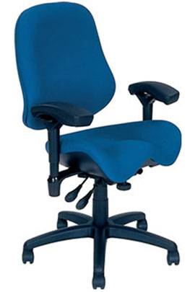
Chair
Objectives of chair
  Support body and limbs to provide relief from weight bearing
  Provide stable base or platform for body and limbs
  Position user at correct height and reach relationship to worksurface and tasks at hand
  Allow for easy change in position/movement of user

Slide 43
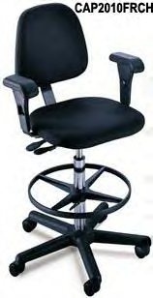
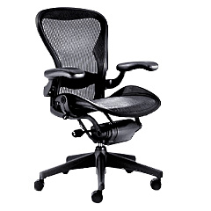
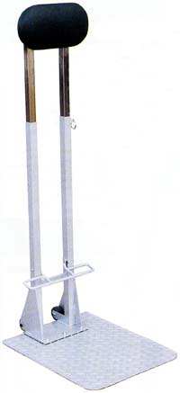
Types of seating systems
Number of seating systems available in workplace
  Office chairs
  Stools
  Lean platforms
  Other miscellaneous seating

Slide 44
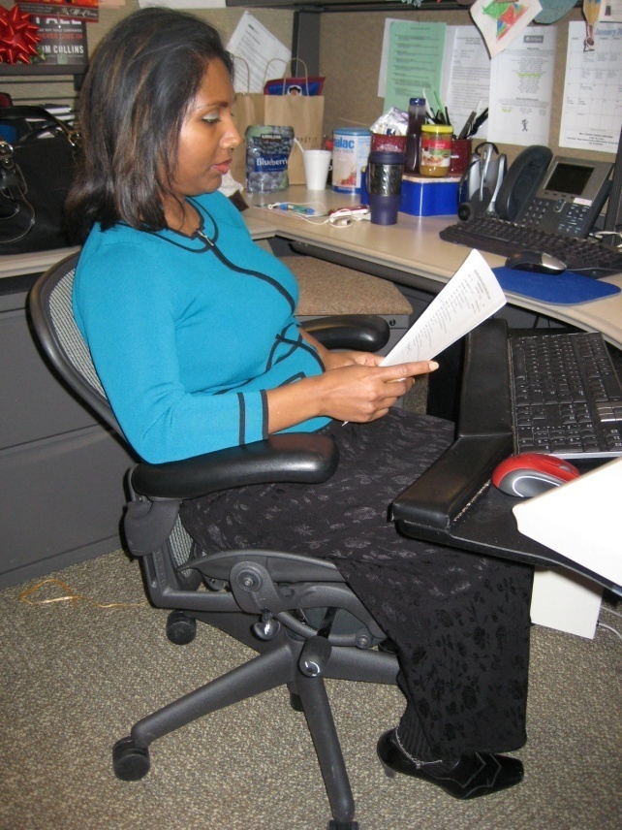
Chair criteria
Type, use and efficiency of chair are critical elements
Acceptable chair criteria determined by:
  Type of job activities performed
  Size and shape of user
  Duration of time spent in chair

Slide 45
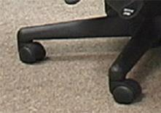
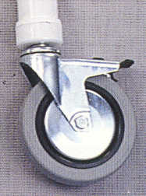
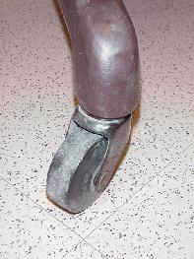
Legs and Casters
Does the chair have at least 5 legs?
Does the chair roll easily on the floor surface?
  Hard caster on soft floor
  Soft caster on hard floor

Slide 46
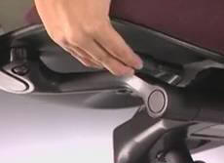
Seatpan Height
Does the chair’s seatpan height adjust up and down?

Slide 47
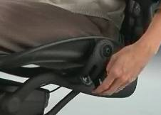
Seatpan Tilt
Does the chair’s seatpan tilt up and down?

Slide 48
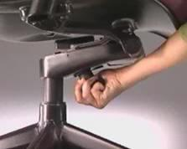
Seatpan Tension
Can you adjust the seatpan tension?

Slide 49
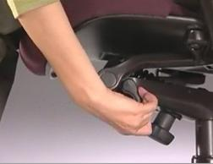
Seatpan Depth
Does the chair’s seat move forward or backward?

Slide 50
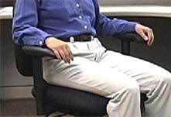
Seatpan Fit
Does the chair’s seat fit body size?

Slide 51
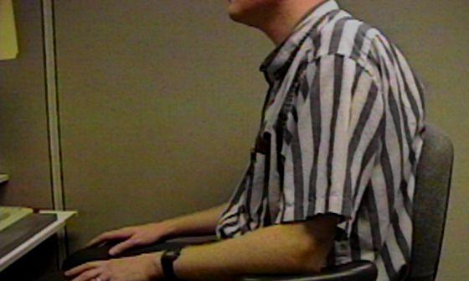
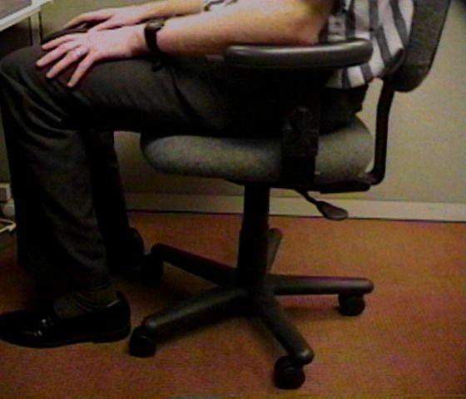
Relationships
Does the chair fit the individual?
  This gentleman is 7’ tall!
  Arrows point to back of knee and front edge of seatpan

Slide 52

Back Support Height
Does chair’s back support move up and down?

Slide 53

Back Support Angle
Does chair’s back rest angle forward or backward?

Slide 54

Cushion
Suitable cushion
  Foam density
  Wearability
  Breathability
  Type of material (fabric or rubberized)

Slide 55

Armrests Adjust
Do chair’s armrests adjust up and down and/or side-to-side?

Slide 56
Relationships

Slide 57

Maintenance
Is chair functioning properly?
No maintenance problems?

Slide 58

Adjustment levers/knobs/controls
Easy to reach
Easy to manipulate
Should not intimidate

Slide 59

Ball Chairs?
Therapeutically, exercise balls used in clinical settings as treatment modalities
  Improve spinal stability
Over past several years, use of exercise balls in place of or in addition to task chairs
  Currently only anecdotal evidence exists to support full-time use
Most ergonomists advocate for properly sized/properly adjusted office task chairs rather than use of ball chairs

Slide 60

Art of Sitting
Body not designed to sit
  Particularly for long periods
  Studies determined even when seated in well-supported postures . . .
  How soon do we want to move?
  About every 20 to 30 minutes!

Slide 61

The Art of Sitting
Three point contact
  Sacrum/Trunk
  Hips/Thighs
  Feet/Floor

Slide 62

The Art of Sitting
90/90 seated posture?
  Only in drawings!
  Most people will sit at 95 to 110 degrees at hips and knees

Slide 63




Sitting styles
Sitting styles quite varied from person to person:
  Percher
  Slouch
  Sit crossed leg
  Sit on leg

Slide 64
Sitting styles
Particular sitting style needs to be assessed
  Habit developed over time
  Response to poor workstation setup
  Combination of both
  What drives problem is frequency and duration of seated position

Slide 65



Functional seated positions
Provide for several different acceptable postures
Rotate throughout day on regular basis:
  Upright “keyboard” position
  Semi-reclined/rocking “conversation” position
  Standing

Slide 66

Adjustment anxiety
Chairs can be pretty expensive
  All kinds of bells and whistles
  Chair only as good as how it is adjusted
Some people have never adjusted their chair
  Just sit down and go to work!
Bottom line
  Need to initially be able to adjust chair to fit
  As well as throughout day

Slide 67

Chair solutions
Manual
  Find and read it!
Position and support body in neutral
  Adjust seat pan/back support tension to hold body in neutral position
  Adjust seatpan height to get feet on floor with even pressure on hips and thighs
  Adjust height and angle of back support to fill in low back curve

Slide 68
Relationships

Slide 69


Chair

Slide 70
MOVE!
Remember, no matter how perfectly adjust chair to fit
  Still comes down to fact that need to move on regular basis to keep body healthy and safe
Movement is critical to the health of the body!

Slide 71

Worksurface
Worksurface objectives
  Provide functional workspace (depth, width)
  Support and position equipment
  Provide access to work materials
  Achieve desired relationship match between user/work

Slide 72
Straight line (desk/table)
The straight in-line configuration is suited for single task activities with minimal reach requirements for other office equipment and materials

Slide 73
L-shape (two worksurfaces)
L-shaped configuration is suited for single to multitask activities that require two or more separate workspaces
One workspace may be used as computer workstation and another as writing or collating workstation

Slide 74
Corner/U-shaped
Corner/U-shaped configuration well suited for multitask activities in same workspace with significant requirements to frequently reach other office equipment and materials
Allows for greatest degree of adjustability and accommodation for user

Slide 75

Worksurface Fixed
Traditional desk at fixed worksurface height of 29 inches - Millions of these!
Not designed to be changed in height or angle
Generally possible to raise fixed height worksurface on supports but also generally very difficult to lower it

Slide 76

Worksurface Fixed/Adjustable
Wall panel mounted worksurface or worksurface on legs
Can be adjusted within given range but once adjusted fixed in that position on fairly permanent basis

Slide 77


Adjustable/adjustable
Sit/stand workstations
  Controlled by mechanical springs or powered mechanisms
Keyboard trays
  User can readily and easily adjust worksurface

Slide 78



Wrong Desk height
If work height is adjustable, adjust it as needed
  Raise height of work surface by putting it up on blocks
  Make sure desk or work surface is solidly placed on blocks and won’t fall off!
Adjust chair height
  Make sure feet are supported either on floor or with footrest
Add height/angle adjustable keyboard tray
  Mounted underneath work surface

Slide 79

Not enough layout space
House cleaning
Other worksurfaces available for use
  File cabinet at standing height to review documents
Relocate some of equipment on desk
Pullout drawers already in desk

Slide 80

Sit/Stand Workstations
Worksurface at standing height
Stool
Foot rest

Slide 81

Sit/Stand Workstations
Portable system placed on desk
  Adjustable keyboard/mouse and monitors
  Use chair when seated

Slide 82


Sit/Stand Workstations
Height adjustable sit/stand workstation

Slide 83

Worksurface

Slide 84


Foot Support
In an ideal world the best foot support when seated in a chair is the floor . . .
However if needed use proper sized foot rest

Slide 85


Knee/foot clearance
Move what is not needed to some other storage position or get rid of it
Survey work area and determine what is blocking access

Slide 86

Foot Support/Clearance

Slide 87

Work organization
Includes organization and structure of tasks/activities performed throughout workday
  e.g. Do not store file boxes on the floor

Slide 88

Work organization solutions
Space in most companies is premium
  Store infrequently used items outside of immediate work environment
Pick up at end of day

Slide 89


Floor surface
Providing ease of rolling chair on floor surface
Nonskid surface to prevent slips and falls
Non glare surface to reduce overall glare in workstation

Slide 90



Keyboard Trays
Keyboard tray configurations
Keyboard tray size
Height adjustment
Angle adjustment
Knee clearance

Slide 91

Keyboard Tray

Slide 92

Computer equipment

Slide 93



Keyboards
Keyboard configurations
  Straight-line
  Curved
  Articulated
Keyboard surface finish
Keyboard size
Keyboard activation pressure
Layout
Wireless

Slide 94


Keyboard Technique
Free float piano playing style
Use of worksurface for forearm support

Slide 95




Non-neutral Keyboard Positions

Slide 96
Keyboard Solutions
Based on technique obtain correct height, reach and angle of keyboard
Adjust keyboard height and position
  Adjust worksurface height
  Keyboard tray
If cannot adjust keyboard height, position chair height to place hands in neutral posture in relation to keyboard
  May require support for feet if no longer touch floor

Slide 97

Wrist rests
To use or not to use . . .
That is the question!

Slide 98



Poor Technique
If technique needs improvement
Training programs that teach improved technique

Slide 99

Take break
Add stretching to day
  A little post it note put on computer monitor
  Software that reminds you to stretch
  Old-fashioned as egg timer
  Team up with someone else in office
  Take advantage of natural breaks between activities
Remember to Stretch!

Slide 100

Keyboard

Slide 101

Pointing device
No not that kind of mouse!
Use mouse as little as possible
  Keyboard shortcuts

Slide 102

Pointing device technique
Neutral positions
  Same plane as keyboard
Mousing style or technique
  Free float piano playing style
  Use of worksurface for forearm support

Slide 103




Pointing Device Non-neutral Positions

Slide 104


Mouse Wrist Rests
In most cases, mouse wrist rest is not recommended
  Wrist rest tends to “anchor” wrist
  Excessive side-to-side deviation of hand
Straight in access
  Allow forearm, wrist and hand moving as unit to manipulate mouse
  Think of mouse as extension of arm NOT just extension of wrist

Slide 105


Pointing Device Solutions
Based on technique
  Adjust worksurface height
  Mouse tray
Cannot adjust mouse height and position
  Position chair height
  May require foot support
Keyboard shortcuts
Zoom with CTRL/SCROLL WHEEL

Slide 106









Choosing Correct Pointing Device

Slide 107

Mouse Setup
Buttons
Pointers
Pointer Options
Wheel
Hardware

Slide 108

Mouse

Slide 109


Computer
Where?
  Computer underneath monitor
  May or may not be appropriate
  Don’t block ventilation
  On/off and disc drives access

Slide 110

Relationships

Slide 111

Computer

Slide 112


Monitor
Everything need access to may be viewed through monitor
Watch people looking at their monitors
  Almost like monitor is a vacuum cleaner
  They turn it on . . . and it sucks their head right in!

Slide 113

Monitors
LCD
Factors
  Physical size
  Resolution
  Display size
  Colors
  Brightness
  Viewing angle

Slide 114


Monitor Alignment
Directly face primary work task
  Primarily data creation or manipulation
    Monitor directly in front
  Primarily data entry - main focus on paper documents
    Monitor slightly off to side
    Copy stand to place paper documents directly in front

Slide 115

Glare
Unwanted light directed or reflected into eyes
Sources
  Overhead lights
  Task lights
  Outside light
  Any shiny surface
  Any white/bright object

Slide 116


Control Glare
First step
  Identify glare source
Control
  Control source
  Control path

Slide 117


Use glare screen
Get what you pay for
  Inexpensive glare screen is generally just wire mesh
  Will cut glare at expense of character quality
  Good quality optical glass glare screen
Don’t have light source such as window directly behind monitor
  Reposition monitor
  Shade window

Slide 118

Adjust monitor screen brightness and contrast

Slide 119


Monitor Resolution
Pixel (picture element)
  640 by 480
  800 by 600
  1024 by 768
  1600 by 1800
Guideline
  Set LCD monitor resolution to the native resolution
  Typically the highest it will go

Slide 120

Monitor Height
Where do we naturally read?
We read looking out and down

Slide 121

Monitor Height
Top of screen no higher than eye level
Look out and use downward eye movement to look at lower part of screen

Slide 122

Monitor too high
If screen too high
  Forces eyes wider open than usual
  Less tearing - eyes become more dry
  Tip head back putting additional strain into neck and shoulders
  Solutions
  Tip monitor slightly forward
  Raise chair slightly
  Lower worksurface

Slide 123



Monitor too low
If screen too low
  Head forward
Solutions
  Adjust monitor stand – if adjustable
  Monitor arms
  Monitor stands/Risers

Slide 124


Monitor Distance
Eyes
  Accommodation Convergence
Guideline
  Get screen as far away from user as possible
    At least arm’s length
    Still be able to read it clearly with good posture

Slide 125

Monitor too far away
Slide screen towards user

Slide 126



Monitor too close
Reconfigure monitor placement on desk
Add keyboard tray
At minimum push chair back from worksurface to give eyes a break

Slide 127

Dirty monitor screens
On regular basis clean monitor screen
Only use approved cleaning measures

Slide 128


Dual Monitors
Primary/Primary
Primary/Primary

Slide 129


Dual Monitors
Primary/Secondary
Primary/Secondary

Slide 130

Eye Examinations
Regular eye examinations
Eyewear prescriptions changes
Eye health in general
Based on job task

Slide 131


Presbyopia
Age-related process
Slow loss of flexibility within lens inside eye
Solutions
  Bifocals
  Computer glasses
  Lower monitor

Slide 132

Monitor

Slide 133



Document holder
Horizontal vs. inclined

Slide 134



Document holders
Landscape
Portrait
Read Write Stand

Slide 135

Document Holder

Slide 136

Laptops
Design violates basic ergonomic principles
Fixed position keyboard and monitor

Slide 137


Occasional Laptop User
Occasional Users
  Better off sacrificing neck posture rather than wrist posture
Find comfortable chair
  Position in lap or on table for most neutral wrist posture that you can achieve
  Angle laptop screen so can see with least amount of neck deviation

Slide 138


Full-time Laptop User
Use separate keyboard/mouse
Port replicator/docking station
Position on desk/worksurface to see screen without bending neck
Elevate off desk surface using stable support surface, such as computer monitor pedestal
Follow postural guidelines for working at computer workstation
Transport with bag or wheeled cart

Slide 139

Telephone
Frequency and duration
  More than 1 to 2 hours/day
  More than 1 to 2 minute calls
  Should have hands free to operate equipment

Slide 140


Telephone Types
Handsets
  Awkward head, neck and arm position
Shoulder cradle
  Still have awkward head, neck and arm position

Slide 141


Telephone Types
Headsets
  Wireless
  Bluetooth

Slide 142

Telephone

Slide 143

Handwriting/Reading
Use good old pen and paper
The paperless office?

Slide 144


Solutions
Inclined
  Document stand or podium
Gripping
  Is it really true, harder you squeeze more ink will come out?

Slide 145

Office equipment
Make use of principles to position office equipment
  Calculator
  Printer
  Fax
  Writing utensils
  Scissors
  Paper clips
  Stapler
  Stuff

Slide 146

Relationships

Slide 147



Storage/Reach zone
Primary
  Frequently accessed from seating system
  Within easy reach
Secondary
  Occasionally accessed
  Located in gray zone
  Danger Zone!
Tertiary
  Very occasionally accessed
  Have to get up and move to access

Slide 148




Storage
Storage types
  Vertical storage racks
  Horizontal storage bin
  Wall hanging storage
File cabinet types
  Vertical
  Lateral
  Rolling
Don’t overfill
  50 files in cabinet that holds 30!

Slide 149

Storage
Don’t overfill
  50 files in cabinet that holds 30!
Purge on regular basis
Position commonly accessed file in suitable reach zone

Slide 150

Storage

Slide 151

Conference rooms
How to enhance audience reception of information
Lack of physical movement
151

Slide 152


Conference Rooms
Look for as many opportunities as possible to move as part of meeting
  Standing mixed in with sitting
Bring in small footrest or back cushion
152

Slide 153




Lighting – General and Task

Slide 154


Light solutions
Too much
  Turn out lights
Too little
  Add overhead lights
    Add indirect lights
    Bounce light off of ceiling and walls
  Add task light
    Desktop or wall panel lamp
    Position light carefully
Lighting Design

Slide 155

Illumination

Slide 156

Noise
Office can be noisy place
Contributing factor to fatigue and general stress
Noise level
  Too much noise
  Too little noise
Noise source
  Figure out where noise is coming from

Slide 157


Control Noise
People noise
  Limit volume and length of conversations
  Make good use of more public areas or conference rooms
Equipment noise
  Move equipment
  Noise enclosures
  White noise

Slide 158

Temperature
Never agree on same temperature!
We have different “internal thermostats”
  Too hot!
  Too cold!

Slide 159



Temperature solutions
Survey group
  General consensus
Controls
  Window shade
  Sweater
  Personal fan

Slide 160


Recommended Specifications

Slide 161


Recommended Specifications

Slide 162

Follow-up

Slide 163

Example Assessment
Introduce you to . . .
Alessandro Goulart
Grain Merchandiser
Uncomfortable in chair
Sore low back

Slide 164



Slide 165



Slide 166



Slide 167




Slide 168



Slide 169


Slide 170

Example Assessment
Introduce you to . . .
Mary Johnson
Customer Service Rep
Uncomfortable in chair
Sore neck and shoulders

Slide 172



Slide 173




Slide 174




Slide 176


Slide 177
Office
Ergonomics
Assessment
Field Studies

Slide 178

Ergonomics – A Potent Tool!
Great number of factors enter into the office ergonomics workplace
Use the principles and ergonomics analysis process to offer solutions that are practical and effective!

Slide 179
THANKS!

Slide 180
ErgoSystems presents . . .
A Practical Approach to Office Ergonomics
Mark Anderson, MA, PT, CPE
Ergonomist and Physical Therapist
ErgoSystems Consulting Group, Inc.

