Slide 1

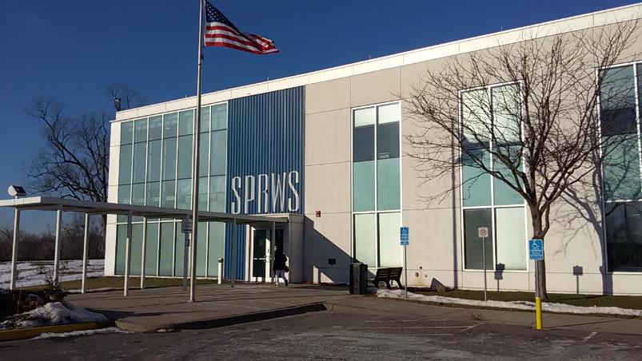
Situational Awareness
for a Healthy and Safe Place to Work!
Workshop developed and presented by:
Mark A. Anderson, PT, CPE
Physical Therapist and Ergonomist
ErgoSystems

Slide 2
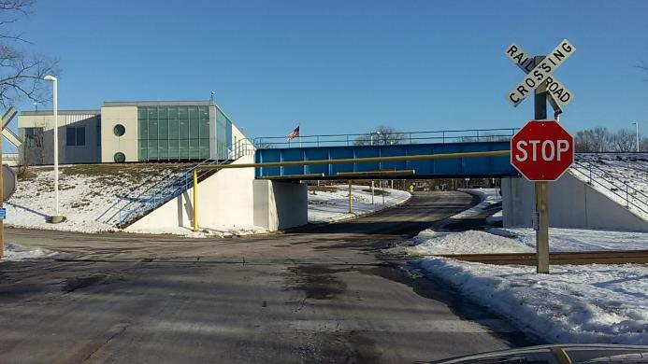
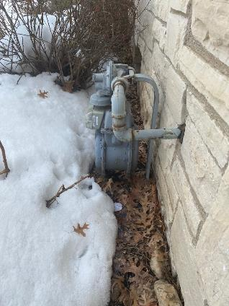
Has this ever happened to you?

Slide 3

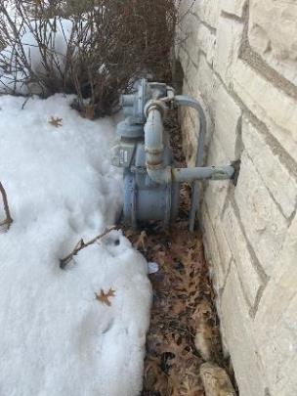
Situational Awareness
Assessing risk
  Aware of what is happening around you in terms of:
    Where you are
    Anything around you is a risk to your health and safety

Slide 4
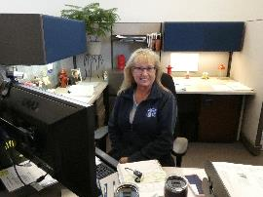
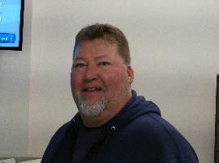

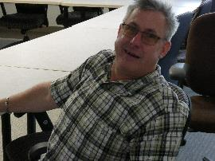
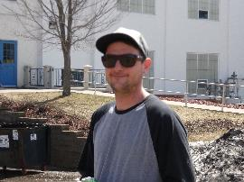
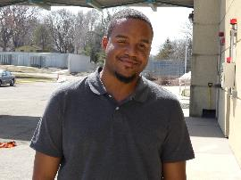
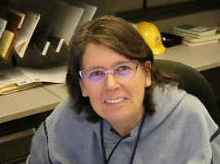
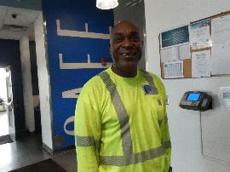
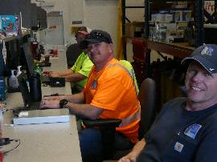
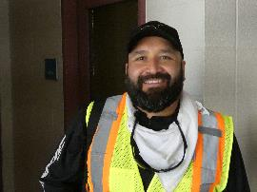
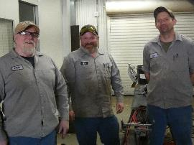
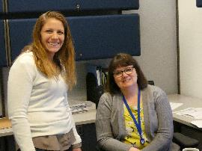
Who best to use Situational Awareness?
People who are the Experts in the job!

Slide 5
What are the FACTORS?
Things we do or don’t do that result in a healthy and safe place to work?
GROUP ACTIVITY

Slide 6
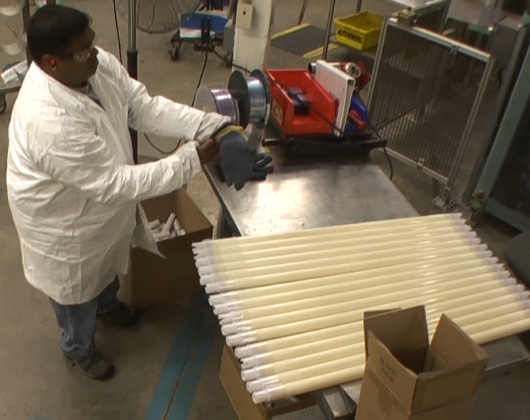
Fatigue Control and Recovery
Can we prevent fatigue in the workplace?
NO!
  Fatigue is a natural part of the cycle of life!
We need to learn strategies to control fatigue during the shift
We need to learn strategies to recover from fatigue to get ready for the next shift or other activities

Slide 7
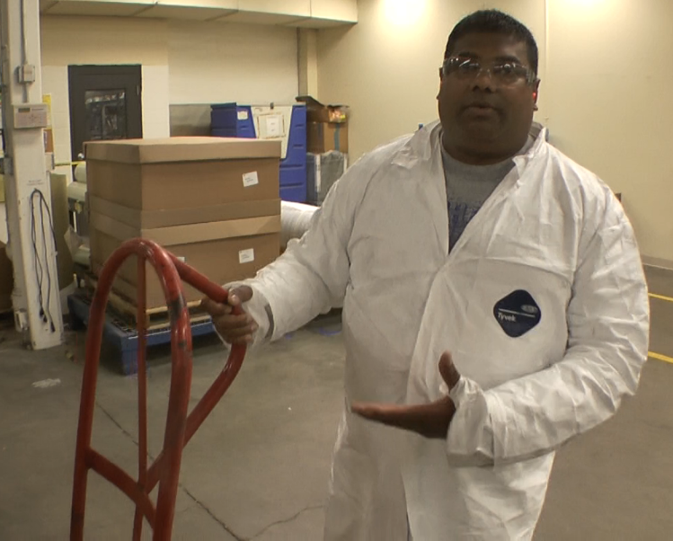
Ergonomics
Does design of tools, equipment and workstations have impact on injuries?
Professional carpenter spend how much on tools and why?
  Safer
  Quicker
  More productive

Slide 8
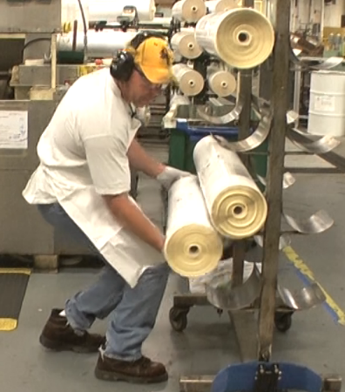
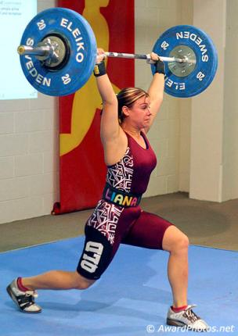
Body Mechanics/Work Techniques
Do body mechanics and work techniques have an impact on injuries?
Ask professional weightlifters – what is more important: STRENGTH or TECHNIQUE?
TECHNIQUE!

Slide 9
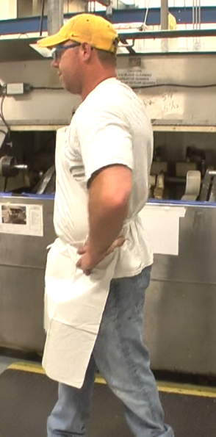
Stretching/Warm-up
Does stretching/warm-up prior to, during and after physical activity have an impact on injuries?
Do athletes warm up/cool down and why?
Yes!
  Otherwise increase risk of injury
  Able to compete at a higher level

Slide 10
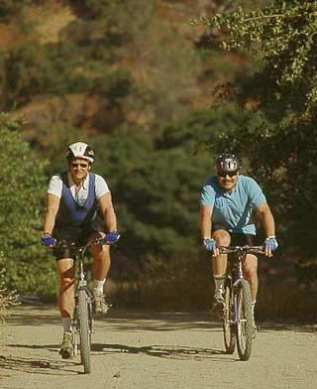
Physical Fitness
Does level of physical fitness (strength, flexibility, aerobic capacity) have impact on injuries?
Your work physically demanding?!?!
But does work provide all physical fitness you need?

Slide 11
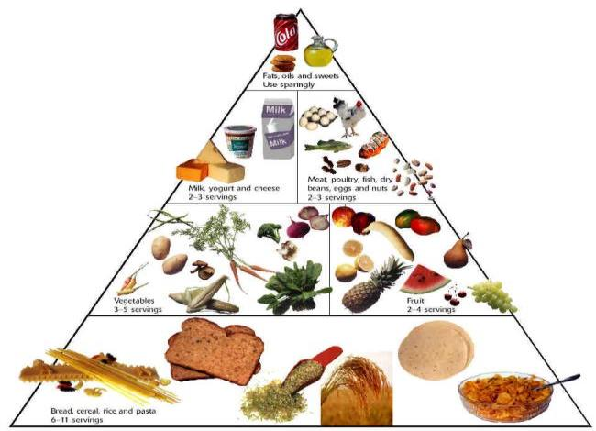
Health and Wellness
Does general health and wellness have impact on injuries?
  Diet and nutrition
  Body weight control
  Stress management
  Smoking cessation
  Blood pressure control
  Adequate rest/sleep
  Fluid intake - don’t get dehydrated

Slide 12

Health and Safety Factors
Fatigue control and recovery
Ergonomics
Body Mechanics/ Techniques
Stretching/Warm-up
Physical Fitness
Health and Wellness

Slide 13
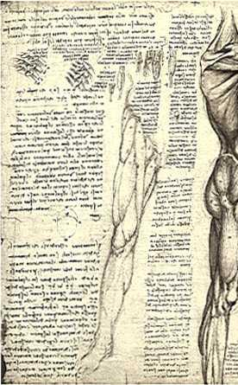
Background on Body
Skeleton
Joint
Ligament
Muscle
Tendon
Nerve

Slide 14
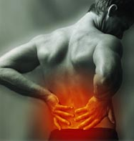
General signs and symptoms
Pain
Numbness
Tingling
Stiff joints
Loss of muscle strength

Slide 15
Health and Safety Factors
Fatigue control and recovery
Ergonomics
Body Mechanics/ Techniques
Stretching/Warm-up
Physical Fitness
Health and Wellness

Slide 16
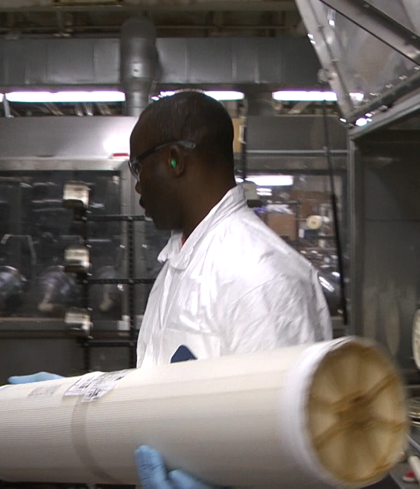
How to Recognize Fatigue
Physical fatigue
  Physically demanding
    Highly repetitive
    Result in muscle fatigue
    Decreased hand-eye coordination
Mental fatigue
  Long periods of vigilance
    Highly repetitive
    Tight deadlines
    Making mistakes

Slide 17

Control Fatigue at Work
  Job rotation!
  Provides both physical and mental task variety
  Give the body and mind a change of pace
  Take breaks!
  Use breaks as recovery time (both physical and mental)
  Get away from the workstation – change of scenery

Slide 18
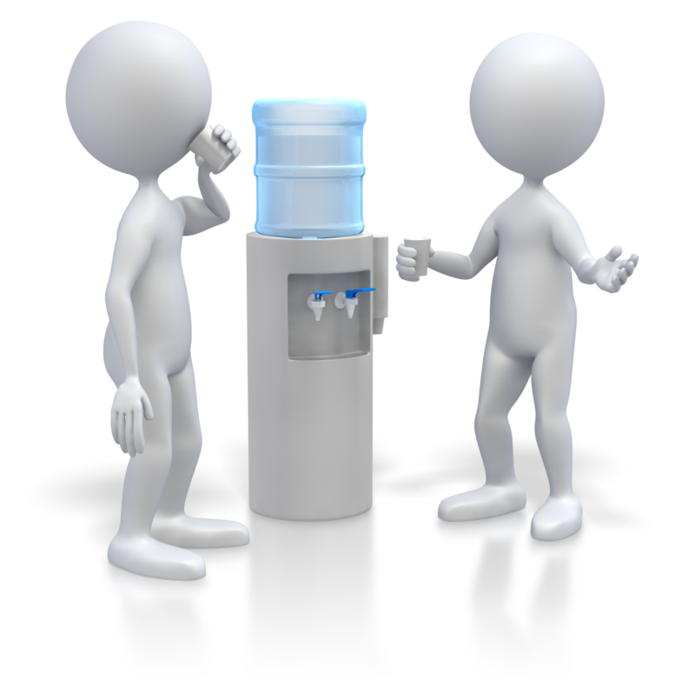
Control Fatigue at Work
  Hydration!
  Maintains blood pressure and blood flow to vital organs of body
  Proper fluid concentration levels
    Sodium, potassium and calcium for healthy cellular activity
      e.g. reduces muscle cramping
  Hydration tips
    Water
      Try to avoid caffeinated / sugared drinks
    How much?
      30 to 40% of body weight in ounces/day
        Weigh 180#, drink 54 to 72 ounces/day
      Listen to your body
      Urine color - pale

Slide 19
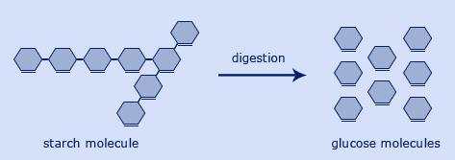

Control Fatigue at Work
Nutrition!
  Fuel the body – we are what we eat!
    Regular consistent consumption
    Don’t skip breakfast
  Combination of complex and simple carbohydrates
    Carbohydrates are sugars that break down into glucose (fuel for body)
    Complex slow burning carbohydrates (whole grains, potatoes, squash, pumpkin and carrots)
    Simple fast burning carbohydrates (fruits, vegetables and honey) provide immediate source of energy
    Simple sugars found in candy bars, soft drinks and cookies provide quick boost, but then a big letdown afterward!

Slide 20
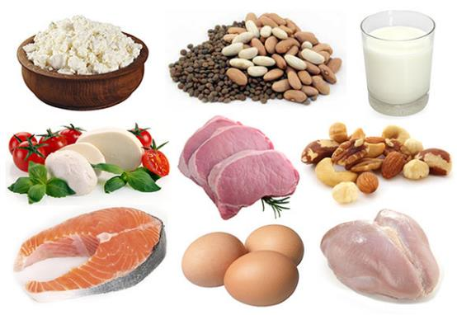

Control Fatigue at Work
Nutrition!
  Add in proteins
    Meat, poultry, fish, eggs, beans, nuts, soy, and low-fat dairy products
  Healthy fats
    Unsaturated fats: found in foods like olive oil, avocados, nuts, and canola oil
Balanced nutrition is the goal!

Slide 21
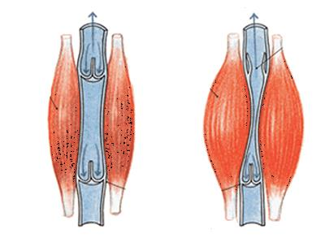
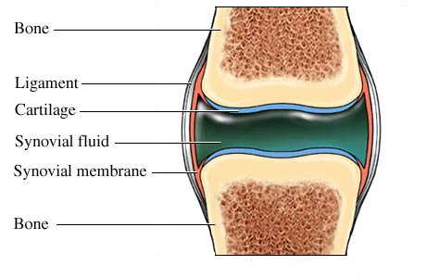
Control Fatigue at Work
  Stretching!
    Oxygen
    Joint lubrication
    More detail later in the session

Slide 22
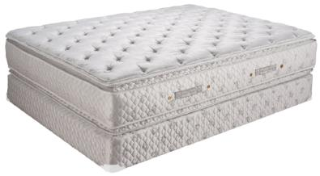
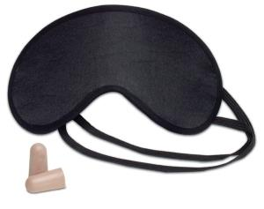
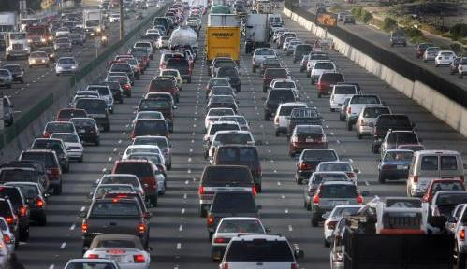
Recover from Fatigue at Home
Rest
  7 to 8 hours sleep
  Adequate mattress
  Darkened room
  Sleep mask with ear plugs
Nutrition/Fluid
  Same as at work
Travel Safely
  Commuting to/from work
Personal/Family time
Physical Fitness
Health and Wellness

Slide 23
Health and Safety Factors
Fatigue control and recovery
Ergonomics
Body Mechanics/ Techniques
Stretching/Warm-up
Physical Fitness
Health and Wellness

Slide 24
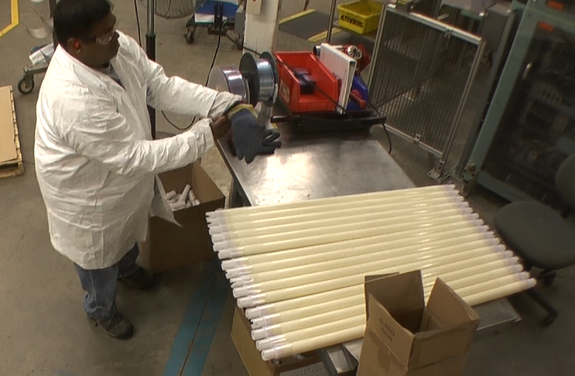
What is Ergonomics?
Ergonomics is working smarter not harder!

Slide 25
Ergonomics Principles

Slide 26
Ergonomics Principles:
Promote effective work processes
Position and support body in neutral
Work in power zone
Provide correct tools, equipment and facilities

Slide 27
Promote effective WORK PROCESSES
Take step back and really examine why something is done as it is
If answer is. . . ‘Because it has always been done that way!’
Take fresh look
Is there better way to get it done?

Slide 28
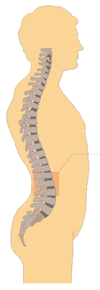
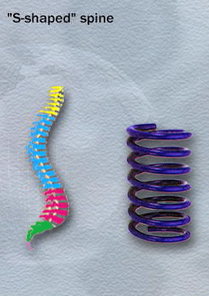
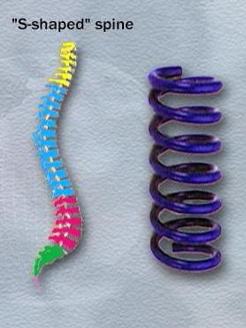
Position and support BODY IN NEUTRAL
Spine neutral position
  S-shape
Spring like

Slide 29
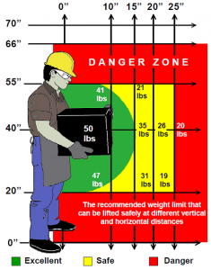
Work in POWER ZONE
Stature and arm’s length determine Power Zone
Determine individual reach and set up workstation to promote work in that zone

Slide 30
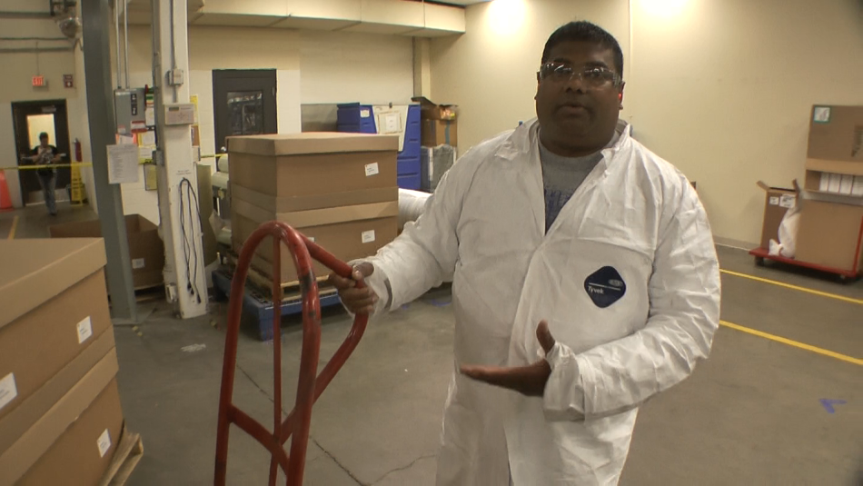
Provide Correct TOOLS, EQUIPMENT and MATERIALS

Slide 31
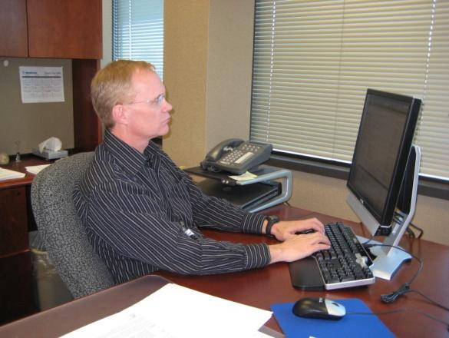
Office Ergonomics
Chair
Desk
Computer
  Keyboard
  Mouse
  Monitors
Lighting
Other

Slide 32
Health and Safety Factors
Fatigue control and recovery
Ergonomics
Body Mechanics/ Techniques
Stretching/Warm-up
Physical Fitness
Health and Wellness

Slide 33
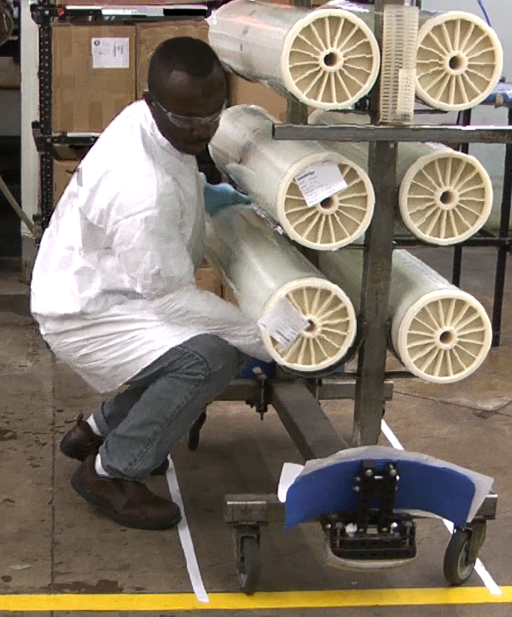
Body Mechanics/Work Techniques
What do we need to lift everyday?
How important are work techniques?

Slide 34
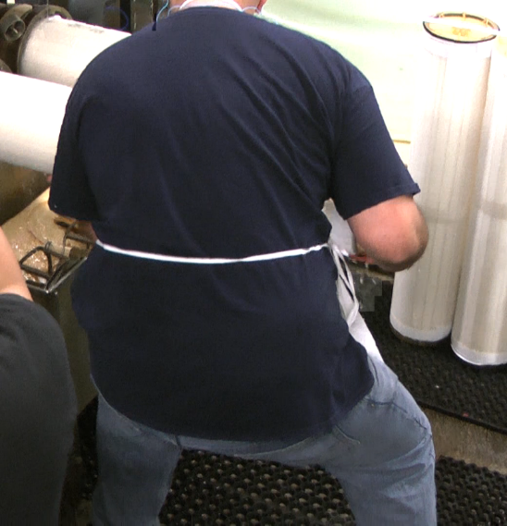
Focus on Technique/Body Mechanics
What is good technique?
In other words, “What are rules of proper body mechanics?”

Slide 35
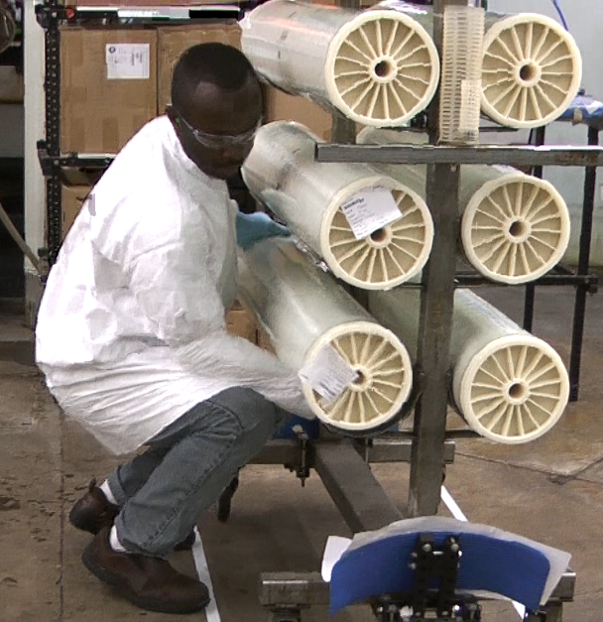
Body Mechanics/Work Techniques
Feet wide
Maintain neutral spine
Keep load close
Counter-balance
Build a bridge
Good grip
Look up

Slide 36
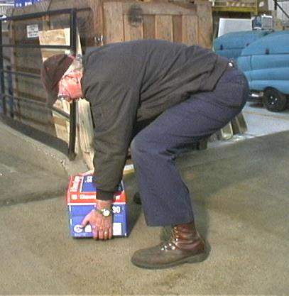
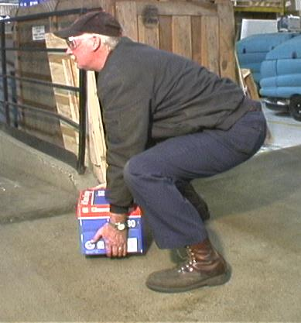
LOOK DOWN
LOOK UP

Slide 37

Body Mechanics/Work Techniques
Feet wide
Maintain neutral spine
Keep load close
Counter-balance
Build a bridge
Good grip
Look up

Slide 38
Health and Safety Factors
Fatigue control and recovery
Ergonomics
Body Mechanics/ Techniques
Stretching/ Warm-up
Physical Fitness
Health and Wellness

Slide 39
Stretching: What’s it all about?
Oxygen
  Helps heart because muscles act like pumps
  Increased blood flow
  More oxygen and nutrition
  Joint Lubrication
  Movement stimulates production of joint lubricating fluid
  Improve joint health

Slide 40
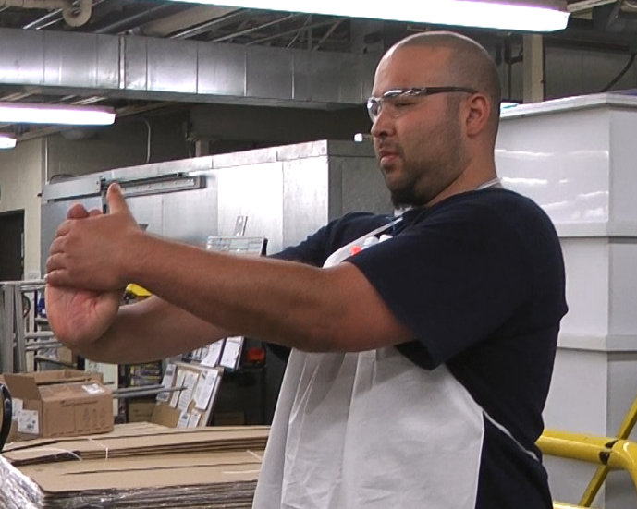
How Should You Stretch?
Absolutely have to follow Doctor's orders for any restricted activities
Technically correct
Energy Input/output
Neutral position
Joint noises
Don’t hold breath
Regular and consistent
Intensity/controlled stretching

Slide 41
Three Great Stretches
Power Squat
Large Arm Circles

Slide 42
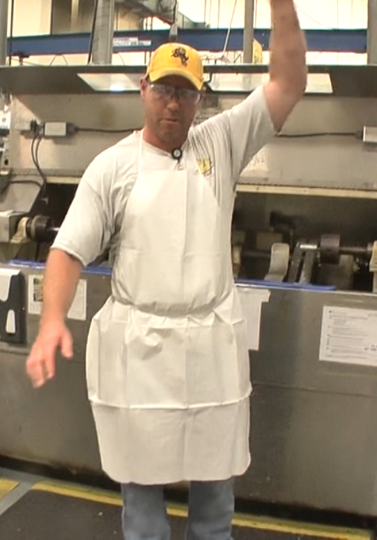
Bottom Line . . . Why Stretch?
Alertness levels
Help prevent injuries
Control stress
Reduce muscle tension
Increase flexibility
Develop body awareness
IT FEELS GOOD!

Slide 43
Health and Safety Factors
Fatigue control and recovery
Ergonomics
Body Mechanics/ Techniques
Stretching/Warm-up
Physical Fitness
Health and Wellness

Slide 44
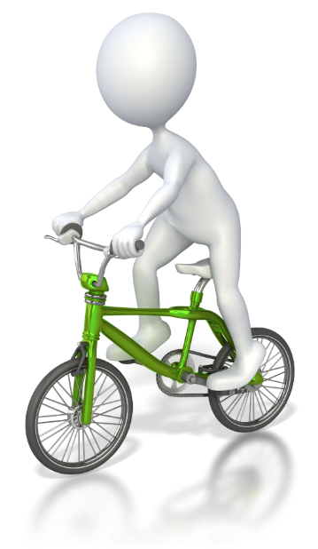
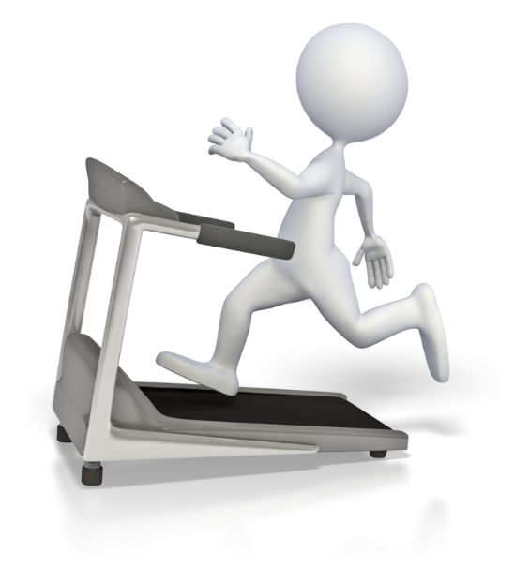
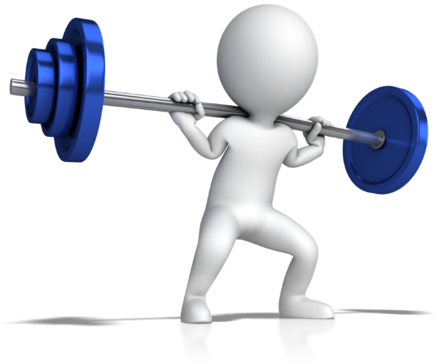
Physical Fitness

Slide 45



Physical Fitness
Basic Guidelines
  Strength, flexibility, aerobic
  Medical check
  Start slow and easy
  Reasonable expectations
  Buddy system
  Commit for 6 months

Slide 46
Health and Safety Factors
Fatigue control and recovery
Ergonomics
Body Mechanics/ Techniques
Stretching/Warm-up
Physical Fitness
Health and Wellness

Slide 47


Health and Wellness
Does General Health and Wellness have an impact on injuries?
  Diet and nutrition
  Body weight control
  Stress management
  Smoking cessation
  Blood pressure control
  Adequate rest/sleep
  Fluid intake - don’t get dehydrated

Slide 48
Health and Safety Factors
Fatigue control and recovery
Ergonomics
Body Mechanics/ Techniques
Stretching/Warm-up
Physical Fitness
Health and Wellness

Slide 49






Summary and Close
Situational Awareness for a healthy and safe workplace!
Integrate strategies into day-to-day routine!

Slide 50
Thanks!

Slide 51
Situational Awareness
for a Healthy and Safe Place to Work!
Workshop developed and presented by:
Mark A. Anderson, PT, CPE
Physical Therapist and Ergonomist
ErgoSystems

