Slide 1
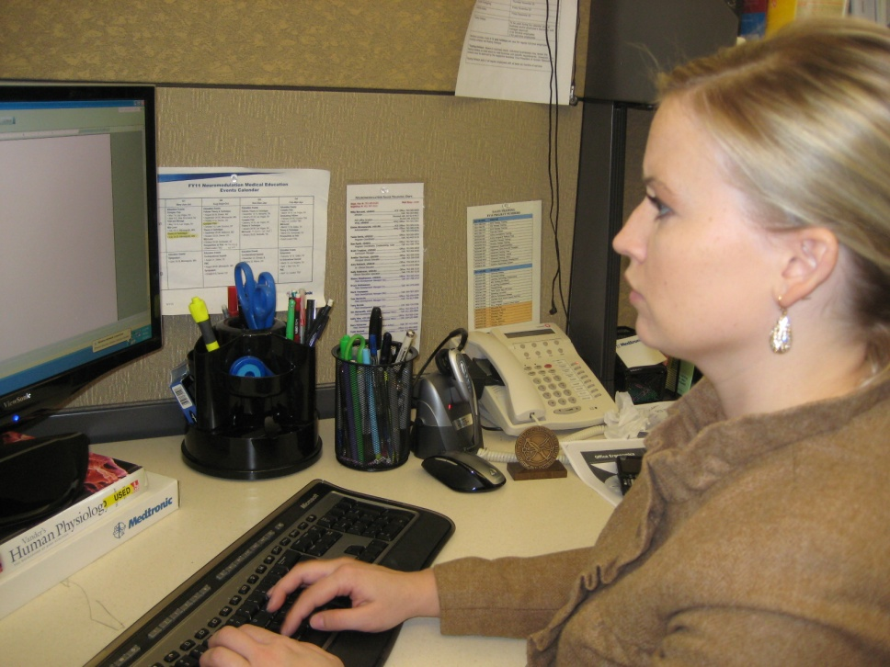
Southwest Health and Human Services
A Practical Approach to
Office Ergonomics
Mark Anderson, PT, CPE
ErgoSystems Consulting Group, Inc.

Slide 2
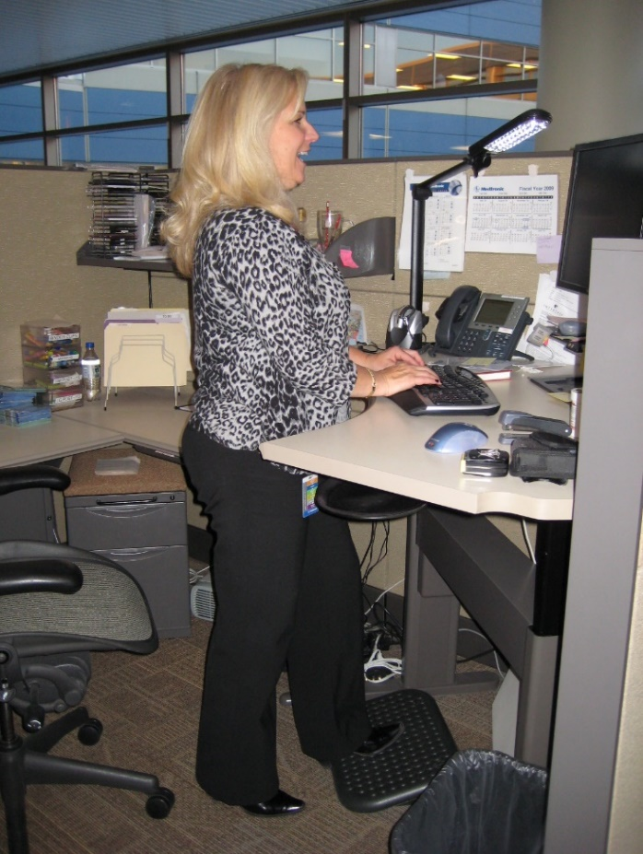
Welcome!
A Practical Approach to Office Ergonomics
Critical tool to enhance
Safety
Productivity
Detailed framework
Conduct office ergonomics assessment
Generate reasonable and feasible recommendations

Slide 3
Workshop Logistics
Manual/Handouts
Workshop Schedule
Starting/ending times
Breaks
Rest rooms
Fire exits
Telephones
Messages
3

Slide 4
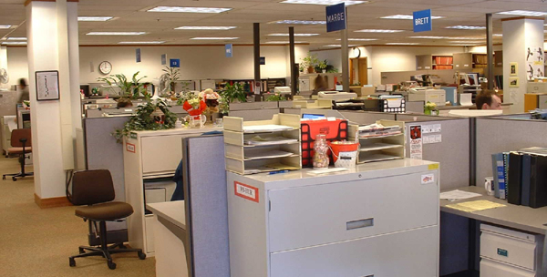
What do you want to accomplish?
Describe successful office workspace . . .

Slide 5
A careful examination
Look carefully at the words
Do you see any pattern or trend?
Is there a predominant theme?

Slide 6
A careful examination
Look carefully at the words
Do you see any pattern or trend?
Is there a predominant theme?

Slide 7
In other words . . .
Words like comfort or comfortable mixed in with:
Productive
Efficient
Satisfying
Effective
Safe and so on
Comfort . . . direct positive relationship to other descriptors
Comfortable
Productive
Efficient
Satisfying
Effective
Safe

Slide 8
Maximize comfort?
The answer is NO!
Maximizing comfort can be very dangerous thing to do . . .
Optimize comfort in workplace!

Slide 9
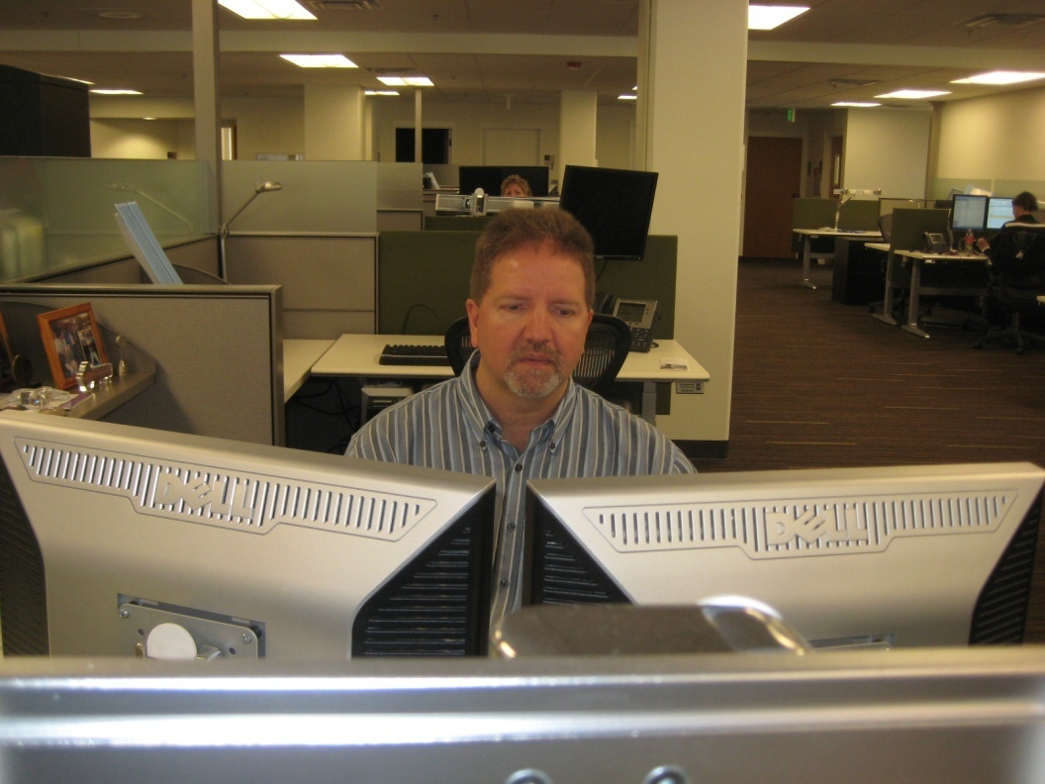
Workshop Objectives
Discover what Office Ergonomics is all about
Identify components that make up the successful office workspace
Learn how to analyze and setup the office workplace
Acquire confidence in using system through practice

Slide 10
Workshop Guidelines
Follow along with demonstrations unless you think they may cause you a problem
Do not go against doctor's orders or do anything that you feel you should not do
If you are uncomfortable sitting during training, feel move to move
Use your good judgment when trying new techniques or exercises once you complete the training

Slide 11
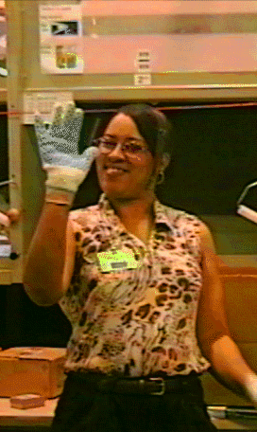
Please take a moment for:
Name
Background
Expectations

Slide 12
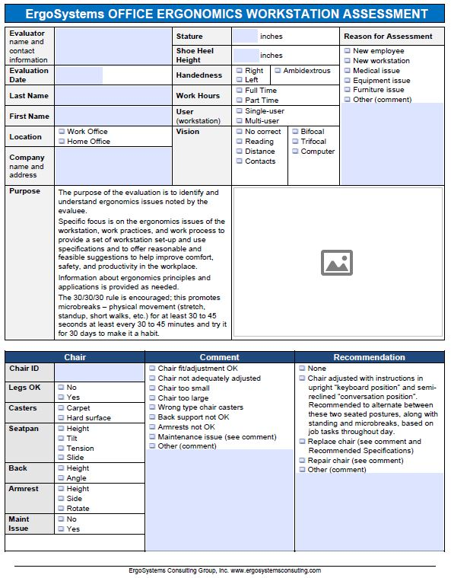
Workstation Assessment Worksheet
Printed Worksheet and PDF Fillable Worksheet
Printed form completed by filling out the form by checking pertinent boxes and writing in comments in each section
PDF fillable document contains checkboxes and comment fields for each section with option to include pictures

Slide 13
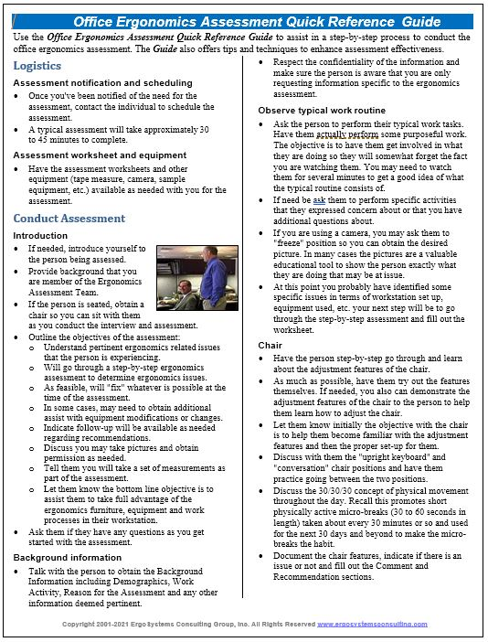
Quick Reference Guide
Assist in step-by-step process to conduct office ergonomics assessment
Take Guide with you for first several assessments to help speed up process
Guide offers tips and techniques to enhance assessment effectiveness

Slide 14
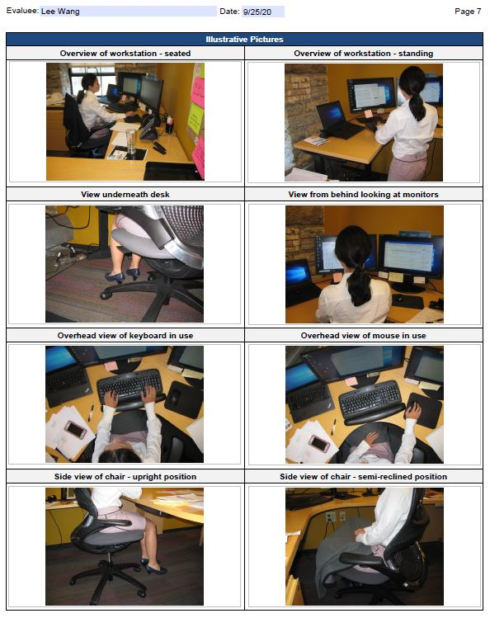
A Word about Pictures
Pertinent pictures may be included in report
“A picture is worth a thousand words!”.
Valuable teaching tool
Help individual “see” issues
Show “before” and “after” pictures
Help supervisor/manager better understand issues/recommendations
Must get approval for pictures
Person being assessed
Supervisors, managers, etc.
Written release may be needed
In some cases, due to proprietary nature of workspace, pictures may not be allowed

Slide 15
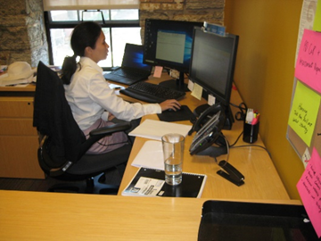
Workshop Case Study
Hands-on practice
Introducing Lisa Wang
Works for XYZ Company in Human Resources
Recently moved into current office and would like to ensure appropriate ergonomics set-up and use of workstation

Slide 16
Workshop Case Study - Logistics
Assessment notification and scheduling
Notified of need for assessment
Contact individual to schedule.
Typical assessment takes approximately 30 to 45 minutes
Assessment worksheet and equipment
Assessment worksheets and other equipment (tape measure, camera, sample equipment, etc.) available

Slide 17
Workshop Case Study - Conduct
Introduction
If needed, introduce yourself to person being assessed
Provide background that you are member of Ergonomics Assessment Team
If person is seated, obtain chair so you can sit with person as you conduct interview and assessment

Slide 18
Workshop Case Study - Conduct
Outline assessment objectives:
Understand pertinent ergonomics related issues
Conduct step-by-step ergonomics assessment to determine ergonomics issues
Work with them to "fix" whatever is possible at time of assessment.
Follow-up available as needed
Discuss pictures and obtain permission as needed.
Let them know you will obtain set of measurements
Ask if they have any questions as you get started with assessment.

Slide 19
Workshop Case Study - Conduct
Background information
Talk with person to complete Background Information section
Refer to Worksheet
Fill out the form by hand
PDF fillable form
Respect confidentiality of information
You are only requesting information specific to ergonomics assessment

Slide 20
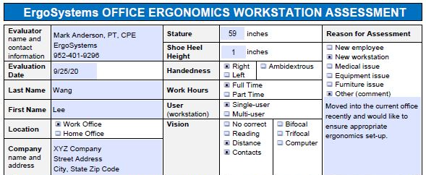
Workshop Case Study - Conduct

Slide 21
Workshop Case Study - Conduct
Observe typical work routine
Perform typical work tasks
Perform purposeful work
Watch for a few minutes
Perform specific activities they expressed concern about or that you have additional questions about
Take pictures as appropriate
Ask them to "freeze" position so you can obtain the desired pictures
Next step
Go through step-by-step assessment
Fill out worksheet

Slide 22
Workshop Case Study - Conduct

Slide 23
Workshop Case Study - Conduct

Slide 24
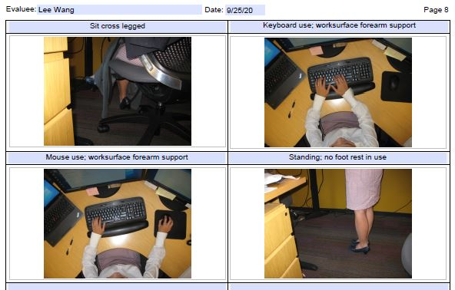
Workshop Case Study - Conduct

Slide 25
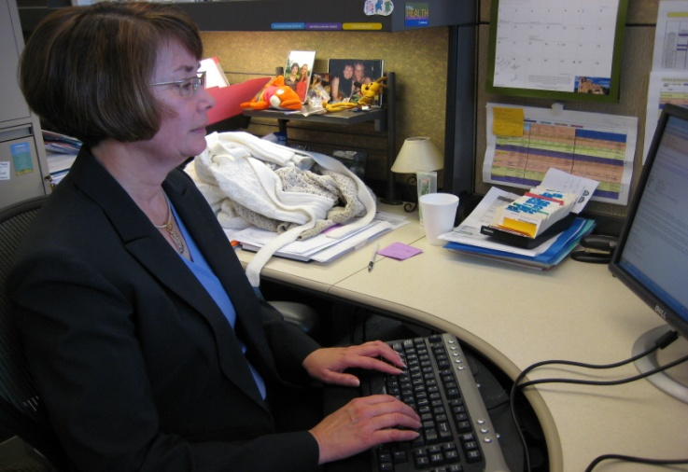
Office Ergonomics Applications
Typewriters to computers!
Where do we use computers?
EVERYWHERE!

Slide 26
Office Components
User – Single/Multi
Tasks – Single /Multi
Floor space
Chair
Worksurface
Floor surface
Computer equipment
Telephone
Office equipment
Storage
Conference tables/chairs
Light

Slide 27
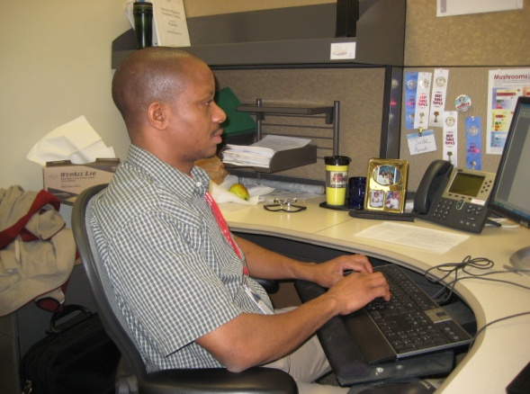
Single user
Less influenced by need for adjustability of workstation itself
Once determine proper height of worksurface
Use fixed height or adjustable/fixed worksurface
Worksurface can be height adjusted but once adjusted is not readily changed

Slide 28
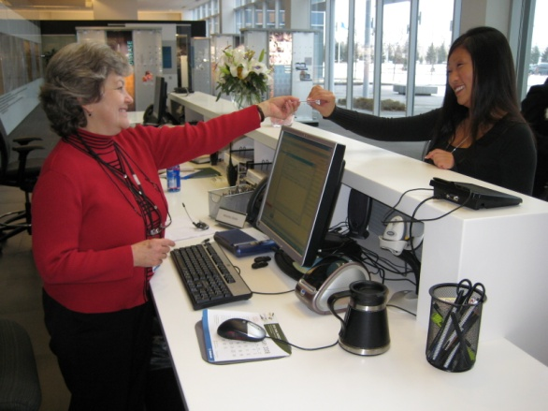
Multi user
Multi-user workstations require significantly greater degree of adjustability
Critical that changeover from one user to next accomplished quickly and easily
Adjustable/adjustable worksurface
Through spring balanced manual system/powered system worksurface height readjusted within seconds

Slide 29
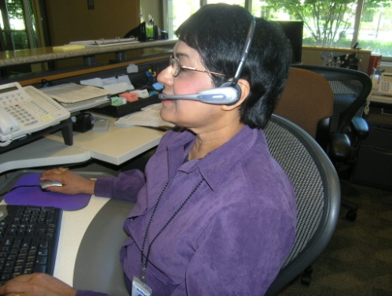
Single-task
Majority of work time accomplishing specific focused task
For example, customer service representative majority of day on computer and telephone performing computer lookup activities
Physically job demands are concentrated in single area
Efficient set up is critical because user tends to maintain sustained position to perform activities

Slide 30
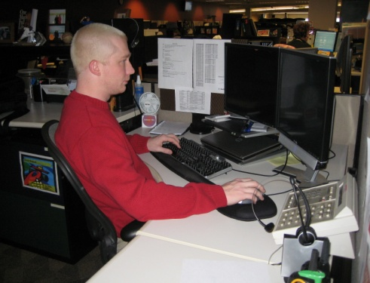
Multi-task
Number of different tasks need to be accomplished
Computer
Telephone
Writing workstation
Attending meetings
And so on

Slide 31
Work Activity
Computer
Telephone
Read
Write
Meetings
Misc
Other

Slide 32
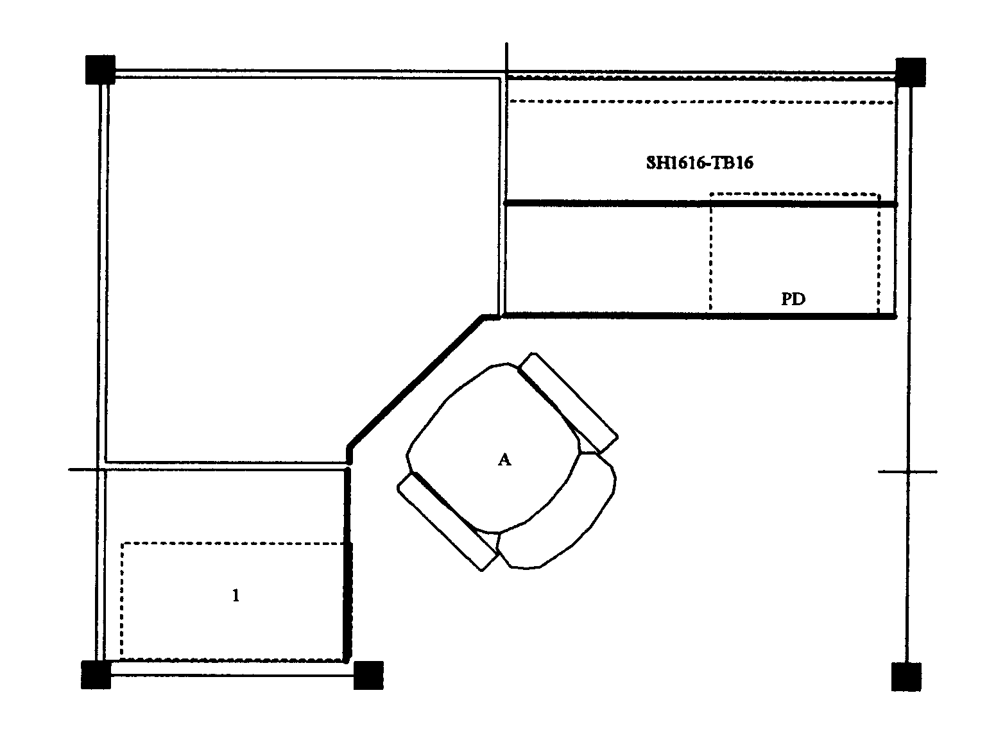
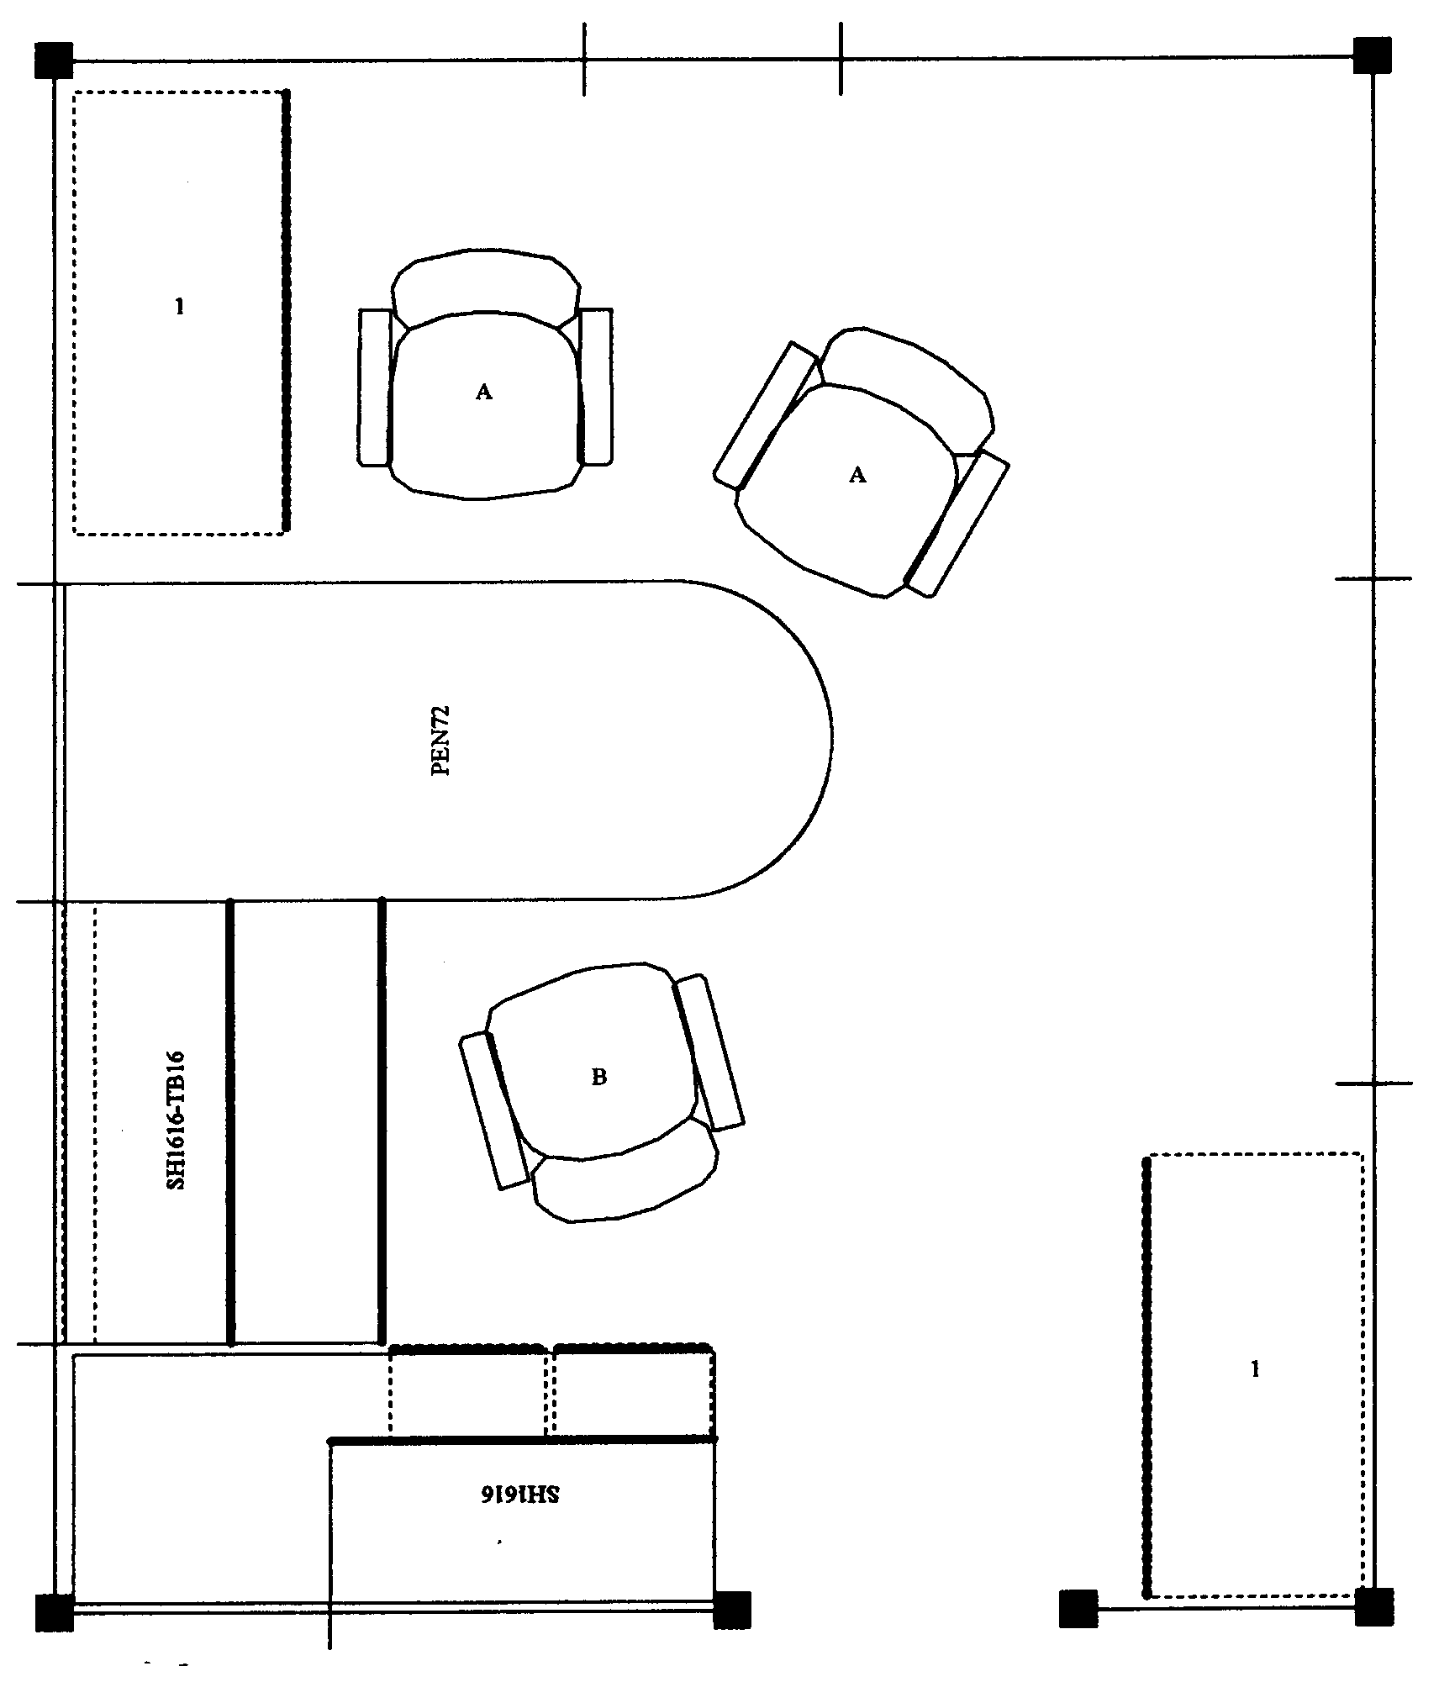
Floor Space
In ideal world, dimensions of office workstation are determined exclusively by job tasks
Some very focused single-task workstations 36 sq ft
Multitask workstation 120 sq ft or even more

Slide 33
We do not Live in an Ideal World
Floor space may be determined by host of factors not relative to job task
Does not negate need to perform an effective job analysis to make recommendations
Does cause us in many cases to be quite creative!

Slide 34
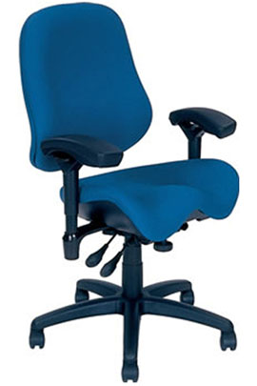
Chair
Objectives of chair
Support body and limbs to provide relief from weight bearing
Provide stable base or platform for body and limbs
Position user at correct height and reach relationship to worksurface and tasks at hand
Allow for easy change in position/movement of user

Slide 35
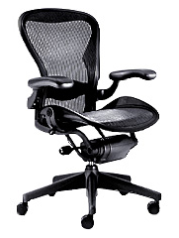
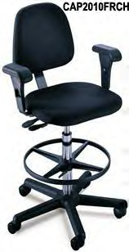
Types of Seating Systems
Number of seating systems available in workplace
Office chairs
Stools
Lean platforms
Other miscellaneous seating

Slide 36
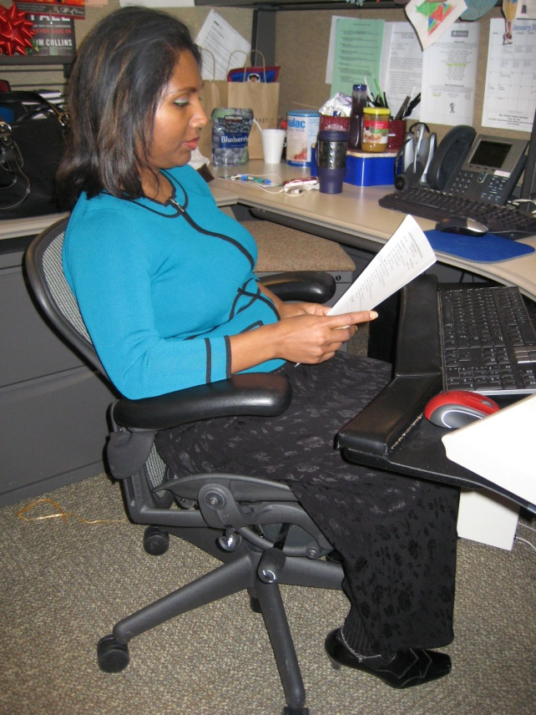
Chair Criteria
Type, use and efficiency of chair are critical elements
Acceptable chair criteria determined by:
Type of job activities performed
Size and shape of user
Duration of time spent in chair

Slide 37
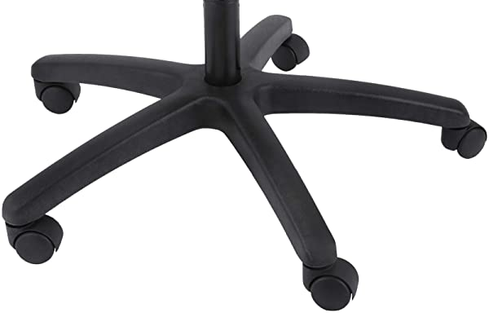
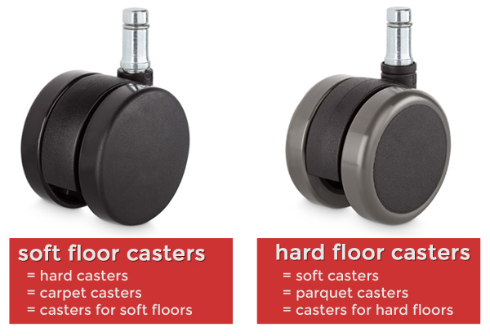
Legs and Casters
Does the chair have at least 5 legs?
Does the chair roll easily on the floor surface?
Hard caster on soft floor
Soft caster on hard floor

Slide 38
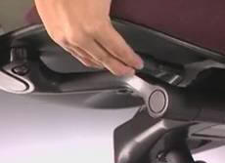
Seatpan - Height
Does the chair’s seatpan height adjust up and down?

Slide 39
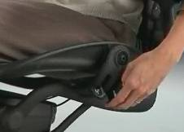
Seatpan - Tilt
Does the chair’s seatpan tilt up and down?

Slide 40
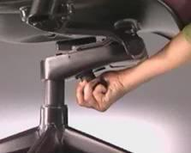
Seatpan - Tension
Can you adjust the seatpan tension?

Slide 41
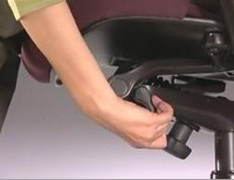
Seatpan - Depth
Does the chair’s seat slide/move forward or backward?

Slide 42
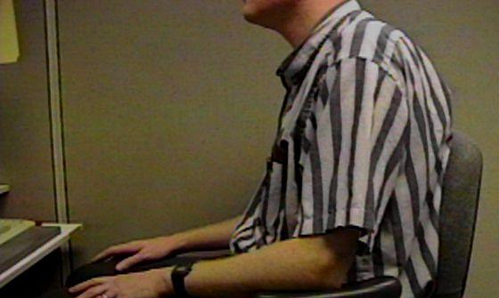
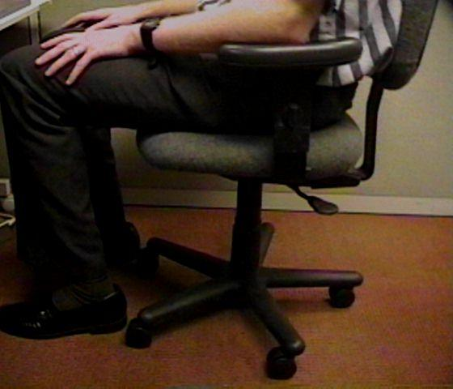
Relationships
Does the chair fit the individual?
This gentleman is 7’ tall!
Arrows point to back of knee and front edge of seatpan

Slide 43
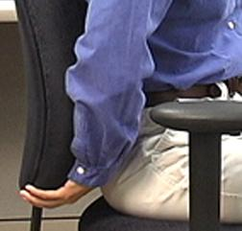
Back Support - Height
Does chair’s back support move up and down?

Slide 44
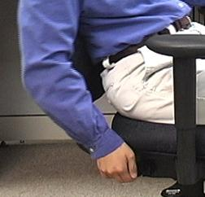
Back Support - Angle
Does chair’s back support angle forward or backward?

Slide 45
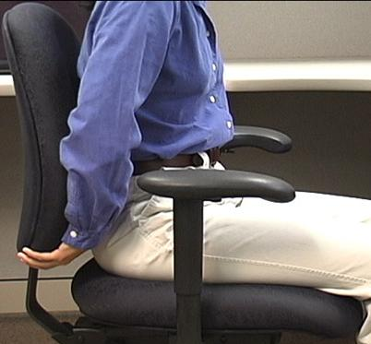
Cushion
Suitable cushion
Foam density
Wearability
Breathability
Type of material (fabric or rubberized)

Slide 46
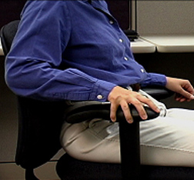
Armrests Adjust
Do chair’s armrests adjust
Up and down
Side-to-side
Rotate

Slide 47
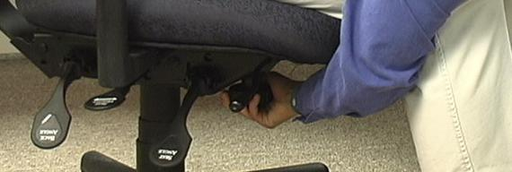
Adjustment levers/knobs/controls
Easy to reach
Easy to manipulate
Should not intimidate

Slide 48
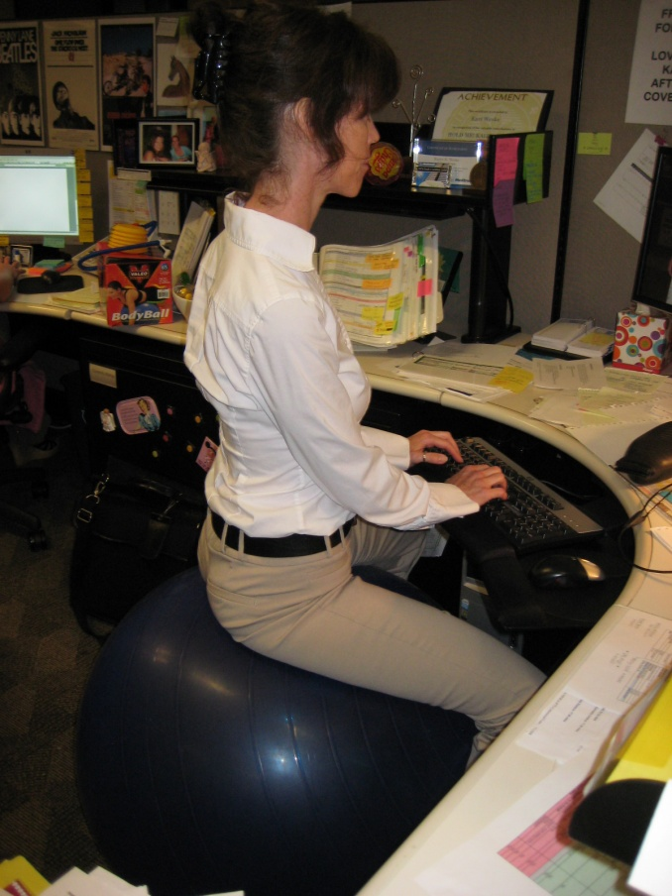
Ball Chairs?
Therapeutically, exercise balls used in clinical settings as treatment modalities
Improve spinal stability
Over past several years, use of exercise balls in place of or in addition to task chairs
Currently only anecdotal evidence exists to support full-time use
Most ergonomists advocate for properly sized/properly adjusted office task chairs rather than use of fulltime ball chairs

Slide 49
Micro-breaks
30/30/30 Rule of Physical Movement
Physically active micro-breaks 30 seconds in length
Taken about every 30 minutes
Practiced for next 30 days to make it a habit
Benefits
Reduce tissue compression and joint stiffness
Enhance circulation
Improve overall comfort levels.
Encourage person to figure out reminders that work for them
Post-it notes
Buddy approach
Drink a lot of water
Set reminders on their calendar

Slide 50
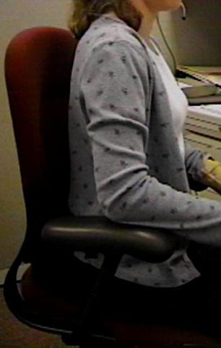
Art of Sitting
Body not designed to sit
Particularly for long periods
Studies determined even when seated in well-supported postures
How soon do we want to move?
About every 20 to 30 minutes!

Slide 51
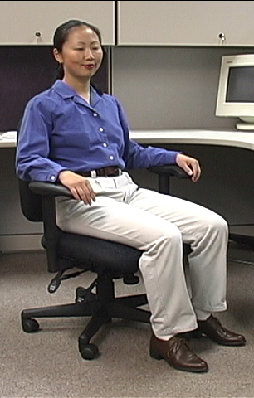
The Art of Sitting
Three-point contact
Sacrum/Trunk
Hips/Thighs
Feet/Floor

Slide 52
The Art of Sitting
90/90 seated posture?
Only in drawings!
Most people will sit at 95 to 110 degrees at hips and knees

Slide 53
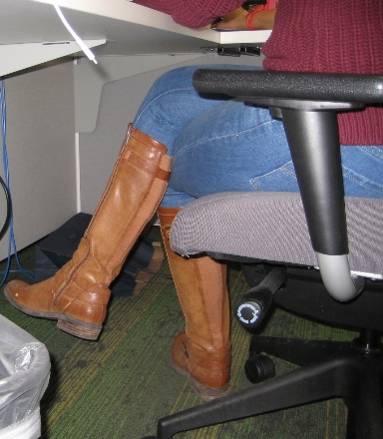
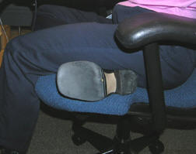
Sitting styles
Sitting styles quite varied from person to person:
Percher
Slouch
Sit crossed leg
Sit on leg

Slide 54
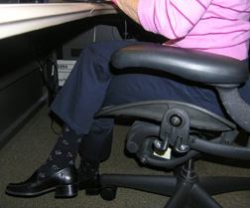
Sitting styles
Particular sitting style needs to be assessed
Habit developed over time
Response to poor workstation setup
Combination of both
What drives problem is frequency and duration of seated position

Slide 55
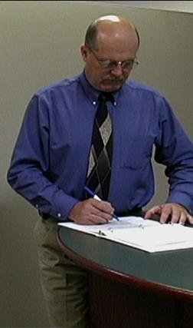
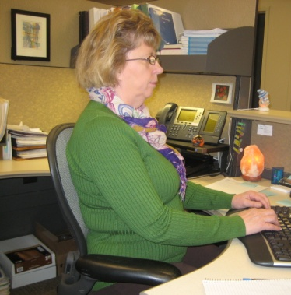
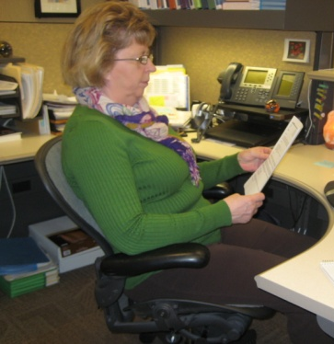
Functional seated positions
Provide for several different acceptable postures
Rotate throughout day on regular basis:
Upright “keyboard” position
Semi-reclined/rocking “conversation” position
Standing

Slide 56
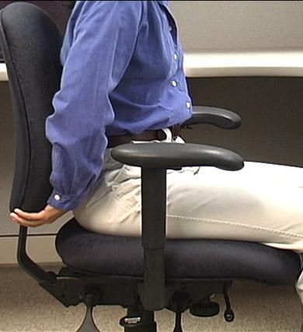
Adjustment anxiety
Chairs can be pretty expensive
All kinds of bells and whistles
Chair only as good as how it is adjusted
Some people have never adjusted their chair
Just sit down and go to work!
Bottom line
Need to initially be able to adjust chair to fit
As well as throughout day

Slide 57
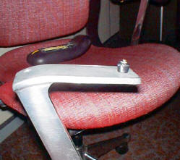
Maintenance
Is chair functioning properly?
No maintenance problems?

Slide 58
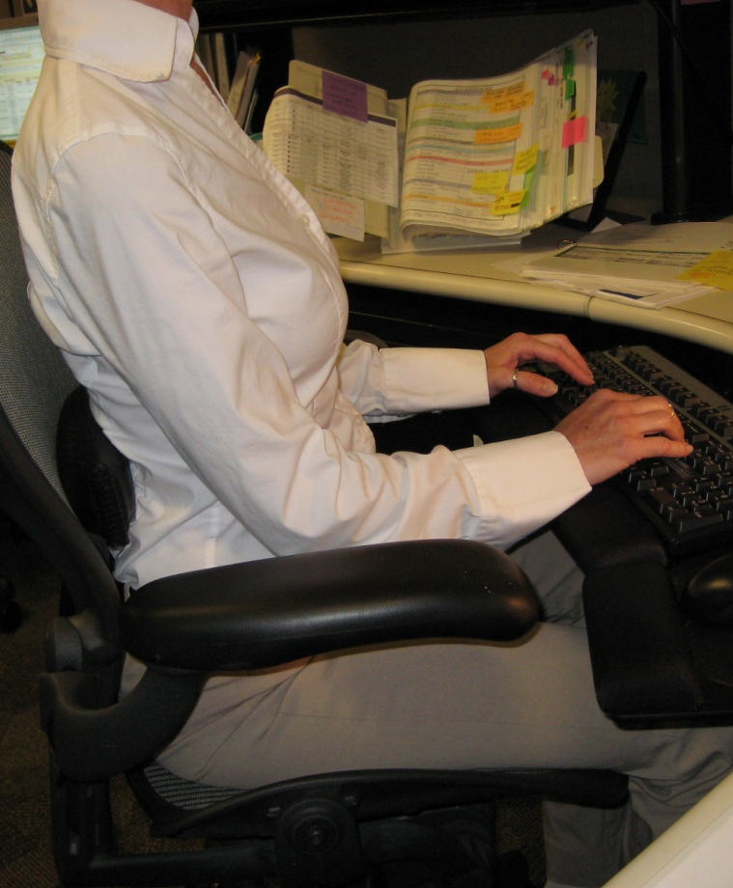
Chair Adjustment
Manual (hardcopy/online)
Find and read it!
Position and support body/limbs in neutral
Adjust seat pan/back support tension to hold body in neutral position
Adjust seatpan height to get feet on floor with even pressure on hips and thighs
Adjust height and angle of back support to fill in low back curve
Adjust armrests to provide arm support

Slide 59
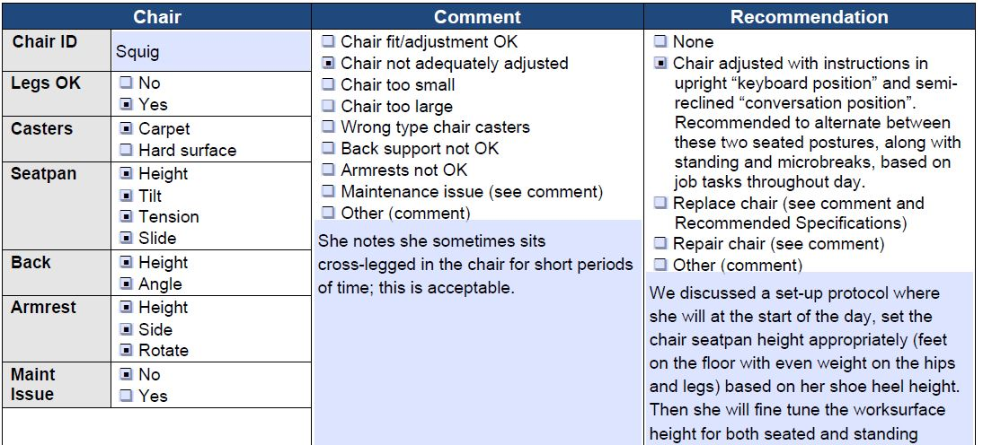
Chair – Case Study

Slide 60
MOVE!
Remember, no matter how perfectly adjust chair to fit
Still comes down to fact that need to move on regular basis to keep body healthy and safe
Movement is critical to the health of the body!

Slide 61
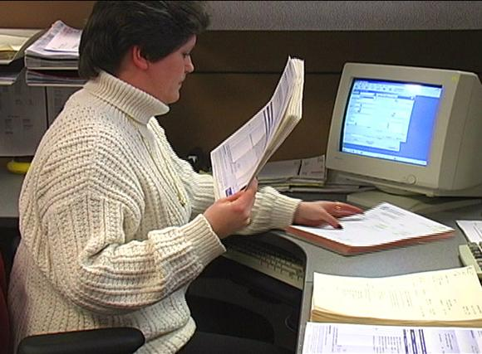
Worksurface
Worksurface objectives
Provide functional workspace (depth, width)
Support and position equipment
Provide access to work materials
Achieve desired relationship match between user/work

Slide 62
Straight line (desk/table)
The straight in-line configuration is suited for single task activities with minimal reach requirements for other office equipment and materials

Slide 63
L/U-shape (two/three worksurfaces)
L-shaped configuration is suited for single to multitask activities that require two or more separate workspaces
One workspace may be used as computer workstation and another as writing or collating workstation

Slide 64
Corner/cockpit
Corner/cockpit configuration well suited for multitask activities in same workspace with significant requirements to frequently reach other office equipment and materials
Allows for greatest degree of adjustability and accommodation for user

Slide 65
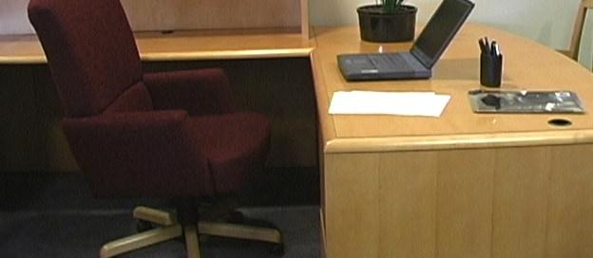
Worksurface Fixed
Traditional desk at fixed worksurface height of 29 inches - Millions of these!
Not designed to be changed in height or angle
Generally possible to raise fixed height worksurface on supports but also generally very difficult to lower it

Slide 66
Worksurface Fixed/Adjustable
Wall panel mounted worksurface or worksurface on legs
Can be adjusted within given range but once adjusted fixed in that position on fairly permanent basis

Slide 67
Adjustable/adjustable
Sit/stand workstations
Controlled by mechanical springs or powered mechanisms
Keyboard trays
User can readily and easily adjust worksurface

Slide 68
Sharp edges
Proper work height in relation to worksurface edge
Many times will eliminate the issue
Pad sharp edge
If cannot eliminate pad the edge

Slide 69
Work organization
Includes organization and structure of tasks/activities performed throughout workday
e.g. Do not store file boxes on the floor

Slide 70
Not enough layout space
House cleaning
Other worksurfaces available for use
File cabinet at standing height to review documents
Relocate some of equipment on desk
Pullout drawers already in desk

Slide 71
Work organization solutions
Space in most companies is premium
Store infrequently used items outside of immediate work environment
Pick up at end of day

Slide 72
Worksurface Height Solutions
If work height is adjustable, adjust it as needed
Raise height of work surface by putting it up on blocks
Make sure desk or work surface is solidly placed on blocks and won’t fall off!
Adjust chair height
Make sure feet are supported either on floor or with footrest
Add height/angle adjustable keyboard tray
Mounted underneath work surface

Slide 73
Sit/Stand Workstations
Worksurface at standing height
Stool
Footrest

Slide 74
Sit/Stand Workstations
Portable system placed on desk
Adjustable keyboard/ mouse and monitors
Use chair when seated

Slide 75
Sit/Stand Workstations
Height adjustable sit/stand workstation

Slide 76
Tips for Sit/Stand Workstations
Correct worksurface heights
Seated and standing
Good footwear
Good walking shoes make for good standing shoes
Anti-fatigue foot mat
May be beneficial
Difficult to roll chairs on mats
Footrest/shift weight
Allows for alternating posture with one foot up and then the other and shifts weight on the feet
Accommodation to sit/stand routine
Start with specific schedule for first week
(e.g. 30-minute stand – 30 to 60 second walk – 30 minute seated - 30 to 60 second walk and repeat)
Modify based on unique response
Remember the mantra: “Don’t wait until it’s too late!”

Slide 77
Conference rooms
How to enhance audience reception of information
Lack of physical movement
77

Slide 78
Conference Rooms
Look for as many opportunities as possible to move as part of meeting
Standing mixed in with sitting
Bring in small footrest or back cushion

Slide 79
Worksurface – Case Study

Slide 80
Foot Support
In an ideal world the best foot support when seated in a chair is the floor . . .
However if needed use proper sized footrest

Slide 81
Knee/foot clearance
Move what is not needed to some other storage position or get rid of it
Survey work area and determine what is blocking access

Slide 82
Foot Support/Clearance

Slide 83
Computer equipment

Slide 84
Keyboards
Keyboard configurations
Straight-line
Curved
Articulated
Keyboard surface finish
Keyboard size
Keyboard activation pressure
Layout
Wireless

Slide 85
Wrist rests
To use or not to use . . .
That is the question!

Slide 86
Keyboard Shortcuts

Slide 87
Keyboard Technique
Free float piano playing style
Worksurface forearm support

Slide 88
Worksurface Height Strategy
Fixed worksurface height
Use chair seatpan height adjustment to position hands at appropriate position
Based on technique
“Piano Player”
“Forearm Supporter”.
Evaluate foot placement
Determine if footrest required
With taller individuals, may need to determine if worksurface can be raised

Slide 89
Worksurface Height Strategy
Adjustable worksurface height
Adjust chair’s seatpan height so hips slightly higher or equal to knees and feet supported on floor
“Piano Player” keyboard user
Position hands where they would be when using keyboard
Adjust worksurface height to match hand position.
“Forearm Supporter” keyboard user
Position hands and forearms where they would be when using keyboard
Adjust worksurface height to match this position

Slide 90
Worksurface Height Strategy
Fixed/Adjustable worksurface height
Access to adjustable sit/stand workstation
Worksurface height dialed in
Take measurement from floor to the top of worksurface
Set worksurface to this height
No access to adjustable sit/stand workstation
Adjust chair’s seatpan height so hips are slightly higher or equal to knees and feet supported on floor
Locate specific point on chair and take vertical measurement from that point to floor.
Have person adjust chair seatpan height to place hands on keyboard using identified keyboard technique
Using same point on chair take second measurement to floor
Difference between two measurements is how much current worksurface height needs to be changed
Example; initial worksurface height 29”, difference in two measurements was 2”, current worksurface lowered by 2” to 27”.

Slide 91
Standing Worksurface Height Strategy
Stand comfortably tall
Not forced erect tall but not slumped either
“Piano Player”
Position hands as if using keyboard
Adjust worksurface height
“Forearm Supporter”
Position hands and forearms appropriately
Adjust worksurface height

Slide 92
Poor Technique
If technique needs improvement
Training programs that teach improved technique

Slide 93
Take break
Add stretching to day
A little post it note put on computer monitor
Software that reminds you to stretch
Old-fashioned as egg timer
Team up with someone else in office
Take advantage of natural breaks between activities
Remember to Stretch!

Slide 94
Keyboard – Case Study

Slide 95
Keyboard Trays
Response to PC’s
Keyboard tray configurations
Keyboard tray size
Keyboard/mouse
Height/angle adjustment
Knee clearance

Slide 96
Keyboard Tray – Case Study

Slide 97
Mouse
No not that kind of mouse!
Use mouse as little as possible
Keyboard shortcuts

Slide 98
Mouse technique
Neutral positions
Same plane as keyboard
Mouse placement
Free float piano playing style
Use of worksurface for forearm support
Right of left hand use

Slide 99
Pointing Device Non-neutral Positions

Slide 100
Mouse Set-up
Mouse Setup
Buttons
Pointers
Pointer Options
Wheel
Hardware

Slide 101
Mouse Wrist Rests
In most cases, mouse wrist rest is not recommended
Wrist rest tends to “anchor” wrist
Excessive side-to-side deviation of hand
Straight in access
Allow forearm, wrist and hand moving as unit to manipulate mouse
Think of mouse as extension of arm NOT just extension of wrist

Slide 102
Choosing Correct Pointing Device

Slide 103
Mouse – Case Study

Slide 104
Laptop/Desktop
Where?
Computer underneath monitor
May or may not be appropriate
Don’t block ventilation
On/off and disc drives access

Slide 105
Laptops
Design violates basic ergonomic principles
Fixed position keyboard and monitor

Slide 106
Occasional Laptop User
Occasional Users
Better off sacrificing neck posture rather than wrist posture
Find comfortable chair
Position in lap or on table for most neutral wrist posture that you can achieve
Angle laptop screen so can see with least amount of neck deviation

Slide 107
Full-time Laptop User
Use separate keyboard/mouse
Port replicator/docking station
Position on desk/worksurface to see screen without bending neck
Elevate off desk surface using stable support surface, such as computer monitor pedestal
Follow postural guidelines for working at computer workstation
Transport with bag or wheeled cart

Slide 108
Laptop/Decktop – Case Study

Slide 109
Monitor
Everything need access to may be viewed through monitor
Watch people looking at their monitors
Almost like monitor is a vacuum cleaner
They turn it on . . . and it sucks their head right in!

Slide 110
Monitor Height
Where do we naturally read?
We read by looking out and down

Slide 111
Monitor Height
Top of screen no higher than eye level
Look out and use downward eye movement to look at lower part of screen

Slide 112
Monitor too high
If screen too high
Forces eyes wider open than usual
Less tearing - eyes become more dry
Tip head back putting additional strain into neck and shoulders
Solutions
Tip monitor slightly forward
Raise chair slightly
Lower worksurface

Slide 113
Monitor too low
If screen too low
Head forward
Solutions
Adjust monitor stand – if adjustable
Monitor arms
Monitor stands/Risers

Slide 114
Monitor Distance
Eyes
Accommodation Convergence
Guideline
Get screen as far away from user as possible
At least arm’s length
Still be able to read it clearly with good posture

Slide 115
Monitor too far away
Slide screen towards user

Slide 116
Monitor too close
Reconfigure monitor placement on desk
Add keyboard tray
At minimum push chair back from worksurface to give eyes a break

Slide 117
Monitor Alignment
Directly face primary work task
Primarily data creation or manipulation
Monitor directly in front
Primarily data entry - main focus on paper documents
Monitor slightly off to side
Copy stand to place paper documents directly in front

Slide 118
Dual Monitors
Primary/Primary
Primary/Primary

Slide 119
Dual Monitors
Primary/Secondary
Primary/Secondary

Slide 120
Monitor Resolution
Pixel (picture element)
640 by 480
800 by 600
1024 by 768
1600 by 1800
Guideline
Set LCD monitor resolution to the native resolution
Typically the highest it will go

Slide 121
Functional Monitor Placement Test
Close eyes and position head in balanced neutral position on neck
Open eyes
With proper monitor height
View top third of screen without any head movement
View bottom third of screen
Look for downward eye movement of up to 30 to 400 and perhaps a small amount of head down tip
Make any monitor position changes indicated

Slide 122
Glare
Unwanted light directed or reflected into eyes
Sources
Overhead lights
Task lights
Outside light
Any shiny surface
Any white/bright object

Slide 123
Control Glare
First step
Identify glare source
Control
Control source
Control path

Slide 124
Use glare screen
Get what you pay for
Inexpensive glare screen is generally just wire mesh
Will cut glare at expense of character quality
Good quality optical glass glare screen
Don’t have light source such as window directly behind monitor
Reposition monitor
Shade window

Slide 125
Adjust monitor screen brightness/ contrast
Check if brightness and contrast can be adjusted
Adjust based on user’s perception of overall quantity and quality of light

Slide 126
Dirty monitor screens
On regular basis clean monitor screen
Only use approved cleaning measures

Slide 127
Eye Examinations
Regular eye examinations
Eyewear prescriptions changes
Eye health in general
Based on job task

Slide 128
Presbyopia
Age-related process
Slow loss of flexibility within lens inside eye
Solutions
Bifocals
Computer glasses
Lower monitor

Slide 129
Monitor – Case Study

Slide 130
Document holder
Horizontal vs. inclined

Slide 131
Document holders
Landscape
Portrait
Read Write Stand

Slide 132
Document Holder

Slide 133
Telephone
Frequency and duration
More than 1 to 2 hours/day
More than 1 to 2 minute calls
Should have hands free to operate equipment

Slide 134
Telephone Types
Handsets
Awkward head, neck and arm position
Shoulder cradle
Still have awkward head, neck and arm position

Slide 135
Telephone Types
Headsets
Wireless
Bluetooth

Slide 136
Telephone

Slide 137
Office equipment
Make use of principles to position office equipment
Calculator
Printer
Fax
Writing utensils
Scissors
Paper clips
Stapler
Stuff

Slide 138
Relationships

Slide 139
Storage/Reach zone
Primary
Frequently accessed from seating system
Within easy reach
Secondary
Occasionally accessed
Located in gray zone
Danger Zone!
Tertiary
Very occasionally accessed
Have to get up and move to access

Slide 140
Storage
Storage types
Vertical storage racks
Horizontal storage bin
Wall hanging storage
File cabinet types
Vertical
Lateral
Rolling
Don’t overfill
50 files in cabinet that holds 30!

Slide 141
Storage

Slide 142
Illumination – Ambient and Task

Slide 143
Ambient Light Solutions
Too much
Turn out lights
Too little
Add overhead lights
Add indirect lights
Bounce light off of ceiling and walls
Add task light
Desktop or wall panel lamp
Position light carefully
Lighting Design

Slide 144
Task Light Solutions
Task lights
Desktop or wall panel lamp
Position light carefully

Slide 145
Illumination

Slide 146
Recommended Specifications – Case Study

Slide 147
Assessment Follow-up – Case Study

Slide 148
Sample Assessnent Reports

Slide 149
Ergonomics – A Potent Tool!
Great number of factors enter into the office ergonomics workplace
Use the principles and ergonomics analysis process to offer solutions that are practical and effective!

Slide 150
Thanks for your Time and Attention!

Slide 151
ErgoSystems Presents:
A Practical Approach to
Office Ergonomics
Mark Anderson, PT, CPE
ErgoSystems Consulting Group, Inc.

Slide 152
Menu
Title Slide
Welcome
Objectives/Guidelines
Worksheet/Reference Guide
Case Study – Introduction
Office Components
Chair
Worksurface
Sit/Stand Workstation
Foot Support/Clearance
Keyboards
Trays
Mouse
Laptop/Desktop
Monitors
Document Holder
Telephone
Storage
Illumination
Recommended Specifications
Sample Reports
Summary/Close
Resources

Slide 153
Resources
Evaluation Worksheets
Ergonomics Workstation Assessment Worksheet PDF Fillable Template Reader Extended PDF
Ergonomics Workstation Assessment Worksheet PDF Fillable Template
Ergonomics Workstation Assessment Worksheet Word Fillable Template
Quick Reference Guide
Office Ergonomics Assessment Quick Reference Guide (PDF)
Office Ergonomics Assessment Quick Reference Guide (Word)
Manual
Office Ergonomics Training Manual (PDF)
Office Ergonomics Training Manual (Word)
Case Study/ Example Reports
Ergonomics Workstation Assessment Worksheet Example 1
Ergonomics Workstation Assessment Worksheet Example 2
Ergonomics Workstation Assessment Worksheet Example 3

