Slide 1
Stretching Stretch Leader Training
Notes:
Toro Introduction to Ergonomics

Slide 2
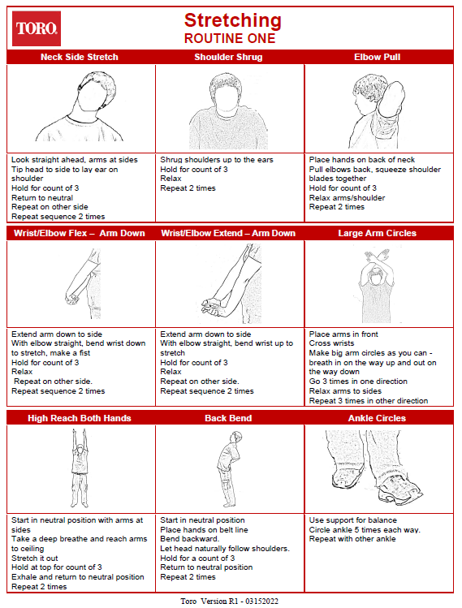
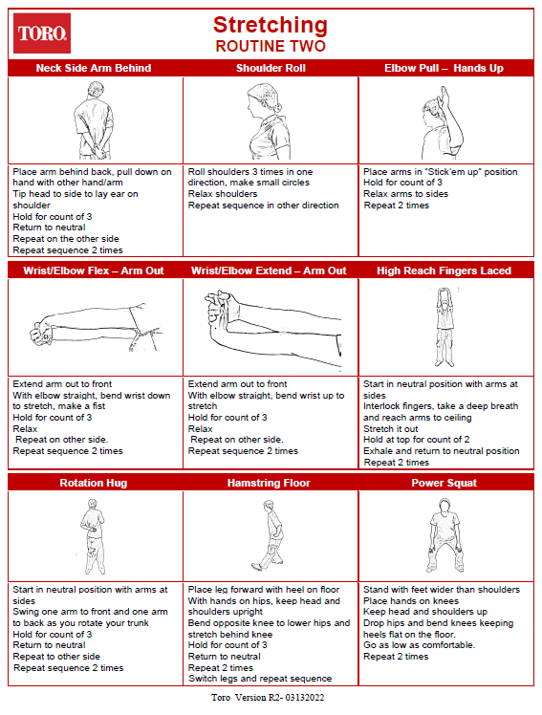
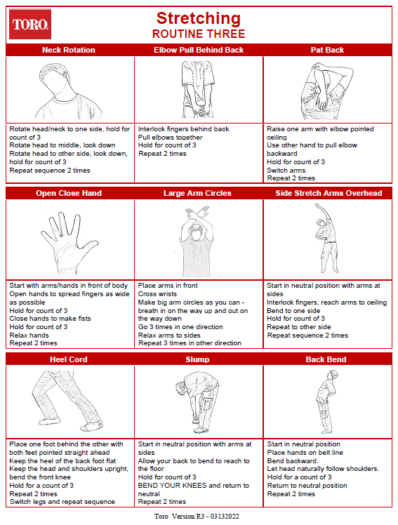
Stretching Routines

Slide 3
Why Should You Stretch?
Cold taffy
Connective tissue is a lot like taffy
When it’s cold and you try to stretch it
It breaks!
Warm taffy
On the other hand, when it’s warm and you stretch it
Much more likely to stretch!

Slide 4
Why Should You Stretch?
Oxygen
Helps heart because muscles act like pumps
Increased blood flow
More oxygen and nutrition
Joint Lubrication
Movement stimulates production of joint lubricating fluid
Improve joint health

Slide 5
When Should You Stretch?
Group
Regularly scheduled times
Individual
Personal preference throughout the workday

Slide 6
How Should You Stretch?
Absolutely have to follow medical restrictions
Able to make modifications per individual but must be approved
Technically correct
Perform correctly
Avoid sloppy technique
Energy Input/Output
Little In = Little Out

Slide 7
Stretching Logistics
How Long
Move the stretches along in energetic manner
Should not take longer than about 5 minutes to complete
Repetitions/Duration
Perform generally 2 to 3 repetitions
Hold for count of about 3

Slide 8
Stretching Guidelines
Joint Noises
Normal (typical with no level of concern)
Snap – minor adhesions letting loose
Crackle- minor rough areas smoothing
Pop – air bubbles popping
Regular and Consistent
Neutral Position
Start from the Neutral Position

Slide 9
Stretching Guidelines
Breathing – don’t hold breath
In with stretch
Out with relaxation
Controlled Stretching
Slow controlled
Graceful
No fast, jerky movements
Intensity
Start slow
Increase on a gradual level
Don’t compete with anyone
Listen to your body

Slide 10
Stretching Guidelines
Assess response
Normal comments
Warmth in area
Tingle in area

Slide 11
Stretching Guidelines
Comments to watch out for
Still really sore after stretch
Feel pain into arm or leg
Unacceptable sensations
Discomfort does not go with warm-up
Radiating pain into arm/leg
Dizziness
Sick to stomach

Slide 12
Stretching Guidelines
Modify stretch
Decrease movement
Decrease forcefulness
Refrain from stretch
If under control, gradually add back into routine
Refer to appropriate party if issue not resolved

Slide 13
Safety First! Always use proper technique, pay attention to body’s response to the stretches and immediately report any concerns or issues.

Slide 14
Bottom Line . . . Why Stretch?
Alertness levels
Help prevent injuries
Control stress
Reduce muscle tension
Increase flexibility
Develop body awareness
IT FEELS GOOD!

Slide 15
Stretching Routines

Slide 16
Thanks!

