Slide 1


Implementing Ergonomics
Your Ergonomics Journey!
ERGONOMICS ON-DEMAND!
Notes:
Implementing Ergonomics
Your Ergonomics Journey!
WorkWell Ergonomics On-Demand

Slide 2
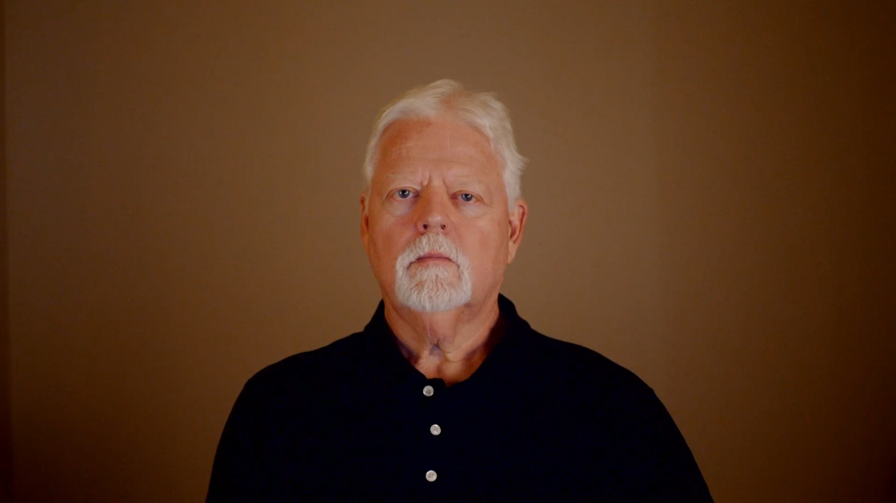
Introduction to Ergonomics
Notes:
Introduction to Ergonomics
I’m Mark Anderson, a Certified Professional Ergonomist and Physical Therapist.
I was first introduced to ergonomics in 1985. I was completing Physical Therapy graduate school and working in an Industrial Rehab program primarily with Worker’s Comp patients. I was trained in performing Functional Capacity Evaluations and the Return-to-Work process.
One day, it occurred to me I needed to have a better idea of the job demands my patients were returning to as they completed the rehab process. I was able to arrange a tour of the workplace of one of my patients. This really was the first step in my ergonomics consulting career.
Shortly after that I attended my first ergonomics course at the Center for Ergonomics at the University of Michigan in Ann Arbor. I found I was able to add the components of ergonomics workstation and tool design and analysis to my clinical practice and recognized this had value.

Slide 3

Evolution of Ergonomics Consultation
Transitioned to full-time ergonomics consulting in the early 1990’s
  Became a Certified Professional Ergonomist (BCPE) in 1993
  Shifted focus to macro-level consulting with companies
  Provided training, facilitated Ergonomics Teams and Programs
Notes:
Evolution of Ergonomics Consultation
I continued my education and experience in ergonomics and in the early 1990’s, I made a decision to move into a full-time ergonomics consulting practice. In 1993, I went through the certification process of the Board of Certification in Professional Ergonomics (www.bcpe.org) to gain certification as a professional ergonomist.
My ergonomics consulting process continued to evolve; where initially I was performing ergonomics analysis and consultation for specific patients and clients, I was now working with companies more at a macro level.
I was providing ergonomics training to company representatives including health and safety, engineering, management and workers. I was asked to facilitate the development and implementation of Ergonomics Teams and Ergonomics Programs.

Slide 4

Collaborative Ergonomics
Developed philosophy of "collaborative ergonomics"
  Emphasizes collaboration among stakeholders
  Identify ergonomics issues
  Recommendations
  implement and follow-up on recommendations
Notes:
Collaborative Ergonomics
I was developing my philosophy of what I call ‘collaborative ergonomics’. You might recall I mentioned this in the Ergonomics Manufacturing Track.
My experience taught me ergonomics is most successful when all the stakeholders – workers, management, supervision, health and safety, engineers, technicians, medical, facilities – come together in collaboration to identify the ergonomics issues, make appropriate recommendations and then work together to implement and follow-up on the recommendations.

Slide 5
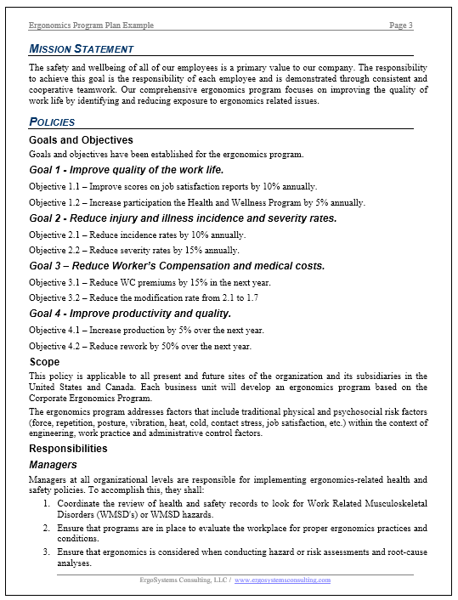
Collaborative Ergonomics
Value of Ergonomics Teams and Programs
Ergonomics Program Plan example
  Click on the Resources Tab
Notes:
Collaborative Ergonomics
What this has essentially taught me, in my experience anyway, is the value of Ergonomics Teams and Programs. To that end, I’ve provided an Ergonomics Program Plan example to give you a framework of an ergonomics program.
Please feel free to review it and use it as it benefits you.

Slide 6
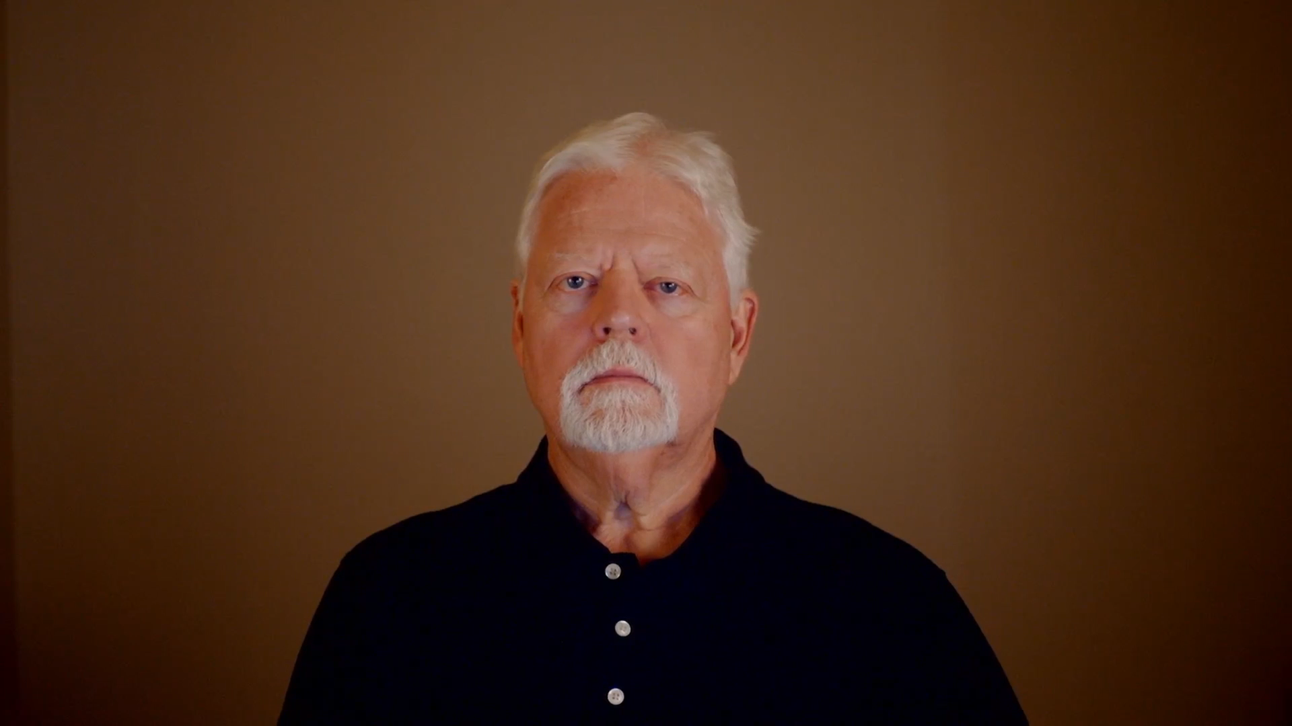
Your Journey?
Notes:
Your Journey?
So, this has been my ergonomics journey so far; I’ve found it to be productive and rewarding! Now where will your journey take you?
I know many health care professionals who have continued to work clinically and have incorporated ergonomics into their practices.
I know of some who have gone the more corporate route working with companies at the macro level.
Bottom line – many opportunities in many different formats are available for health care professionals. I wish you the best in whatever direction your unique journey takes you!
Thanks for your time and attention!

