Slide 1

ERGONOMICS ON-DEMAND!
Healthcare Professional
  Enhance expertise
  Bring substantial benefits to your practice
Notes:
Are you a healthcare professional looking to enhance your expertise and bring substantial benefits to your practice?

Slide 2

ERGONOMICS ON-DEMAND!
2025 Revision
  Cutting-edge training program
  Offered through WorkWell
Notes:
Welcome to the 2025 revision of ERGONOMICS ON-DEMAND!, a cutting-edge training program offered through WorkWell.

Slide 3

ERGONOMICS ON-DEMAND!
Notes:
For nearly three decades, WorkWell has been a leader in the occupational health industry, partnering with employers and providers for work injury prevention and management services, and providing high-quality training in occupational health programs that help you deliver top-notch care to your clients.

Slide 4
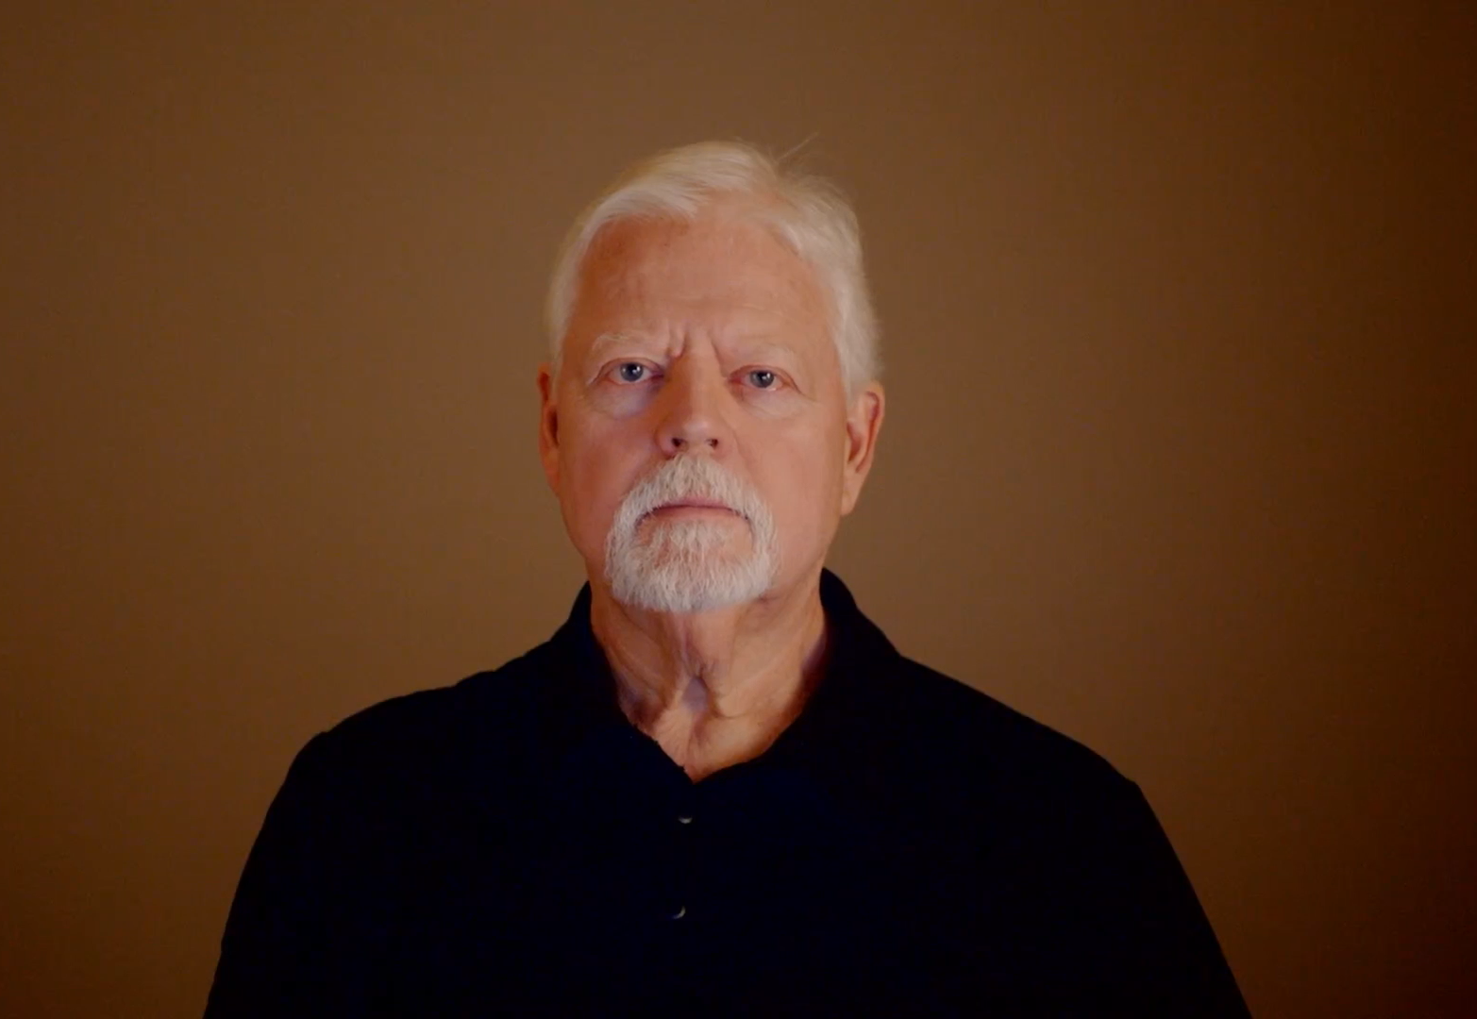
ERGONOMICS ON-DEMAND!
Mark Anderson, MA, PT CPE
  Physical Therapist
  Certified Professional Ergonomist
  Founder of ErgoSystems Consulting, LLC
  More than 35 years experience in ergonomics field
Notes:
I’m Mark Anderson. I’m a Physical Therapist and Certified Professional Ergonomist. I’m the founder of ErgoSystems Consulting, LLC. I’ve integrated my more than 35 years of experience in the ergonomics field into the development of ERGONOMICS ON-DEMAND!

Slide 5
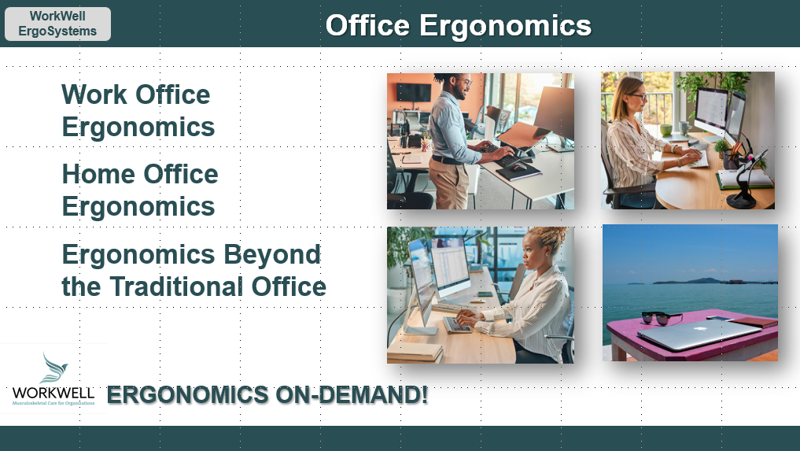
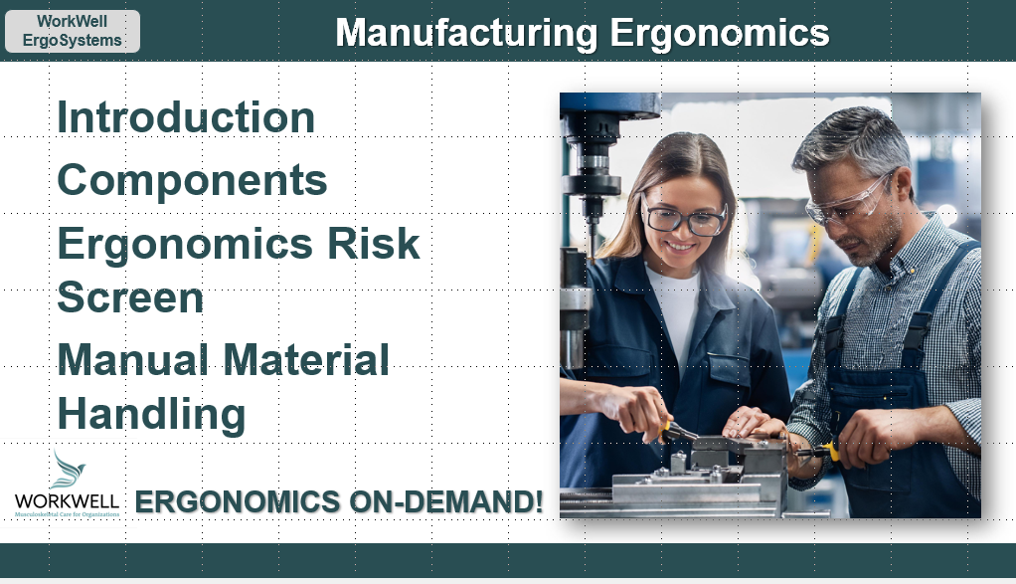
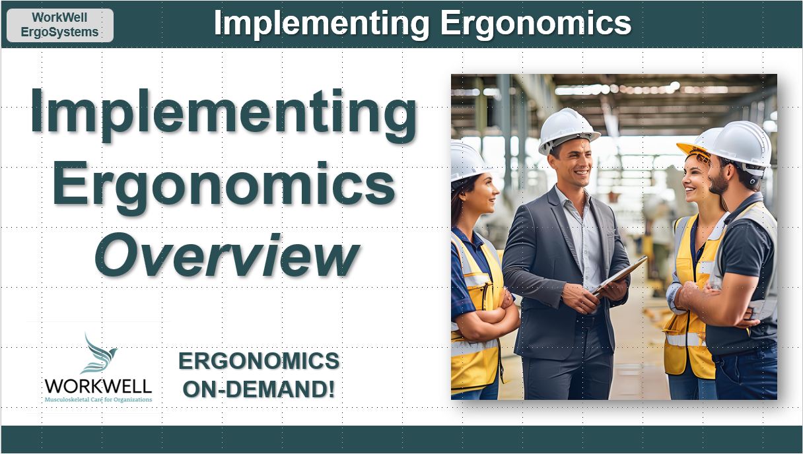
ERGONOMICS ON-DEMAND!
Flexible, modular framework
Four Tracks
  Introduction to Ergonomics
  Office Ergonomics
  Manufacturing Ergonomics
  Implementing Ergonomics
Notes:
ERGONOMICS ON-DEMAND! offers a flexible, modular framework tailored to your needs. The program consists of four comprehensive tracks: Introduction to Ergonomics, Office Ergonomics, Manufacturing Ergonomics, and the all new Implementing Ergonomics track.

Slide 6


ERGONOMICS ON-DEMAND!
Focus on
  Office setups
  Manufacturing environments
  Both
Help you
  Create effective interventions
  Identify job modifications
  Develop and deliver training
  Prevent injuries
  Convenient, on-demand format
Notes:
Whether you're focusing on office setups, manufacturing environments, or both, this training will help you create effective interventions, identify job modifications, develop and deliver training and, most importantly, prevent injuries. All of this is delivered in a convenient, on-demand format.

Slide 7
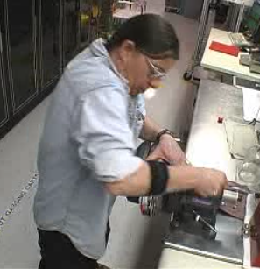
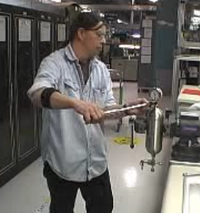
ERGONOMICS ON-DEMAND!
Practical application
  Hands-on activities
  Case studies
  Interactive tools
  Translate knowledge into action
Notes:
This program isn't just about theory; it's about practical application. You'll engage in hands-on activities, case studies, and interactive tools that translate knowledge into action.

Slide 8

ERGONOMICS ON-DEMAND!
Seasoned practitioner or new to ergonomics
  Skills to make a real difference in
    Lives of your clients
    Success of organizations you serve
Notes:
Whether you're a seasoned practitioner or new to ergonomics, ERGONOMICS ON-DEMAND! will equip you with the skills to make a real difference in the lives of your clients and the success of the organizations you serve.

Slide 9
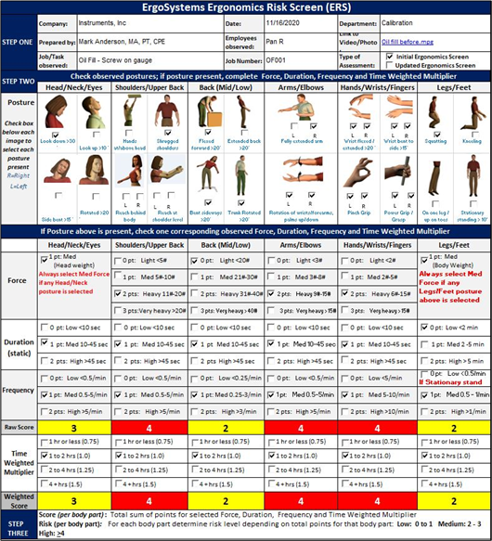

ERGONOMICS ON-DEMAND!
Foundational skillset and be equipped
  Forms
  Tools
  Resources
Notes:
You’ll come away from the training with a foundational skillset and be equipped with a variety of forms, tools and resources to aid in implementation.

Slide 10
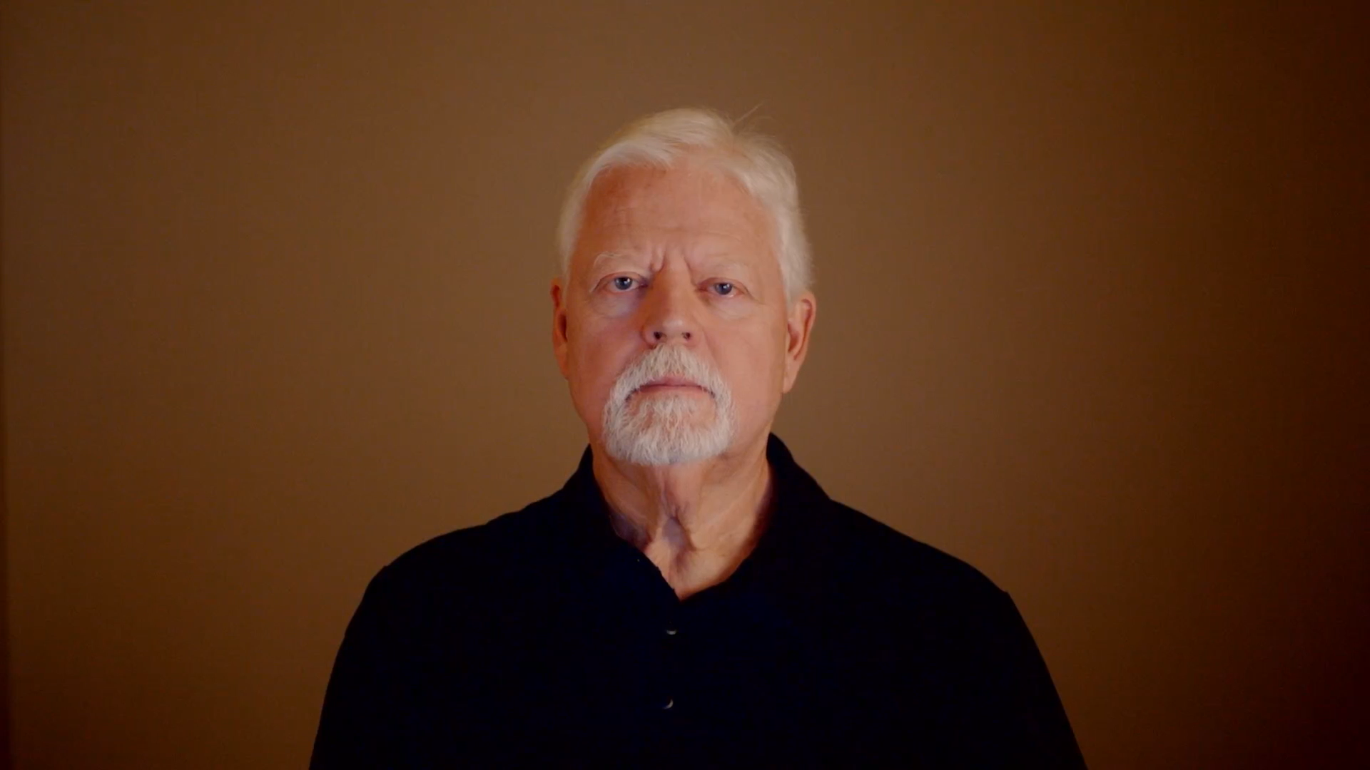
ERGONOMICS ON-DEMAND!
Elevate your professional practice with ERGONOMICS ON-DEMAND!
Discover transformative power of ergonomics!
Notes:
Seize the opportunity to elevate your professional practice with ERGONOMICS ON-DEMAND! Start your journey with us and discover the transformative power of ergonomics.

Slide 11
ERGONOMICS ON-DEMAND!

