Slide 1
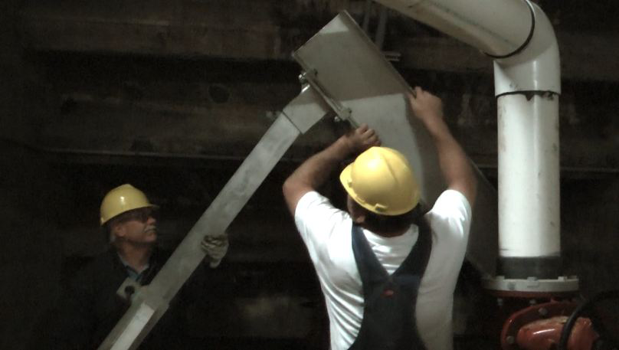
WorkWell Prevention and Care and ErgoSystems Present
WorkWell and ErgoSystems Present
ERGONOMICS ON-DEMAND!
Ergonomics for Health Care and Safety Professionals
Ergonomics Design Guidelines
Presented by Mark Anderson, PT, CPE
MENU
Notes:
WorkWell and ErgoSystems Present
ERGONOMICS ON-DEMAND!
Ergonomics for Health Care and Safety Professionals
Ergonomics Design Guidelines
Presented by Mark Anderson, PT, CPE

Slide 2
Guidelines to Optimize your Learning Experience
Menu
PRESENTER INFO Tab
RESOURCES Tab
OUTLINE and NOTES Tab
Slide controls
Notes:
Please use these Guidelines to optimize your learning experience.
Click on the Menu link to access the Menu.
Presenter Info is available by clinking on the PRESENTER INFO tab in the upper left.
Handouts are available by clicking on the RESOURCES tab in the upper left.
Click on the OUTLINE or NOTES Tab in the upper right to view the outline or notes.
You can advance through the slide by clicking on the Play or Pause control in the bottom left.
You can also replay the slide, change the audio levels and expand to full screen.
To advance to the next slide, click on NEXT or PREV to return to the previous slide.

Slide 3
Ergonomics Design Guidelines Track
Welcome!
Ergonomics Design Guidelines Track
Mark Anderson
Certified Professional Ergonomist
Physical Therapist
30 plus years experience
Notes:
Welcome!
Welcome to the Ergonomics Design Guidelines Track!
Hello everyone, I’m Mark Anderson. I am a Certified Professional Ergonomist and Physical Therapist with more than 30 years of experience working with ergonomics in a wide variety of settings.

Slide 4
Questions, Questions, Questions!
Answer questions like
How high should workbench be?
We need transport cart, what specifications?
Position foot and hand controls for machine?
Position touch screen monitors
How high should conveyor belt be?
Force needed to grip a tool and what is acceptable?
How much weight to reasonably lift?
What clearance for operator’s feet and legs at workbench?
How should we adjust shelf heights?
Getting my point!
Go-to resource
Notes:
Questions, Questions, Questions!
One of the things I have discovered in working in ergonomics on an on-going, day-in, day-out basis is you need to be able to answer questions like:
How high should that workbench be?
We need a transport cart, what specifications does it need to meet?
Where should we position the foot and hand controls for that machine?
How should we position the touch screen monitors on the production line?
How high should the conveyor belt be?
How much force is needed to grip a tool and what is acceptable?
How much weight can a worker reasonably lift?
What clearance do we need for the operator’s feet and legs at the workbench?
We are setting up a storage racking system, how should we adjust the shelf heights?
Honestly, the list of questions goes on and on!
I suspect you are getting the point I am making. You become the go-to resource in ergonomics workstation, tool and equipment design.
.

Slide 5
Ergonomics Defined
Optimizing all aspects of job performance - safety, quality and productivity - accomplished through the appropriate DESIGN AND USE of work processes, workstations, tools and equipment and the overall organization of work.
Notes:
Ergonomics Defined
In the Introduction to Ergonomics Track we defined ergonomics in the systems design context as:
“Optimizing all aspects of job performance - safety, quality and productivity - accomplished through the appropriate DESIGN AND USE of work processes, workstations, tools and equipment and the overall organization of work.”
Design is a critical word in the definition. Over the past 30 years I have been compiling answers to at least some of the questions.
Believe me I am still learning everyday as something new pops up!
Honestly, that is what keeps it interesting to me. Like you, I enjoy solving problems and seeing the positive results.

Slide 6
Ergonomics Design Guidelines
Series of
Checklists
Guidelines
Specifications
Guidelines
Separate document
Print out and/or access as you need
Notes:
Ergonomics Design Guidelines
At any rate, I have put together a series of Checklists, Guidelines and Specifications for workstations, tools and equipment in terms of ergonomics.
The Guidelines are available to you as a separate document you can print out and/or access as you need.

Slide 7
Table of Contents
Wide range of topics
Carts to Chairs/Stools
Controls to Conveyors
Fixtures to Grip and Hand Strength
Microscopes to Manual Material Handling
Seated and Standing Workstation Guidelines and Specifications
Notes:
Table of Contents
Looking at the Table of Contents for the Guidelines you will see a wide range of topics ranging from Carts to Chairs/Stools to Controls to Conveyors to Fixtures to Grip and Hand Strength to Microscopes to Manual Material Handling to a whole host of Seated and Standing Workstation Guidelines and Specifications.

Slide 8
Accessing Ergonomics Design Guidelines
Introduce Guidelines to you?
Did NOT want to go through each and every Checklist and Specification
I don’t think I would be awake at end and I’m sure you would not be!
Browse Ergonomics Design Guidelines
Referenced in other Tracks
Can’t guarantee every question answered, but I hope it provides some pertinent answers
Thanks for your time and attention!
Notes:
Accessing the Ergonomics Design Guidelines
When thinking how best to introduce the Ergonomics Design Guidelines to you, I knew for sure I did NOT want to go through each and every Checklist and Specification with you!
I don’t think I would be awake at the end and I’m pretty sure you wouldn’t be either!
Instead, I would encourage you to browse the Guidelines to get a sense of what is included.
You may have noticed in the other Tracks; I reference the Guidelines as appropriate.
As you continue to work in ergonomics, please access the Guidelines as you run across questions that you need to answer.
I can’t guarantee every question is answered, but I hope it provides some pertinent answers.
Thanks for your time and attention!

Slide 9
Instructor Background/Experience
Mark A. Anderson, MA, PT, CPE
Founder of Minneapolis, Minnesota based ErgoSystems Consulting, LLC
Industrial Rehabilitation clinical practice in mid 1980’s led to interest in ergonomics
Since 1993 certified by Board of Certification in Professional Ergonomics as Certified Professional Ergonomist (www.bcpe.com)
Consulted in ergonomics for over 30 years
Education
Bachelor of Science Degree from University of North Dakota Physical Therapy program
Master of Arts Degree in Physical Therapy from the University of Iowa
Worked with WorkWell developing Office and Manufacturing Ergonomics training courses
Notes:
Instructor Background and Experience
Mark A. Anderson, MA, PT, CPE is the founder of Minneapolis, Minnesota based ErgoSystems Consulting, LLC.
Work in an Industrial Rehabilitation clinical practice in mid 1980’s led to his interest in ergonomics.
Since 1993 Anderson has been certified by the Board of Certification in Professional Ergonomics as Certified Professional Ergonomist (www.bcpe.com).
He has consulted in ergonomics for over 30 years
His education includes a Bachelor of Science Degree from the University of North Dakota Physical Therapy program and a Master of Arts Degree in Physical Therapy from the University of Iowa.
Anderson worked with WorkWell developing the Office and Manufacturing Ergonomics courses and the ERGONOMICS ON-DEMAND series.

Slide 10
Menu
Title Slide
Guidelines
Welcome
Questions, Questions, Questions!
Ergonomics Design Guidelines
Summary and Close
Instructor Background
Menu
Notes:
Menu

