Slide 1
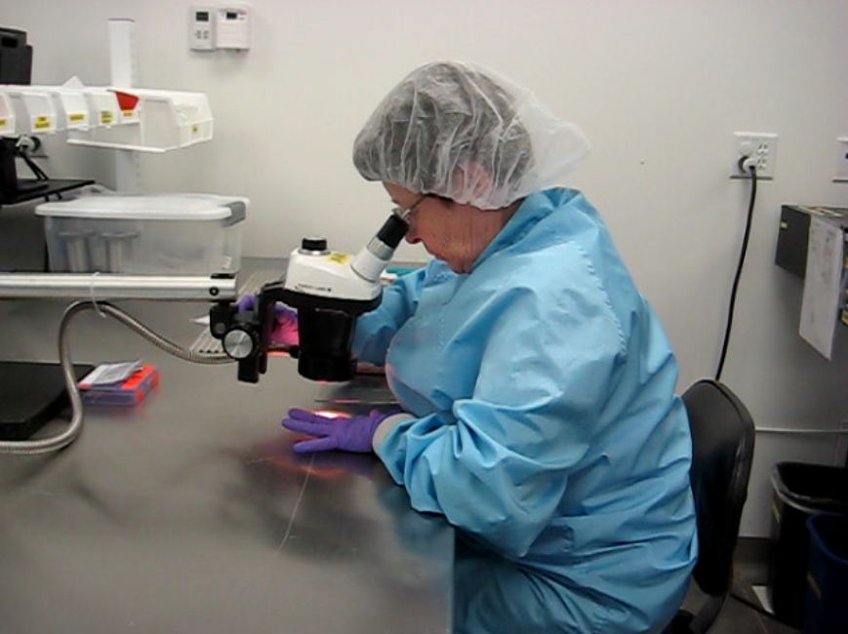
WorkWell Prevention and Care and ErgoSystems Present
Introduction to Ergonomics
MENU

Slide 2
Welcome to Introduction to Ergonomics
Welcome to Introduction to Ergonomics!
Notes:
Hi everyone, welcome to the Introduction to Ergonomics.

Slide 3
Ergonomics – Not a New Word to You
Common usage
1980’s
“I work in Ergonomics.”
“How is the corn crop looking this year?”
Agronomics!
Question then made sense
Nice conversation about Ergonomics and corn!
Notes:
I’m reasonably sure the word, ‘ergonomics’ is not new to you. At this point it seems the word has entered the lexicon of common usage. This was not always the case.
When I first started practicing ergonomics in the 1980’s, I recall traveling by airplane to work on a project and the passenger next to me asked what I did for a living. I responded, “I work in ergonomics.”
His next question to me was, “How is the corn crop looking this year?” I had a puzzled look on my face until I realized he thought I worked in Agronomics which of course is the branch of economics dealing with the distribution, management, and productivity of land. His question made sense to me then!
We then went on to have a nice conversation about ergonomics, corn and probably a few other topics as well!

Slide 4
Ergonomics – Marketing Niche
Consumer products
‘Ergonomic benefit’
Listen for use in marketing
Marketed as ‘ergonomic’
Really makes it better?
Maybe or maybe not!
“Let the buyer beware!”
Notes:
At any rate, from the consumer’s perspective, ergonomics has now found a niche in the marketing of consumer products. Chairs, toothbrush handles, keyboards, tools, you name it. The product (fill in the blank) is touted as having an ‘ergonomic benefit’. Ergonomics has become a common word! For the next week, listen to how many times you hear the word, ‘ergonomics’ in advertising. I think you might be astounded!
However, just because a product is marketed as ‘ergonomic’, does that really mean it is better? It may be better, or it may not be better!
The old adage, “Let the buyer beware!” has significant impact.

Slide 5
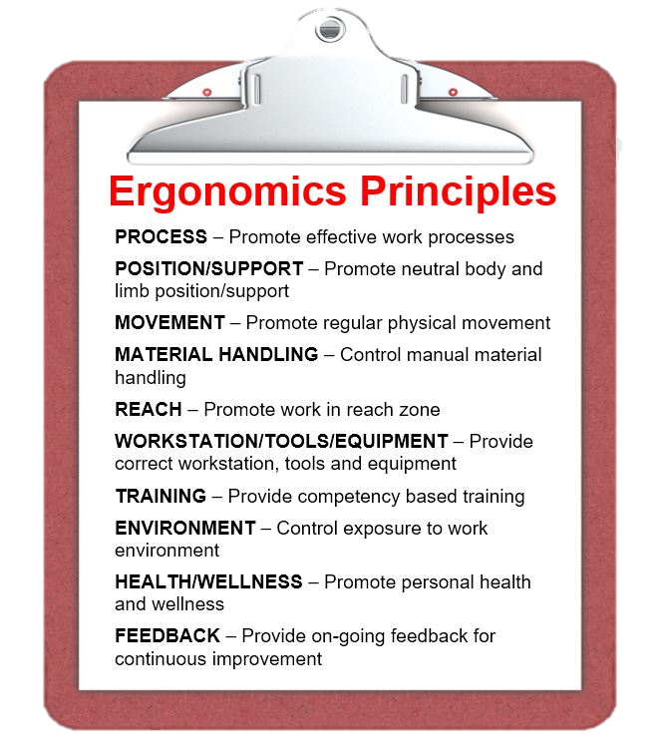
Ergonomics
Ergonomics Foundations
Epidemiology
Work Physiology
Engineering Psychology
Anthropometry
Occupational Biomechanics
Ten Ergonomics Principles
Let’s get started!
Epidemiology
Work Physiology
Engineering Psychology
Anthropometry
Occupational Biomechanics
Notes:
In the Introduction to Ergonomics Track, we’ll delve into what ergonomics is really all about. We’ll layout the Foundations of Ergonomics (Epidemiology, Work Physiology, Engineering Psychology, Anthropometry and Occupational Biomechanics) and integrate them into a set of ten practical Ergonomics Principles.
Let’s get started!

Slide 6
Ergonomics – Defined
Word “ergonomics” comes from the Greek
“ergon” means work
“nomos” means the laws or study of
So, ergonomics is literally
“laws or study of work”
Notes:
The word ‘ergonomics’ was coined by a Polish scholar in 1857.
In Greek, ‘ergon’ means work and ‘nomos’ means the laws or study of.
So, ergonomics is literally the “the laws or study of work.”

Slide 7
Ergonomics – What is the Goal?
Eliminate?
Physical stress
Too little?
“Don’t use it you will lose it!”
Too much?
Breakdown, especially if inadequate recovery times
Mental stress
Too little?
Not much happen, some stress acts as a motivator
Too much?
Decompensation and dysfunction
Notes:
Ergonomics – What is the Goal?
We all would agree that the goal of ergonomics is to improve the health, safety and productivity of activities – whether at home or at work.
We would also agree that aspects of physical and mental stress contribute to the factors of health, safety and productivity.
Is the goal of ergonomics to . . . ELIMINATE physical and mental stress?
Eliminate physical stress . . . what is the outcome? We are aware that if physical stress is eliminated (bed rest, for example) the result is disastrous. (If you don’t use it . . . you will lose it!)
And of course, we also realize that excessive physical stress without time for adequate recovery is equally problematic.
Eliminate mental stress . . . what is the outcome? As it turns out . . . not much! We recognize that some mental stress acts as a motivator. However, we also know that too much mental stress results in decompensation and dysfunction.

Slide 8
Ergonomics – What is the goal?
Replace word ELIMINATE with OPTIMIZE
Optimize physical stress
Optimize mental stress
“Just Right Continuum”
Optimize!
“Just Right Window”
That is the challenge!
Notes:
How about if we replace the word ‘ELIMINATE’ with the word ‘OPTIMIZE’.
• OPTIMIZE physical stress
• OPTIMIZE mental stress
A completely different connotation is appreciated.
Think of it as the ‘Just Right Continuum’; a certain window of optimization is apparent.

Slide 9
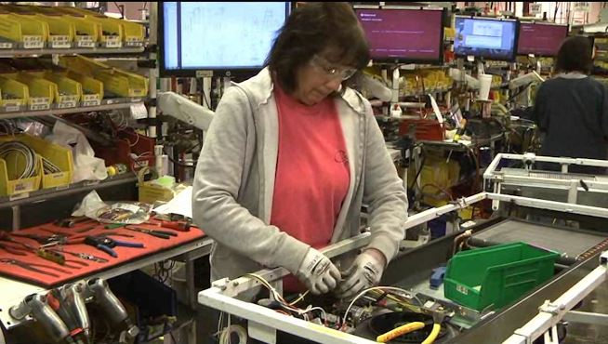
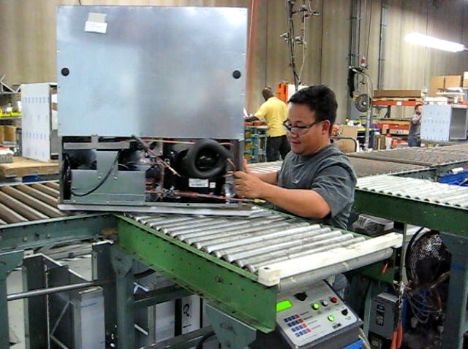
Critical Question
Is JUST RIGHT window same for each person?
Or what may be TOO MUCH for one individual is JUST RIGHT and very acceptable for another?
Other factors
Time of day
Fatigue
Workstation design, tools and equipment
Training
Environmental conditions supervision
List can go on and on
Notes:
Critical Question
Here is a critical question.
Is the ‘JUST RIGHT’ window the same for each person?
Or is it true that what may be TOO MUCH for one individual is JUST RIGHT and very acceptable for another?
Do other factors influence the ‘JUST RIGHT’ window? Factors like the time of the day, fatigue, workstation design, tools and equipment, training, environmental conditions, supervision - this list can go on and on - also impact the ‘JUST RIGHT’ window.

Slide 10
Challenge of Ergonomics
True challenge of ergonomics analysis and intervention
Recognize influence of individual performance variations
AND figure out how best to deal with these variations to optimize performance
We’ll discuss this in more detail when we take a closer look at ergonomics interventions
Notes:
The true challenge of ergonomics analysis and intervention is to recognize the influence of individual performance variation AND figure out how best to deal with these variations to optimize performance.
We’ll discuss this in more detail when we take a closer look at ergonomics interventions.

Slide 11
How is Ergonomics Defined?
Most people have heard word, ‘Ergonomics’
Ergonomically designed corn chips?
ScoopsTM are designed to not break when you dip!
Which is a good thing, otherwise next person has to figure out how to get broken chip out of salsa bowl!
Notes:
How is Ergonomics Defined?
As we discussed, at this point in the evolution of the science of ergonomics, most people have heard the word, ‘Ergonomics’ and have a sense of how it is used.
Did you know you can even enjoy ergonomically designed corn chips?
Yep, Scoops are designed to not break when you dip!
Which is a good thing, otherwise the next person has to figure out how to get the broken chip out of the salsa bowl!

Slide 12
How is Ergonomics Defined?
You probably have heard of a few definitions of ergonomics
Working Smarter; Not Harder!
Fit the Job to the Person; Don’t Force the Person to Fit the Job!
These are reasonable definitions and make good sense
In our context, we are going to go after it with a little different twist
Notes:
You probably have heard some definitions of ergonomics:
• “Working Smarter; Not Harder!”
• “Fit the Job to the Person; Don’t Force the Person to Fit the Job!”
These are reasonable concepts. In our context, we are going to go after it with a little different twist.

Slide 13
Ergonomics and Gravity
Throwing ball into the air
What happens?
Correct!
Ball comes back down!
Why?
Because GRAVITY works!
Circumstances predict response
Don’t want ball to come back down?
Tell it . . . “BALL, STAY UP!”
Not going to work!
Because GRAVITY does works!
Notes:
Ergonomics and Gravity
Ergonomics is like throwing a ball into the air.
What happens?
Correct!
The ball comes back down. Why? Gravity works!
In fact, if it didn't come back down, we would be quite surprised!
As we understand the laws of gravity, when we stand on the face of the earth and throw a ball into the air, it will come back down.
In other words, the . . . Circumstances Predict the Response!
Now, imagine we DON’T want the ball to come back down. What do we need to do? How about throw the ball up and just tell it to stay in the air?
“BALL - STAY UP!!”
Everyone will agree this is ridiculous! You can’t get a ball to stay in the air just by telling it to. Unless you are a magician and they really can’t do it either!

Slide 14
Ergonomics and Gravity
How do we get the ball to stay in the air?
Attach Velcro to it
Throw it into a net
Attach it to a string
Launch yourself into outer space
You get the picture!
We need to change the circumstances to change the response!
Relates to Ergonomics?
Notes:
How do we get the ball to stay in the air? We need to change something . . . attach Velcro to it, throw it into a net, attach it to a string, launch yourself into outer space . . . you get the picture!
We need to change the circumstances to change the response!
How does this relate to what ergonomics is all about?

Slide 15
Circumstances Predict the Response!
Apply to work
Assemble component at low level
Bend over at the waist
All agree, not a good position!
But very common!
Solution
Whenever see someone in this poor position, tactfully tap them on shoulder and say,
‘”When you are in that bad position, be really, really, really careful you don’t hurt yourself!”
That makes about as much sense as telling the ball to, “Just stay in the air!”
Notes:
Circumstances predict the response!
Well, rather than throw a ball into the air, let's say you need to assemble a component at a knee-high level. The body position most likely used is to just bend over at the waist.
From a health and safety, as well as productivity standpoint, we recognize this work position can cause problems.
But unfortunately, it is a commonly observed work position. Next time you are in a workplace, pay attention to how many times you observe the knee-straight, back-bent position.
How about this for a solution - whenever we see someone in this poor position, we tactfully tap them on the shoulder and say,
“When you are in that bad position, be really, really, really careful you don’t hurt yourself!”
That makes about as much sense as telling the ball to, “Just stay in the air!”
I think we need a different strategy.

Slide 16
Driving Force for Poor Position
Question
What is driving force behind bent over posture?
Answer
Setup of workstation with assembly task occurring at about knee level
What can be done to improve setup?
CHANGE THE CIRCUMSTANCES TO CHANGE THE RESPONSE!
What are some options?
Intuitively recognize recommended body position
Neutral Position
Notes:
QUESTION
Look at the person in this example working with the knee-straight, back-bent posture.
What is driving force behind that bent over posture? What set of circumstances are in place?
ANSWER
Is it fair to say, the setup of the workstation with the assembly task occurring at about knee level is the driving factor?
What can be done to improve the setup?
We need to . . .
‘Change the Circumstances to Change the Response!’
How should we change the circumstances?
Intuitively, I think you recognize the recommended body position. You would like them to be more upright in some way. We call this the Neutral Position. We’ll get into the details a little later.

Slide 17
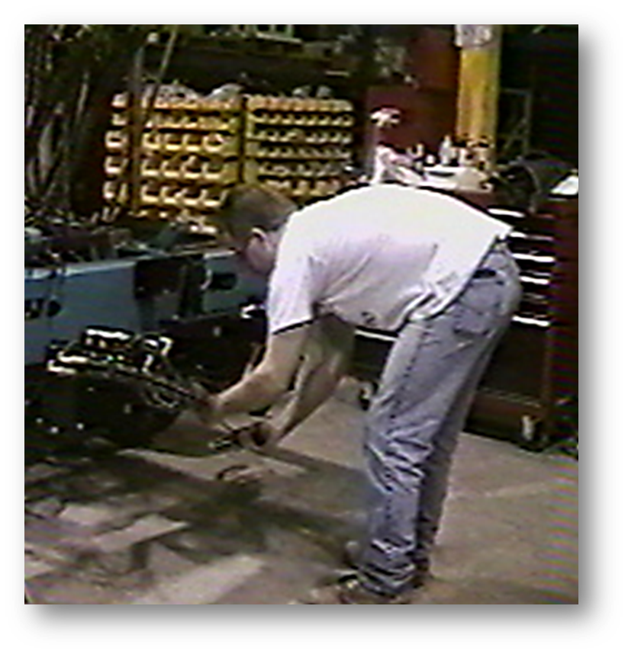
Brainstorming session
List options for ergonomics improvements
__________________________
__________________________
__________________________
__________________________
__________________________
Notes:
Brainstorming session
List options for ergonomics improvements.
1. ________________________________
2. ________________________________
3. ________________________________
4. ________________________________
5. ________________________________

Slide 18
Brainstorm Ideas
Option One
Reposition the work
Mechanical lift
Option Two
Lower Assembler
Go into the floor
Option Three
Reposition the Assembler
Rolling mechanic’s stool
Engineering Psychology
Population Stereotypes
Notes:
What did you come up with?
Option One
One option would be to put the assembly on a lift the assembler can control and literally raise the work height. Now, as it turns out what he is working on is a large, heavy street sweeper. But with enough resources (money and time) that could be an option.
Option Two
Another option would be to reposition the assembler. We could cut a hole into the floor and have the assembler work from the lower level.
Now, before you think I have taken a step off the deep end, have you ever seen the workstations at the quick oil change places. They actually have a pit they work in and position the vehicle to gain access to the underneath of the vehicle.
Once again, some pretty significant resources would be required. But it is possible in the right situation.
Option Three
How else could we reposition the assembler? How about a rolling stool?
Honestly, that is what was done in this situation. The assembler is now seated on a rolling mechanic’s stool. Posture is dramatically improved.
What we understand, based on Engineering Psychology Principles (more about this a little later), is given a certain set of circumstances, we will generally respond in a fairly predictable way. Now we know this is not 100% the case and we will talk about this when we discuss what are called Population Stereotypes in the Engineering Psychology section.

Slide 19
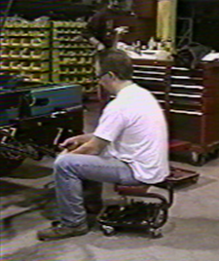
Change Circumstances to Change Response!
Notes:
If we want to change the RESPONSE
We need to change the CIRCUMSTANCES!

Slide 20
Systems Design
Essence of ergonomics
Workstations
Work processes
Work environment
Work culture
Effort wasted because of
Poor positioning of tools, equipment and parts
Poor design of tools
Haphazardly thought-out work processes
Poor work environments
Systems design approach provides solid foundation
Notes:
Systems Design
The essence of ergonomics is design. Design of workstations, work processes, work environment and work culture dictates the level of workplace safety and productivity.
For example, effort may be wasted because of:
• Poor positioning of tools, equipment and parts.
• Poor design or maintenance of tools.
• Haphazardly thought-out work processes.
• Poor work environments due to poor ventilation and lighting.
We can effectively deal with these problems and other problems by using ergonomics.
A systems design approach provides a solid foundation.

Slide 21
A Little Mind Reading!
Concept of ergonomics systems design
One: Choose a number between one and nine.
Two: Multiply that number by nine.
Three: Add together the digits of the result of Step Tw
Four: Subtract five from the result of Step Three.
Five: Choose the letter of the alphabet that corresponds to the result of Step Four, e.g., A=1, B=2, C=3, etc.
Six: Choose a country that begins with that letter.
Seven: Choose an animal that begins with the last letter of that country.
Eight: Choose a color that begins with the last letter of the animal.
Notes:
A Little Mind Reading!
To get a handle on the concept of ergonomics systems design . . . get out your crystal ball and try this example. I will attempt to read your minds!
One: Choose a number between one and nine.
Two: Multiply that number by nine.
Three: Add together the digits of the result of Step Two.
Four: Subtract five from the result of Step Three.
Five: Choose the letter of the alphabet that corresponds to the result of Step Four, e.g., A=1, B=2, C=3, etc.
Six: Choose a country that begins with that letter.
Seven: Choose an animal that begins with the last letter of that country.
Eight: Choose a color that begins with the last letter of the animal.

Slide 22
Country/Animal/Color Exercise
Did you come up with
Orange Kangaroo from Denmark?
Majority of people generally will!
Example of a well-designed system
Let's discuss why
Notes:
Did you come up with an Orange Kangaroo from Denmark?
A majority of people generally will!
This is an example of a well-designed system; let's discuss why.

Slide 23
Systems Design: Principles
Human Factors and Ergonomics Design Handbook defines system as
Mission-oriented grouping of elements into an integrated, functional whole
Includes facility, equipment, furnishings and fixtures
Involves variety of people who use, operate or maintain it
Must perform mission or function and must work in an environment
Notes:
Systems Design Principles
The Human Factors Design Handbook defines a system as:
• Mission-oriented grouping of elements into an integrated, functional whole
• It includes the facility, equipment, furnishings and fixtures
• It involves a variety of people who use, operate and maintain it
• It must perform a mission or function and must work in an environment

Slide 24
Country/Animal/Color Exercise
Orange Kangaroo from Denmark
Yields a consistent response for majority of people
Based on set of principles that make up system
Or, if you choose to – you can believe it really is possible to read minds!
Or, you can use the Principle of Nines!
Google it!
Notes:
Country-Animal-Color
The Country-Animal-Color (Orange Kangaroo from Denmark) exercise you just completed yields a consistent response for a majority of people based on a set of principles that make up a system.
Or, if you choose to – you can believe it really is possible to read minds! Or you can use the Principle of Nines! Google it.
As a hint you all should have come up with the letter, ‘D’ in Step Five. If you didn’t, you may want to review your work!

Slide 25
Systems Design Principles
Human Factors and Ergonomics Design Handbook
Adapted to the human
Facilitates highest level of performance to which operator is capable
Optimizes physical and mental stress imposed on operator
Provides personal satisfaction for user
Functions to serve the human
Recognizes individual variation in human capabilities and limitations
Influences human behavior either positively or adversely
Does not exist in isolation
Notes:
The Human Factors Design Handbook lists a set of general principles of the Systems Design approach:
• The system is adapted to the human
• The system facilitates the highest level of performance to which the operator is capable
• The system optimizes physical and mental stress imposed on the operator
• The system provides personal satisfaction for the user in terms of use
• The system and its components, function to serve the human
• The system recognizes individual variation in human capabilities and limitations
• The design of the system influences human behavior either positively or adversely
• A system, by definition, does not exist in isolation

Slide 26
Ergonomics Defined
Optimizing all aspects of job performance – safety, quality and productivity – accomplished through the appropriate design and use of workstations, work processes and the overall organization of work.
Notes:
Ergonomics Defined
With this concept in mind here is our definition of ergonomics:
Optimizing all aspects of job performance - safety, quality and productivity - accomplished through the appropriate DESIGN AND USE of work processes, workstations, tools and equipment and the overall organization of work.

Slide 27
Systems Design Foundations
Foundations include number of disciplines
Epidemiology
Work Physiology
Engineering Psychology
Anthropometry
Occupational Biomechanics
Notes:
Systems Design Foundations
The study of systems design encompasses many fields. For our purposes, we will examine several that have direct influence on ergonomics.
Each of them is a full-fledged discipline.
As we introduce the ten ergonomics principles we will discuss:
• Epidemiology
• Work Physiology
• Engineering Psychology
• Anthropometry
• Occupational Biomechanics

Slide 28
Why does Ergonomics Work?
Strategies to identify and solve problems
Design based; addresses true root cause not just symptoms
Cost-effective; incorporates an incremental approach
One more crucial element?
Cherry-Picker monorail
Routine maintenance
Hand-held belt sander
Issues?
Automated system
Notes:
Why does Ergonomics Work?
But first, here is a question for you, “Why does ergonomics work?” Well, in my experience it works because:
• Ergonomics employs strategies to identify and solve problems.
• Ergonomics is design based; it addresses the true root cause not just the symptoms.
• Ergonomics is cost-effective, it incorporates an incremental approach to the mitigation of identified issues.
These are all valid reasons. I have come to recognize one more crucial element to making sure ergonomics is effective.
Let me give you an example. Some years ago, I was working with a military installation with a large warehouse.
Look at the picture, in the background you can almost make out what is called a Cherry-Picker, essentially a lift used by a Picker to place and remove materials stored in the racking system. The Cherry-Picker runs on a mono-rail that is readily seen in the foreground. You also will see a maintenance technician on his hands and knees with a tool in his hands.
As it turns out the tool he is using is a hand-held belt sander. He is performing routine maintenance on the mono-rail. What do you think about the ergonomics of the work set-up? Can you envision any safety and productivity issues? Picture yourself doing the job.
Everyone who performed this task reported musculoskeletal issues. What body parts do you think were at issue? How about the knees, hips, back, shoulders, arms and hands? In fact, it is easier to list the body parts not affected!
You may be aware an automated system is available that attaches to the Cherry-Picker and performs the maintenance on an on-going basis. You probably also may be aware these systems are not cheap and require a significant capital expenditure. Even when approved, it will take some time to implement.

Slide 29
Brainstorming session
List options for ergonomics improvements
__________________________
__________________________
__________________________
__________________________
__________________________
Notes:
Brainstorming session
Our immediate objective was to figure out something that could be implemented within a maximum $500 budget and within a two-week time-frame.
Any ideas?
List options for ergonomics improvements.
1. ________________________________
2. ________________________________
3. ________________________________
4. ________________________________
5. ________________________________

Slide 30
Why does Ergonomics Work?
Proposed
Knee pads
Rolling stool to sit on
Padded gloves
Taking more frequent breaks
Perhaps some other ideas
Ergonomics work
Identify and solve problems.
Addresses true root cause
Incremental cost-effective approach
One more crucial element
What is that element?
Notes:
You might have proposed knee pads, a rolling stool to sit on, padded gloves, taking more frequent breaks and perhaps some other ideas.
Recall I noted in my experience, ergonomics works because it:
• Employs strategies to identify and solve problems.
• Addresses the true root cause, not just the symptoms.
• Incorporates an incremental cost-effective approach.
And then I mentioned one more crucial element to make sure ergonomics is effective. What is that element?

Slide 31
Why does Ergonomics Work?
Criteria
Maximum $500 budget
Two-week timeframe
Sander modified
Fabricating adjustable height handle with trigger
Roller system
‘Sander-on-a-stick’
Whose idea do you think this was?
Makes use of best ergonomists in world; people who do the work!
Notes:
Well, working within our criteria of a maximum $500 budget and a two-week timeframe, the existing sander was modified by fabricating an adjustable height handle with a trigger and a roller system so it could be maneuvered on the mono-rail from a standing position.
It was called a ‘sander-on-a-stick’. Catchy name, huh? Honestly, an incredible difference was noted!
So, what is the last crucial element? Now, whose idea do you think this was?
You probably have guessed it already; it came from the people doing the job! They knew the issues and had some sound ideas for improvement. They just needed affirmation and a little assistance.
In my experience the best people to practice ergonomics are the people who actually do the work.
As health and safety professionals, we certainly bring our expertise to the table and when combined with the expertise of the worker and others in the organization, significant improvements are possible.
Who makes the best ergonomists in the world . . . people who actually do the work!

Slide 32
Ten Ergonomics Principles
Let’s get into details
Summary of ten Ergonomics Principles
Integrate ergonomics foundations and systems design approach
Notes:
Ergonomics Principles and Foundations
Let’s get into the details of the ten Ergonomics Principles and integrate the Ergonomics Foundations.
Here is a summary of the principles:
1. PROCESS – Promote effective work processes
2. POSITION/SUPPORT – Promote neutral body and limb position/support
3. MOVEMENT – Promote regular physical movement
4. MATERIAL HANDLING – Control manual material handling
5. REACH – Promote work in the reach zone
6. WORKSTATION/TOOLS/EQUIPMENT – Provide correct workstations, tools and equipment
7. TRAINING – Provide competency-based training
8. ENVIRONMENT – Control exposure to work environment
9. HEALTH/WELLNESS – Promote personal health and wellness
10. FEEDBACK – Provide on-going feedback for continuous improvement

Slide 33
30/30/30 Micro-breaks
A Micro-breaks
Frequent and regular body movement is basic ergonomics principle
30/30/30 Rule of Physical Movement
Physically active micro-breaks 30 seconds in length
About every 30 minutes
30 days to make it a habit
Benefits
Reduce tissue compression and joint stiffness,
Enhance circulation
Practice what we preach!
Introduce basic stretch
Notes:
Micro-breaks
As we have discussed, frequent and regular body movement is a basic ergonomics principle to promote health and safety in the workplace.
You may already be familiar with the 30/30/30 Rule of Physical Movement that encourages physically active micro-breaks of about 30 seconds in length taken about every 30 minutes and do it for 30 days to make it a habit! I want to emphasize the concept because benefits include reducing tissue compression and joint stiffness and enhancing circulation.
Let’s practice what we preach by introducing a basic stretch, the Back Bend.

Slide 34
Micro-breaks – Guidelines
Guidelines
Absolutely have to follow doctor's orders
Technically correct
Energy input/output
Neutral Position
Joint noises
Don’t hold breath
Regular and consistent
Intensity/controlled stretching
Back Bend
To do Back Bend, roll curser over video to play video
Notes:
Before we try out the Back Bend here are the essential guidelines for safe and effective performance.
Absolutely have to follow any doctor's orders for restricted activities
Perform the stretches in a technically correct manner
Energy input is related to the benefit; be as vigorous as possible
Start the stretch from the Neutral Position
Joint noises, ‘snap, crackle and pop’ are normal
Don’t hold your breath, breath in with the stretch and out with the relaxation
Regular and consistent performance is the way to obtain the benefits
Always control the intensity of the stretch based on your response to the stretch
Back Bend
If you choose to do the Back Bend, follow along with the video.

Slide 35
Promote Effective Work Processes
Center cog
Interlock and rotate
Take step back and really examine why something is done as it is
If answer is . . .
“Because it has always been done that way!”
Has it become commonplace?
We don’t pay attention anymore!
Take fresh look
Is there better way to get it done?
Notes:
Introduction
Promoting the effectiveness of the work process is the overarching principle of ergonomics.
This ergonomics principle is the ‘center cog’ about which the other ergonomics principles interlock and rotate.
The goal is to take a step back and really ask why something is done as it is.
If the answer is . . .
“Because it has always been done that way!”
Has it become commonplace?
We don’t pay attention anymore!
It may be worth the effort to take a fresh look. Is there a better way to get it done?

Slide 36
Promote Effective Work Processes
Here is a personal example
“Did I stop back there at the stop sign at the intersection to turn onto our street?”
Majority of motor vehicle accidents happen close to home
Don’t pay attention anymore!
We bring a fresh set of eyes
“Why is it being done that way?”
We can help to identify better ways to get it done!
Notes:
Here is a personal example. We lived at the same house for about 25 years. I drove home literally thousands of times in those 25 years. To be very honest I recall a time or two after a very busy, tiring day, I pulled into the driveway and had the thought, “Did I stop back there at the stop sign at the intersection to turn onto our street?”
I truly did not remember. I had done it so many times I was on “mental cruise”. As far as my mind was concerned, I was home already; I simply had not gotten the rest of me home yet!
What is the big deal? Well, you might be aware a majority of motor vehicle accidents happen close to home. Now part of that is because we do drive more often close to home, but a large reason is because it has become common place; we simply don’t pay attention anymore!
This same effect has been demonstrated in the workplace. Workers don’t pay attention and bad things can happen. One of the great advantages we bring to the workplace is a fresh set of eyes. We can ask the question, “Why is it being done that way?” We can help to identify better ways to get it done.

Slide 37
Work Process – Ergonomics Defined
Optimizing all aspects of job performance – safety, quality and productivity – accomplished through the appropriate design and use of workstations, work processes and the overall organization of work.
Notes:
Work Process
Recall we defined ergonomics as:
Optimizing all aspects of job performance - safety, quality and productivity - accomplished through the appropriate DESIGN AND USE of work processes, workstations, tools and equipment and the overall organization of work.

Slide 38
Promote Effective Work Processes
By optimizing job performance have dramatic impact on work process effectiveness
Buzz words come and go
Lean Manufacturing
Continuous Process Improvement
Value Stream Mapping
Kaizen Events
Six Sigma
5S+1 and 6S
Ergonomics is integral to them all!
Notes:
By optimizing job performance, we have a dramatic impact on the effectiveness of the work. Buzz words come and go:
• Lean Manufacturing
• Continuous Process Improvement
• Value Stream Mapping
• Kaizen Events
• Six Sigma
• 5S+1 and 6S
In one way or another, these types of strategies encompass the goal of promoting effective work processes. This is what ergonomics is all about. Ergonomics is now recognized as an essential component and business tool in organizations across the country and the world. The work process principle really includes all of the ergonomics factors we will discuss and integrates them into the whole picture of a successful workplace.

Slide 39
Look at the Whole Picture
Essential part of ergonomics analysis and modification
Goal is to
Design work to take into account basic predictable human behavior
Provide adequate level of job complexity and challenge
Involve worker in design process
Implement engineering, work practice and administrative controls as appropriate
Notes:
Look At The Whole Picture
Looking at the entire picture is an essential part of ergonomics analysis and modification.
The goal is to:
• Design work to take into account basic predictable human behavior.
• Provide an adequate level of job complexity and challenge.
• Involve the worker in the design process.
• Implement engineering, work practice and administrative controls as appropriate.

Slide 40
Promote Effective Work Processes
Management/Supervision
Without it, Ergonomics interventions will not be effective
Notes:
Management and supervision issues are included in the work process component. Without appropriate management of the workplace, ergonomics interventions will not be effective.
Check out more information about management and supervision issues in the manual.

Slide 41
Promote Effective Work Processes
Work Force
Work force component is critical
Essence of ergonomics focuses on enhancing health, safety and productivity of work force
Work Force Demographics
Description of individual worker and/or workforce
Age
Fitness levels
Training and experience levels
Gender breakdown
Body stature and morphology
Hand dominance
Psychosocial aspects
Notes:
Work Force
The work force, the people performing the jobs, is the critical component. The essence of ergonomics focuses on enhancing the health, safety and productivity of the work force.
When ergonomics is used at the organizational level, it is to develop a description of the workforce: age, fitness level, training and experience levels, gender breakdown, body stature, hand dominance and so on.
Ergonomics findings and recommendations can be greatly influenced by these factors. Let’s take a closer look at them.

Slide 42
Promote Effective Work Processes
Age
Physiological changes
Strength and flexibility may significantly decrease
Aerobic capacity and endurance decrease
Visual acuity may deteriorate
Reflexes and hand-eye coordination may deteriorate
Changes in psychosocial aspect
With age, work experience associated with work expertise is enhanced
Experienced workers bring a valuable factor to the workplace
Notes:
Age
Physiological changes occur as a matter of aging:
• Strength and flexibility may significantly decrease.
• Aerobic capacity and endurance decreases.
• Visual acuity may deteriorate.
• Reflexes and hand-eye coordination may deteriorate.
Changes also take place in psychosocial aspects. With age, work experience associated with work expertise is enhanced.
Experienced workers bring a valuable factor to the workplace. They have what is sometimes called, ‘Institutional Memory’.

Slide 43
Promote Effective Work Processes
Gender
Fit and use of workstations, tools, equipment and clothing
Small hand size vs. large hand size in relation to tool handle size
Appropriate match between physical demands of job and functional capacity levels of worker
Notes:
Gender
Knowledge of the gender breakdown is often required to implement successful ergonomics interventions. This is important to know in terms of proper:
• Fit and use of workstations, tools, equipment and clothing. For example, small hand size vs. large hand size in relation to tool handle size.
• Appropriate match between physical demands of the job and the functional capacity levels of the worker.

Slide 44
Promote Effective Work Processes
Stature and Morphology
Anthropometry
Study of the size and shape of body plays an important role
In other words
How tall?
How short?
How big?
How small?
Notes:
Stature and Morphology
Anthropometry - the study of the size and shape of the body plays an important role.
Assessing the stature and morphology numerical ranges of the workforce is necessary to provide for adequate design and use of the workplace.
In other words, . . . How tall? How short? How big? How small?

Slide 45
Promote Effective Work Processes
Hand dominance
Approximately 90% of general population is right-hand dominant
Most workstations, tools and equipment are designed and set up to accommodate right hand dominance use
Complications for remaining 10% of workforce
Something as simply as using scissors or snips
Of course, there are those lucky few who are ambidextrous!
Notes:
Hand Dominance
Approximately 90% of the general population is right-hand dominant. As a result, most workstations, tools and equipment are designed and set up to accommodate right hand dominance use.
This often presents complications for the remaining 10% of the workforce. Of course, there are those lucky few who are ambidextrous! Workstation, tool and equipment design should take into account hand dominance factors.

Slide 46
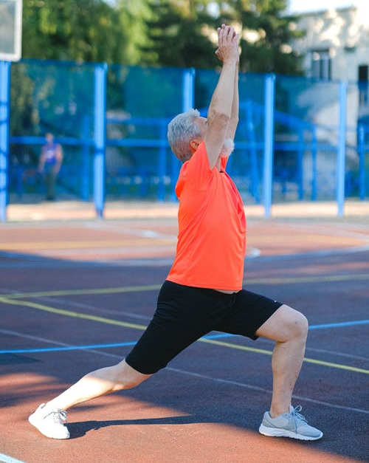
Promote Effective Work Processes
Fitness Level
Job Match
Does worker demonstrate physical fitness and functional reserve needed to safely and effectively perform the job demands?
Health and Wellness
Good health is essential requisite
Body’s systems able to repair
Response to everyday stresses of life including work and home activities
Health and Wellness is one of the ten Ergonomics Principles!
Notes:
Fitness level
Job Match
Every athlete recognizes the extreme importance of suitable physical fitness levels to perform at competitive levels. Fitness levels also have significant influence in the business and industrial environment.
Does the worker or workforce in general demonstrate the physical fitness and functional reserve needed to safely and effectively perform the job demands?
Health and Wellness
While more difficult to measure, general health and wellness of the worker has influence on ergonomics issues. Good health is the essential requisite if the body’s systems are able to repair themselves in response to the everyday stresses of life including work and home activities.

Slide 47
Promote Effective Work Processes
Training
Best ergonomics design rendered worthless if worker is poorly trained in its use
Technical
Worker properly demonstrate technical aspects of job process and work demands?
Safety
Trained in safe performance
Control fatigue?
Workstation setup
Tool use
Breaks
Stretching and warm-up activities
Notes:
Training
Appropriate workstation design is only part of the issue. The very best ergonomics design can be rendered worthless if the worker is poorly trained in its use. Training may be considered to have two primary parts.
Technical
• Has the worker been adequately trained in and can demonstrate the technical aspects of the work process?
Safety
• Has the workforce been adequately trained in methods (workstation setup, tool use, breaks, stretching, and warm-up activities, etc.) to work safely and control job fatigue?

Slide 48
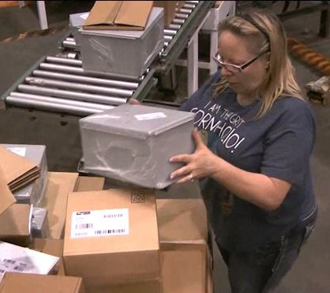
Promote Effective Work Processes
Work experience
Level
What is general work experience level of workforce or worker?
Is level of work experience a significant factor in performing job task?
Scope
What is scope of experience of workforce or worker?
Cross-trained in other job demands; are they able to deal with emergency situations, etc.?
Is scope of experience of workforce or worker a significant issue?
Notes:
Work Experience
An experienced, well-seasoned workforce is a valuable resource. We need to examine the workforce in terms of level and scope of experience.
Level
• What is the general work experience level of the workforce or worker?
• Is the level of work experience considered a significant factor in performing the job task?
Scope
• What is the scope of experience of the workforce or worker?
• Are they cross-trained in other job demands; are they able to deal with emergency situations, etc.?
• Is the scope of experience of the workforce or worker considered a significant issue?

Slide 49
Promote Effective Work Processes
Epidemiology
Establish present state of health
Epidemiology is study (scientific, systematic and data-driven) of distribution (frequency and pattern) and determinants (causes and risk factors) of health-related states and events (not just diseases) in specified populations and application of this study to control of health problems.
Centers for Disease Control and Prevention
Principles of Epidemiology in Public Health Practice, Third Edition
An Introduction to Applied Epidemiology and Biostatistics
Notes:
One of the important components of the ergonomics process is to establish a picture of the present state of affairs. The field of Epidemiology can help us accomplish this. The Centers for Disease Control and Prevention defines Epidemiology.
“Epidemiology is the study (scientific, systematic and data-driven) of the distribution (frequency and pattern) and determinants (causes and risk factors) of health-related states and events (not just diseases) in specified populations and the application of this study to the control of health problems.”

Slide 50
Promote Effective Work Processes
Metric benefits
Establish injury and illness baseline against which future interventions can be measured
Provide guidance for allocation of resources
Compare particular company to industry wide statistics
Provide work force input and enhance communication
Reactive records review
Injury and illness metrics
Proactive data collection
Surveys
Notes:
Part of this is an examination of the company's record of injury/illness reports, productivity reports, quality reports, etc. This information can:
• Establish an injury and illness baseline against which future interventions can be measured
• Provide guidance for allocation of resources
• Compare a particular company to industry wide statistics
• Provide for work force input to enhance communication
Typically, this includes a reactive records review and proactive data collection.

Slide 51
Promote Effective Work Processes
Discomfort Surveys
Administered to an individual or to entire group
Caveats include
DO NOT administer survey without express authorization of appropriate company representatives
Determine up-front how information will be collected, disseminated and acted upon
If data collected and little if any positive actions taken as result, outcome may not be favorable
Information is subjective, based on respondent’s perceptions
Survey responses need to be correlated with objective findings of ergonomics analysis
Notes:
Discomfort Survey
Use of a Discomfort Survey is one method to directly obtain input from the workforce. We have included one for you to use.
The Discomfort Survey may be administered to an individual for whom you are doing a specific ergonomics assessment, or it may be administered to an entire group to gain their overall perspective.
A few caveats for using surveys like this include:
• DO NOT administer a survey to an individual or group without the express authorization of the appropriate company representatives.
• If the survey is administered to a group, determine up-front how the information will be collected, disseminated and acted upon.
•Group surveys will reveal and publicize issues; if the data is collected and little if any positive actions are taken as a result, the outcome may not be favorable.
• The information obtained is subjective in nature. Comments will, of course, be influenced by the respondent’s perception of the job demands.
• Survey responses need to be correlated with the more objective findings of the ergonomics analysis.
• Discrepancies between the survey and the analysis results will certainly occur and typically will be minor; if major discrepancies emerge, you will want to work with appropriate company representatives to understand and resolve them.
Surveys can be valuable tools if used appropriately.

Slide 52
Designing Effective Work Processes – Common Sense
Is Ergonomics just application of common sense?
Do we all the same sense in common?
Population Stereotypes
Turn knob
Move arrow indicator to display center how would YOU turn knob?
❑ Clockwise
❑ Counter-clockwise
About 95% of respondents
Answer “Counter-clockwise”
Makes sense to them, turn knob counter-clockwise and arrow will move to left
Unless you understand
Knob is actually controlling a pressure valve
Need to turn knob clockwise to close valve and thereby reduce pressure
All right, so about 95% common sense!
But what about that 5%
Could bad things happen with even 5% ambiguity?
Notes:
Population Stereotypes
The practice of ergonomics has sometimes been described as the application of common sense to the situation. ‘Common sense’ is an interesting concept.
This implies we all have the same ‘sense in common’. To test this, we can apply the concept of Population Stereotypes in the field of Engineering Psychology. Here is an exercise that may shed some light on the validity of the ‘in-common’ common sense hypothesis.
Turn Knob
To move the arrow indicator to the center of the display how would YOU turn the knob?
Clockwise
Counter-clockwise
About 95% of respondents will answer “Counter-clockwise”. This makes sense to them. You turn the knob counter-clockwise and the arrow will move to the left.
Unless you understand the knob is actually controlling a pressure valve. The display represents the pressure in the system (less pressure to the left on the display) and you need to turn the knob clockwise to close the valve and thereby reduce the pressure.
All right, so about 95% common sense!
But what about that last 5%. Could bad things happen with even 5% ambiguity?

Slide 53
Designing Effective Work Processes – Stereotypes
Population Stereotypes
Pressure High”
Working with fire crew, “hoseman” yells back to person controlling water pressure, “PRESSURE HIGH”
What should be done to water pressure?
❑ Lower the Pressure
❑ Raise the Pressure
Working with fire crews have observed both answers to be true
Some people look at this as “Present State” Pressure High means pressure is too high and they want it lowered
Some people look at this as “Action Command” Pressure High means pressure is too low and they want more pressure
Could be a big problem if lack of uniformity and consistency in the command!
Notes:
“Pressure High”
Working with a fire crew, the “hoseman” (person controlling the business end of the hose) yells back to the person controlling the water pressure (at the hydrant or the pumper), “PRESSURE HIGH!”
What should be done to the water pressure?
Lower the Pressure
Raise the Pressure
Working with different fire crews we have observed both answers to be true.
• Some people look at this as a “Present State”. Pressure High means the pressure is too high and they want it lowered.
• Some people look at this as an “Action Command”. Pressure High means the pressure is too low and they want more pressure.
Obviously, you can see where this could be a big problem if there is lack of uniformity and consistency in the command.

Slide 54
Designing Effective Work Processes – Stereotypes
Population stereotypes
As we have just discovered
We do not all have the same “sense in common"
View of our world is greatly shaped by our past experiences
Falling back on
“Well, it’s just common sense!“
Will not provide desired consistent and reliable result we are striving to achieve
We need to go beyond “common sense”
Notes:
Population stereotypes, as you have just discovered, indicate that while we do share some common perceptions, we do not all have the same exact same "common sense." Our view of the world is shaped by our experiences.
Falling back on the, "Well, it is just common sense!" will not provide the desired consistent and reliable result we are striving to achieve. We need to go beyond ‘common sense’.

Slide 55
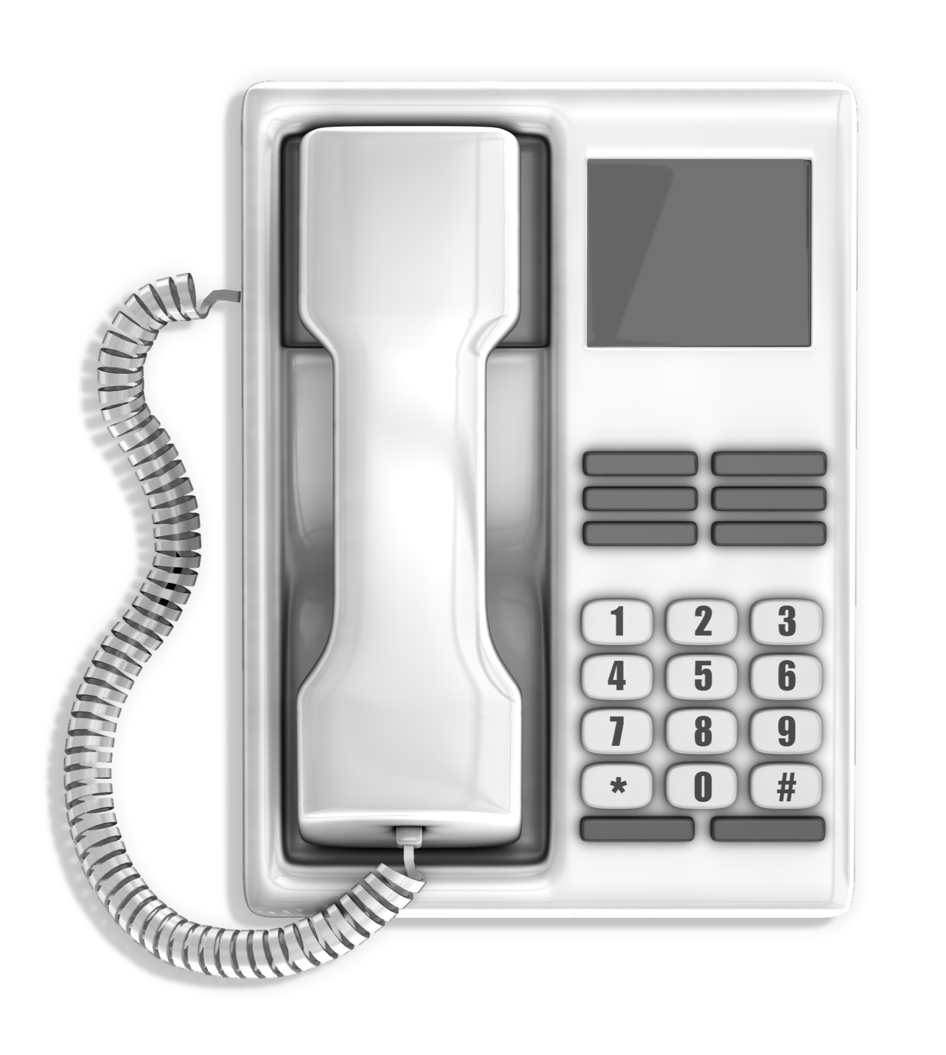
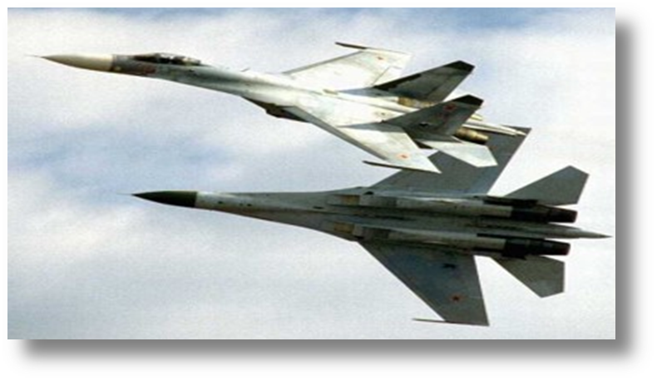
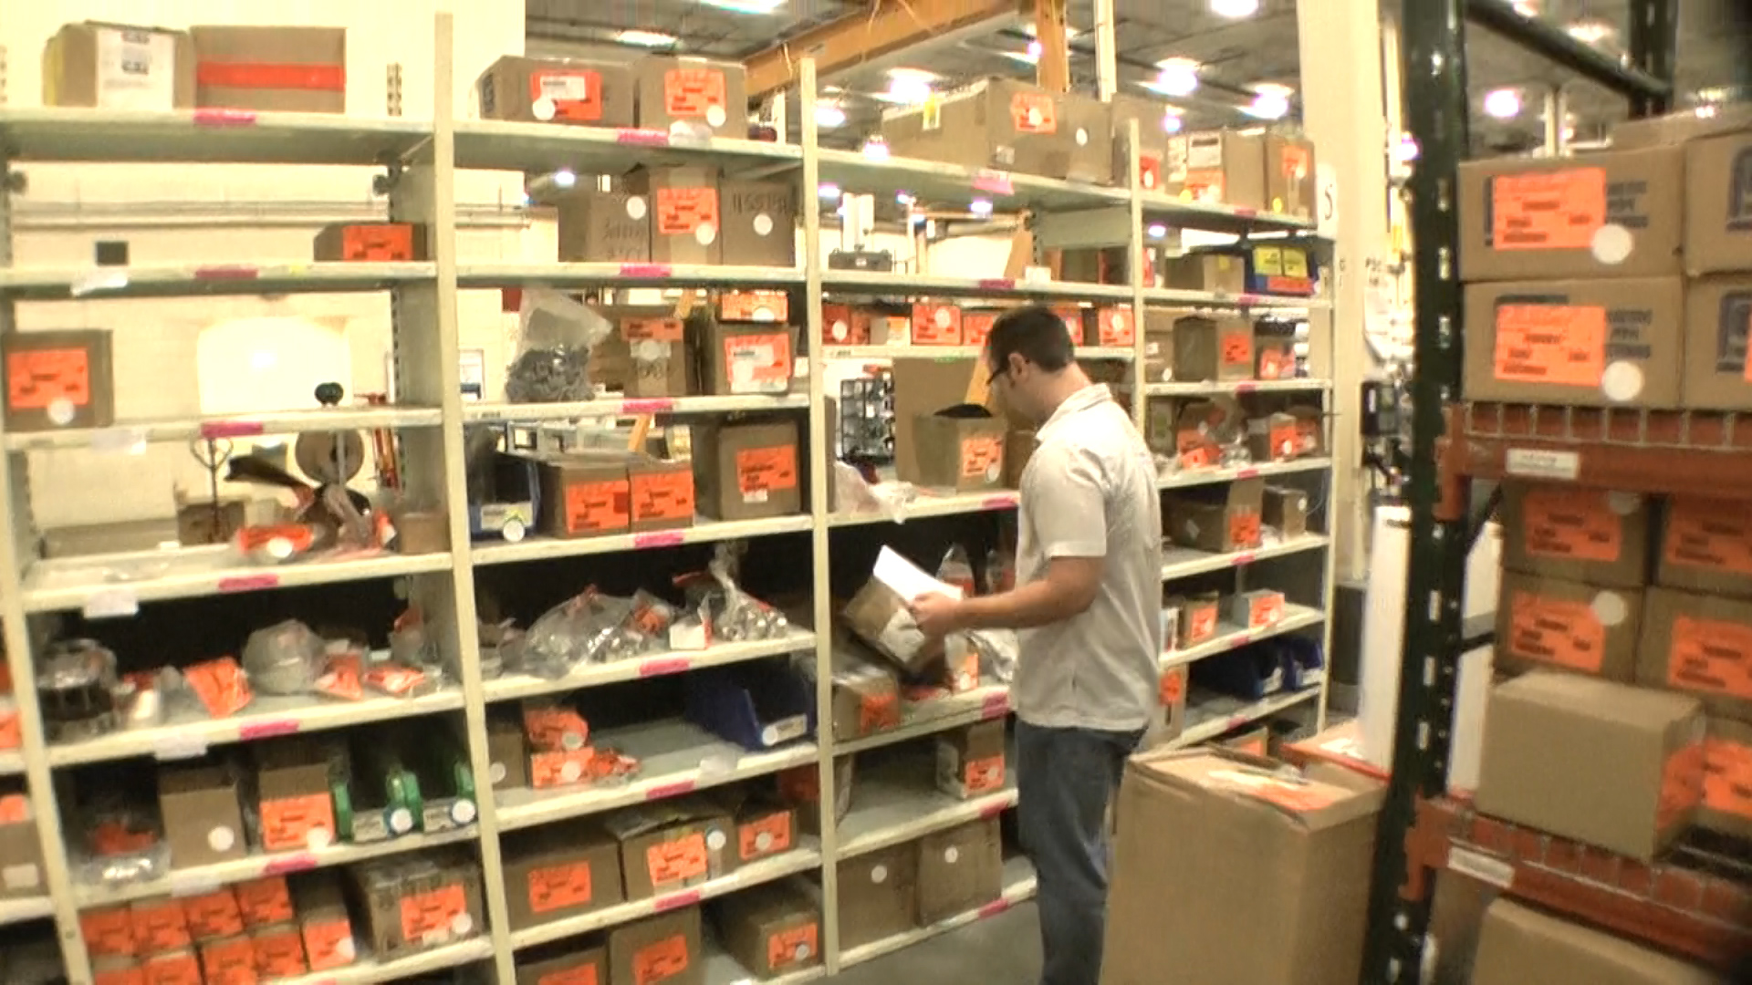
Engineering Psychology
Overload
Typical US telephone number
With area code is 10 digits long
Too long for most people to remember it
Fighter jet pilots
Shut down some of displays
Underload
Can job be too boring?
Job lacks reasonable challenge results in problems
Workers not challenged to stay on task
Mind tends to drift with potentially very serious consequences
Different levels of information processing capabilities
Work to understand operator’s perspective
Notes:
Design Conventions and Human Behavior
Engineering Psychology involves designing systems with information processing capabilities and limitations in mind. Once again, optimizing performance is the objective. A crucial aspect of a good systems design involves understanding and applying design conventions and human behavior.
Overload/Underload
As technologies become more complex, systems may overload human information processing capabilities.
• For example, a typical telephone number with the area code is 10 digits long; too long for most people to remember it long enough to dial it.
• Fighter jet pilots have been known to actually shut down some of their displays to control the amount of information they receive.
Can a job be too boring?
• A job that lacks reasonable challenge results in problems.
• Workers are not challenged to stay on task and minds tend to drift with potentially very serious consequences.
People who make up the workforce will have different levels of information processing capabilities. We need to work to understand the worker’s perspective in terms of information overload and underload. Design systems need to take into account information human processing capabilities and limitations.

Slide 56
Design Conventions and Human Behavior
Previous experience
Accurate information processing
Future expectations based on previous experiences
Does absolutely no good to pound on center of steering wheel of 1983 Ford LTD station wagon to warn driver of car that is about to back into you!
Depressing turn signal stalk activates horn, NOT pushing on center of steering wheel
Notes:
Previous Experience
Accurate information processing is also predicated on future expectations based on previous experiences.
For instance, it does absolutely no good to pound on the center of the steering wheel of a 1983 Ford LTD station wagon to warn the driver of the car that is about to back into you. Depressing the turn signal stalk activates the horn, NOT pushing on the center of the steering wheel. I know this from personal experience!

Slide 57
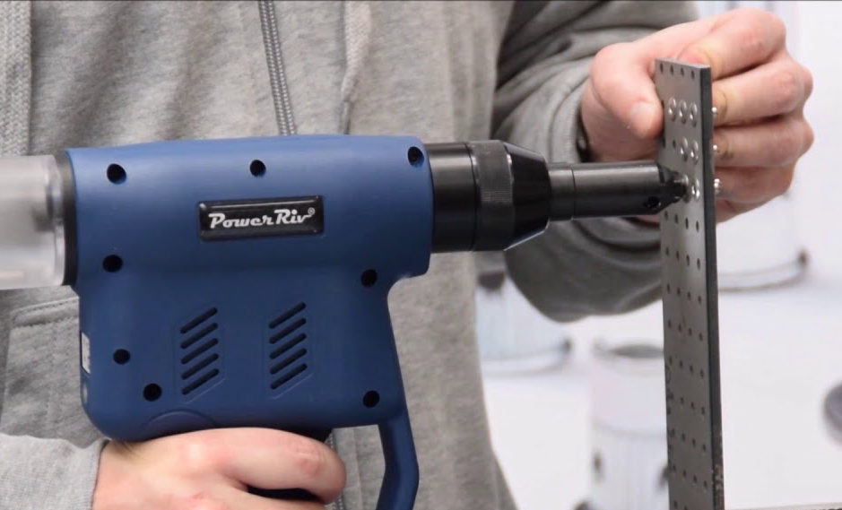
Design Conventions and Human Behavior
Based on understanding of human behavior
Possible to design tool, workstation, work process and work environment to optimize performance
Donald Norman
The Design of Everyday Things, Basic Books, Inc. New York, 2013
Good visibility
Mapping relationship
Feedback to user
Anything kind of weird with the teapot?
Notes:
Effective Work Process Design Principles
Based on an understanding of behavior it is possible to design a tool, workstation, work process, and work environment in a manner that enhances performance.
Donald Norman, in The Design of Everyday Things, (Basic Books, Inc. New York, 2013) outlines relevant basic principles of design in a practical manner: design for good visibility of the operation, ensure the mapping relationship is clear and provide appropriate feedback to the user regarding the outcome of the action.

Slide 58
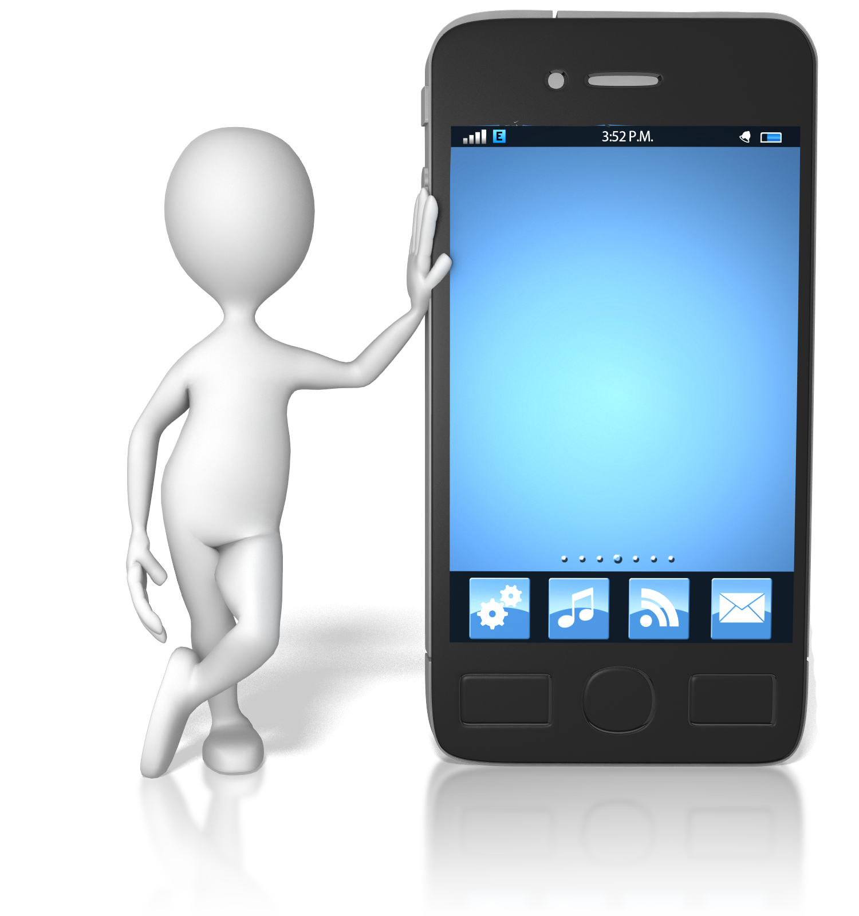
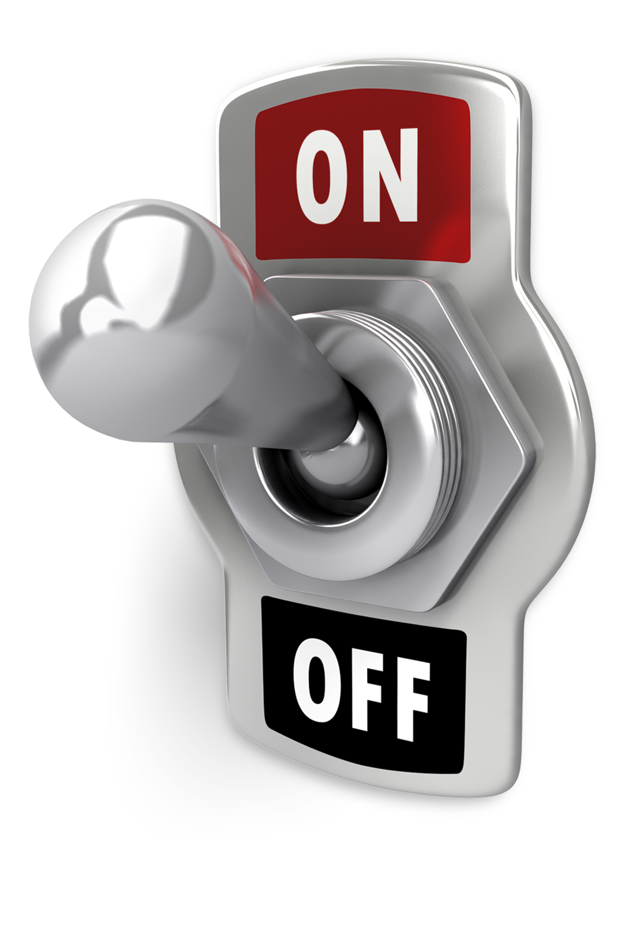
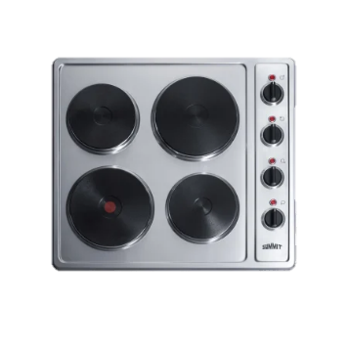
Effective Work Process Design Principles
Design for good visibility
Make it visually apparent what controls on equipment do
Many people never fully use full features of cell phones or computer software
Apply mapping
Make clear relationship between things
To steer car to right, turn wheel to right
Indicator moving up means on not off
Turn on wrong stove burner?
Provide feedback
Return information to user regarding outcome of user’s actions
Without adequate feedback, how do you really know correctly programmed alarm clock?
Notes:
Effective Work Process Design Principles
Design for good visibility
Design for good visibility. Make it visually apparent what the control on a piece of equipment does. The input should be reflected in a tangible output. The control may be buried deep in a menu selection.
Application example:
For example, many people never fully use the full features of their cell phones or computer software. The controls, by themselves, may not be visually apparent.
Apply the principles of mapping
Make clear the relationship between things – between controls, their movements, and the results in the real world. Make use of physical analogies and cultural standards.
• To steer a car to the right, turn the wheel to the right.
• An indicator moving up typically means an increase in whatever.
• An indicator moving from left to right means an increase in whatever.
• Pushing a light switch up to turn on the light. (Is this always true?) How about three way light switches?
Application example:
Ever been in someone’s kitchen and turned on the wrong stove burner? The relationship between the actual burner location and the control knobs wasn’t properly mapped.
Be honest now, ever happen with your own stove!
Provide feedback
Provide feedback by returning information to the user regarding the outcome of the user’s actions. The problem becomes even more significant when more features are available, but less feedback is provided.
Application example:
Without adequate feedback, how do you really know you have correctly programmed your alarm clock? Or entered the correct number in your cell phone?

Slide 59
Design Conventions and Human Behavior
Design Conventions
Avoid operator overload and underload
Previous experience influences future performance
Design Principles
Visibility – design for good visibility for operation
Mapping – make sure the relationship is clear
Feedback – provide to the user regarding outcome
Visibility
Mapping
Feedback
Notes:
Effective Work Process Design Principles – Synopsis
Here is a synopsis of the effective work process design conventions and principles.
Design Conventions
• Avoid operator overload (as well as underload)
• Previous experience influences future performance
Design Principles
• Visibility – design for good visibility for operation
• Mapping – make sure the relationship is clear
• Feedback – provide to the user regarding outcome

Slide 60
Promote Neutral Position and Support
Foundation of the body?
Is it the feet?
Consider if a person sprains an ankle
Pair of crutches they still get around
What if a person “sprains” their back
Significant problem even getting out of bed to get to the bathroom!
Foundation/core of body truly is spine and pelvis
Directly relates to position of body in general and to posture in specific
Allows use of legs and arms
Notes:
Promote Neutral Position and Support
Position and support of the body and limbs in the neutral position is the next ergonomics principle.
Neutral Position
One way to think about the neutral position is to consider what really is the foundation of the body?
Is it the feet? Consider if a person sprains an ankle . . . by using a pair of crutches they can still get around.
On the other hand, what if a person “sprains” their back? You know someone who's been in this condition – they have a significant problem even getting out of bed to get to the bathroom.
The foundation or core of the body truly is the spine and pelvis. This directly relates to the position of the body in general and to posture in specific. With the spine and pelvis in a good position, good use of the legs and arms is possible.

Slide 61
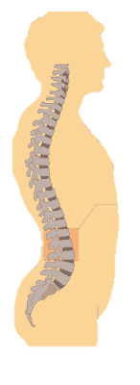
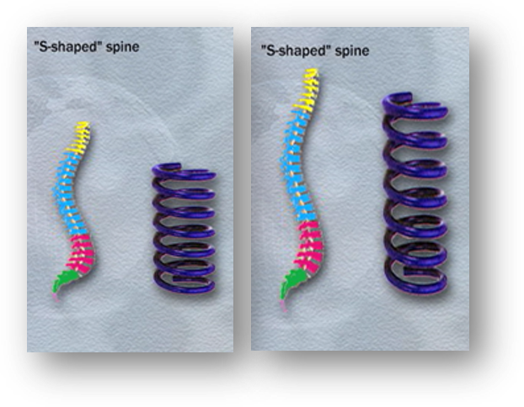
Promote Neutral Position and Support
Spine neutral position
S-shape (side view)
Inward curves in low back and neck
Outward curve in midback
Spring-like shape
Deal with compression and shear stresses
Notes:
Spine neutral position
What is the neutral spine position?
Viewed from the side, a neutral spine is in an S-shape: inward curves in the low back and neck, outward curve in the midback.
The advantage is that the spring-like shape is able to better deal with compression and shear stresses in the spine.

Slide 62
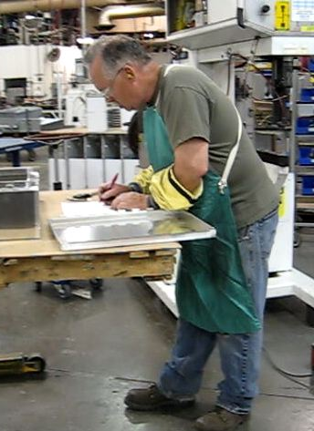
Neutral Spine Posture/Function Demonstration
Slumped Position
Let body slump
Head will come forward
Shoulders will round
Spine will go from S-Shape curve to C-Shape
Forward Reach
Reach hands out in front as if working at workbench
Deep Breath
Take as deep a breath as you can
Arms Overhead
Reach hands as far as you can overhead
Notes:
Neutral Spine Posture/Function Demonstration
You can try out a demonstration for yourself to get a sense of the functionality of the neutral position.
Slumped Position
First, stand with your arms at your sides. From this standing position let your body slump. Your head will come forward, your shoulders will round, your spine will go from the S-Shape curve to a C-Shape. You will be slumped. So, this is the opposite of the neutral position. And what is the big deal? What is the relationship between function and posture?
Forward Reach
From this slumped posture reach your hands out in front of you as if you were working at a workbench at some reach from your body. You just got a signal from your body. Was is a good signal or a bad one. You felt more stress into your arms, shoulders and particularly in your back!
Deep Breath
Still slumped return your hands to your sides. From this slumped position take as deep a breath as you can. What did you find out? It was tough wasn’t it. You couldn’t get your rib cage to expand to create the negative pressure in your thorax to get a real deep breath. Let me ask you an obvious question and feel free to give me the obvious answer. “How important is breathing?”
Pretty important is the obvious answer. Now, it is true working from a slumped position won’t stop you from breathing, but pulmonary studies have shown a 20 to 25% decrease in pulmonary function when comparing slumped to neutral posture.
Arms Overhead
Ok, one more example. Still in your slumped position, reach your hands as far as you can overhead. You definitely feel the decrease in range of motion of your shoulders. Relax your arms to your sides.

Slide 63
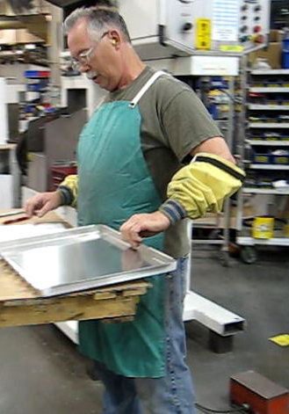
Neutral Spine Posture/Function Demonstration
Puppet on a String!
Upright neutral position
Repeat three demonstrations
Reach hands forward
Take a deep breath
Reach overhead
Functional benefits
Decreased biomechanical stress
Increased respiratory function
Improved range of motion
Neutral position is a big deal in ergonomics!
Notes:
Puppet on a String!
What is the neutral position? Well, from your slumped position reach your hand to the top of your head and imagine you are a puppet on a string and the puppeteer is pulling straight-up. Assume the position as if you were hanging from the very top of your head. This is the upright neutral position. Your head is balanced over your shoulders, over your low back, over your hips, knees and ankles.
From this neutral position repeat the three demonstrations.
• Reach your hands forward. You feel less stress, don’t you!
• Take a deep breath. You can actually get one now!
• Reach as far as you can overhead. Quite impressive!
Significant Benefit
You have just shown yourself the significant, functional benefits of promoting the neutral spine position.
• Decreased biomechanical stress
• Increased respiratory function
• Improved range of motion
Neutral position is a big deal in ergonomics!

Slide 64
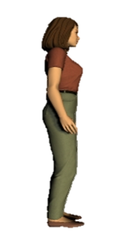
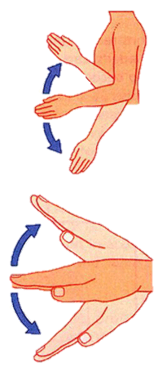
Promote Neutral Position and Support
Limb joint neutral position
What is neutral position for arms and hands, the hips, knees and ankles?
Mid-range for arms/hands
Shoulders relaxed
Elbows at sides flexed to about 90 degrees
Hands positioned with thumbs pointing up
Mid-range for hips and legs
Resting length of the muscle groups
Mid-range of joint position
Notes:
Limb joint neutral position
What is neutral for the joints of the arms and hands, the hips, knees and ankles?
Neutral is the midrange of joint position. For the arms/hands this is with the shoulders relaxed, elbows at the sides flexed to about 90 degrees and the hands positioned with the thumbs pointing up.
Let’s establish a more in-depth look at neutral and mid-range of joint position.

Slide 65
Promote Neutral Position and Support
Occupational Biomechanics
“Biomechanics is the study of the physical structure of living organisms.
As related to workplace ergonomics, the human body is viewed as a system of levers.
At the simplest level, by knowing the weight of a held object and the distance from a joint, the load on that joint can easily be calculated.”
Dan MacLeod
Ergoweb Learning Center
https://ergoweb.com/biomechanics/
Notes:
One of the building blocks of Ergonomics is Occupational Biomechanics.
“Biomechanics is the study of the physical structure of living organisms. As related to workplace ergonomics, the human body is viewed as a system of levers. At the simplest level, by knowing the weight of a held object and the distance from a joint, the load on that joint can easily be calculated.”
Dan MacLeod
Ergoweb Learning Center
https://ergoweb.com/biomechanics/
A significant amount of research has been accomplished over the past 30 to 40 years that addresses the loads on the body’s joints.

Slide 66
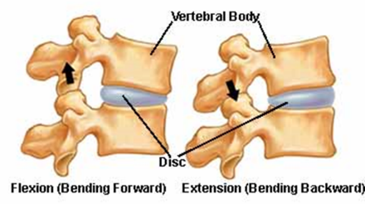
Promote Neutral Position and Support
Spine – Functional Unit
Two adjacent vertebra
Intervertebral disc
Facet joints
Associated ligaments
In 1970’s research studies
Postural influences on in vivo lumbar intervertebral disc pressures
Alf Nachemson, MD, PhD and colleagues
Results revealed increased discal pressures in out-of-neutral spine configurations
Notes:
Specific to the spine, the combination of two adjacent vertebra, the intervertebral disc, facet joints and the associated ligaments make up the functional spine unit.
In the 1970’s what have become classic research studies in the investigation of postural influences on in vivo lumbo-sacral intervertebral disc pressures were conducted by Alf Nachemson, MD, PhD and colleagues.
Results revealed increased discal pressures in out-of-neutral spine configurations.
With in vivo lumbar intervertebral disc pressures normalized to 100% when in a neutral upright standing position, pressures in various postures were measured.
For example, a straight-leg/back-bent posture of 30⁰ forward bend resulted in about 225% increase, seated slumped posture to about a 200% increase and lifting about a 30 lbs box from a 30⁰ flexed forward posture of the low back position of almost a 500% increase!

Slide 67
Promote Neutral Position and Support
Limbs
Neutral position is midrange of joint position
Occupational Biomechanics/ Work Physiology rationale?
Consider elbow joint flexion and extension
Question – At what angle of flexion is elbow most functional?
Able to generate greatest muscular force?
Answer – Fully flexed, fully extended?
Based on strength testing about at about 90 degrees of flexion
Notes:
Limbs
We have defined neutral position for the shoulders, arms, wrists and hands and the hips, knees and ankles as the midrange of joint position. From a functional perspective consider the elbow joint in terms of flexion and extension.
Question – At what angle of flexion is the elbow most functional? In other words, able to generate the greatest muscular force?
Answer – Fully flexed or fully extended?
Based on strength testing, the answer is about at about 90 degrees of flexion.

Slide 68
Promote Neutral Position and Support
Length tension relationship
Relationship between muscle length and force muscle can produce at that length
A bit into weeds here
As joint is flexed or extended through range
Overlap of actin and myosin contractile proteins changes
Affects potential for development of cross-bridges and muscle force production
At about resting length (mid-range of joint position) highest muscle force production is observed
Notes:
A fundamental functional property of skeletal muscle is the length tension relationship defined as the relationship between muscle length and the force the muscle can produce at that length.
A bit into the weeds here.
From a physiological perspective it has to do with the overlap of the contractile proteins (actin and myosin).
As a joint is flexed or extended through its range, the overlap of the actin and myosin contractile proteins changes.
This affects the potential for the development of cross-bridges and muscle force production. At about resting length (mid-range of joint position) the highest muscle force production is observed.

Slide 69
Promote Neutral Position and Support
15 % Neutral Position Club
100% of time in neutral, mid-range joint positions?
NO!
But how about 15% more time?
Increase neutral position and support by about 15%
Significantly decrease level of stress into body's tissue
Enhance performance and increase comfort levels
We encourage membership in 15% Club!
Notes:
15 % Neutral Position Club
Realistically speaking can a person really position themselves 100% of the time in neutral positions?
Of course, the answer is NO!
But how about 15% more time? In many situations, it is very feasible to significantly improve the situation to increase neutral position and support by about 15%.
15% more time in neutral with good support can significantly decrease the level of stress into the body's tissue, enhance performance and increase comfort levels. We encourage membership in the 15% Club!

Slide 70
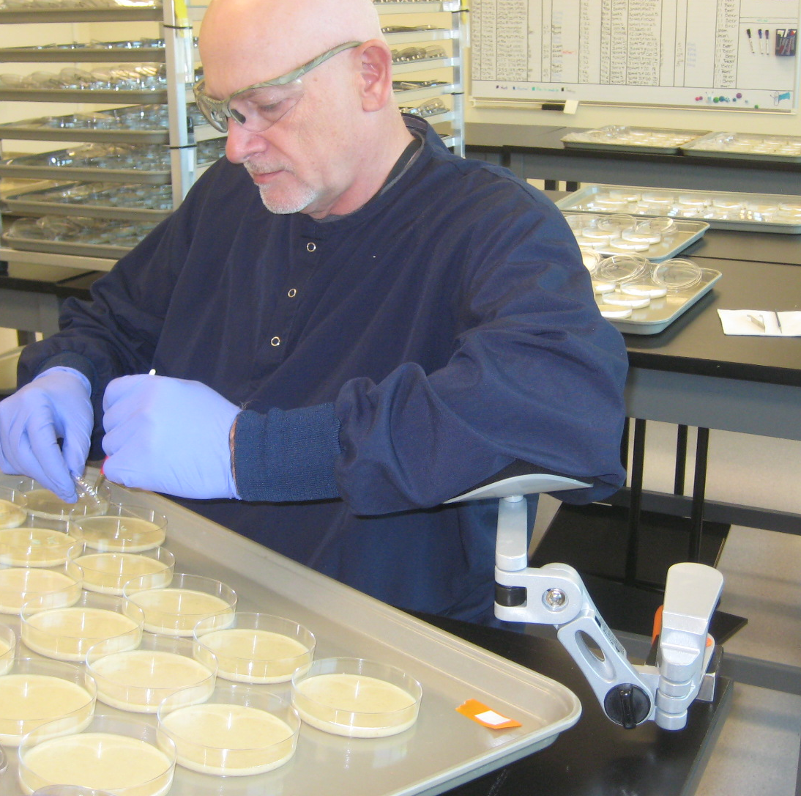
Promote Neutral Position and Support
Seated
Inadequate seated support
Compression of soft tissues
Decrease in blood flow and circulation
Well supported seated posture quickly becomes uncomfortable
How long sit in one position before body gives signal to move?
Limbs
Removes strain of weight bearing
Unload neck, shoulders and back
Standing
For extended periods not desired
Joint compression
Fluid tends to pool in lower extremities
Notes:
Seated
With the body and limbs positioned in neutral, the second part of the principle is to provide suitable support for the weight of the body and limbs.
Inadequate and improper seated support creates problems. People sit on their legs on the chair. They cross their legs for extended times. Compression of the soft tissues occurs with a decrease in blood flow and circulation.
Proper seated support is critical. In fact, even well supported seated posture becomes uncomfortable quite quickly.
How long do you sit in one position before your body gives you a signal to move?
Answer. Studies have shown about 20 to 30 minutes!
Limbs
Proper support for the limbs (for example, chair armrests) removes the strain of weight bearing and also unloads the neck, shoulders and back.
Hold your arms half way out in front of you. How long can you do it before you experience discomfort and fatigue?
Standing
Unsupported standing for extended periods is not desired.
Joint compression occurs, actually decreasing the amount of joint space and not allowing adequate joint lubrication. Fluid tends to pool in the lower extremities.
The bottom line . . . it is tiring!
In fact, as individuals, we try very hard to eliminate sustained unsupported standing. Look at people standing in a line. What do you see them do to obtain relief? They look for something to lean against.

Slide 71
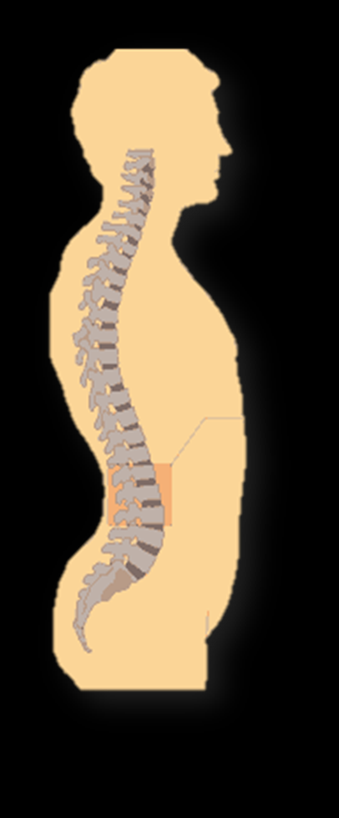
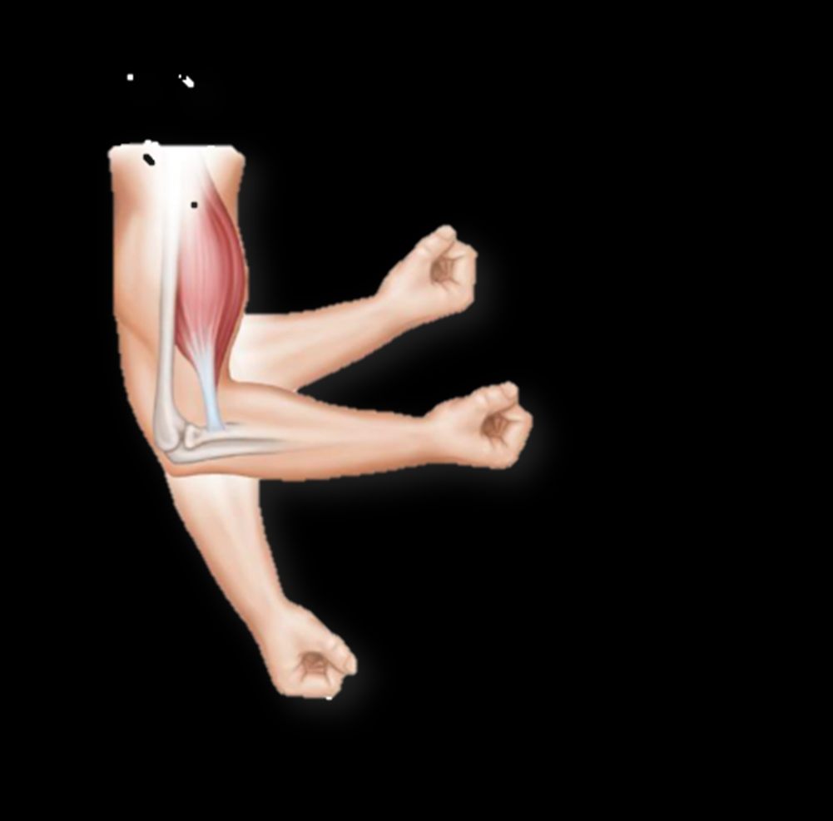
Promote Neutral Position and Support
Neutral Position and Support Ergonomics Principle
Very large part of ergonomics analysis and intervention process
Notes:
Bottom Line
The Neutral Position and Support Ergonomics Principle is a very large part of the ergonomics analysis and intervention process.

Slide 72
Promote Dynamic Physical Movement
Stand or Walk?
Most people have carried backpack
Group of friends going for a hike
Backpack weighs 30#
What would YOU rather do?
Stand in one place for next 20 minutes OR
Take backpack and start to walk
To a person, everyone agrees it is much better to walk – not to stand!
Movement is superior to sustained position
Need to move to be comfortable!
Why is this the case?
Notes:
Promote Dynamic Physical Movement
Promotion of Dynamic Physical Movement in the workplace on an on-going basis is the next ergonomics principle.
Stand or Walk?
Most people have carried a backpack at some point. Picture this scenario - you are with a group of friends going for an extended hike; your backpack weighs 30 lbs. and you have put it on your shoulders.
What would you rather do: stand in one place for the next 20 minutes OR take that same backpack and start to walk for a few miles?
To a person, everyone agrees that it is much better to walk – not to stand. I have never had a single person say, “I would love to just stand around for 20 minutes with a 30 lb. pack!”
We intuitively know that movement is superior to maintaining one position. In other words, we need to move to be comfortable.
That is what this ergonomics principle is all about and there are sound physiological reasons why this is the case.

Slide 73
Promote Dynamic Physical Movement
Work Physiology
Metabolism
Blood flow
Glucose and oxygen stored in small quantities in muscle tissue
To sustain performance
Provide additional quantities
Oxygen
Nutrients
Remove metabolites
Notes:
Metabolism (Work Physiology)
To accomplish work, the body is able to take in nutrients, convert them into chemical energy and then ultimately into mechanical energy (e.g., muscular contraction) and heat.
This is called metabolism and is an important component of Work Physiology.
Glucose and oxygen are stored in relatively small amounts within the muscle tissue.
Consequently, to sustain performance, continuous flow of oxygen and energy-rich blood into the tissue in addition to removal of metabolic waste products is required.

Slide 74
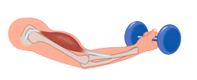
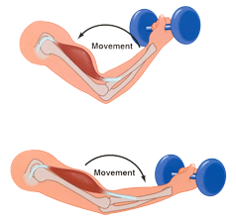
Promote Dynamic Physical Movement
Muscle contraction types
Static (isometric)
Blood vessel compression
Essentially occluded at 60% of maximum voluntary isometric contraction (MVIC)
Sustained force levels
Maximal (100%) < 10 seconds
Moderate (40 to 60%) < 60 seconds
Slight (5 to 15%) < 240 seconds
Dynamic
Muscle contracts and relaxes
Promotes blood flow
Notes:
Static Muscle Contraction
Type of muscular effort has been shown to have a profound impact on blood flow.
Static muscle contractions (the muscle shortens but no joint movement occurs) results in blood vessel compression due to internal muscle pressure.
At contraction levels of 60% and greater of the maximum voluntary isometric contraction (MVIC) of the muscle, blood flow ceases.
The muscle depends on the quite limited initial reserves stored internally. Waste products accumulate and only short duration contractions are possible.
Dynamic Muscle Contraction
On the other hand, dynamic muscle contractions are the alternating contracting and relaxing of muscle groups to perform tasks.
In terms of enhancing performance and controlling fatigue, dynamic muscle contractions are a significant improvement over static muscle contractions.
Dynamic muscle activity promotes blood and fluid flow by acting as a pump to increase oxygen and nutrition to the working muscles and helps to remove the waste products of metabolism.

Slide 75
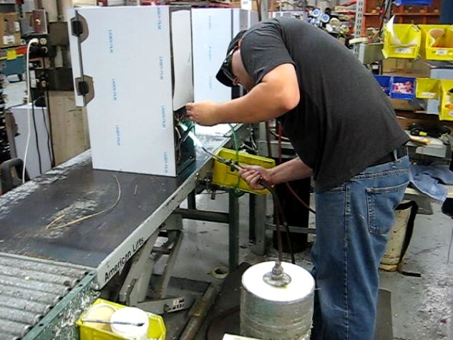
Promote Dynamic Physical Movement
Sustained Position
Metabolic fatigue occurs as result of sustained position
Blood flow volume and rate of flow decreases
Pooling of fluid in extremities
Awkward positions
Muscular contractions required to maintain position
Potential decrease in blood flow
Internal impingement
External contact stress
Notes:
Position—Sustained/Awkward
Metabolic fatigue also occurs as the result of sustained position. Blood flow – both volume and rate of flow – decreases. Pooling of fluid in the extremities occurs.
The body’s tissues require ongoing nutrition even at low or minimal activity levels. The position of the body when sedentary has impact. Sustained awkward positions result in:
• Muscular contractions to maintain the position.
• Potential decrease in blood flow due to internal impingement or external contact stress.

Slide 76
Promote Dynamic Physical Movement
Movement/activity
Promote dynamic not static muscle contractions
Build-in adequate physical recovery times
Incorporate movement into the work process
Position and support
Design for neutral positions
Design for body/limb support at workstations
Notes:
Metabolic/Work Physiology Synopsis
A summary of metabolic and work physiology principles includes.
Movement/activity
• Promote dynamic not static muscle contractions
• Build-in adequate physical recovery times
• Incorporate movement into the work process
Position and support
• Design for neutral positions
• Design for body/limb support at workstations
In the other ERGONOMICS ON-DEMAND! Tracks we will get into the details of how the set-up and use of workstations, tools and equipment whether in the office or manufacturing work environments are influenced by work physiology.

Slide 77
Control Manual Material Handling
How Much Can a Person Lift?
Manual material handling risk for back injuries
In 2019, 111,000 injuries reported by National Safety Council
What are factors involving manual material handling?
Control manual material handling
Studied extensively over past 40 to 50 years
Notes:
How Much Can a Person Lift?
The next ergonomics principle asks the question,
“How much can a person safely and effectively lift?”
Why is this of concern? Lifting objects or manually handling materials has been shown to put workers at risk for back injuries. More than 111,000 such injuries requiring days away from work were recorded in 2019, according to Injury Facts, an online database created by the National Safety Council.
https://injuryfacts.nsc.org/work/work-overview/top-work-related-injury-causes/
What are the factors involving manual handling that need to be considered? What can be done to control manual material handling?
These questions have been studied extensively over the past 40 to 50 years in the scientific and ergonomics community.

Slide 78
Control Manual Material Handling
All about lever arms
Hold 10 lb. load at arm’s length
Versus held as close as possible to body
Hold the load as close as possible
Reduce lever arm length to reduce stress into body
Notes:
All about lever arms
A simple example of lever arms in action is to compare the load on the body when holding a 10 lb. load at arm’s length versus held as close as possible to the body.
Everyone has done something like this and immediately recognizes you want to hold the load as close as possible to you to lessen the load!
We intuitively know the goal is to reduce the lever arm length to reduce the stress into the body.

Slide 79
Control Manual Material Handling
Intervertebral discal pressures
Increased discal pressures based on lever arm lengths in spinal column
30 lb. box from 30⁰ flexed forward posture almost 500%
Upright posture as close to body as possible about half at 225%
Decreasing lever arm distance makes a huge difference
Notes:
Intervertebral discal pressures
In the 1970’s, what have become classic research studies in the investigation of postural influences on in vivo lumbar intervertebral disc pressures were conducted by Alf Nachemson, MD, PhD and colleagues.
Results revealed increased discal pressures based on lever arm lengths in the spinal column.
With in vivo lumbar intervertebral disc pressures normalized to 100% when in a neutral upright standing position, discal pressures with lifting about a 30 lb. box from a 30⁰ flexed forward posture of the low back position were almost 500%!
Holding the same box in an upright posture as close to the body as possible resulted in about half that of about 225%. Decreasing the lever arm distance makes a huge difference.

Slide 80
Control Manual Material Handling
Increase lever arm length
Use leverage to advantage
Small kid on teeter totter can ‘outweigh’, larger kid
Archimedes
“Give me a lever long enough and a fulcrum on which to place it, and I shall move the world.”
Notes:
Increase lever arm length
In ergonomics sometimes we want the opposite, we want to increase the lever arm length. We want to use leverage to our advantage.
This is how the small kid on the teeter totter can ‘outweigh’, so to speak, the larger kid on the playground.
Famously, Archimedes said,
“Give me a lever long enough and a fulcrum on which to place it, and I shall move the world.”
We’ll discuss application details in the Ergonomics Manufacturing Track. For now, let’s focus on manual material handling.

Slide 81
Control Manual Material Handling
Occupational Biomechanics
Lifting Factors
Mathematical formula to predict how much person can safely lift
What factors would need to go into equation?
NIOSH (National Institute for Occupational Safety and Health)
Published NIOSH Work Practices Guide for Manual Lifting in 1981
Check out the NIOSH Ergonomics Guidelines for Manual Material Handling at
https://www.cdc.gov/niosh/docs/2007-131/default.html
Notes:
Lifting Factors and Lifting Calculators
If we were going to come up with a mathematical formula to predict how much a person can safely lift what factors would need to go into our equation?
Well not surprisingly, lifting formulas have been in existence for several decades. NIOSH (National Institute for Occupational Safety and Health) first published the NIOSH Work Practices Guide for Manual Lifting in 1981.
Check out the Guide at: https://www.cdc.gov/niosh/docs/2007-131/default.html.

Slide 82
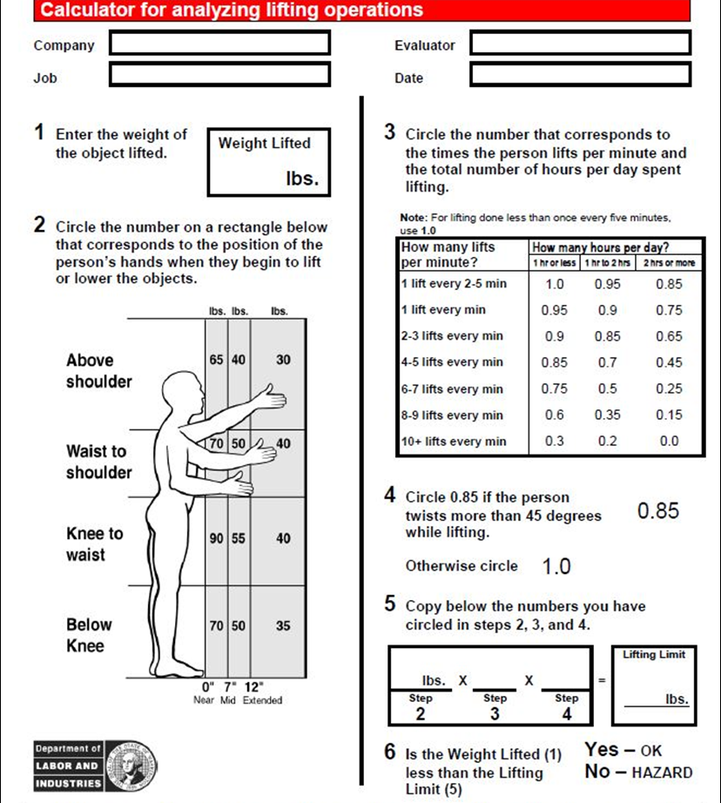
Control Manual Material Handling
LNI Lifting Calculator
Oregon OSHA and Washington State Department of Labor and Industries
Developed a simplified version of NIOSH Work Practices Guide for Manual Lifting
Easy to use and provides valuable information
On-line, interactive version is available
https://osha.oregon.gov/OSHAPubs/apps/liftcalc/lifting-calculator-app.html
Notes:
The States of Washington and Oregon Departments of Labor and Industries developed a simplified version of the NIOSH Work Practices Guide for Manual Lifting.
We’ll get into the details of lifting calculators with application examples in the Ergonomics Manual Material Handling Track.
Also take a look at the Manual Material Handling Checklist as needed for the general ergonomics analysis process in the Ergonomics Design Guidelines Track.

Slide 83
Promote Work in Reach Zone
Hand Use
How much do we use our hands every day?
More than half day?
Most people will say at least 99.9% of day!
Where do we tend to use our hands?
Need to see what we are doing
Tend to use hands in front of and to the sides of body
Two reach zones
Comfort Reach Zone
Functional Reach Zone
Notes:
Promote Work in Reach Zone
Here is a question for you. “How much do we use our hands every day?”
More than half the day? How about more than 75% of the day? Well in fact, most people will say they use their hands 99.9% of the day!
All right then, where do we tend to use our hands? For example, does anybody work behind their back? Pretty hard to see what you're doing! Because in most cases we need to see what we are doing we tend to use our hands in front of and to the sides of our body.
Based on hand use, our next ergonomics principle is to Promote Work in the Reach Zone. From an ergonomics perspective we can define two reach zones:
• Comfort Reach Zone
• Functional Reach Zone

Slide 84
Promote Work in Reach Zone
Comfort Reach Zone
In front and to side when doing precise hand activity
Forearm length determines dimensions
To get a feel for this
Position elbows at sides with elbows bent about 90°, swing hands from side to side
About three or 4 inches above and below elbow level
Typical activities
Keyboard and mouse use
Handwriting
Precision assembly where minimal downward force is exerted
Notes:
Comfort Reach Zone
Think of the comfort reach zone as that area in front and to the side where we’d like to use our hands when we’re doing precise hand activity. Forearm length will determine the dimensions of the Comfort Reach Zone.
To get a feel for this, position your elbows at your sides with your elbows bent at about 90°, swing your hands from side to side. The height of this reach zone will be about three or 4 inches above and below your elbow level. This is your Comfort Reach Zone.
Typical activities in the Comfort Reach Zone will include keyboard and mouse use along with handwriting. This also includes precision assembly in a manufacturing environment where a minimal downward force is exerted.

Slide 85
Promote Work in Reach Zone
Functional Reach Zone
Zone to front and to side to comfortably reach to obtain parts/materials
Arm length determines dimensions
Reach arms in front of body with elbows straight
From tip of shoulder to middle of hand is forward functional reach
Swing arms out to side about 45° from midline of body
Side-to-side functional reach
Drop hands to sides
Bottom zone of functional reach
Arms raised them to shoulder level
Upper zone of functional reach
Notes:
Functional Reach Zone
Think of the Functional Reach Zone as that area in front and to the side where we’ll be able to comfortably reach to obtain parts and materials.
Arm length determines the dimensions of the Functional Reach Zone. An easy way to get a feel for this is to reach your arms out in front of your body with your elbows straight. From your shoulder to the middle of your hand is your forward functional reach.
Now swing your arms out to the side about 45° from the midline of your body. This is the side-to-side functional reach.
Drop your hands so they are relaxed at your sides. This is called knuckle height and is the bottom zone of the functional reach. Finally, with your arms extended raise them so they are about shoulder level. This is the upper zone of the functional reach.

Slide 86
Provide Correct Workstations, Tools and Equipment
Safer, faster, productive!
What does Correct Mean?
Can the job be performed:
In neutral positions?
With appropriate body/limb support?
Within acceptable reach zones?
While controlling manual handling?
With adequate training?
In controlled environment?
If answers are primarily YES, then more than likely it is correct
If answers are NO, need to understand why not and make appropriate change
Manufacturing Track
Notes:
Provide Correct Workstations, Tools and Equipment
Providing the correct tools, equipment and facilities is a critical ergonomics principle. Safer, faster and more productive are the tangible results.
The correct workstation, tools and equipment can make the difference between getting the job done or not at all. And even worse, the wrong tool can result in injury to the user.
What does Correct Mean?
In overview, a good way to assess if you have the correct workbench, tools and equipment is to apply the ergonomics principles. Can the job be performed:
•In neutral positions?
• With appropriate body and limb support?
• Within acceptable reach zones?
• While controlling manual handling?
• With adequate training?
• In a controlled environment?
If the answer to these questions is primarily YES, then more than likely it is correct.
If the answer is NO, then we need to understand why not and make appropriate changes.
Specific information about assessing and providing the correct workstations, tools and equipment is detailed in the Manufacturing Ergonomics Track.

Slide 87
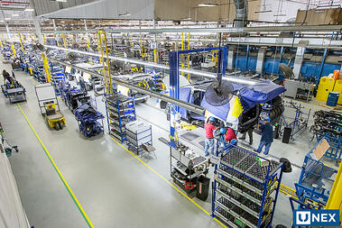
Provide Competency Based Training
Results not achieved?
Spend thousands of dollars on ergonomically designed tools, equipment and facility
Workforce doesn't know how to make most of tool or equipment or furniture
Example of office chairs
Notes:
Provide Competency Based Training
Providing competency based training is a critical part of the ergonomics process.
Results not Achieved?
A company spends thousands of dollars on tools, equipment and facility that are ergonomically designed but they don't achieve the desired results. What happened?
In many situations the problem is that the workforce doesn't know how to make the most of the tool or equipment or furniture.
Two sides of the coin emerge: you need to have the correct item AND you need to know how to use it properly. For the workforce to really get the benefits of ergonomics they need to be able to demonstrate competency in the setup and use of the tool or equipment.
To give you an example. A company purchased new fully featured ergonomics office chairs. They were delivered and put into use. A short while later during an ergonomics audit it was determined that no one had adjusted the chairs for their specific needs.
They hadn't received any instruction in how to use the chairs - they just sat down and went to work. In fact, a number of individuals reported they actually felt intimidated by the chair and all of its "bells and whistles"!

Slide 88
Provide Competency Based Training
Acquire new skills
Need to correctly practice new technique or process to acquire skill level
“Practice does not make perfect. Only perfect practice makes perfect.”
Vince Lombardi
Notes:
Does practice make perfect?
If you want to improve your golf game (or some other physical skill) what do you need to do? Right, you need to practice the new technique to acquire the skill level to advance. How you practice is critical.
Vince Lombardi, the famous Green Bay Packers football coach said it well.
“Practice does not make perfect. Only perfect practice makes perfect.”
He understood the need to practice correctly. If you don’t, you will get really good at doing it incorrectly! That’s why we stress competency-based training approaches.
Ergonomics is all about learning new skills; we encourage training sessions that involve a hands-on approach. Over time, with proper feedback and practice, the desired result will be accomplished.

Slide 89
Control Exposure to Work Environment
Controlling exposure
Light
Noise
Temperature
Ventilation
Thermostat
Level that everyone will agree to?
How work environment influences performance
Depending on background and experience
Notes:
Control Exposure to Work Environment
Controlling exposure to the work environment including light, noise, temperature and ventilation is the next ergonomics principle.
What do you think, can we set the thermostat at a level that everyone will agree to? The goal is to shoot for the middle and let individuals use personal controls based on their needs.
In ergonomics we are involved in how the work environment influences performance. Depending on your background and experience you may be well versed in analyzing work environment factors and offering recommendations. If not, make sure you tap into the expertise of other professionals as needed. Here are some basic concepts.

Slide 90
Control Exposure to Work Environment
Cold
Cold environments, tools, or pneumatic tool exhaust
Reduction in tissue sensitivity, manual dexterity, and grip strength
Adequate personal protective equipment
Appropriate worker rotation (in and out of cold environment) effective
Directing tool exhaust away from user
Notes:
Cold
Cold environments, tools, or pneumatic tool exhaust may bring about a reduction in tissue sensitivity, manual dexterity, and grip strength.
When sensitivity decreases the amount of force exerted to perform a task increases. This requires the individual to perform more work than necessary.
Adequate personal protective equipment and appropriate worker rotation (in and out of cold environment) are also effective.
Directing tool exhaust away from the user is important for maintaining tissue sensitivity.

Slide 91
Control Exposure to Work Environment
Heat
Increase metabolic demand
Affect ability to grasp tools and parts and to manipulate controls due to effect of perspiration on grasp
Fogging eye protection
Adequate ventilation and clothing
Adequate hydration
Worker rotation is effective
Notes:
Heat
Hot environments result in an increase in metabolic demand. Heat may also affect an individual's ability to grasp tools and parts and to manipulate controls due to the effect of perspiration on grasp.
When perspiration increases, friction between the hand and the tool decreases. Higher force levels are again required to maintain the integrity of the grasp. Hot and humid environments may also result in the fogging of eye protection, again complicating effective task completion.
Adequate ventilation and clothing as well as worker rotation are effective.

Slide 92
Control Exposure to Work Environment
Temperature
Too cold? Too hot?
Radiant heat sources
Rapid temperature changes?
Quality
Air contaminant settles on displays, making them difficult to see?
Suspended dust, mists and other particulates?
Flow
Air circulation too low?
Too much air movement?
Rapid environmental changes?
Humidity
Humidity enough to interfere with job?
Wet locations
Notes:
Air
Air temperature, quality, flow and humidity are important to consider.
Temperature
• Is the air temperature too cold? Too hot?
• Is it too humid in the workplace?
• Are radiant heat sources placed near any work stations?
• Are there rapid changes in temperature in the work environment?
Quality
• Is there so much air contaminant in the process that it settles on displays, making them difficult to see?
• Are suspended dust, mists and other particulates present in the air?
Flow
• Is air circulation too low?
• Is there too much air movement?
• Are workers exposed to rapid environmental changes?
Humidity
• Is the humidity frequently uncomfortable enough to interfere with the job?
• Are there wet locations that may produce shock hazards for work with electrically powered equipment?

Slide 93
Control Exposure to Work Environment
Noise is any unwanted sound
High noise levels drastically impede effective communication
Concentration is affected, negatively influencing productivity
Noise has also been blamed for excessive fatigue
Decibel (dB) levels
60 dB - social conversation
80 dB - conversing in loud noise less than one foot away
105 dB - jet engine
150 dB - reduced visual acuity, chest wall vibration, "gagging" sensation
Notes:
Noise
Noise is any unwanted sound. One person's music may be another person's noise. Potentially damaging noise is frequently encountered in work environments.
High noise levels can drastically impede effective communication in the workplace. Concentration is affected, negatively influencing productivity. Noise has also been blamed for excessive fatigue.
Noise has basic components of frequency, level, and duration. Frequency, or pitch, is measured in Hertz (Hz), or cycles per second; the higher the frequency, the higher the pitch. The range of human hearing is 20 Hz to 20 kHz. Noise is measured in decibels (dB) and is perceived as loudness.
For example:
• 60 dB - social conversation.
• 80 dB - conversing in loud noise less than one foot away.
• 105 dB - jet engine.
• 150 dB - reduced visual acuity, chest wall vibration, "gagging" sensation.
Sounds may have a very short duration, such as the crack of a rifle, or a long duration, such as the engine of an industrial generator.

Slide 94
Control Exposure to Work Environment
Noise abatement
Controlling noise at source is always best possible solution
Reduce noise level of process
If not possible to control source of noise, changing its path can also control it
Use acoustical sound barriers, enclosures, and sound absorbing tiles and carpet
Noise - Questions
So much process noise that hearing loss could occur?
Interferes with speech or audible signals of various kinds?
Interfere with conversation or performing the job?
Notes:
Noise Abatement
Because noise is essentially another form of vibration, intervention strategies are similar to those for the control of vibration.
Controlling noise at its source is always the best possible solution. For example, replacing noisy printers with laser printers can be effective in office environments.
If it is not possible to control the source of the noise, changing its path can also control it. Use acoustical sound barriers, enclosures, and sound absorbing tiles and carpet.
Noise - Questions
• Is there so much process noise that hearing loss could occur?
• Is there so much noise that it interferes with speech or audible signals of various kinds?
• Are there noise levels that interfere with conversation or performing the job?
Refer to the Environment Checklist in the Ergonomics Design Guidelines Track for more information.

Slide 95
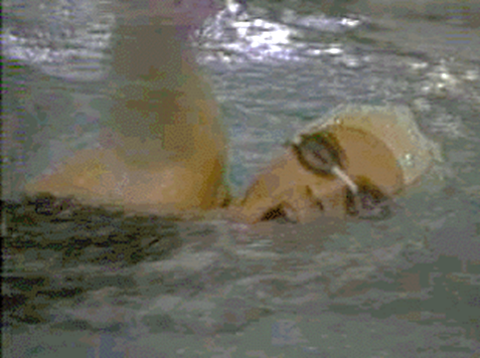
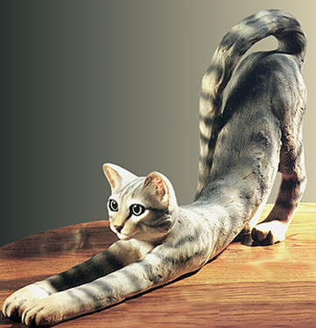
Health and Wellness
Most important tool we all own?
Our minds and our bodies
In other words, our physical and mental health
Health and wellness
Diet and nutrition
Body weight control
Stress management
Smoking cessation
Blood pressure control
Fluid intake
Adequate rest/sleep
Who has dogs or cats at home?
First get up from a little nap what is first thing they do?
We have an instinctive need to move
Just need to pay attention to it!
Notes:
Promote Health and Wellness!
Here is a question for all of us.
“What is the most important tool we all own?”
Of course, the answer is.
“The most important tool we all have is ourselves; our minds and our bodies; in other words, our physical and mental health.”
As health and safety professionals we have valuable information and can play an important role in promoting health and wellness in the workplace.
Health and Wellness Factors
Our goal is to provide a workplace where regular health and wellness concepts and practices are built into the course of doing business. Health and wellness factors include:
• Diet and nutrition
• Body weight control
• Stress management
• Smoking cessation
• Blood pressure control
• Fluid intake - don’t get dehydrated
• Adequate rest/sleep
Movement to control fatigue
We recognize movement helps to control fatigue by relieving awkward and sustained positions and promoting circulation to the body's tissues.
Who has dogs or cats at home? When they first get up from a little nap what is the first thing they do? They stretch!
We also have an instinctive need to move . . . we just need to pay attention to it. Promote movement in the workplace!
Health and wellness is an important ergonomics principle and fits well within our purview as health care and safety professionals.

Slide 96
Provide On-going Feedback and Follow-up
100% correct first time?
Unintended consequences!
Schedule formal follow-up sessions
Document outcome of follow-up
Alleviate issues identified
Continuous Process Improvement and Ergonomics
Strategies have tremendous benefit
Waste is reduced
Productivity is enhanced
Applying ergonomics principles to overall Continuous Process Improvement effort is integral to success of process!
Notes:
100% Correct the First Time?
In your experience does any new process work 100% correctly out of the gate?
Even with the best up-front planning there will be unintended consequences, something will vary from the plan. This is why providing on-going feedback as part of the follow-up process is so critical.
Schedule formal follow-up sessions at regularly intervals; for example, one week post-implementation and then one month, six months and one year.
Document the outcome of the follow-up, very importantly alleviate the issues identified in a timely manner and publicize the lessons learned.
Continuous Process Improvement and Ergonomics
Applying ergonomics principles to the overall continuous process improvement effort is integral to the success of the process.
Ergonomics, when focused on optimizing performance –enhancing safety and quality and productivity – is made stronger when on-going feedback and follow-up is performed.

Slide 97
Ergonomics – A Potent Tool!
Ergonomics is a potent tool!
When principles of ergonomics are applied the outcome is demonstrated improvements in quality, productivity, health and safety!
Thanks!
Notes:
I have found ergonomics to be a potent tool! When the principles of ergonomics are applied the outcome is demonstrated improvements in quality, productivity, health and safety!
I hope the information has been helpful to you.
Thanks for your time and attention!

Slide 98
Instructor Background/Experience
Notes:
Instructor Background and Experience

Slide 99
Title Slide
Welcome/Introduction
Ergonomics – Defined
Systems Design
Ergonomics Principles
Work Process
Population Stereotypes
Design Conventions
Neutral Position and Support
Promote Physical Movement
Control Material Handling
Reach Zone
Tools, Equipment, Workstation
Training
Work Environment
Health/Wellness
Feedback
Closing Slide
Menu
Instructor
Notes:
Menu

