Slide 1
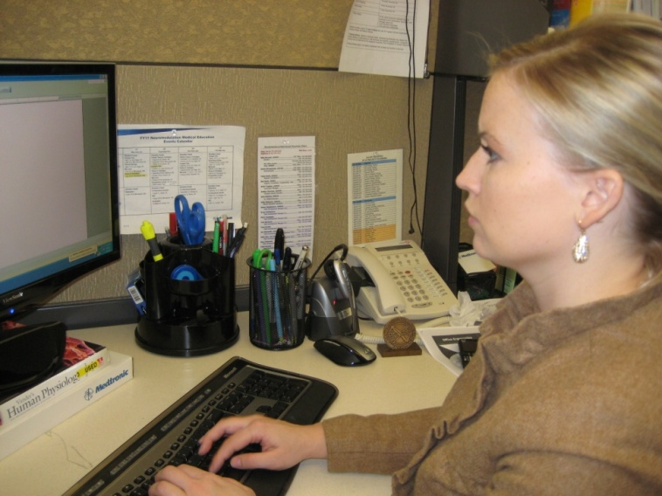

Office Ergonomics 2.0
New Developments in Office Ergonomics
Mark Anderson, MA, PT, CPE
Ergonomist and Physical Therapist
ErgoSystems Consulting Group, Inc.

Slide 2
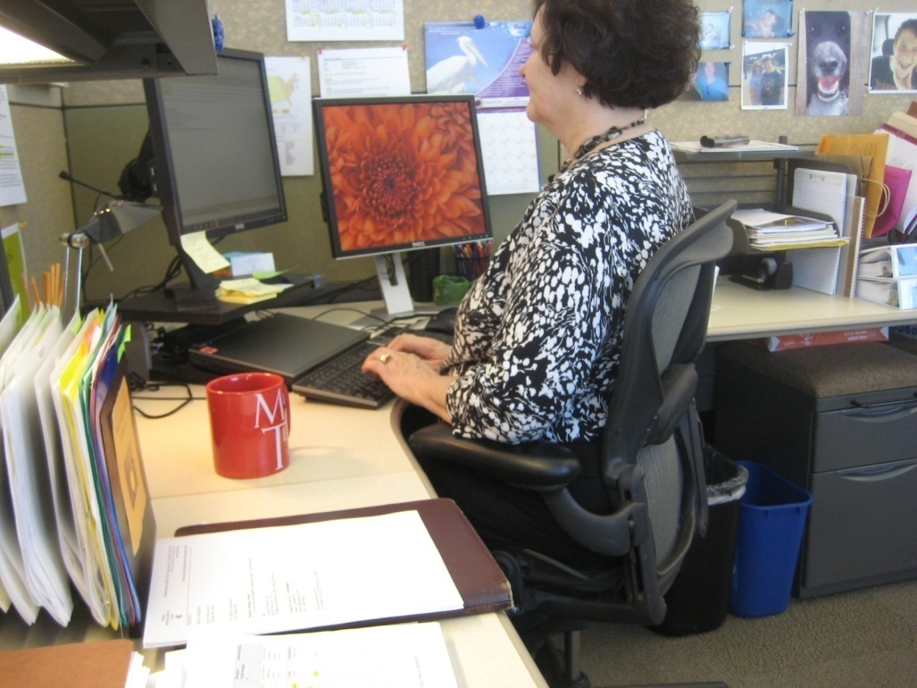
Case Study
Introduce you to . . .
Mary Johnson
Customer Service Rep
Uncomfortable in chair
Sore neck and shoulders

Slide 3
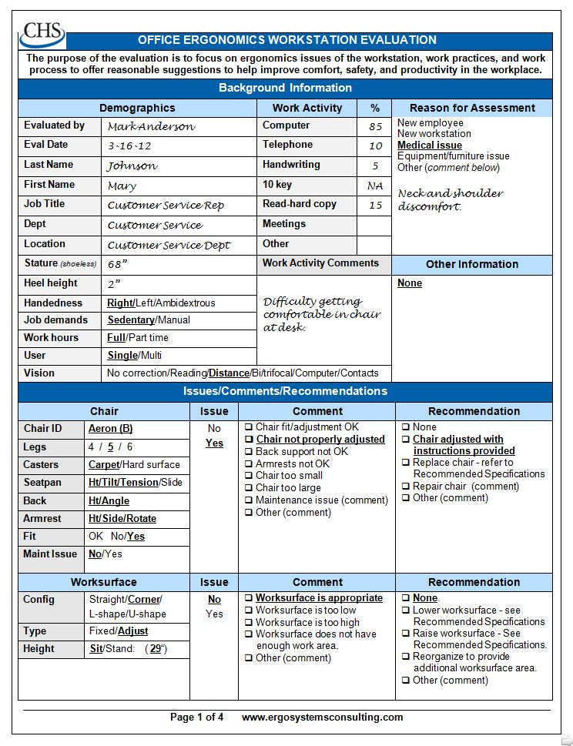

Slide 4
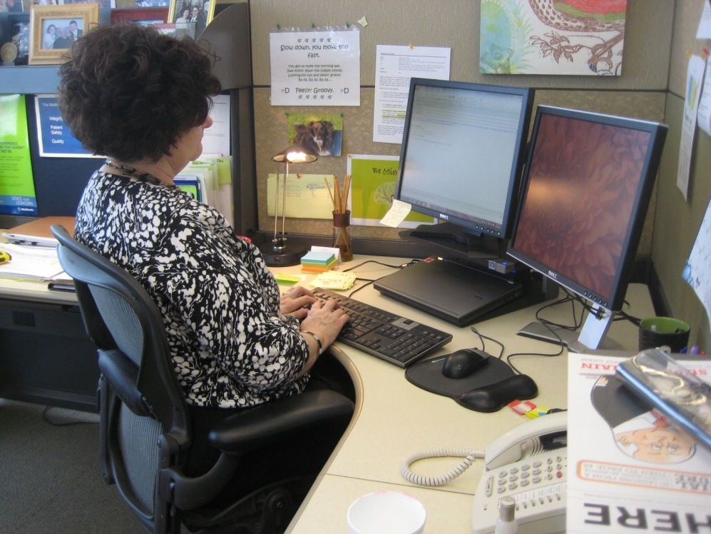
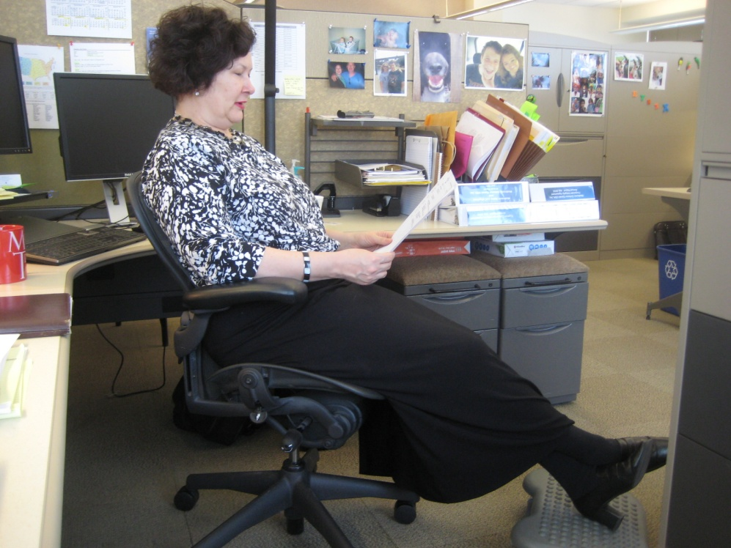

Slide 5
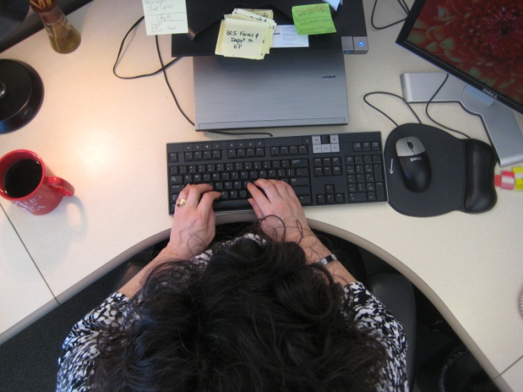
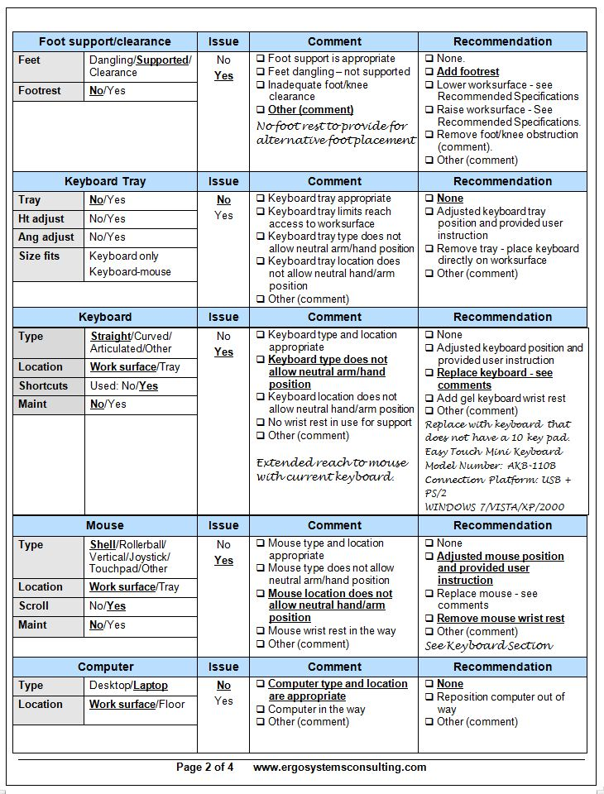
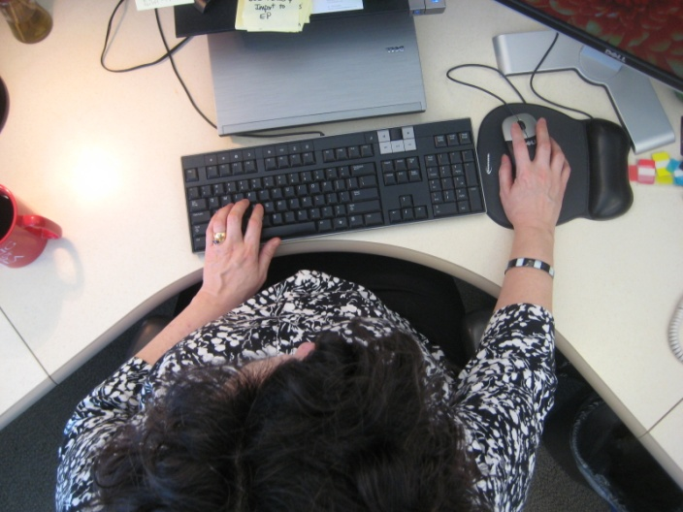

Slide 6

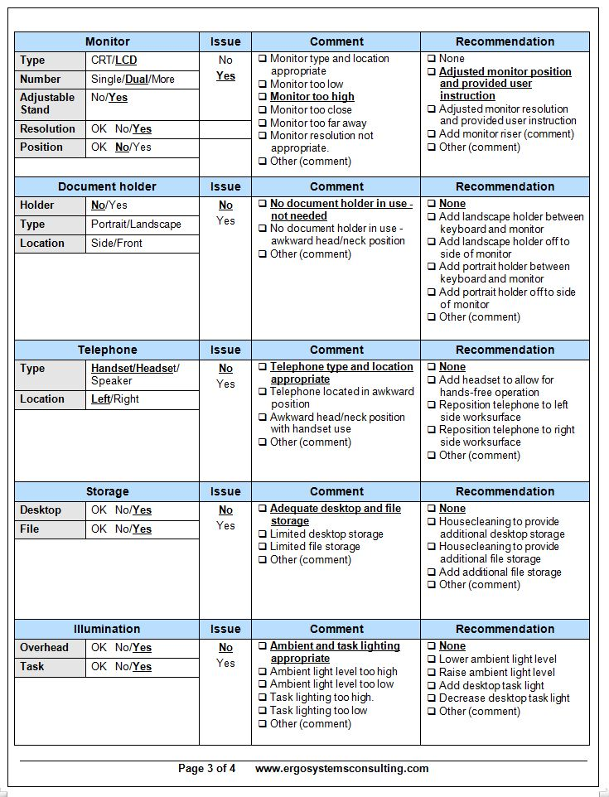
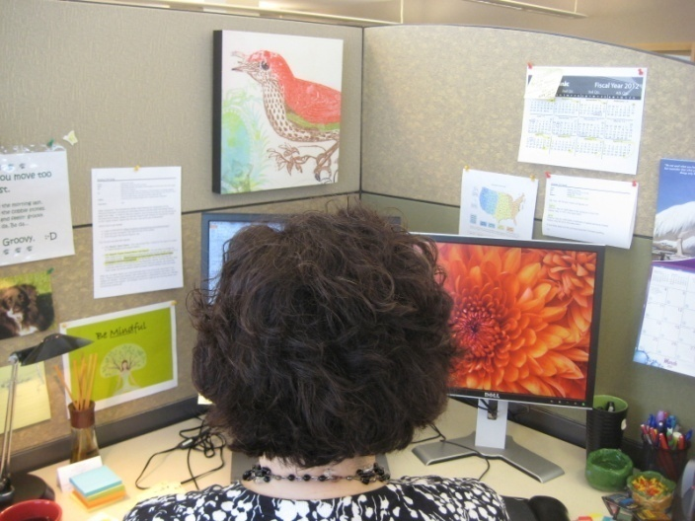

Slide 7
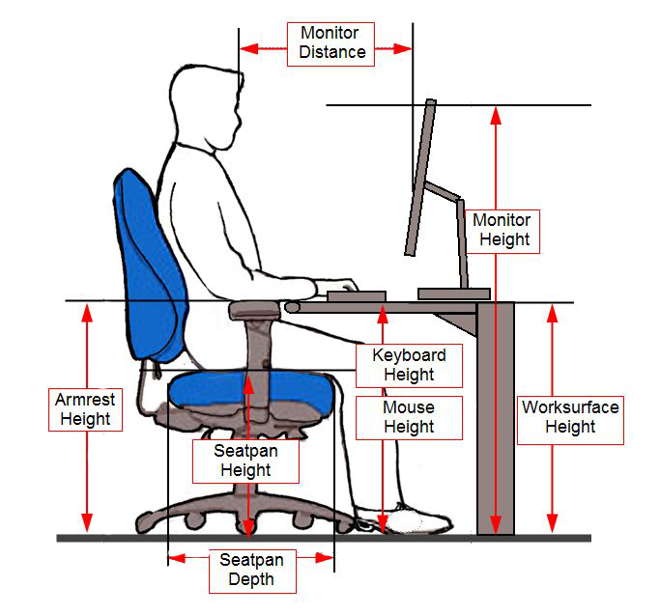
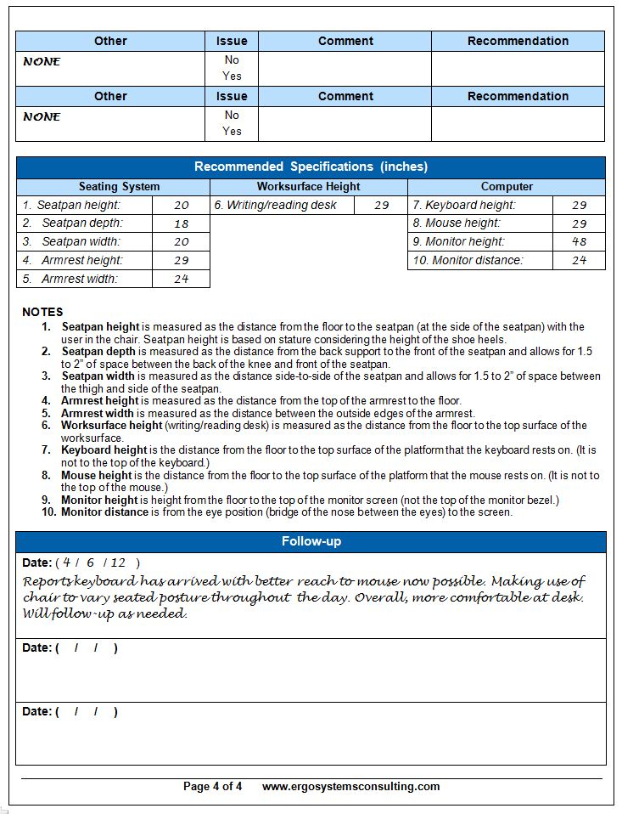

Slide 8
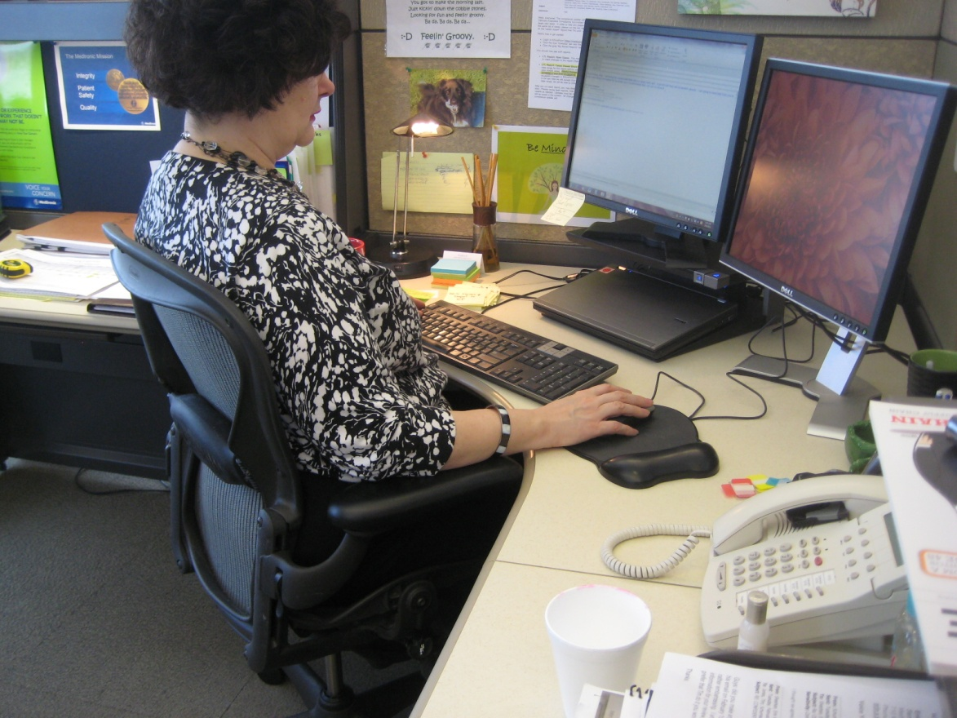

Slide 9
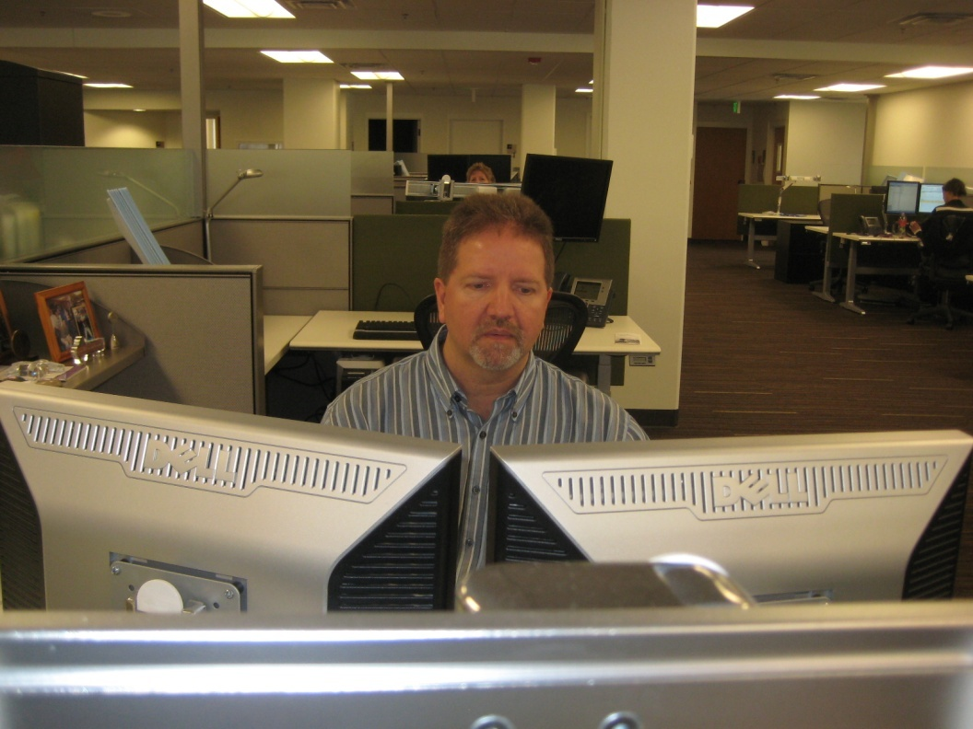
Workshop Objectives
Review what Office Ergonomics is all about
Identify components that make up the successful office workspace
Go in-depth on the office ergonomics components
Address specific examples via case studies

Slide 10
Attendee Case Studies
One issue that we’re currently dealing with is sit to stand workstations. We have employees standing all the time (which I believe is still not good for you).
We also have others requesting standing mats- is this something that we should approve or deny? If their feet hurt from standing, shouldn’t they sit down?
Kate Mischnick | Human Resources Generalist

Slide 11
Attendee Case Studies
I do have an upcoming issue. We have a staff person that has had a recent injury that has left her thumb from the elbow down with limited range of lateral motion and the use of her fingers. The majority of her job is working on a keyboard so what would be the best keyboard option be for her?
ROXANNE LAPLANTE | MANAGEMENT ANALYST SUPERVISOR | MANAGEMENT SERVICES DIVISION

Slide 12
Attendee Case Studies
A specific example of a work station evaluation issue you have encountered and were unsure how to address.
Changing a district court bench to accommodate the Judge. The bench is too high for the Judge. Her height is about 5’1”. The dual monitors need to be in front of her and yet need to be low enough so she can see over them and observe the individuals in the courtroom. She is not comfortable using a foot rest.
We have a court clerk area in a courtroom which needs to be larger. Two clerks have rolled off the steps due to lack of space. It is clearly a safety hazard. There has been a struggle with the County Board remodeling the bench and clerk area but now seems to be better after an ergonomic assessment.
A specific example of a success story.
The installation of sit-stand units that have really helped a few employees with back problems.
Other situations that you would like more information on.
Would like more information on sit-stands as they are becoming more popular. How to write professional recommendations in a summary format.
Jill A. Hendrickson
Human Resources Coordinator
Ninth Judicial District
Bemidji, Minnesota 56601

Slide 13
Attendee Case Studies
Could you ask Mark to talk about sit/stand workstations. We are installing them in many of our court locations.
We also have requests for the standing mats but we are unsure how to respond to the request. It has been our feeling that if they are standing and begin to get tired then they should be sitting down. Their jobs do not require that they stand and we feel that they need to alternate between sitting and standing. Because of that we are not providing the mats because they tend to get in the way when an employee wants to sit back down.
Mary Ann Stock
Human Resources Coordinator
Seventh and Eighth Judicial Districts
St. Cloud, MN 56302

Slide 14
Attendee Case Studies
A specific example of a work station evaluation issue you have encountered and were unsure how to address.
On significant issues for us is that we have moved toward a paperless environment, so scanners are now a piece of equipment everyone uses. Where should they be placed? Is there model or method that is recommended? We started with top feeders and have moved to front feeders.
An example of an issue(s) that you are uncomfortable handling.
We have an employee with several workers compensation claims. She seems to have multiple claims open at one time. We have directions from professional staff on how items should be set up at her desk but she tends to alter the layout. She tends to find a way to file a claim if she is assigned a task she does not specifically care for. We even had an professional provide an ergonomic review of her desk. She volunteered to be sample sit/stand work station. In the first 24 hours she wanted a standing pad, a standing pad was provided and she wanted a thicker standing pad. The ergonomic expert did a review of desk and explained that she needs to alternate sitting and standing. The first day she stood for three hours.
Other situations that you would like more information on.
We have installed many sit/stand work stations. What is the best way to address ergonomics in the sitting and standing positions. Should there be a standing mat? If so, how think should the mat be? How does a chair roll over a mat? Etc.
Setrum, Marcia

Slide 15
Attendee Case Studies
One encounter that was a bit challenging was assessing a work station and the employee had already “decided” what she wanted and was somewhat resistant to the overall process.
Success story: we were able to make a few adjustments to the employee’s chair, combined with a footrest, to ensure all positions were appropriate; we will follow up in a week to gather feedback on the effectiveness of the adjustments.
I did not experience this, but I think it would be awkward when assessing someone who is too large for the chair.
Another issue would be when the employees have already made up their minds about what they “want” as opposed to what they may “need.”
Miller, Paul

Slide 16
Workshop Guidelines
Follow along with demonstrations unless you think they may cause you a problem
Do not go against doctor's orders or do anything that you feel you should not
If you are uncomfortable sitting during workshop, move to side or rear of classroom
Use your good judgment when trying new techniques or exercises after you leave workshop

Slide 17

Course Logistics
Manual/handouts
Course Schedule
  Starting/ending times
  Rest breaks
Rest rooms
Fire exits
Telephones
Messages
Group Introductions

Slide 18
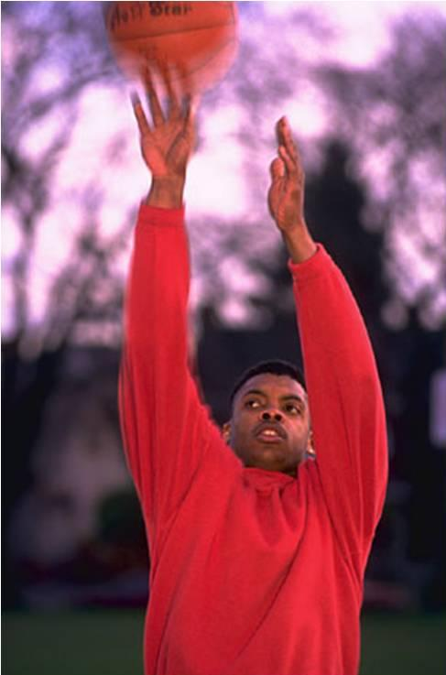
First of all . . . What is Ergonomics?
Ergonomics is like throwing a ball into the air
What happens?
Correct! The ball comes back down
Why? Because GRAVITY works!

Slide 19
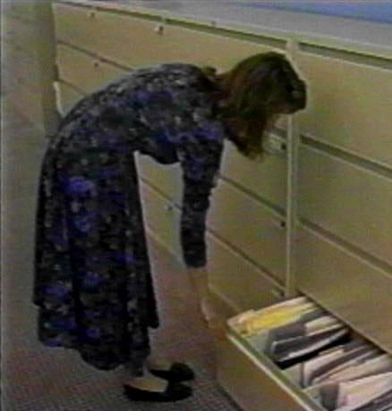
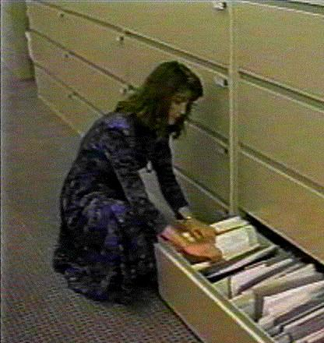
Applied to work

Slide 20
So, in our workspace, given a certain set of circumstances we will respond in a fairly predictable way

Slide 21
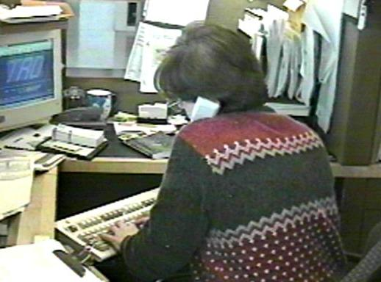
Definition of Ergonomics
The word “ergonomics” comes to us from the Greek
Ergon means work and nomos means the laws or study of
So, ergonomics is literally the “study of work”

Slide 22
Ergonomics . . .
The enhancement of all aspects of job performance – safety, quality and productivity – accomplished through the appropriate design and use of workstations, work processes and the overall organization of work

Slide 23
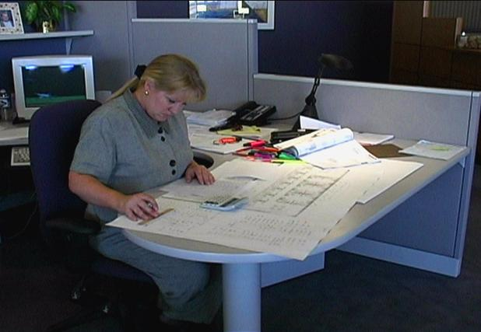
Ergonomics Principles

Slide 24
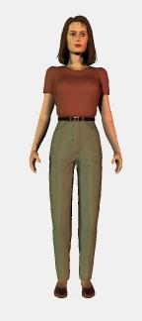
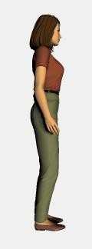
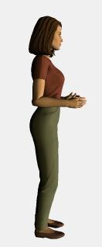
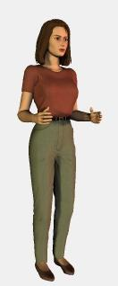
Position and support in neutral
Body neutral
Arm/Hand neutral

Slide 25
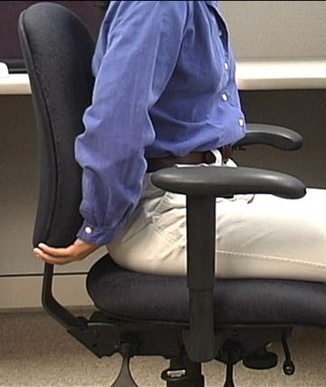
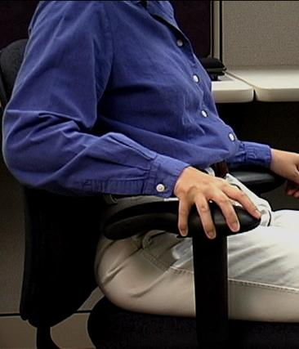
Provide support for body/limbs
Seated
  Compression of soft tissues
  Decrease in blood flow and circulation
  Proper seated support is critical
Limbs
  Proper support for limbs
  Removes strain of weight bearing
  Unloads neck, shoulders and back

Slide 26
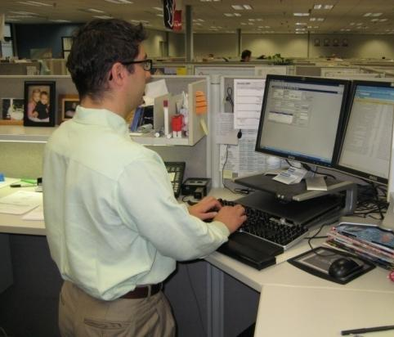
Provide support for body/limbs
Standing – sustained
  Unsupported standing for extended periods is not desired
  Joint compression occurs decreasing joint space
  Inadequate joint lubrication
  Fluid tends to pool in lower extremities
The bottom line . . . tiring!

Slide 27
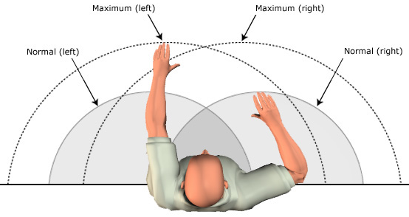
Work in reach zone
Stature and arm’s length determine reach zone
Determine individual reach zone and set up workstation to promote reach in that zone

Slide 28
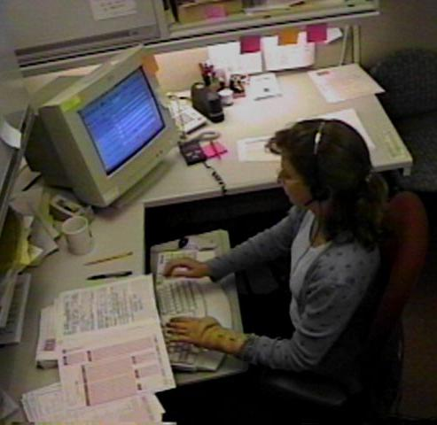
Promote effective work processes
Take step back and really examine why something is done as it is
If answer is, ‘Because it has always been done that way!’
Take fresh look
Is there better way to get it done?

Slide 29
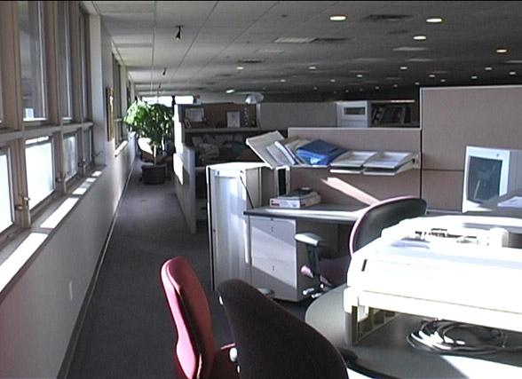
Moderate Environment
Light
Noise
Temperature
Ventilation

Slide 30

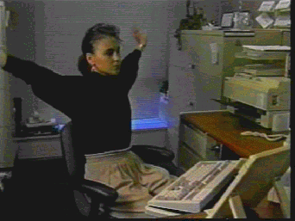
Movement, Movement, Movement!
Directly addresses our need to move to stay healthy
Provide workplace where regular movement is built into course of doing business
Movement helps to control fatigue by:
  Relieving awkward and sustained positions
  Promoting circulation to body's tissues

Slide 31
Ergonomics Principles
Position and support body in neutral
Provide support for body/limbs
Work in reach zone
Promote effective work processes
Provide moderate environment
Promote physical movement

Slide 32
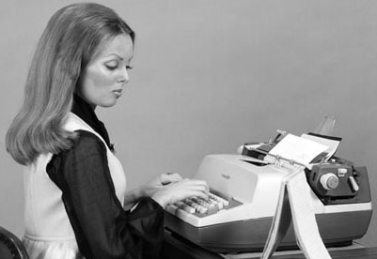
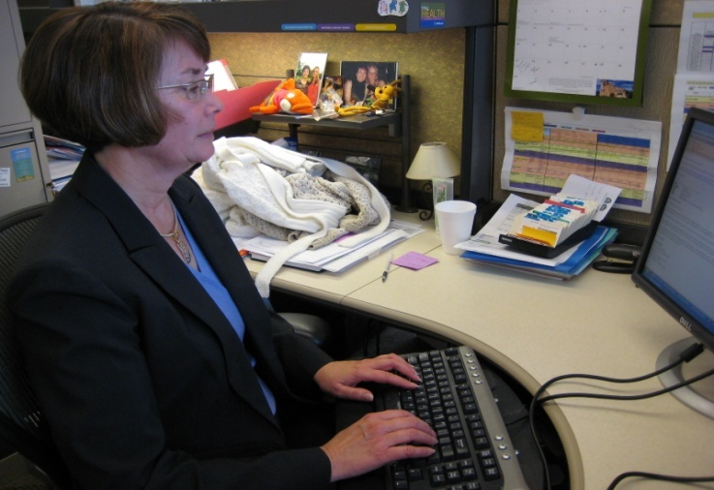
Office Ergonomics Applications
Typewriters to computers!
Where do we use computers?
EVERYWHERE!

Slide 33
Typical office components
User population profile
User – Single/Multi
Tasks – Single /Multi
Floor space
Seating system
Worksurface
Floor surface
Computer equipment
Telephone
Office equipment
Storage
Conference tables/chairs
Light
Noise
Temperature

Slide 34
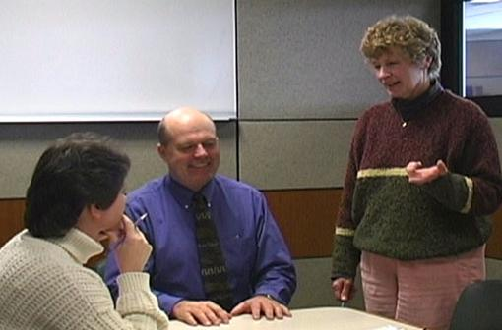
User population profile
Very important first step - accurately define user population
  Age
  Gender
  Stature
  Vision
  Hand dominance
  Other
Defining user profile lays the foundation for remainder of process

Slide 35
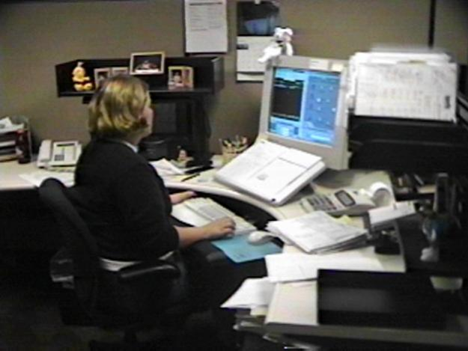
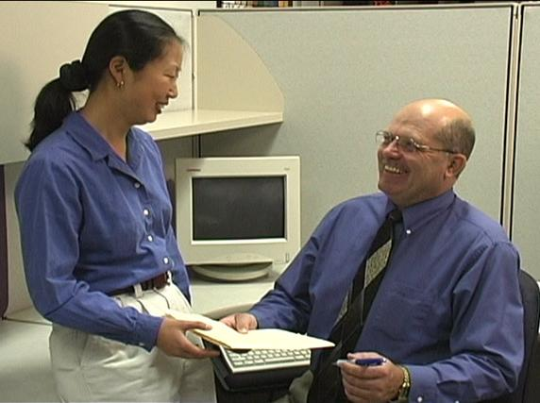
User: Single/Multi

Slide 36
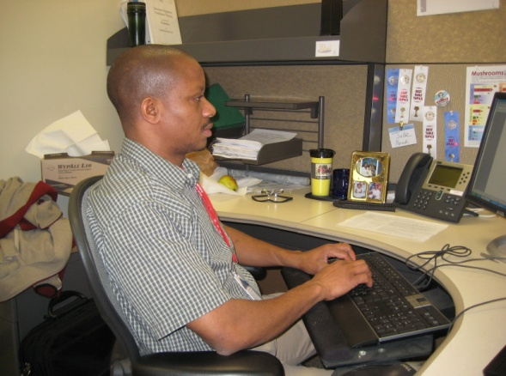
Single user
Less influenced by need for adjustability of workstation itself
Once determine proper height of worksurface
  Use fixed height or adjustable/fixed worksurface
  Worksurface can be height adjusted but once adjusted is not readily changed

Slide 37
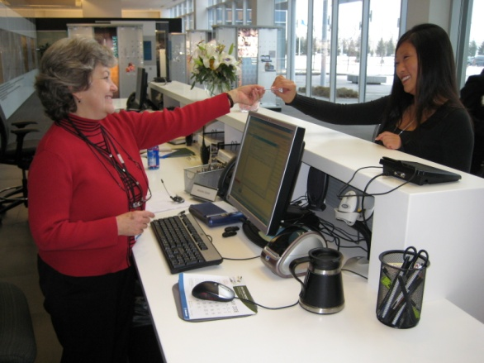
Multi user
Multi-user workstations require significantly greater degree of adjustability
Critical that changeover from one user to next accomplished quickly and easily
Adjustable/adjustable worksurface
  Through spring balanced manual system/powered system worksurface height readjusted within seconds

Slide 38
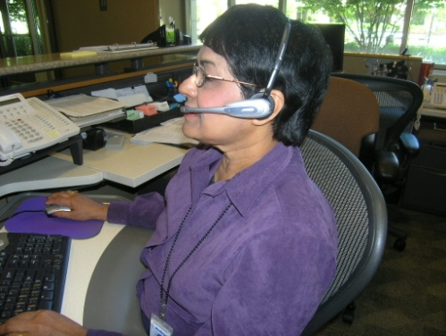
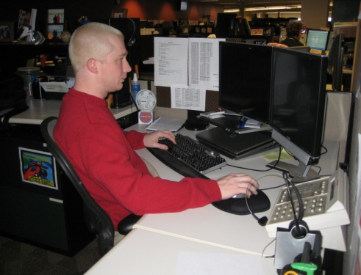
Tasks: Single-task or Multi-task

Slide 39
Single-task
Majority of work time accomplishing specific focused task
  For example, customer service representative majority of day on computer and telephone performing computer lookup activities
  Physically job demands are concentrated in single area
Efficient set up is critical because user tends to maintain sustained position to perform activities

Slide 40
Multi-task
Number of different tasks need to be accomplished
  Computer
  Telephone
  Writing workstation
  Attending meetings
  And so on

Slide 41

Work Activity
(percentage breakdown)
Computer
Telephone
Read
Write
Meetings
Misc
Other

Slide 42
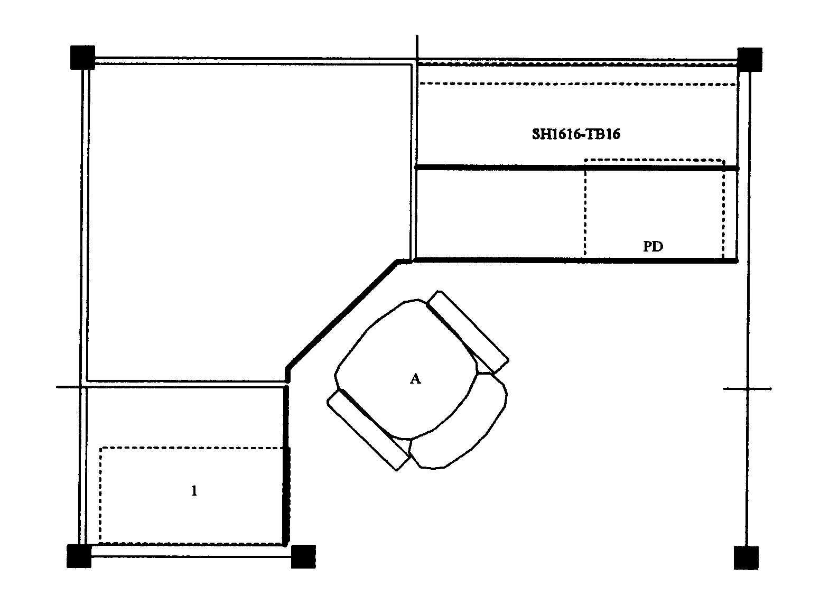
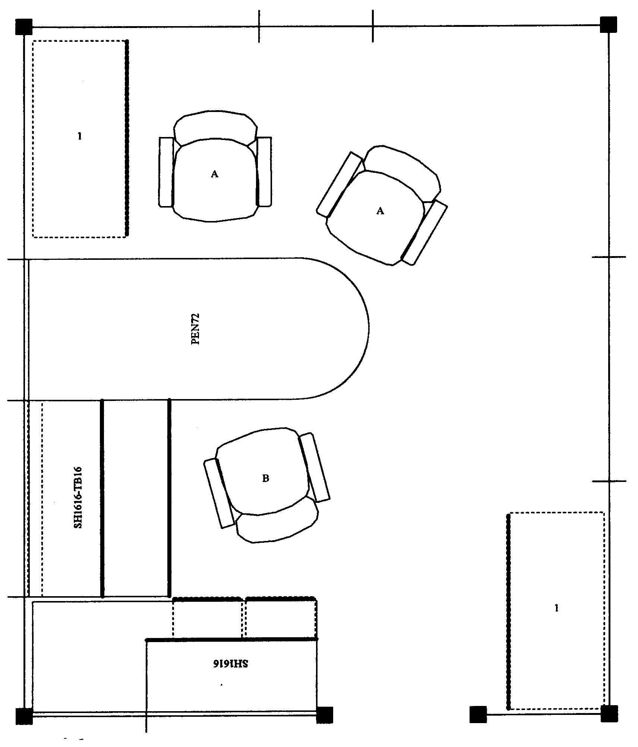
Floor space
In ideal world, dimensions of office workstation are determined exclusively by job tasks
  Some very focused single-task workstations 48 sq ft
  Multitask workstation 120 sq ft or even more

Slide 43
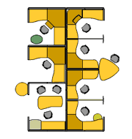
We do not live in an ideal world
Floor space may be determined by host of factors not relative to job task
Does not negate need to perform an effective job analysis to make recommendations
Does cause us in many cases to be quite creative!

Slide 44
Office Ergonomics
Workstation Evaluation Form

Slide 45
Office Ergonomics
Workstation Evaluation Form
Background Information
  Demographics
  Work Activity
  Reason for assessment

Slide 46
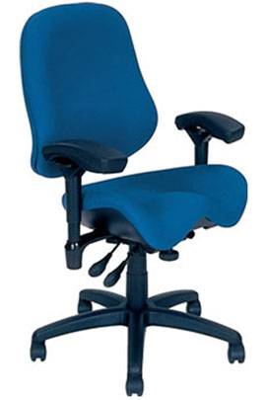
Chair
Objectives of chair
  Support body and limbs to provide relief from weight bearing
  Provide stable base or platform for body and limbs
  Position user at correct height and reach relationship to worksurface and tasks at hand
  Allow for easy change in position/movement of user

Slide 47
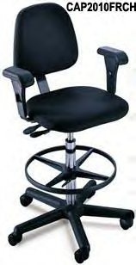
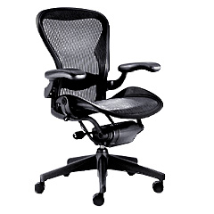
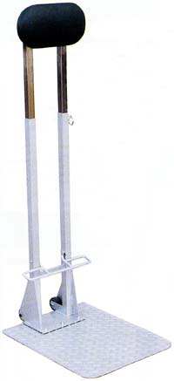
Types of seating systems
Number of seating systems available in workplace
  Office chairs
  Stools
  Lean platforms
  Other miscellaneous seating

Slide 48
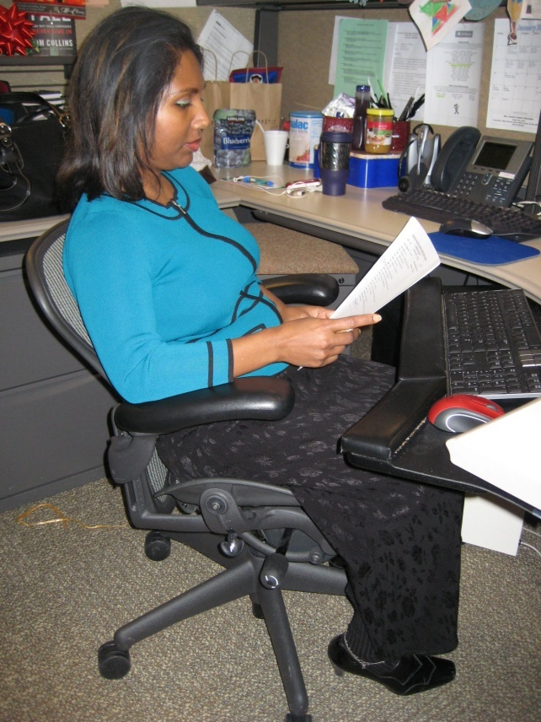
Chair criteria
Type, use and efficiency of chair are critical elements
Acceptable chair criteria determined by:
  Type of job activities performed
  Size and shape of user
  Duration of time spent in chair

Slide 49
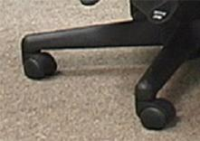
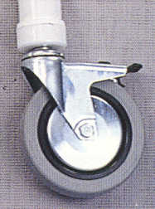
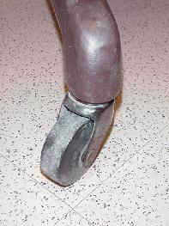
Legs and Casters
Does the chair have at least 5 legs?
Does the chair roll easily on the floor surface?
  Hard caster on soft floor
  Soft caster on hard floor

Slide 50

Seatpan Height
Does the chair’s seatpan height adjust up and down?

Slide 51

Seatpan Tilt
Does the chair’s seatpan tilt up and down?

Slide 52

Seatpan Tension
Can you adjust the seatpan tension?

Slide 53

Seatpan Depth
Does the chair’s seat move forward or backward?

Slide 54

Seatpan Fit
Does the chair’s seat fit body size?

Slide 55


Relationships
Does the chair fit the individual?
  This gentleman is 7’ tall!
  Arrows point to back of knee and front edge of seatpan

Slide 56

Back Support Height
Does chair’s back support move up and down?

Slide 57

Back Support Angle
Does chair’s back rest angle forward or backward?

Slide 58

Cushion
Suitable cushion
  Foam density
  Wearability
  Breathability
  Type of material (fabric or rubberized)

Slide 59

Armrests Adjust
Do chair’s armrests adjust up and down and/or side-to-side?

Slide 60


Relationships

Slide 61

Maintenance
Is chair functioning properly?
No maintenance problems?

Slide 62

Adjustment levers/knobs/controls
Easy to reach
Easy to manipulate
Should not intimidate

Slide 63


Ball Chairs?
Therapeutically, exercise balls used in clinical settings as treatment modalities
  Improve spinal stability
Over past several years, use of exercise balls in place of or in addition to task chairs
  Currently only anecdotal evidence exists to support full-time use
Most ergonomists advocate for properly sized/properly adjusted office task chairs rather than use of ball chairs

Slide 64

Considerations
Size of the ball should be appropriate to position individual with feet on floor in arms at appropriate height
  Typically 55 to 65 cm balls are used
Inflation level of ball
  Important to provide for adequate support and height
  Ball will deflate overtime and needs to be monitored and re-inflated as needed
Puncture issues
  Higher-quality balls should be used
  Vigilance in ensuring ball will not come in contact with sharp objects

Slide 65
Considerations
Ball use technique
  Feet on floor
  Knees spread at least as wide as shoulder width or wider
  Maintain spine in neutral position works normal lower back inward curve
  Once individual becomes fatigued, they tend to roll over back of ball with resulting slumped lower back position
  Ball will not swivel on floor; to rotate position person needs to lift bodyweight off ball and reposition ball and self

Slide 66

Considerations
Ball with wheels and back supports!
  To compensate for some of limitations some manufacturers have incorporated ball concept into a chair configuration
One example is Gaiam Balance Ball Chair
  http://www.amazon.com/Gaiam-Balance-Ball-Chair-Black/dp/B0007VB4NE/ref=sr_1_1?s=sporting-goods&ie=UTF8&qid=1338126730&sr=1-1
Additional information and comment
  http://www.ergoweb.com/news/detail.cfm?id=1091

Slide 67

Art of Sitting
Body not designed to sit
  Particularly for long periods
  Studies determined even when seated in well-supported postures . . .
  How soon do we want to move?
  About every 20 to 30 minutes!

Slide 68

The Art of Sitting
Three point contact
  Sacrum/Trunk
  Hips/Thighs
  Feet/Floor

Slide 69

The Art of Sitting
90/90 seated posture?
  Only in drawings!
  Most people will sit at 95 to 110 degrees at hips and knees

Slide 70




Sitting styles
Sitting styles quite varied from person to person:
  Percher
  Slouch
  Sit crossed leg
  Sit on leg

Slide 71
Sitting styles
Particular sitting style needs to be assessed
  Habit developed over time
  Response to poor workstation setup
  Combination of both
  What drives problem is frequency and duration of seated position

Slide 72



Functional seated positions
Provide for several different acceptable postures
Rotate throughout day on regular basis:
  Upright “keyboard” position
  Semi-reclined/rocking “conversation” position
  Standing

Slide 73

Adjustment anxiety
Chairs can be pretty expensive
  All kinds of bells and whistles
  Chair only as good as how it is adjusted
Some people have never adjusted their chair
  Just sit down and go to work!
Bottom line
  Need to initially be able to adjust chair to fit
  As well as throughout day

Slide 74

Chair solutions
Manual
  Find and read it!
Position and support body in neutral
  Adjust seat pan/back support tension to hold body in neutral position
  Adjust seatpan height to get feet on floor with even pressure on hips and thighs
  Adjust height and angle of back support to fill in low back curve

Slide 75


Relationships

Slide 76
Future trends in chair design
How do we sit?

Slide 77




How do we sit?

Slide 78

Chair form and function
Work chairs should provide postural equilibrium—proper support for body’s natural alignment—through full range of postures.
By providing support for where the body wants to be in space, a chair allows person to have a healthy relationship to technology in his or her workspace.
Such alignment, coupled with movement throughout the range of postures, keeps people healthier, more attentive, and able to perform at their best. (Herman Miller)

Slide 79
Promoting Healthy Movement and Natural Alignment:
The Research and Design Behind the Embody Tilt
http://www.hermanmiller.com/research/solution-essays/promoting-healthy-movement-and-natural-alignment.html
NOTE: We are not promoting any particular manufacturer or model of chair, example is for illustrative purposes only.

Slide 80


Chair Examples

Slide 81




Chair Examples

Slide 82


Chair Examples

Slide 83


Chair Examples

Slide 84


Chair Examples

Slide 85


Chair Examples

Slide 86

Chair Examples

Slide 87

Chair Examples

Slide 88


Chair Examples

Slide 89


Chair

Slide 90
MOVE!
Remember, no matter how perfectly adjust chair to fit
  Still comes down to fact that need to move on regular basis to keep body healthy and safe
Movement is critical to the health of the body!

Slide 91

Is Sitting the New Smoking?

Slide 92


Historical perspective – Changes from 1800 to 2000
In 1800 where did most Americans live?
  Rural or Urban?
How about in 2000?
  Rural or Urban?

Slide 93

Historical perspective – Changes from 1800 to 2000
"The Changing Psychology of Culture From 1800 Through 2000" by P. Greenfield in Psychological Science. Note: Census Bureau used two different definitions for "urban population" in 1950 and 1960.

Slide 94

Where we Live – Rural vs. Urban?
United States Census Bureau

Slide 95

Activity Level – Rural vs. Urban

Slide 96

Activity Level – Rural vs. Urban

Slide 97


How Long We Live (1850 vs. 2000)?

Slide 98


How We Die – 1800 vs. 2000?
Acute Illness/Injury (1800) vs. Chronic Diseases (2000)
  Acute Illness/Injury
    Pneumonia
    Tuberculosis
    Diarrhea related
    Childhood diseases
    Accidents
  Chronic Disease
    Heart disease
    Cancer
    Strokes
    Diabetes
    Respiratory
    Arthritis

Slide 99


How We Die – 1850 vs. 2000?

Slide 100
Big Changes since 1800!
Where we live – Urban
Activity level – Much more sedentary
How long we live – Longer
How we die – Chronic disease

Slide 101

Is Sitting the New Smoking?
We recognize the negative impact of smoking!
Is the impact of our sedentary society (sitting) comparable to the negative effects of smoking?

Slide 102
Brief Overview – Smoking
Tobacco use leads to disease and disability
  Smoking causes cancer, heart disease, stroke, and lung diseases (including emphysema, bronchitis, and chronic airway obstruction).^{1,2}
  For every person who dies from smoking-related disease, 20 more people suffer with at least one serious illness from smoking.³
Tobacco use is leading preventable cause of death
  Worldwide, tobacco use causes more than 5 million deaths per year, and current trends show that tobacco use will cause more than 8 million deaths annually by 2030.⁴
  Cigarette smoking is responsible for about one in five deaths annually (i.e., more than 440,000 deaths per year, and an estimated 49,000 of these smoking-related deaths are the result of secondhand smoke exposure).^{1,2}
  On average, smokers die 10 years earlier than nonsmokers.⁵
Tobacco use costs United States billions of dollars each year
  In 2000–2004, cigarette smoking cost more than $193 billion (i.e., $97 billion in lost productivity plus $96 billion in health care expenditures).¹
  Information published in 2005 documented that secondhand smoke costs more than $10 billion (i.e., health care expenditures, morbidity, and mortality).⁷

Slide 103

Impact of Sitting
What about the impact of excessive sitting (evidenced by sedentary life styles)?
How much do we really sit?
In other words . . . how sedentary are we?

Slide 104

Audience Survey
Categorize YOUR typical day
  Sit
  Stand
  Walk
  Recumbent

Slide 105

How much do we sit?
Researchers reported people spent average of:
  64 hours a week sitting
  28 hours standing
  11 hours milling about (non-exercise walking)
    International Journal of Behavioral Nutrition and Physical Activity, 2012

Slide 106

Impact of Sitting?
Do a Google search and you will find . . .
Can sitting really have that level of impact?
  What do you think?

Slide 107
Brief Overview of the literature
Mortality
  123,216 people's health outcomes during a 14-year period
  Women who sit for more than six hours/day were about 40% more likely to die during course of study than those who sat fewer than three hours/day
  Men were about 20% more likely to die
    American Cancer Society
Cancer
  Worker at a sedentary job have almost twice risk of a specific type of colon cancer
    The American Journal of Epidemiology

Slide 108
Brief Overview of the literature
Diabetes, Cardiovascular events (Meta-analysis of 18 studies)
  Diabetologia, November 2012 analyzed results of 18 studies with total of nearly 800,000 participants
  Compared people who spent most time sitting with those who spent least time, researchers found increases in risks of:
    Diabetes (112%)
    Cardiovascular events (147%)
    Death from cardiovascular causes (90%)
    Death from all causes (49%)

Slide 109

Underlying factors
Obesity
  "There is debate as to whether it is the chair or the knife and fork that have caused the increase in obesity rates,"
    James Levine, MD, PhD, Mayo Clinic, 2012
  Sedentary life styles contribute to obesity

Slide 110
Underlying factors
Metabolism
  "Your body is designed to move. Sitting for an extended period of time causes your body to shut down at the metabolic level. When your muscles, especially certain leg muscles, are immobile, your circulation slows.
  So you use less of your blood sugar and you burn less fat, which increases your risk of heart disease and diabetes.
  Indeed, a study of 3,757 women found that for every two hours they sat in a given work day, their risk for developing diabetes went up seven percent, which means their risk is 56 percent higher on days they sit for eight hours.”
    Marc Hamilton, Ph.D., Professor and Director of the Inactivity Physiology Department at Pennington Biomedical Research Center

Slide 111

Underlying factors
Enzyme production
  Key gene (called lipid phosphate phosphatase-1 or LPP1)
  Helps prevent blood clotting and inflammation to keep cardiovascular system healthy
  Significantly suppressed with sitting for few hours

Slide 112

Underlying factors
Depression
  2013 survey of nearly 30,000 women
  Those who sat nine or more hours a day more likely to be depressed than those who sat fewer than six hours a day
  Prolonged sitting reduces circulation, causing fewer feel-good hormones to reach brain

Slide 113
Bottom Line –
Is sitting the new smoking?
“Sitting disease is getting much publicity lately—and for good reason. The scientific evidence is mounting that being idle for long stretches, day in and day out, may be the root of our nation’s poor state of health, contributing to not only back pain and obesity but type 2 diabetes, heart disease and even certain types of colon and other cancers.
It’s important to keep in mind that in many ways the verdict is still out on whether we really are sitting ourselves to death.
Lots of data confirm that smoking causes cancer and a slew of other health problems.
The research on prolonged periods of inactivity, on the other hand, mostly shows an association with ill health.
The distinction has caused some commentators to declare the sitting issue another oversimplification of healthcare research overhyped by the media.
Although headlines are meant to draw in readers, there is valid research showing that the human body functions best when it stays in motion.”
Kelly Casey, Pittsburgh Quarterly, Summer 2012

Slide 114
What can we do?
Mindset
  You have all heard this expression . . .
    If you don’t use it . . . you will ______ ____!
  How about this one . . .
    The more you do the ______ you can do!
    The less you do the _____ you can do!
  For 25 years have preached the 30/30/30 Rule!
  Look for as many opportunities as possible to incorporate movement into our lives!

Slide 115

At home and work – Ideas?

Slide 116
At home and out
Ice cream lovers. Do not bring it into the house! Walk to the store, buy a single serving and walk as you eat it!
Take the stairs!
Walk the dog (or the neighbor’s dog)!
Walk with a friend.
Try the 10,000 step per day approach!
Watch TV standing up and stepping in place.
Stand or step in place when talking on the phone.
Limit screen time for yourself and family members.
Set-up movement reminders – apps are available.
Walk at the Mall during inclement weather.
Work on walking faster when you do walk.
Dance!
Play a musical instrument when standing – even air guitar!
Add a 15 minute walk at lunch time.
Use a rake instead of a leaf blower.
Park farther from the door at the Mall.
Ride your bike or walk to run errands.
Keep track of your activities and give yourself a suitable reward.
Figure out what works for you and go for it!

Slide 117
At work
No email for a day . . . get up and say what you need to in person!
Walk with a friend at break time.
Take the stairs.
Drink a lot of water . . . A LOT OF WATER!
Stand or step in place when talking on the phone.
Take the sit-down tables out of conference rooms.
Have walking meetings rather than gathering in conference rooms.
Set-up movement reminders – apps are available.
Build purposeful movement into the work process that promotes regular movement.
Add a 15 minute walk at lunch time.
Work on walking faster when you do walk.
Park on the perimeter of the parking lot – not the closest space.
Set up Sit/Stand workstations – lots of options!

Slide 118

Final Thoughts
Take the 30/30/30 Rule to heart!
MOVE!
MOVE!
MOVE!

Slide 119

Worksurface
Worksurface objectives
  Provide functional workspace (depth, width)
  Support and position equipment
  Provide access to work materials
  Achieve desired relationship match between user/work

Slide 120
Straight line (desk/table)
The straight in-line configuration is suited for single task activities
Minimal reach requirements for other office equipment and materials

Slide 121
L-shape (two worksurfaces)
L-shaped configuration is suited for single to multitask activities that require two or more separate workspaces
One workspace may be used as computer workstation and another as writing or collating workstation

Slide 122
Corner/U-shaped
Corner/U-shaped configuration well suited for multitask activities in same workspace with significant requirements to frequently reach other office equipment and materials
Allows for greatest degree of adjustability and accommodation for user

Slide 123

Worksurface: Fixed
Traditional desk at fixed worksurface height of 29 inches - Millions of these!
Not designed to be changed in height or angle
Generally possible to raise fixed height worksurface on supports but also generally very difficult to lower it

Slide 124

Worksurface: Fixed/Adjustable
Wall panel mounted worksurface or worksurface on legs
Can be adjusted within given range but once adjusted fixed in that position on fairly permanent basis

Slide 125


Worksurface: Adjustable/Adjustable
Sit/stand workstations
  Controlled by mechanical springs or powered mechanisms
Keyboard trays
  User can readily and easily adjust worksurface

Slide 126



Wrong Desk height
If work height is adjustable, adjust it as needed
  Raise height of work surface by putting it up on blocks
  Make sure desk or work surface is solidly placed on blocks and won’t fall off!
Adjust chair height
  Make sure feet are supported either on floor or with footrest
Add height/angle adjustable keyboard tray
  Mounted underneath work surface

Slide 127

Not enough layout space
House cleaning
Other worksurfaces available for use
  File cabinet at standing height to review documents
Relocate some of equipment on desk
Pullout drawers already in desk

Slide 128

Sit/Stand Workstations
Current trend in office environments is sit/stand workstations
Recommendation: Have a policy in place how you will handle requests for sit/stand workstations
Many configuration options

Slide 129
Basic Tenets for
Sit/Stand Workstations
Correct worksurface heights (seated and standing)
Good footwear
Anti-fatigue foot mat may be beneficial – however it is difficult to roll chairs on mats
Foot rest if needed to eliminate dangling legs
Remember time will be needed to allow accommodation to sit/stand routine
Start with a specific schedule for first week (e.g. 30 minute stand – 30 to 60 second walk – 30 minute seated - 30 to 60 second walk and repeat) AND then modify based on unique response. Remember the mantra . . . “Don’t wait until it’s too late!”

Slide 130


Podium on Desk

Slide 131


Fixed Height Split:
(Seated and Standing)

Slide 132

Fixed Height:
(Standing with Stool and Footrest)

Slide 133

Fixed height: Add-on

Slide 134

Adjustable Height: Add-on

Slide 135


Adjustable Height Worksurface

Slide 136


Rationale
Variety of postures
  Offers variety of sit, stand and walk postures and activities within workstation area

Slide 137

Configurations
Fixed height with stool and platform
  How to determine fixed height
    Have individual stand comfortably with elbows and shoulders relaxed mimicking placement of hands for keyboard and other hand related activities on the work surface
    Measure from floor to height of the surface where the keyboard, etc will be placed
    As with all of the measurements taken, the measurement reflects the “functional height”
Portable
  Options (e.g. ErgoTron Workfit)
Powered workstation
  Options (e.g. WorkRite Sierra)

Slide 138

Tips
Sit/stand routines
  Encourage establishment of a regular routine of alternating sitting/standing postures
  Don’t wait until it’s too late!
Stools
  For fixed height standing worksurfaces a stool (elevated chair) is required to provide for body weight support in a seated position
  Most chair manufacturers make stools – same features as a chair with a taller cylinder and a foot-ring
  Different height cylinders are available

Slide 139


Tips
Lean platforms
  Another option for fixed height standing worksurfaces is a lean platform
    These are NOT chairs, you do not sit on them
    They provide a platform to support weight of the body through leaning
    They typically are height and seat pan angle adjustable
    One option is Lyon Industrial Sit Stand Stool

Slide 140


Tips
Wireless telephone headset
  Use wireless headsets if significant telephone use
    Particularly if hands are used for keyboard and handwriting activities
  Allows for ease of movement in the workstation

Slide 141

Tips
Anti-fatigue mats
  Small mats (2' x 3', 3’ by 4’) provide cushioning
  Ensure size of mat allows for several steps within walking area of workstation
  Easy to move in and out of position when going between sitting and standing
  Ensure beveled edge to manage trip hazard

Slide 142

Tips
Good shoes
  Adequate shoes with arch support and cushioning
Footrests-fixed standing height work surface
  If fixed standing height workstation is used, adjustable height foot rest is mandatory to provide for foot support when seated on the stool
  One option is the Lyon Industrial footrest

Slide 143


Tips
Footrests-adjustable work surface height
  When seated footrest allows for alternative hip, leg and foot positioning
  When standing, allows for alternating between one foot up/one foot down leg positioning
  Think of the foot rest provided by a foot rail at a bar

Slide 144


Treadmill Desk

Slide 145

Treadmill Desks - Rationale
Basal metabolic rate
  Intended to allow increase in energy expenditure in the office environment
  Introduced into the office workstation in the past several years
  James Levine, MD (formerly of the Mayo Clinic) conducted some of the initial research

Slide 146

Experience to date
Commercially available
  Steelcase
  http://store.steelcase.com/brochures/walkstation/
  TrekDesk
  http://www.amazon.com/Trek-TD-01-TrekDesk-Treadmill-Desk/dp/B002IYRBI0
  Note: this is the desk only does not include treadmill

Slide 147
Experience to date
Safety issues
  Typically pace of 1.5 to 2 mph
  Potential step off and trip hazard
Cost issue
  Commercially available combined height adjustable desk with treadmill in the range of $3-$5000
Future?
  Time will tell if the treadmill office workstation becomes a viable alternative or simply the next fad.

Slide 148


Work Surface Examples

Slide 149

Work Surface Examples

Slide 150

Worksurface

Slide 151


Foot Support
In an ideal world the best foot support when seated in a chair is the floor . . .
However if needed use proper sized foot rest

Slide 152

Foot Support

Slide 153



Knee/foot clearance
Move what is not needed to some other storage position or get rid of it
Survey work area and determine what is blocking access

Slide 154

Foot Support/Clearance

Slide 155

Work organization
Includes organization and structure of tasks/activities performed throughout workday
  e.g. Do not store file boxes on the floor

Slide 156

Work organization solutions
Space in most companies is premium
  Store infrequently used items outside of immediate work environment
Pick up at end of day

Slide 157


Floor surface
Providing ease of rolling chair on floor surface
Nonskid surface to prevent slips and falls
Non glare surface to reduce overall glare in workstation

Slide 158



Keyboard Trays
Keyboard tray configurations
Keyboard tray size
Height adjustment
Angle adjustment
Knee clearance

Slide 159


Keyboard Tray Examples

Slide 160

Keyboard Tray

Slide 161

Computer equipment

Slide 162



Keyboards
Keyboard configurations
  Straight-line
  Curved
  Articulated
Keyboard surface finish
Keyboard size
Keyboard activation pressure
Layout
Wireless

Slide 163


Keyboard Technique
Free float piano playing style
Use of worksurface for forearm support

Slide 164




Non-neutral Keyboard Positions

Slide 165


Non-neutral Keyboard Techniques

Slide 166
Keyboard Solutions
Based on technique obtain correct height, reach and angle of keyboard
Adjust keyboard height and position
  Adjust worksurface height
  Keyboard tray
If cannot adjust keyboard height, position chair height to place hands in neutral posture in relation to keyboard
  May require support for feet if no longer touch floor

Slide 167



Poor Technique
If technique needs improvement
Training programs that teach improved technique

Slide 168

Keyboard Shortcuts
Keyboard Shortcut Challenge
Shortcut demo

Slide 169


Keyboard Examples

Slide 170


Keyboard Examples

Slide 171


Keyboard Examples

Slide 172


Keyboard Examples

Slide 173


Keyboard Examples

Slide 174



Keyboard Examples

Slide 175



Voice Recognition
Talk to your computer/phone/??
  Star Trek is here and now!
Uses
  Control computer
  Enter data
  Find out if it is raining
Drawbacks
  Noise in the office
  Reliability
  Training

Slide 176

Keyboard

Slide 177

Take break
Add stretching to day
  A little post it note put on computer monitor
  Software that reminds you to stretch
  Old-fashioned as egg timer
  Team up with someone else in office
  Take advantage of natural breaks between activities
Remember to Stretch!

Slide 178

Break reminder software
Apps available
  One option is TimeLeft
  http://www.timeleft.info/
  TimeLeft can be used as a countdown clock, reminder, clock, alarm clock, tray clock, stopwatch, timer, sticker, auction watch, work days/hours countdown clock and time synchronization utility
  Check with IT about use!

Slide 179

Pointing device
No not that kind of mouse!
Use mouse as little as possible
  Keyboard shortcuts

Slide 180

Pointing device technique
Neutral positions
  Same plane as keyboard
Mousing style or technique
  Free float piano playing style
  Use of worksurface for forearm support

Slide 181




Pointing Device Non-neutral Positions

Slide 182


Mouse Wrist Rests
In most cases, mouse wrist rest is not recommended
  Wrist rest tends to “anchor” wrist
  Excessive side-to-side deviation of hand
Straight in access
  Allow forearm, wrist and hand moving as unit to manipulate mouse
  Think of mouse as extension of arm NOT just extension of wrist

Slide 183


Pointing Device Solutions
Based on technique
  Adjust worksurface height
  Mouse tray
Cannot adjust mouse height and position
  Position chair height
  May require foot support
Keyboard shortcuts
Zoom with CTRL/SCROLL WHEEL

Slide 184









Choosing Correct Pointing Device

Slide 185


Mouse Setup
  Buttons
  Pointers
  Pointer Options
  Wheel
  Hardware

Slide 186


Mouse Examples

Slide 187


Mouse Examples

Slide 188


Mouse Examples

Slide 189


Mouse Examples

Slide 190




Keyboard/Mouse Examples

Slide 191



Keyboard/Mouse Examples

Slide 192



Keyboard/Mouse Examples

Slide 193

Mouse/Keyboard/Writing Example

Slide 194



Equipment Examples

Slide 195

Mouse

Slide 196


Computer
Where?
  Computer underneath monitor
  May or may not be appropriate
  Don’t block ventilation
  On/off and disc drives access

Slide 197

Relationships

Slide 198

Computer

Slide 199


Monitor
Everything need access to may be viewed through monitor
Watch people looking at their monitors
  Almost like monitor is a vacuum cleaner
  They turn it on . . . and it sucks their head right in!

Slide 200

Visual Considerations
At Computer Workstations

Slide 201

Near Work
Viewing monitor, or any other close object, eyes need to accommodate and converge

Slide 202

Accommodation
Accommodation - process by which eyes adapt to maintain clear focus as visual targets get closer
Small muscle in each eye (ciliary muscle) changes shape of lens capsule.
With proper accommodation, lens bends incoming light rays so they strike retina at a single point, allowing sharp image to be interpreted by brain

Slide 203
Resting Point of Accommodation
Distance at which eyes focus when there is no object on which to focus
Accommodation is more or less "relaxed"
Differs among individuals
Average is around 31.5” for young people and increases with age

Slide 204

Near Point of Accommodation
Closest distance at which object can be brought into sharp focus
With age, lens undergoes changes which cause near point to recede (Grandjean, 1987)
  A 16-year-old can focus as close as 3 inches
  At age 32 the near point averages 4.7 inches
  At age 44 it is 9.8 inches
  At age 50 it is 19.7 inches
  At age 60 it reaches 39.4 inches
At around age 40, begin to hold reading material farther and farther from eyes until "arms get too short"
Then require reading glasses

Slide 205

Accommodative Problems
Computer users generally have more accommodative disorders than rest of population (Sheedy, 1990)
  Complain of blurred vision when looking at screen
  Sometimes have difficulty in shifting focus
  Gets worse later in the day and can continue after work

Slide 206

Making Accommodation Easier
The first step in reducing the demands on accommodation is simply to do less of it
  Moving screen back will reduce the load on accommodation
  Only practical limit on how far away screen can be is size of letters
  Comfortably interpret what we're looking at; screen is not too far away
Take "vision" breaks
  Look at something at a farther distance or close eyes
  Intersperse computer work with other tasks such as filing

Slide 207


Making Accommodation Easier
Lowering monitor
  When eyes gaze downward, the near point of accommodation moves inward
  Subjects over age 42 increased ability to accommodate by average of 25.5 % by directing eyes downward in "usual reading position" Ripple (1952)

Slide 208

Making Accommodation Easier
Try this for yourself
  Hold business card at arm's length in front of your eyes
  Bring it toward you until letters just begin to blur
  Without moving head, gradually lower business card in arc, keeping it the same distance from your eyes
  Notice letters getting sharper

Slide 209


Convergence
View close objects, eyes converge, or turn inward towards nose
  Projects image of object to same relative place on each retina
  Without accurate convergence, see double images
  The closer the object, the greater the strain on the muscles that converge the eyes (Collins, 1975)

Slide 210
Resting Point of Vergence
With nothing to look at, eyes converge to a distance called "resting point of vergence."
Convergence plays larger role in eye strain at computer workstations than accommodation (Jaschinski-Kruza, 1988)
  Subjects with "far" resting points of vergence experienced more eye strain working at a computer 20 inches away than those subjects with "close" resting points of vergence
  Subjects with close resting points of vergence had less eye strain viewing the monitor at 40 inches.

Slide 211
Resting Point of Vergence
Resting point of vergence changes with gaze angle (Heuer and Owens, 1989)
  Looking horizontally, resting point averages about 45 inches
  Looking upward 30⁰, resting point of vergence goes out to about 53”
  30⁰ downward gaze angle, it moves inward to 35”

Slide 212

Convergence Problems
Obvious sign of too much stress on the convergence system is double vision
Other symptoms are headaches, irritated eyes and general fatigue

Slide 213

Making Convergence Easier
Increase distance
  Just as placing monitor farther away reduces demand on accommodation, it also reduces demand on convergence
  The farther away a visual target is, the less convergence is required
Lowering monitor
  Because resting point of convergence moves inward with a downward gaze angle, lowering monitor reduces demand on vergence system
  Monitor would have to be 45 inches from eyes at a horizontal gaze angle to reduce effort of convergence to same level it would be at 32” with a 40⁰ downward gaze angle

Slide 214

Depth of Focus
Viewing distance
  When viewing distance changes, eyes must refocus to maintain sharp image
  Depth of focus is range of distances that do not require eyes to refocus

Slide 215

Depth of Focus Problems
Depth of focus can be factor for the over age 40 computer user who works with both screen and documents
  If user has lenses set for one viewing distance, both screen and document must be at approximately same distance
  If letters are large enough, both screen and document can be placed at a far distance
Most of time, document has smaller characters than screen
  Moving documents farther back could make letters too small to read
  Moving screen closer increases stresses on convergence and accommodation

Slide 216

Depth of Focus Solutions
Make font sizes on documents larger
  Both screen and document can then be placed at a farther viewing distance

Slide 217

Depth of Focus Solutions
Increase luminance levels
  Constricting pupil increases depth of focus
  Pupils automatically constrict with higher light levels
  Increase depth of focus by increasing luminance levels of screen and documents
Increase task lighting (not room lighting)
  Avoid increasing overall room lighting because that can increase glare and reflections on screen
  Strategically placed, variable-intensity task lighting can increase brightness of source documents without introducing glare

Slide 218

Dry Eyes
Thin layer of tears that covers surface of eyes dries out when exposed to the air
Blinking spreads a new tear layer
If tear layer evaporates, result can be dry eye syndrome
  Sufferers complain of burning, itchy eyes, eye irritation and "red eyes"
  Caused by combination of infrequent blinking and dust particles or other irritants in air

Slide 219

Dry Eyes
Tears evaporate at a faster rate when gaze straight ahead at monitor than when look downward in reading position
Blink less with increased rate of tear evaporation when viewing monitor than under relaxed conditions
Look downward at a 45⁰ angle, exposed over 40 percent less of the eyeball's surface than when looking straight ahead

Slide 220


Dry Eye Solutions
Eliminate airborne irritants (change the air filter in HVAC system)
Increase humidity
Apply a solution of artificial tears
Look downward (lower monitor and tilt screen upward)
  Eyelids partially close when looking downward
  Reduces surface of eyeball exposed to the atmosphere
  Helps counteract effects of reduced blinking

Slide 221

Monitors
LCD
Factors
  Physical size
  Resolution
  Display size
  Colors
  Brightness
  Viewing angle

Slide 222


Glare
Unwanted light directed or reflected into eyes
Sources
  Overhead lights
  Task lights
  Outside light
  Any shiny surface
  Any white/bright object

Slide 223


Control Glare
First step
  Identify glare source
Control
  Control source
  Control path

Slide 224


Use glare screen
Get what you pay for
  Inexpensive glare screen is generally just wire mesh
  Will cut glare at expense of character quality
  Good quality optical glass glare screen
Don’t have light source such as window directly behind monitor
  Reposition monitor
  Shade window

Slide 225

Adjust monitor screen brightness and contrast

Slide 226

Monitor Resolution
Pixel (picture element)
  640 by 480
  800 by 600
  1024 by 768
  1600 by 1800

Slide 227


Determine Resolution
Display dialogue box
Is it set to Native Resolution?

Slide 228

Native vs. Non-Native Resolution
Use Native Resolution along with increased text size to your advantage
Your eyes will thank you for it!

Slide 229
Increase text size
Windows default text size
The very first thing to do is to increase your default Windows text size to Extra Large
Here is how: (first make sure you are displaying in native resolution) Note: the exact method will vary based on the computer’s operating system
  Go to your Desktop
  Right mouse click in any open space on the desktop to open the dialog box.
  Click Properties
  Click Settings
  Click Advanced Select Extra Large font size under Display
  Click OK

Slide 230
Word and Excel text size
In software like Word and Excel use the zoom feature to increase text size. Here is how:
  In the Tool bar select the Zoom 100% tool and either select a default value like 150% or type in the desired zoom, for example 125%.
  Alternatively use the scroll wheel on your mouse by holding the Ctrl key and roll the wheel to make the text larger or smaller (pretty cool, huh?)

Slide 231

Outlook text size
Your Outlook Inbox will still have small text (the default is 8 pt)
Here is how to increase text size (note: may vary based software version):
  On the View menu
  Point to Arrange By
  Point to Current View
  Click Customize Current View
  Click Other Settings
  Click Row Font In the Size box
  Type the font size that you want to use for your e-mail list
  Click OK three times

Slide 232

Monitor Height
Where do we naturally read?
We read looking out and down

Slide 233

Monitor Height
Top of screen no higher than eye level
Look out and use downward eye movement to look at lower part of screen

Slide 234

Monitor too high
If screen too high
  Forces eyes wider open than usual
  Less tearing - eyes become more dry
  Tip head back putting additional strain into neck and shoulders
  Solutions
  Tip monitor slightly forward
  Raise chair slightly
  Lower worksurface

Slide 235



Monitor too low
If screen too low
  Head forward
Solutions
  Adjust monitor stand – if adjustable
  Monitor arms
  Monitor stands/Risers

Slide 236


Monitor Distance
Eyes
  Accommodation Convergence
Guideline
  Get screen as far away from user as possible
    At least arm’s length
    Still be able to read it clearly with good posture

Slide 237

Monitor too far away
Slide screen towards user

Slide 238



Monitor too close
Reconfigure monitor placement on desk
Add keyboard tray
At minimum push chair back from worksurface to give eyes a break

Slide 239

Monitor Placement Recommendations
Distance
  Further is better
  More than 25 inches
  Increase image size: CTRL +, CTRL -; CTRL + Mouse Scroll Wheel
Height
  The center of screen at -350
  Viewing area between -150 & -500
  Essentially position height to allow monitor to be in the usual reading zone
Tilt/ Angle of screen
  Tilt/angle of screen to allow equal viewing distance from eyes to screen from top to bottom of screen

Slide 240

Monitor Placement Recommendations
Alignment (side-to-side)
  Particularly for dual and more monitor setups
  Projected onto inside wall of a sphere
  Want to maintain focal distance of each of part of the screen
  Create a monitor array to allow for equal viewing distance from the eyes to the screens from side to side of the screen
  Configuration
    Primary/Primary (each monitor viewed approximately 50% of the time)
    Primary/Secondary (one monitor is viewed predominantly)

Slide 241

Dirty monitor screens
On regular basis, clean monitor screen
Only use approved cleaning measures

Slide 242


Dual Monitors
Primary/Primary
Primary/Primary

Slide 243


Dual Monitors
Primary/Secondary
Primary/Secondary

Slide 244

Eye Examinations
Regular eye examinations
Eyewear prescriptions changes
Eye health in general
Based on job task

Slide 245

Eyeglasses

Slide 246

Bifocal
Upper part set for distance
Lower area is set to focus at the typical reading distance

Slide 247

Trifocal
Top part for distance
Middle part for arm’s length
Bottom part for near vision

Slide 248

PAL (Progressive Addition Lenses)
Progressive lenses have basically the same three distances of focus as a trifocal
Infinite number of focus points in between each of them
Disadvantage of progressive lenses:
  Distortion in peripheral vision (where they eliminate the lines)
  Small intermediate area
  Lot of head movement required to use lenses

Slide 249


Presbyopia
Age-related process
Slow loss of flexibility within lens inside eye
More presbyopes select eyeglasses over contact lenses and surgery to improve their vision.
74% of patients ages 45 to 54 and about 85% of patients 55 and over wear eyeglasses (Jobson’s Vision Watch study of approximately 100,000 patients)
Solutions
  Bifocals
  Computer glasses
  Lower monitor

Slide 250

Computer glasses
  Single lens
  Used only at the computer workstation
  Computer screens are primarily viewed with limited hardcopy
  If hardcopy viewed, it can be placed at same position as monitor
  Bifocal lens
  Used only at the computer workstation
  Combination of monitor and hardcopy viewing
  Monitors placed at 24 to 30 inches
  Hardcopy is placed at 14 to 16 inches at lower-level
  Best position for hardcopy is between the keyboard and monitor

Slide 251

Touchscreen monitors
Physical touch as well as visual issue
Arm’s reach
  Any touchscreen requires user to sit within arm’s reach of device
  Simply replacing traditional computer monitor with a touch-enabled screen is not acceptable
  In most cases, new screen will be outside of acceptable “Reach envelope”
Data entry
  Touchscreen monitors effective with minimal data entry required
  If significant data entry required, separate keyboard and mouse will be needed

Slide 252

Touchscreen monitors
Touchscreen and beyond
  Gesture recognition
    Interpreting human gestures via mathematical algorithms
    Gestures can originate from any bodily motion or state but commonly originate from face or hand
  Only a hint of things to come!

Slide 253


Monitor Examples

Slide 254


Monitor Examples

Slide 255


Monitor Examples

Slide 256


Monitor Examples

Slide 257


Monitor Examples

Slide 258


Monitor Examples

Slide 259


Monitor Examples

Slide 260

Monitor

Slide 261



Document holder
Horizontal vs. inclined

Slide 262



Document holders
Landscape
Portrait
Read Write Stand

Slide 263


Document Holder Examples

Slide 264


Document Holder Examples

Slide 265
Document Holder Examples

Slide 266

Document Holder

Slide 267

Laptops
Design violates basic ergonomic principles
Fixed position keyboard and monitor

Slide 268


Occasional Laptop User
Occasional Users
  Better off sacrificing neck posture rather than wrist posture
Find comfortable chair
  Position in lap or on table for most neutral wrist posture that you can achieve
  Angle laptop screen so can see with least amount of neck deviation

Slide 269


Full-time Laptop User
Use separate keyboard/mouse
Port replicator/docking station
Position on desk/worksurface to see screen without bending neck
Elevate off desk surface using stable support surface, such as computer monitor pedestal
Follow postural guidelines for working at computer workstation
Transport with bag or wheeled cart

Slide 270


Tablets revolutionizing computer use!
E-book readers
Merging of cell phone and computer
Social media
Instant access to information
Business applications

Slide 271

Tablets have all ergonomics challenges associated with laptops
Typing on tablet touchscreen while tablet rests on flat surface
  Forces neck into more extreme static neck flexion or extension depending on user’s posture

Slide 272


Keyboards and monitor position
Issue with neutral arm position to use keyboard
Monitor is tied to the keyboard in terms of position
  Result is out of neutral head and neck and position in conjunction with out of neutral upper extremity position
Platform holders/separate keyboards
  One option is the use of portable keyboards and holder for the tablet

Slide 273

Telephone
Frequency and duration
  More than 1 to 2 hours/day
  More than 1 to 2 minute calls
  Should have hands free to operate equipment

Slide 274


Telephone Types
Handsets
  Awkward head, neck and arm position
Shoulder cradle
  Still have awkward head, neck and arm position

Slide 275


Telephone Types
Headsets
  Wireless
  Bluetooth

Slide 276


Telephone Examples

Slide 277


Telephone Examples

Slide 278

Telephone

Slide 279

Handwriting/Reading
Use good old pen and paper
The paperless office?

Slide 280


Solutions
Inclined
  Document stand or podium
Gripping
  Is it really true, harder you squeeze more ink will come out?

Slide 281

Office equipment
Make use of principles to position office equipment
  Calculator
  Printer
  Fax
  Writing utensils
  Scissors
  Paper clips
  Stapler
  Stuff

Slide 282

Relationships

Slide 283



Storage/Reach zone
Primary
  Frequently accessed from seating system
  Within easy reach
Secondary
  Occasionally accessed
  Located in gray zone
  Danger Zone!
Tertiary
  Very occasionally accessed
  Have to get up and move to access

Slide 284




Storage
Storage types
  Vertical storage racks
  Horizontal storage bin
  Wall hanging storage
File cabinet types
  Vertical
  Lateral
  Rolling
Don’t overfill
  50 files in cabinet that holds 30!

Slide 285

Storage
Don’t overfill
  50 files in cabinet that holds 30!
Purge on regular basis
Position commonly accessed file in suitable reach zone

Slide 286



Carts and Shelves

Slide 287


Storage Examples

Slide 288


Storage Examples

Slide 289


Storage Examples

Slide 290


Storage Examples

Slide 291

Storage

Slide 292

Conference rooms
How to enhance audience reception of information
Lack of physical movement
292

Slide 293


Conference Rooms
Look for as many opportunities as possible to move as part of meeting
  Standing mixed in with sitting
Bring in small footrest or back cushion
293

Slide 294




Lighting – General and Task

Slide 295


Light solutions
Too much
  Turn out lights
Too little
  Add overhead lights
    Add indirect lights
    Bounce light off of ceiling and walls
  Add task light
    Desktop or wall panel lamp
    Position light carefully
Lighting Design

Slide 296

Illumination

Slide 297

Noise
Office can be noisy place
Contributing factor to fatigue and general stress
Noise level
  Too much noise
  Too little noise
Noise source
  Figure out where noise is coming from

Slide 298


Control Noise
People noise
  Limit volume and length of conversations
  Make good use of more public areas or conference rooms
Equipment noise
  Move equipment
  Noise enclosures
  White noise

Slide 299

Temperature
Never agree on same temperature!
We have different “internal thermostats”
  Too hot!
  Too cold!

Slide 300



Temperature solutions
Survey group
  General consensus
Controls
  Window shade
  Sweater
  Personal fan

Slide 301


Recommended Specifications

Slide 302
Recommended Specifications

Slide 303

Follow-up

Slide 304

Future Trends in Office Technology
Office of the Future: 2020 (International Association of Administrative Professionals) www.iaap-hq.org

Slide 305

Technology tools provide even greater flexibility
Miniature wireless devices, WiFi, WiMax and mobile technology will continue to allow a company’s staff to work outside of office with greater ease
Virtual environments and web-based conferencing services will provide off-site employees with real-time access to meetings, reducing need to travel

Slide 306

Telecommuting to rise
Improved wireless connectivity will allow for increasingly flexible workforce
  Eighty-seven percent of executives surveyed believe telecommuting will increase in the next 10 to 15 years
  Telecommuting enables employees to work where it’s most convenient, but it also challenges interpersonal skills
  Must build relationships with coworkers while having fewer in-person interactions

Slide 307
Staff to put in more time
Forty-two percent of executives surveyed by OfficeTeam think employees will be working more hours in 10 to 15 years.
Only 9 percent said they would be working fewer hours.

Slide 308

Workers will stay in touch while on vacation
With the proliferation of wireless technology, staff will be expected to remain in close contact with the office while they’re away
Eighty-six percent of executives surveyed said workers will be more connected to the office while on vacation in the future

Slide 309
Companies/employees take a new view on work/life balance
People may put in more time, but they will do so using tools that provide more control over their schedules and enable them to better balance priorities
There will be an increasingly blurred line between work and other activities; people will need to multitask to meet all of their obligations efficiently

Slide 310
Plug and play offices
Increasingly, companies will depend on temporary, instant "plug and play" offices that can be established wherever needed
In commercial spaces that are fully wired and readily adaptable to the needs of business tenants, for example

Slide 311

Ubiquitous wireless connectivity
Permit people to easily collaborate with their colleagues
Advanced electronic communication devices will eliminate traditional time, distance and language barriers, facilitating communication and preventing lags in production

Slide 312

NEW TRENDS IN OFFICE DESIGN (by Bob Brooke)
Flexibility
Downsizing workspace
Telecommunications rooms
Modular furniture systems
Open environment
Power to the workstation
Hoteling

Slide 313

Must-know Trends in Office Fitouts (By Peter Fabris)
Say goodbye to high partitions—hello, open office
Manage noise and privacy—and not just through design
Program in more team rooms, not necessarily more conference rooms
Allow for appropriate amount of flexible space
Design common areas to serve organizational goals

Slide 314

Ergonomics and the Aging Workforce
“Thirty-five is when you finally get your head together and your body starts falling apart.”
  Caryn Leschen

Slide 315
Life Expectancy
Year born | Average life expectancy (male) | Average life expectancy (female)
1850 | 38.3 | 40.5
1900 | 48.2 | 51.1
1950 | 66.3 | 72.0
2000 | 74.8 | 80.0

Slide 316
Acute Illness/Injury vs.
Chronic Diseases of Aging
Acute Illness/Injury
  Pneumonia
  Tuberculosis
  Diarrhea related
  Accidents
  Childhood diseases
Chronic Disease
  Heart disease
  Cancer
  Strokes
  Diabetes
  Respiratory
  Arthritis

Slide 317
Aging Worker – Defined
40 years or older – in terms of age discrimination
  The Age Discrimination in Employment Act of 1967
45 years or older – other agencies
  The Committee for Economic Development’s New Opportunities for Older Workers
50 years or older – AARP membership
55 years or older – as consumers
  The “Senior Discount!”
?? – What age do you consider a person to be old?

Slide 318

Working Longer
By 2010, more than 25% of working population reached retirement age
AARP study: 69% of baby boomers plan to continue working past the age of 65
Working to retain medical benefits
Personal fulfillment as a reason to stay active in the workforce
  Desire to feel useful and valued
  To perform activities of interest
  Maintain social contacts

Slide 319

Benefits of Accommodating
Older Workforce
Maintain productive workforce
  More flexible in schedules
  High level of work ethic
  Loyal and dependable
Optimize wisdom and experience of aging employees
  Experienced employees serve as mentors to younger generations
Retaining skilled employee reduces expense of staff turnover

Slide 320

Changes in our minds and bodies
Brain/mind
Vision
Hearing
Balance
Muscle mass
Bones
Joints/Flexibility
Nervous system
Skin
Sleep

Slide 321

Brain/Mind Changes
Changes in memory, logical thinking and ability to perform tasks
  Only slightly affected by normal aging process
  Any significant loss should be evaluated medically
Older workers have:
  Experience-based knowledge
  Show better judgment and increased accuracy in performance
  Better able to handle familiar tasks than younger persons

Slide 322

Vision
Vision often first sense noticeably affected with age
In 40’s, pupil responsible for regulating amount of light that enters eye
  Becomes smaller and eye lens becomes thicker and yellows
  Reacts more slowly to changes in darkness and light
Eyes becomes more sensitive to glare
Eyes are less adaptable in dark
More difficult to focus and read smaller print

Slide 323

Vision
Depth perception decreases
Visual field and peripheral vision may become more limited
Difficulty distinguishing between pastel colors, especially blues and greens
Diseases
  Cataracts
  Glaucoma
  Macular degeneration

Slide 324

Hearing
Changes in ability to hear certain sounds also commonly occur in the 4th and 5th decades
  Eardrum can thicken
  Bones and cochlear hairs undergo age-related changes
Loss in sharpness of sounds and ability to hear certain sound pitches
  More difficult to hear others speaking, especially in noisy environment
Noise-induced hearing loss

Slide 325

Balance
Reaction times increase
Inner ear, responsible for balance
As balance and gait are affected - increased risk for falls

Slide 326

Muscle Mass
Older workers may experience significant muscle strength loss compared to age 20
Muscle power in relation to age and gender

Slide 327

Bones
Bones become more brittle as density is lost
Osteoporosis places employees at higher risk of fractures during accidents

Slide 328


Joints/Flexibility
Joint pain, stiffness and swelling become more frequent
  Cartilage breaks down and bones begin rubbing on bone
Hands may feel stiffer
  Ability to perform fine motor activity
  More challenging with arthritic joint changes
Posture change
  Shoulders may become more stooped and rounded
Disc degeneration
  Gel-like discs between the spinal vertebrae becoming less fluid and thinner

Slide 329

Nervous Systems
Reflexes begin to slow down or may be lost as the nervous system loses cells
Nerve impulses transmitted more slowly

Slide 330

Skin
Skin becomes thinner and less elastic
Amount of subcutaneous fat is reduced
  Causing difficulties in body temperature regulation
  Less tolerance to heat and cold
Bruising may occur more easily

Slide 331

Sleep
Quality of sleep more readily affected
Changes in work schedule and work environment

Slide 332

Tough to Get Old
Throw in the towel?
The white flag of surrender?

Slide 333

Strategies
Ease physical stressors
Improve safety in employees with gradual decline in age-related physiological function
“The body can be comfortable
and the mind can excel!”

Slide 334

Specific Strategies
Vision
Hearing
Environment
Muscle strength, joint function and flexibility, speed of reflexes and balance

Slide 335


Age-related visual strategies
Lighting
  Increase area lighting
  Use task lighting with desk lamps (consider up to a 60% increase in task lighting)
  Reduce glare
Signs/Symbols
  Use brighter colors to draw the focus and attention
  Safety signs and symbols should be marked with high-contrast, bright materials
Eye exams and eye care
  Schedule or encourage regular visits to an eye-care specialist.
  Eye drops and artificial tears can reduce the discomfort of dry eyes and irritations
  Take frequent breaks when reading, computing and performing work that requires intense visual focus

Slide 336

Age-related visual strategies
Monitors/Screens
  Adjust monitor angle of computer so print can be easily read and glare reduced
  Increase font size in written communications and computer screen
  Reduce visual clutter in correspondence and monitor screen
  Clean computer screens regularly
  Adjust screen color and contrast so print is most legible
  Use high resolution monitors
  Use larger monitor screens
Reading
  Reading glasses
  Consider purchasing eyeglasses prescribed specifically for computer use
  Have magnifiers or magnifying glasses readily available
  Be aware of neck and shoulder posture if using bifocals

Slide 337

Stretching
Absolutely have to follow Doctor's orders for any restricted activities
Technically Correct
Energy Input/Output
Neutral Position
Joint Noises
Don’t Hold Breath
Regular and Consistent
Intensity/Controlled Stretching

Slide 338
Three Great Stretches
Back Bend
Power Squat
Large Arm Circles

Slide 339


Physical Fitness/
Health and Wellness

Slide 340

Five guys in 1966
Dallas Bed Rest Study
  Five volunteers
  20 years old
  Healthy
  20 days bed rest

Slide 341

Five guys in 1966
Before bed rest tested
  Exercise capacity
  Heart/lung fitness

Slide 342
Five guys in 1966
20 days
  Strict bed rest
  Results?
  You guessed it!
  Significant decline

Slide 343

Five guys in 1966
8 weeks training
  Good recovery
  Even surpassed initial level
  Training worked!

Slide 344

Five guys in 1996
30 years later
  Found 5 guys
  Retested
  Results?

Slide 345

Five guys in 1996
30 years later
  30 years of living had same effect as 20 days of bed rest
  Age does make a difference!?

Slide 346

Five guys in 1996
30 years and 6 months later
  Conditioning program
  4 to 5 hours per week
  Results?

Slide 347
Five guys in 1996
30 years and 6 months later
  Returned to before bed rest condition AS OF AGE 20!
  AS LITTLE AS 6 MONTHS OF CONDITIONING REVERSED 30 YEARS OF AGING!
  IT IS NEVER TOO LATE!!

Slide 348



Physical Fitness
Basic Guidelines
  Medical check
  Start slow and easy
  Reasonable expectations
  Buddy system
  Commit for 6 months

Slide 349

Technique/Body Mechanics
What is good technique?
In other words, “What are rules of proper body mechanics?”

Slide 350
Power Lift Basics
Feet wide
Maintain neutral spine
Keep load close
Build a Bridge
Good grip
LOOK UP!

Slide 351


LOOK DOWN
LOOK UP

Slide 352
Ergonomics and Aging Workforce
Many things we can do to counter effects of aging!
Give them a try over the next 30 days and beyond!
We’re not just getting older . . . We’re getting better!

Slide 353


Office
Ergonomics
Case Studies

Slide 354

Case Study
Introduce you to . . .
Alessandro Goulart
Grain Merchandiser
Uncomfortable in chair
Sore low back

Slide 355



Slide 356



Slide 357



Slide 358




Slide 359



Slide 360


Slide 361
Office
Ergonomics
Attendee Case Studies

Slide 362
Attendee Case Studies
One issue that we’re currently dealing with is sit to stand workstations. We have employees standing all the time (which I believe is still not good for you).
We also have others requesting standing mats- is this something that we should approve or deny? If their feet hurt from standing, shouldn’t they sit down?
Kate Mischnick | Human Resources Generalist

Slide 363
Attendee Case Studies
I do have an upcoming issue. We have a staff person that has had a recent injury that has left her thumb from the elbow down with limited range of lateral motion and the use of her fingers. The majority of her job is working on a keyboard so what would be the best keyboard option be for her?
ROXANNE LAPLANTE | MANAGEMENT ANALYST SUPERVISOR | MANAGEMENT SERVICES DIVISION

Slide 364
Attendee Case Studies
A specific example of a work station evaluation issue you have encountered and were unsure how to address.
Changing a district court bench to accommodate the Judge. The bench is too high for the Judge. Her height is about 5’1”. The dual monitors need to be in front of her and yet need to be low enough so she can see over them and observe the individuals in the courtroom. She is not comfortable using a foot rest.
We have a court clerk area in a courtroom which needs to be larger. Two clerks have rolled off the steps due to lack of space. It is clearly a safety hazard. There has been a struggle with the County Board remodeling the bench and clerk area but now seems to be better after an ergonomic assessment.
A specific example of a success story.
The installation of sit-stand units that have really helped a few employees with back problems.
Other situations that you would like more information on.
Would like more information on sit-stands as they are becoming more popular. How to write professional recommendations in a summary format.
Jill A. Hendrickson
Human Resources Coordinator
Ninth Judicial District
Bemidji, Minnesota 56601

Slide 365
Attendee Case Studies
Could you ask Mark to talk about sit/stand workstations. We are installing them in many of our court locations.
We also have requests for the standing mats but we are unsure how to respond to the request. It has been our feeling that if they are standing and begin to get tired then they should be sitting down. Their jobs do not require that they stand and we feel that they need to alternate between sitting and standing. Because of that we are not providing the mats because they tend to get in the way when an employee wants to sit back down.
Mary Ann Stock
Human Resources Coordinator
Seventh and Eighth Judicial Districts
St. Cloud, MN 56302

Slide 366
Attendee Case Studies
A specific example of a work station evaluation issue you have encountered and were unsure how to address.
On significant issues for us is that we have moved toward a paperless environment, so scanners are now a piece of equipment everyone uses. Where should they be placed? Is there model or method that is recommended? We started with top feeders and have moved to front feeders.
An example of an issue(s) that you are uncomfortable handling.
We have an employee with several workers compensation claims. She seems to have multiple claims open at one time. We have directions from professional staff on how items should be set up at her desk but she tends to alter the layout. She tends to find a way to file a claim if she is assigned a task she does not specifically care for. We even had an professional provide an ergonomic review of her desk. She volunteered to be sample sit/stand work station. In the first 24 hours she wanted a standing pad, a standing pad was provided and she wanted a thicker standing pad. The ergonomic expert did a review of desk and explained that she needs to alternate sitting and standing. The first day she stood for three hours.
Other situations that you would like more information on.
We have installed many sit/stand work stations. What is the best way to address ergonomics in the sitting and standing positions. Should there be a standing mat? If so, how think should the mat be? How does a chair roll over a mat? Etc.
Setrum, Marcia

Slide 367
Attendee Case Studies
One encounter that was a bit challenging was assessing a work station and the employee had already “decided” what she wanted and was somewhat resistant to the overall process.
Success story: we were able to make a few adjustments to the employee’s chair, combined with a footrest, to ensure all positions were appropriate; we will follow up in a week to gather feedback on the effectiveness of the adjustments.
I did not experience this, but I think it would be awkward when assessing someone who is too large for the chair.
Another issue would be when the employees have already made up their minds about what they “want” as opposed to what they may “need.”
Miller, Paul

Slide 368
Assessment Policies and Procedures

Slide 369
Next Steps

Slide 370

Ergonomics – A Potent Tool!
Great number of factors enter into the office ergonomics workplace
Use the principles and ergonomics analysis process to offer solutions that are practical and effective!

Slide 371
THANKS!

Slide 372
Office Ergonomics 2.0
New Developments in Office Ergonomics
Mark Anderson, MA, PT, CPE
Ergonomist and Physical Therapist
ErgoSystems Consulting Group, Inc.

