Slide 1
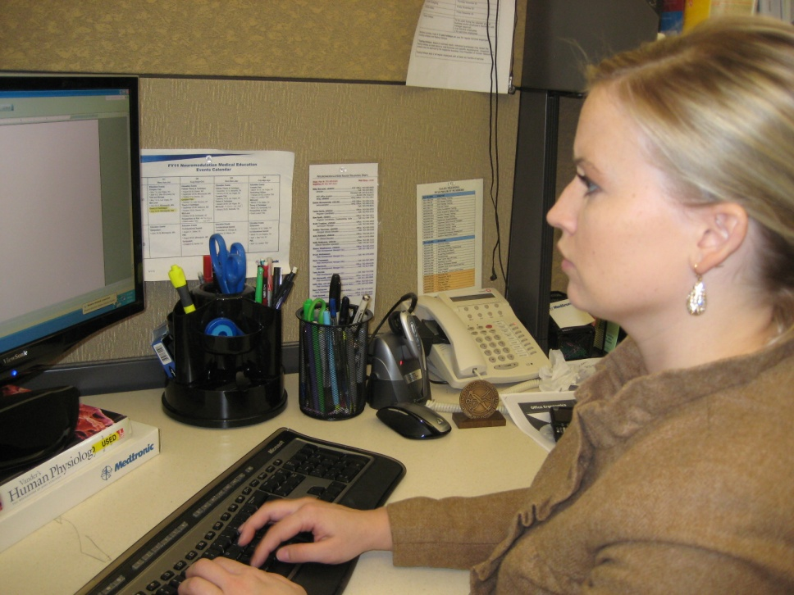
WorkWell and ErgoSystems Present:
Office Ergonomics
for Health Care Professionals
WorkWell Systems, Inc.
ErgoSystems Consulting Group, Inc.

Slide 2
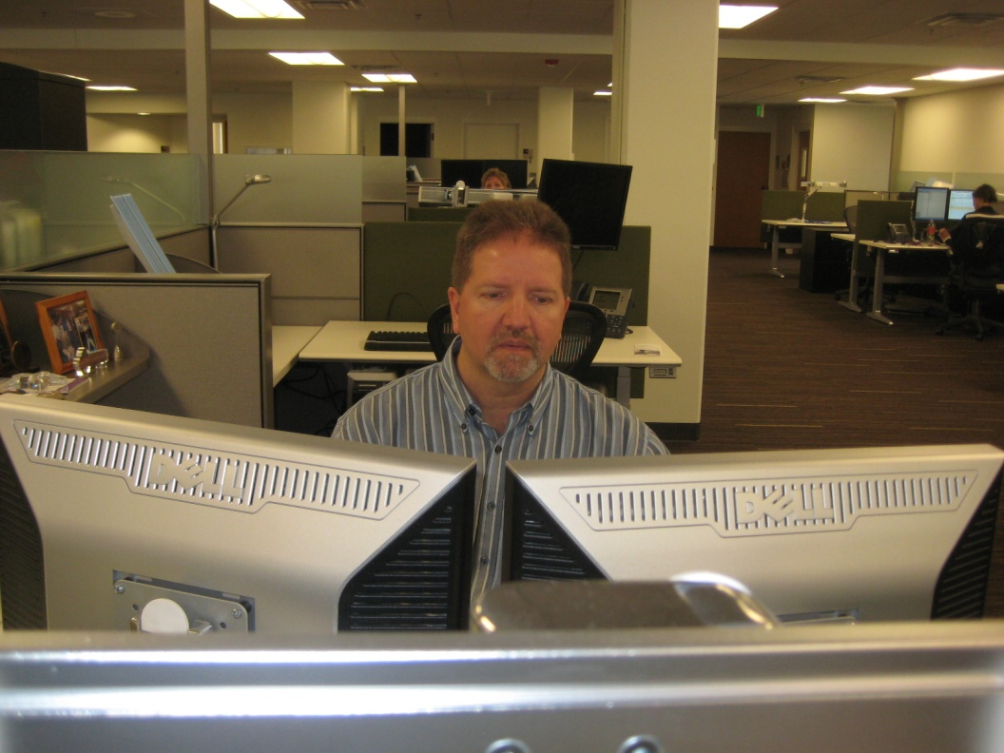
Welcome!
Objectives
Discover what Office Ergonomics is all about
Identify components that make up the successful office workspace
Learn how to analyze and setup the office workplace
Acquire confidence in using system through practice

Slide 3
Workshop Guidelines
Follow along with demonstrations unless you think they may cause you a problem
Do not go against doctor's orders or do anything that you feel you should not
If you are uncomfortable sitting during workshop, move to side or rear of classroom
Use your good judgment when trying new techniques or exercises after you leave workshop

Slide 4
Course Logistics
Manual/handouts
Course Schedule
Starting/ending times
Rest breaks
Rest rooms
Fire exits
Telephones
Messages
Group Introductions

Slide 5
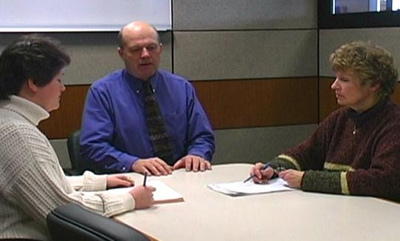
It’s all about relationships!
The relationships we form are one very important part of life
In office ergonomics, relationships between the user and the chair, workstation and equipment are also a critical component

Slide 6
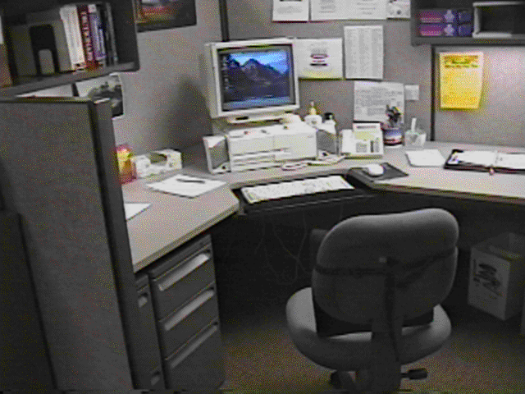
Relationships
What do you see as potentials problems in this example?

Slide 7
Discovery
You already know a good deal about office ergonomics!
You really can’t tell a whole lot until you see the workspace in use!

Slide 8
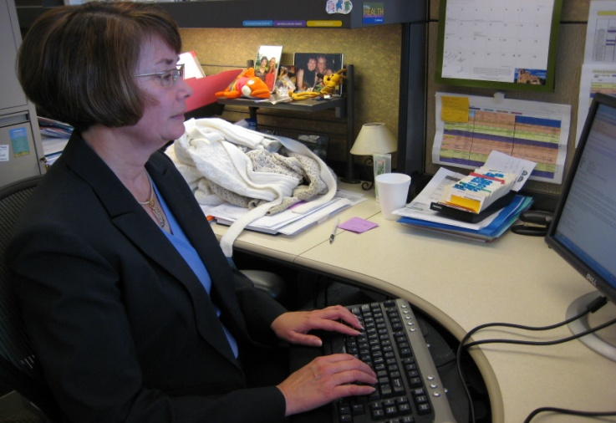
Office Ergonomics Applications
Typewriters to computers!
Where do we use computers?
EVERYWHERE!

Slide 9
Typical office components
User population profile
User – Single/Multi
Tasks – Single /Multi
Floor space
Seating system
Worksurface
Floor surface
Computer equipment
Telephone
Office equipment
Storage
Conference tables/chairs
Light
Noise
Temperature

Slide 10
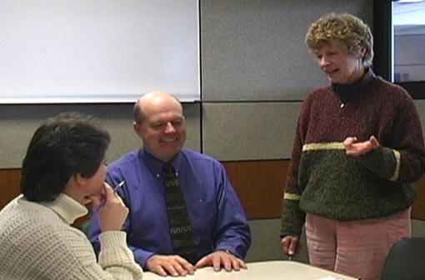
User population profile
Very important first step - accurately define user population
Age
Gender
Stature
Vision
Hand dominance
Other
Defining user profile lays the foundation for remainder of process

Slide 11
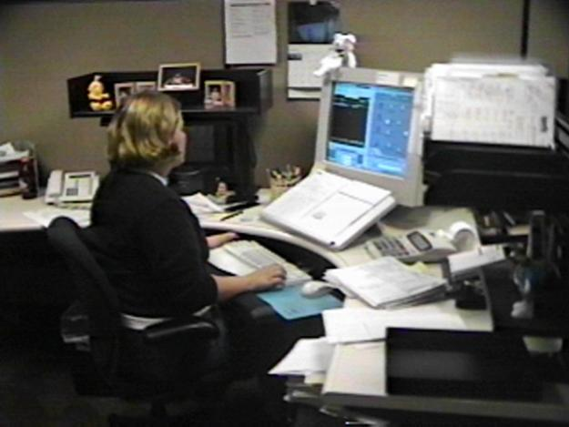
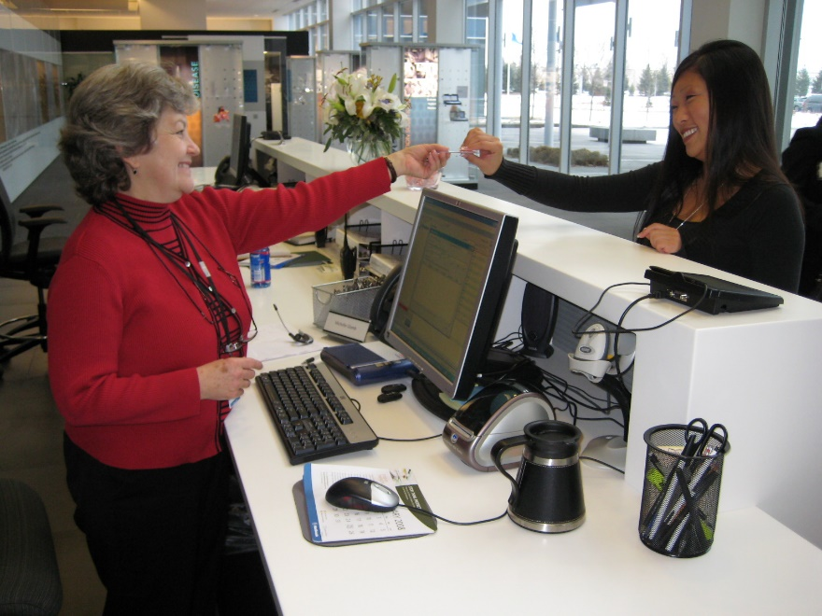
User –Single/Multi

Slide 12
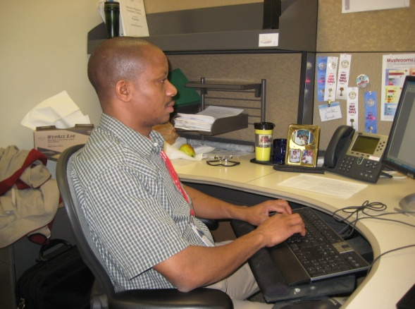
Single user
Less influenced by need for adjustability of workstation itself
Once determine proper height of worksurface
Use fixed height or adjustable/fixed worksurface
Worksurface can be height adjusted but once adjusted is not readily changed

Slide 13
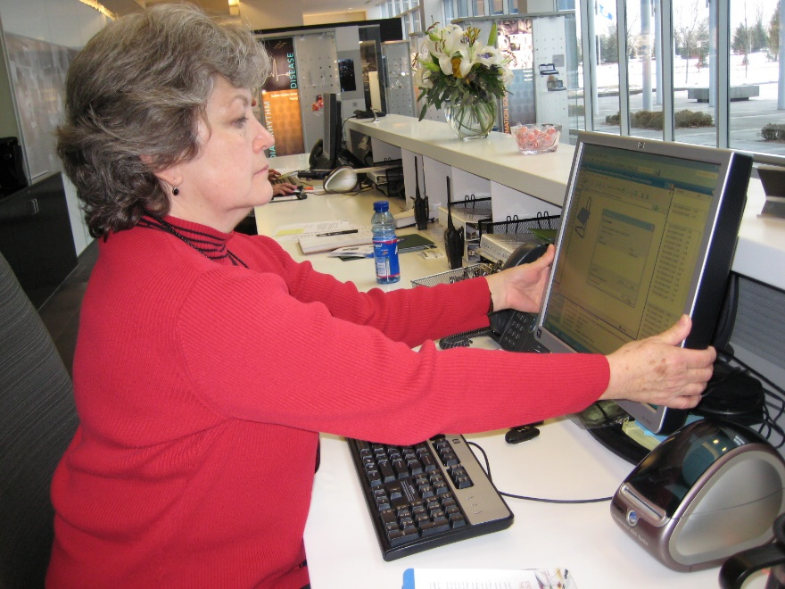
Multi user
Multi-user workstations require significantly greater degree of adjustability
Critical that changeover from one user to next accomplished quickly and easily
Adjustable/adjustable worksurface
Through spring balanced manual system/powered system worksurface height readjusted within seconds

Slide 14
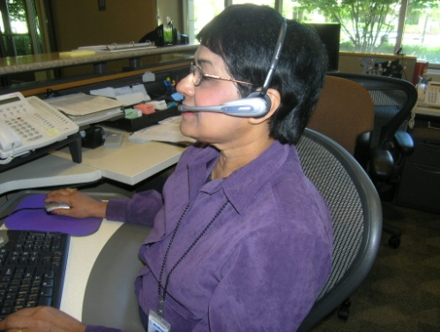
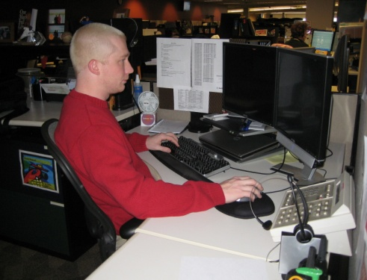
Tasks: Single-task or Multitask

Slide 15
Single-task
Majority of work time accomplishing specific focused task
For example, customer service representative majority of day on computer and telephone performing computer lookup activities
Physically job demands are concentrated in single area
Efficient set up is critical because user tends to maintain sustained position to perform activities

Slide 16
Multi-task
Number of different tasks need to be accomplished
Computer
Telephone
Writing workstation
Attending meetings
And so on

Slide 17
Work Activity (percentage breakdown)
Computer
Telephone
Read
Write
Meetings
Misc
Other

Slide 18
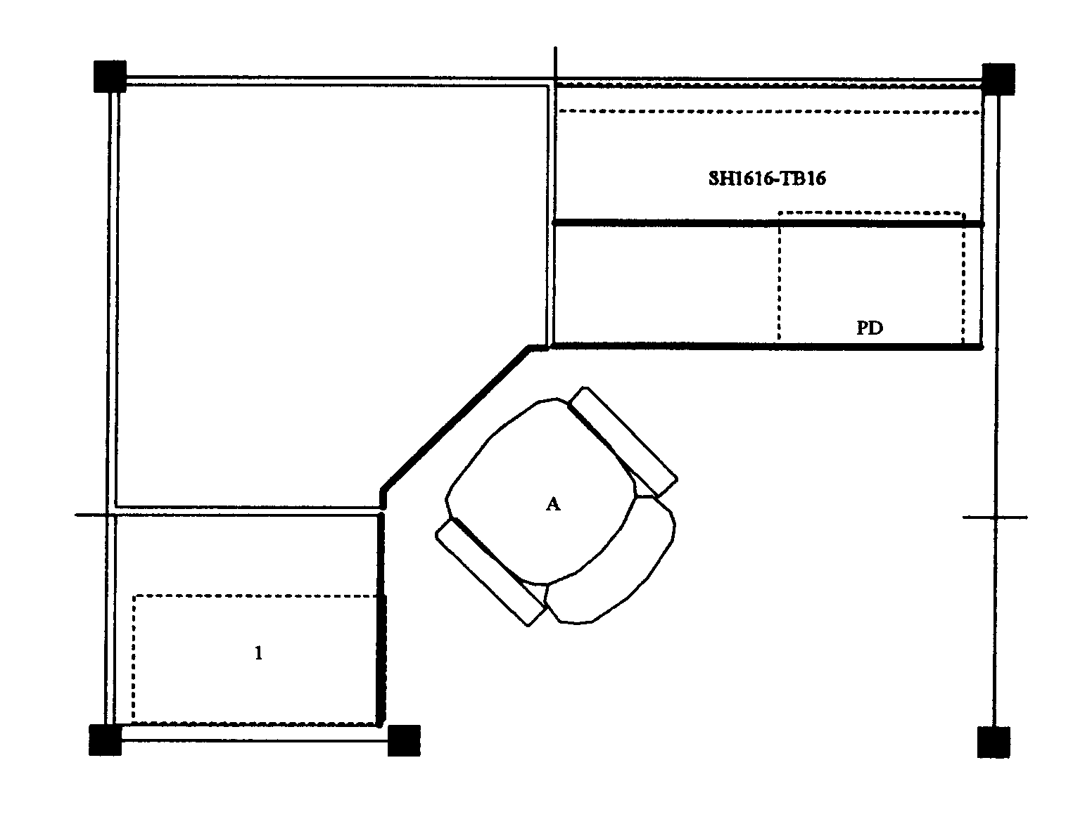
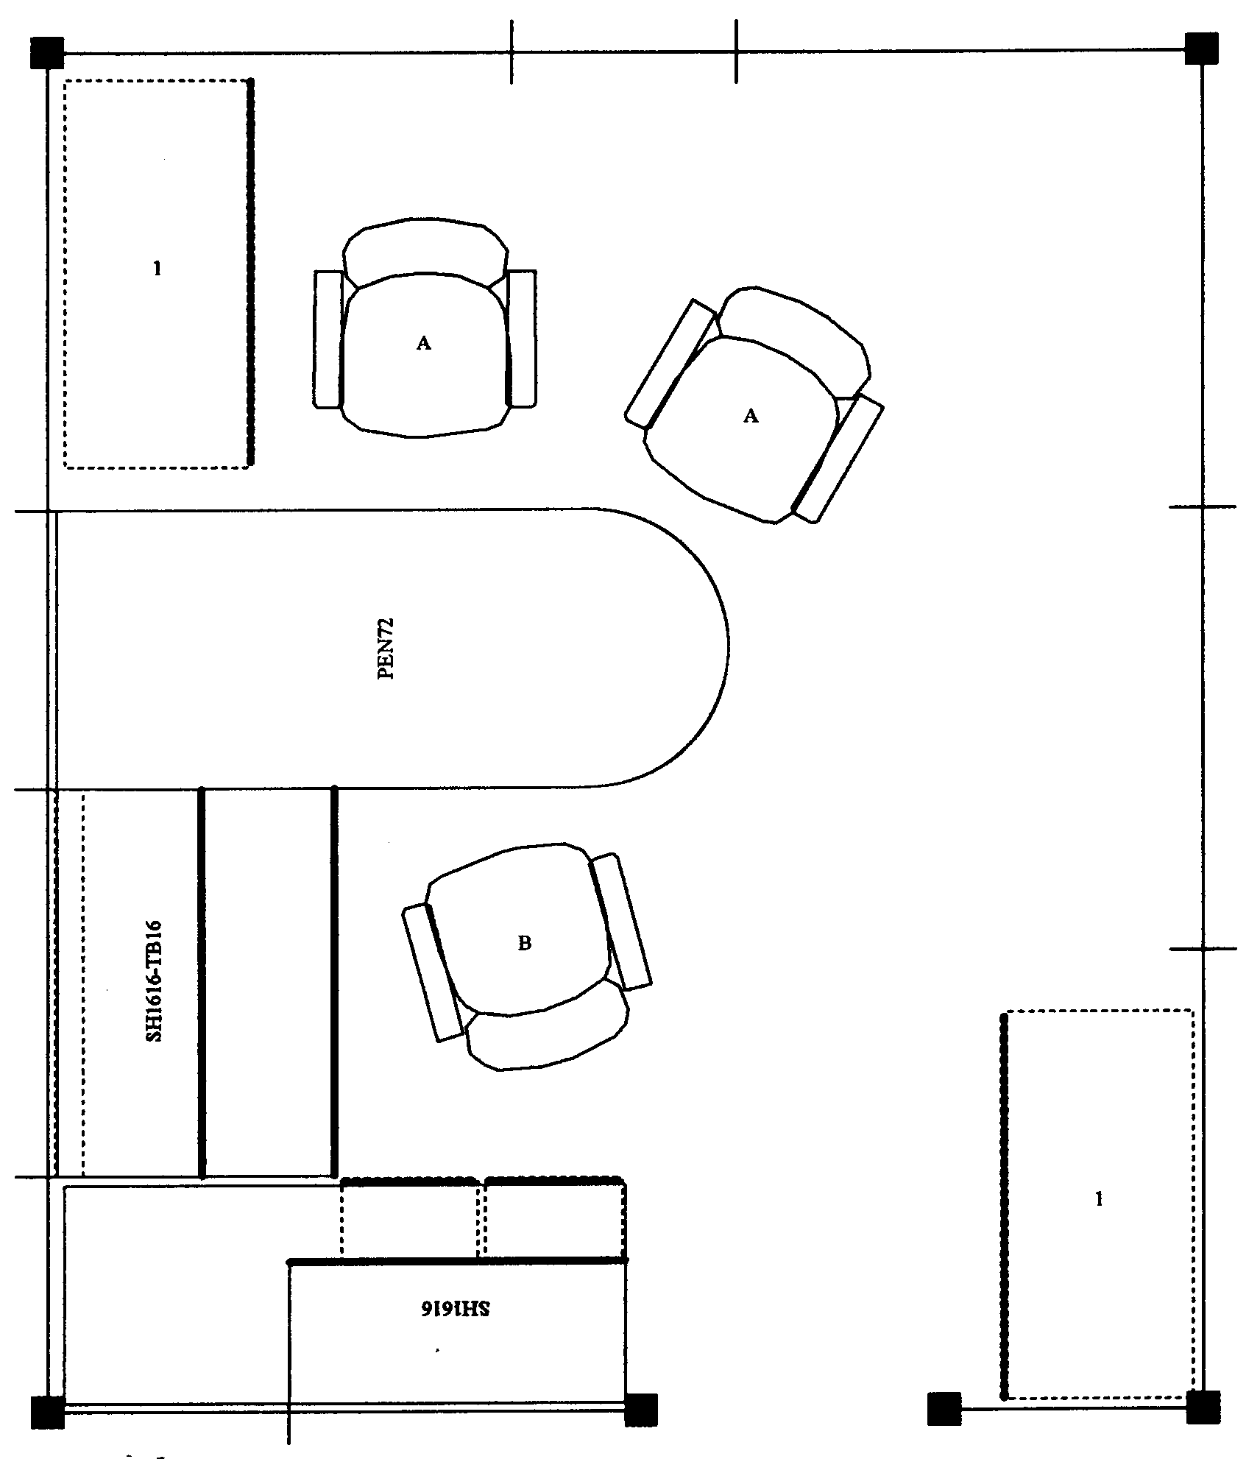
Floor space
In ideal world, dimensions of office workstation are determined exclusively by job tasks
Some very focused single-task workstations 48 sq ft
Multitask workstation 120 sq ft or even more

Slide 19
We do not live in an ideal world
Floor space may be determined by host of factors not relative to job task
Does not negate need to perform an effective job analysis to make recommendations
Does cause us in many cases to be quite creative!

Slide 20
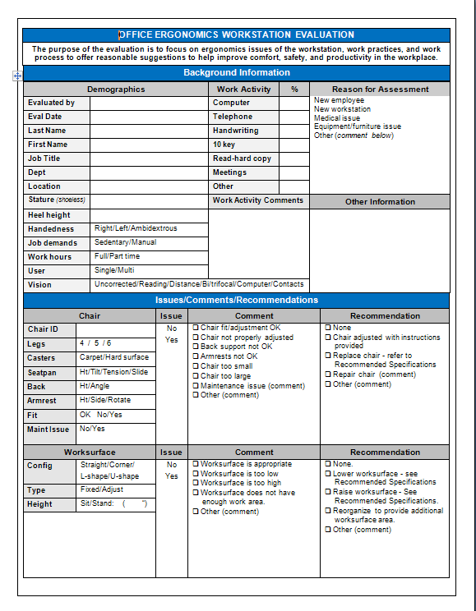
Office Ergonomics Workstation Evaluation Form

Slide 21
Office Ergonomics Workstation Evaluation Form
Background Information
Demographics
Work Activity
Reason for assessment

Slide 22
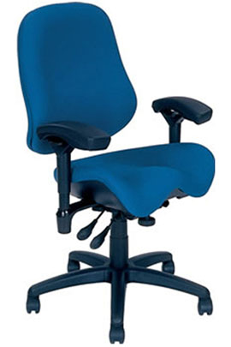
Chair
Objectives of chair
Support body and limbs to provide relief from weight bearing
Provide stable base or platform for body and limbs
Position user at correct height and reach relationship to worksurface and tasks at hand
Allow for easy change in position/movement of user

Slide 23
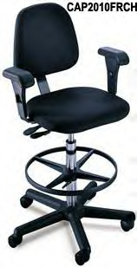
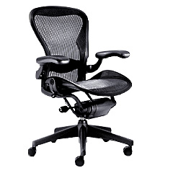
Types of seating systems
Number of seating systems available in workplace
Office chairs
Stools
Lean platforms
Other miscellaneous seating

Slide 24
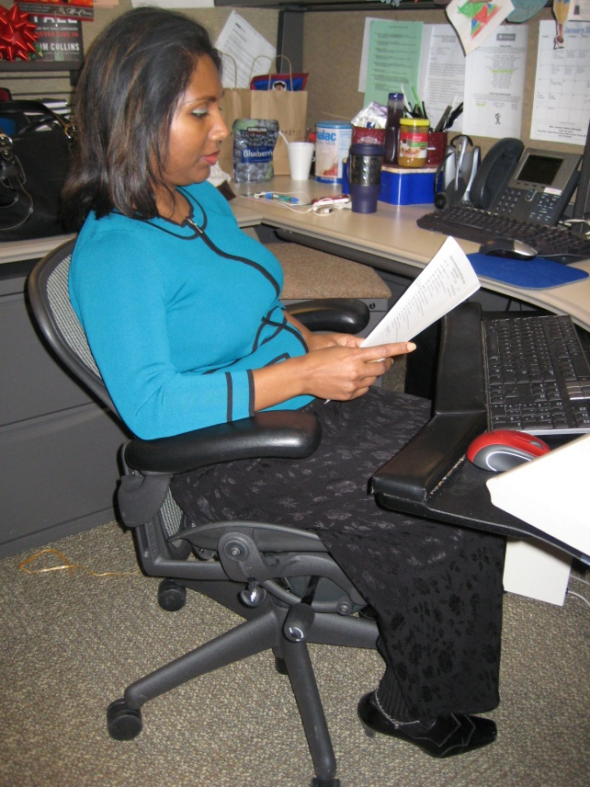
Chair criteria
Type, use and efficiency of chair are critical elements
Acceptable chair criteria determined by:
Type of job activities performed
Size and shape of user
Duration of time spent in chair

Slide 25
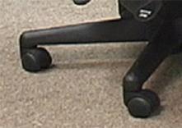
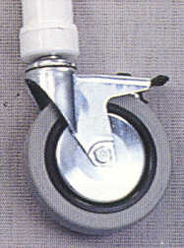
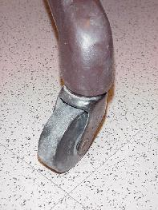
Legs and Casters
Does the chair have at least 5 legs?
Does the chair roll easily on the floor surface?
Hard caster on soft floor
Soft caster on hard floor

Slide 26
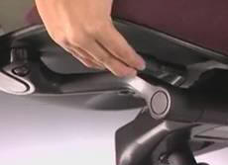
Seatpan Height
Does the chair’s seatpan height adjust up and down?

Slide 27
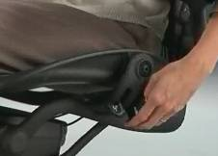
Seatpan Tilt
Does the chair’s seatpan tilt up and down?

Slide 28
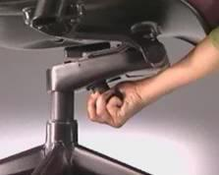
Seatpan Tension
Can you adjust the seatpan tension?

Slide 29
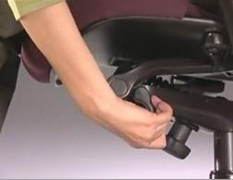
Seatpan Depth
Does the chair’s seat move forward or backward?

Slide 30
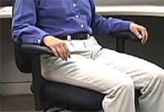
Seatpan Fit
Does the chair’s seat fit body size?

Slide 31
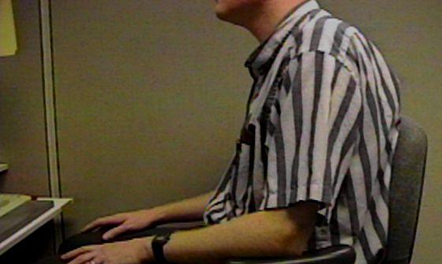
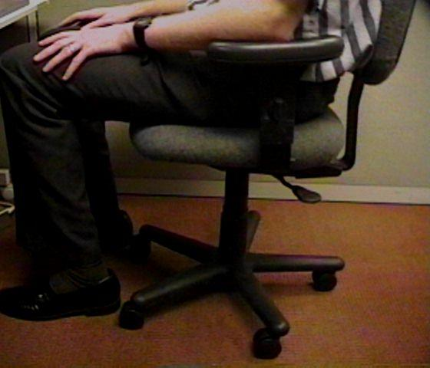
Relationships
Does the chair fit the individual?
This gentleman is 7’ tall!
Arrows point to back of knee and front edge of seatpan

Slide 32
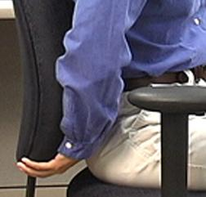
Back Support Height
Does chair’s back support move up and down?

Slide 33
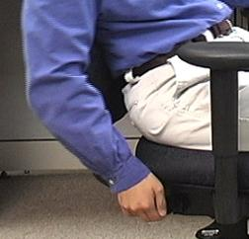
Back Support Angle
Does chair’s back rest angle forward or backward?

Slide 34
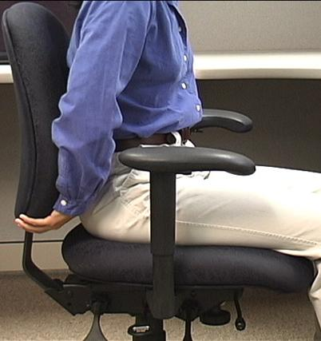
Cushion
Suitable cushion
Foam density
Wearability
Breathability
Type of material (fabric or rubberized)

Slide 35
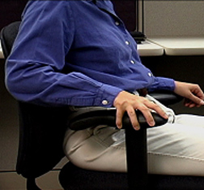
Armrests Adjust
Do chair’s armrests adjust up and down and/or side-to-side?

Slide 36
Relationships

Slide 37
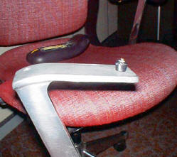
Maintenance
Is chair functioning properly?
No maintenance problems?

Slide 38
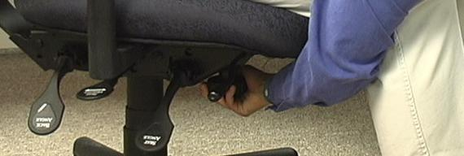
Adjustment levers/knobs/controls
Easy to reach
Easy to manipulate
Should not intimidate

Slide 39
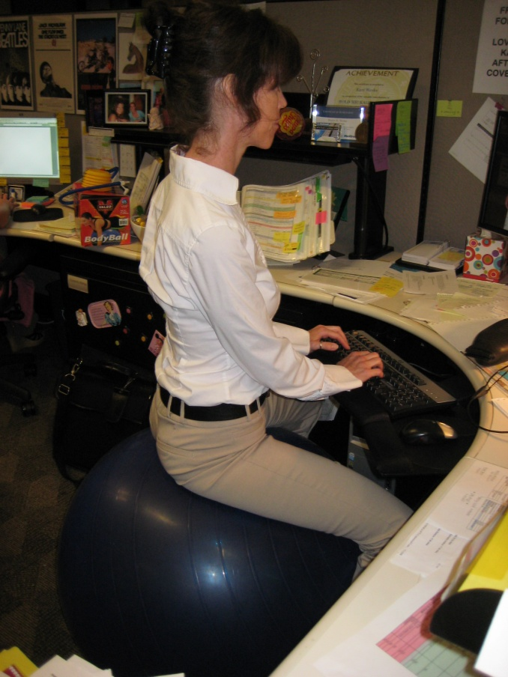
Ball Chairs?
Therapeutically, exercise balls used in clinical settings as treatment modalities
Improve spinal stability
Over past several years, use of exercise balls in place of or in addition to task chairs
Currently only anecdotal evidence exists to support full-time use
Most ergonomists advocate for properly sized/properly adjusted office task chairs rather than use of ball chairs

Slide 40
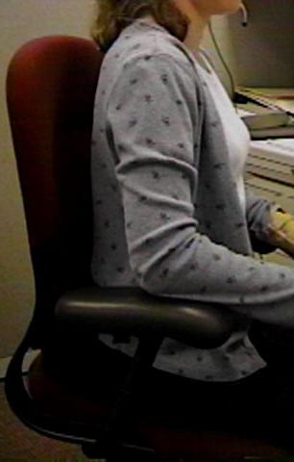
Art of Sitting
Body not designed to sit
Particularly for long periods
Studies determined even when seated in well-supported postures . . .
How soon do we want to move?
About every 20 to 30 minutes!

Slide 41
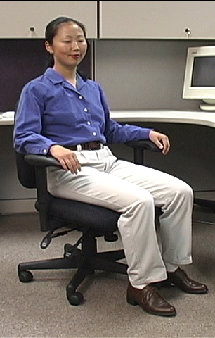
The Art of Sitting
Three point contact
Sacrum/Trunk
Hips/Thighs
Feet/Floor

Slide 42
The Art of Sitting
90/90 seated posture?
Only in drawings!
Most people will sit at 95 to 110 degrees at hips and knees

Slide 43
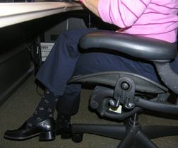
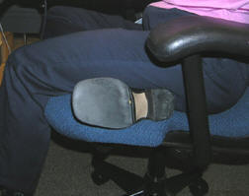
Sitting styles
Sitting styles quite varied from person to person:
Percher
Slouch
Sit crossed leg
Sit on leg

Slide 44
Sitting styles
Particular sitting style needs to be assessed
Habit developed over time
Response to poor workstation setup
Combination of both
What drives problem is frequency and duration of seated position

Slide 45
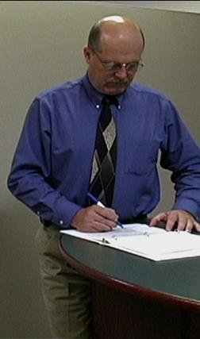
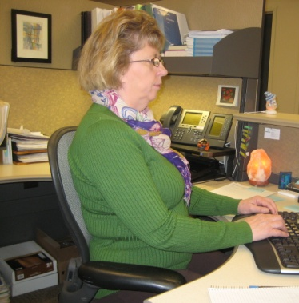
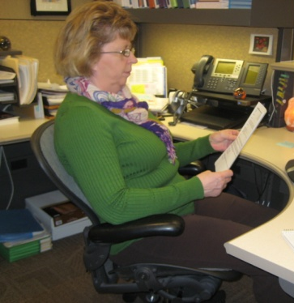
Functional seated positions
Provide for several different acceptable postures
Rotate throughout day on regular basis:
Upright “keyboard” position
Semi-reclined/rocking “conversation” position
Standing

Slide 46
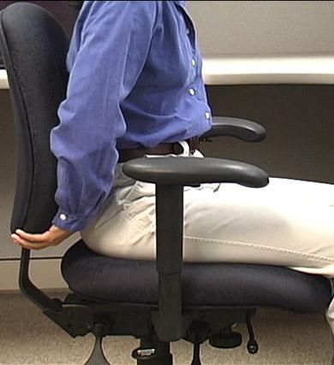
Adjustment anxiety
Chairs can be pretty expensive
All kinds of bells and whistles
Chair only as good as how it is adjusted
Some people have never adjusted their chair
Just sit down and go to work!
Bottom line
Need to initially be able to adjust chair to fit
As well as throughout day

Slide 47
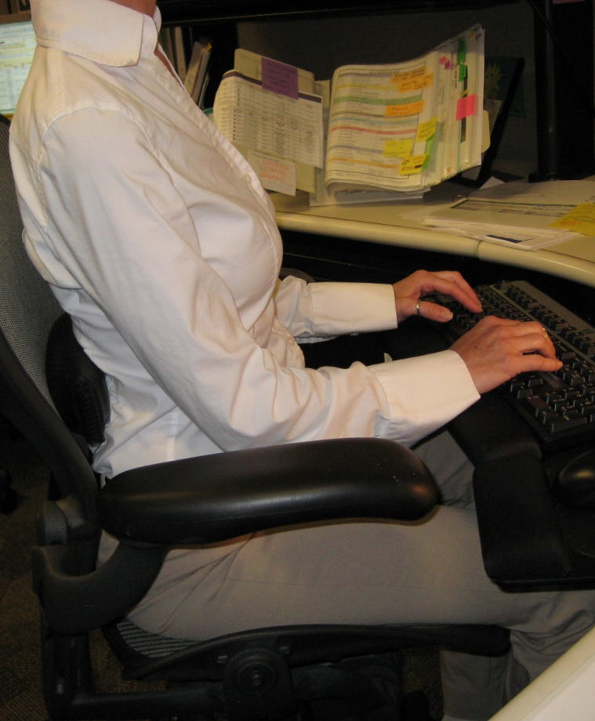
Chair solutions
Manual
Find and read it!
Position and support body in neutral
Adjust seat pan/back support tension to hold body in neutral position
Adjust seatpan height to get feet on floor with even pressure on hips and thighs
Adjust height and angle of back support to fill in low back curve

Slide 48
Relationships

Slide 49
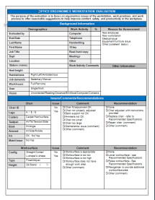
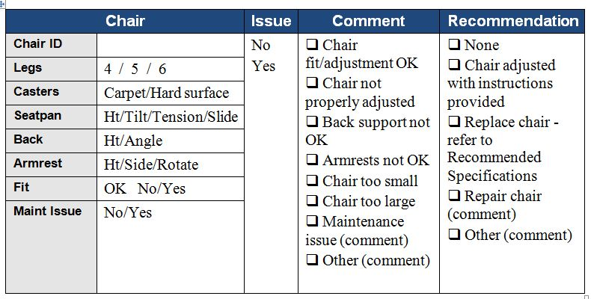
Chair

Slide 50
MOVE!
Remember, no matter how perfectly adjust chair to fit
Still comes down to fact that need to move on regular basis to keep body healthy and safe
Movement is critical to the health of the body!

Slide 51
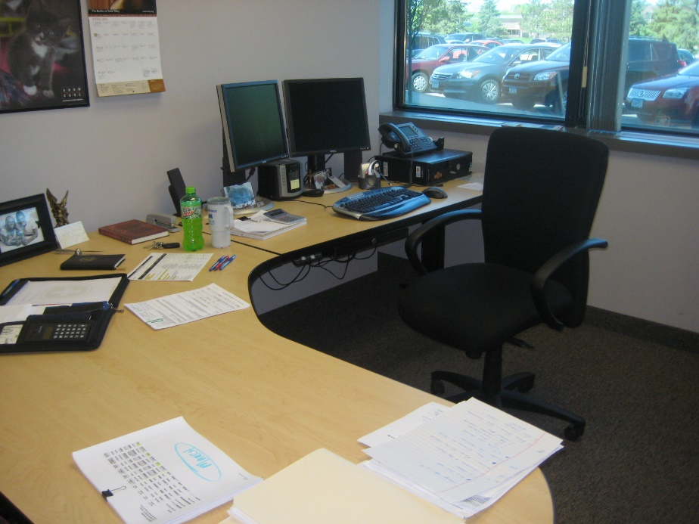
Worksurface
Worksurface objectives
Provide functional workspace (depth, width)
Support and position equipment
Provide access to work materials
Achieve desired relationship match between user/work

Slide 52
Straight line (desk/table)
The straight in-line configuration is suited for single task activities with minimal reach requirements for other office equipment and materials

Slide 53
L-shape (two worksurfaces)
L-shaped configuration is suited for single to multitask activities that require two or more separate workspaces
One workspace may be used as computer workstation and another as writing or collating workstation

Slide 54
Corner/U-shaped
Corner/U-shaped configuration well suited for multitask activities in same workspace with significant requirements to frequently reach other office equipment and materials
Allows for greatest degree of adjustability and accommodation for user

Slide 55
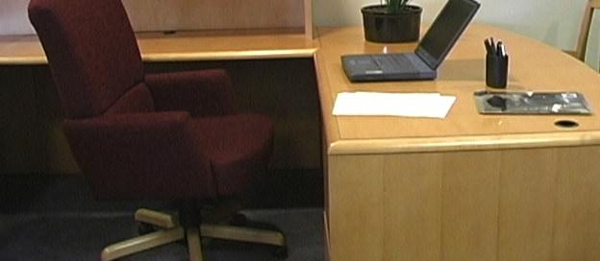
Worksurface Fixed
Traditional desk at fixed worksurface height of 29 inches - Millions of these!
Not designed to be changed in height or angle
Generally possible to raise fixed height worksurface on supports but also generally very difficult to lower it

Slide 56
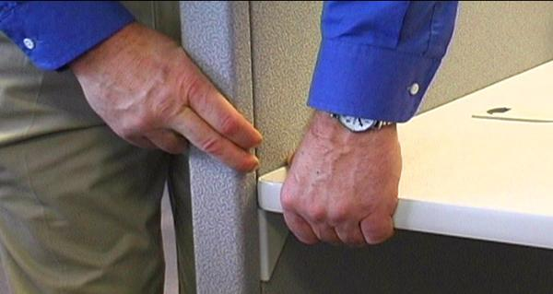
Worksurface Fixed/Adjustable
Wall panel mounted worksurface or worksurface on legs
Can be adjusted within given range but once adjusted fixed in that position on fairly permanent basis

Slide 57
Adjustable/adjustable
Sit/stand workstations
Controlled by mechanical springs or powered mechanisms
Keyboard trays
User can readily and easily adjust worksurface

Slide 58
Wrong Desk height
If work height is adjustable, adjust it as needed
Raise height of work surface by putting it up on blocks
Make sure desk or work surface is solidly placed on blocks and won’t fall off!
Adjust chair height
Make sure feet are supported either on floor or with footrest
Add height/angle adjustable keyboard tray
Mounted underneath work surface

Slide 59
Not enough layout space
House cleaning
Other worksurfaces available for use
File cabinet at standing height to review documents
Relocate some of equipment on desk
Pullout drawers already in desk

Slide 60
Sit/Stand Workstations
Worksurface at standing height
Stool
Foot rest

Slide 61
Sit/Stand Workstations
Portable system placed on desk
Adjustable keyboard/mouse and monitors
Use chair when seated

Slide 62
Sit/Stand Workstations
Height adjustable sit/stand workstation

Slide 63
Worksurface

Slide 64
Foot Support
In an ideal world the best foot support when seated in a chair is the floor . . .
However if needed use proper sized foot rest

Slide 65
Knee/foot clearance
Move what is not needed to some other storage position or get rid of it
Survey work area and determine what is blocking access

Slide 66
Foot Support/Clearance

Slide 67
Sharp edges
Proper work height in relation to worksurface edge
Many times will eliminate the issue
Pad sharp edge
If cannot eliminate pad the edge

Slide 68
Work organization
Includes organization and structure of tasks/activities performed throughout workday
e.g. Do not store file boxes on the floor

Slide 69
Work organization solutions
Space in most companies is premium
Store infrequently used items outside of immediate work environment
Pick up at end of day

Slide 70
Floor surface
Providing ease of rolling chair on floor surface
Nonskid surface to prevent slips and falls
Non glare surface to reduce overall glare in workstation

Slide 71
Computer equipment

Slide 72
Keyboards
Keyboard configurations
Straight-line
Curved
Articulated
Keyboard surface finish
Keyboard size
Keyboard activation pressure
Layout
Wireless

Slide 73
Keyboard Technique
Free float piano playing style
Use of worksurface for forearm support

Slide 74
Non-neutral Keyboard Positions

Slide 75
Keyboard Solutions
Based on technique obtain correct height, reach and angle of keyboard
Adjust keyboard height and position
Adjust worksurface height
Keyboard tray
If cannot adjust keyboard height, position chair height to place hands in neutral posture in relation to keyboard
May require support for feet if no longer touch floor

Slide 76
Wrist rests
To use or not to use . . .
That is the question!

Slide 77
Poor Technique
If technique needs improvement
Training programs that teach improved technique

Slide 78
Take break
Add stretching to day
A little post it note put on computer monitor
Software that reminds you to stretch
Old-fashioned as egg timer
Team up with someone else in office
Take advantage of natural breaks between activities
Remember to Stretch!

Slide 79
Keyboard Trays
Keyboard tray configurations
Keyboard tray size
Height adjustment
Angle adjustment
Knee clearance

Slide 80
Keyboard Tray

Slide 81
Keyboard

Slide 82
Pointing device
No not that kind of mouse!
Use mouse as little as possible
Keyboard shortcuts

Slide 83
Pointing device technique
Neutral positions
Same plane as keyboard
Mousing style or technique
Free float piano playing style
Use of worksurface for forearm support

Slide 84
Pointing Device Non-neutral Positions

Slide 85
Mouse Wrist Rests
In most cases, mouse wrist rest is not recommended
Wrist rest tends to “anchor” wrist
Excessive side-to-side deviation of hand
Straight in access
Allow forearm, wrist and hand moving as unit to manipulate mouse
Think of mouse as extension of arm NOT just extension of wrist

Slide 86
Pointing Device Solutions
Based on technique
Adjust worksurface height
Mouse tray
Cannot adjust mouse height and position
Position chair height
May require foot support
Keyboard shortcuts
Zoom with CTRL/SCROLL WHEEL

Slide 87
Choosing Correct Pointing Device

Slide 88
Mouse Setup
Buttons
Pointers
Pointer Options
Wheel
Hardware

Slide 89
Mouse

Slide 90
Computer
Where?
Computer underneath monitor
May or may not be appropriate
Don’t block ventilation
On/off and disc drives access

Slide 91
Relationships

Slide 92
Computer

Slide 93
Monitor
Everything need access to may be viewed through monitor
Watch people looking at their monitors
Almost like monitor is a vacuum cleaner
They turn it on . . . and it sucks their head right in!

Slide 94
Monitors
LCD
Factors
Physical size
Resolution
Display size
Colors
Brightness
Viewing angle

Slide 95
Monitor Alignment
Directly face primary work task
Primarily data creation or manipulation
Monitor directly in front
Primarily data entry - main focus on paper documents
Monitor slightly off to side
Copy stand to place paper documents directly in front

Slide 96
Glare
Unwanted light directed or reflected into eyes
Sources
Overhead lights
Task lights
Outside light
Any shiny surface
Any white/bright object

Slide 97
Control Glare
First step
Identify glare source
Control
Control source
Control path

Slide 98
Use glare screen
Get what you pay for
Inexpensive glare screen is generally just wire mesh
Will cut glare at expense of character quality
Good quality optical glass glare screen
Don’t have light source such as window directly behind monitor
Reposition monitor
Shade window

Slide 99
Adjust monitor screen brightness and contrast

Slide 100
Monitor Resolution
Pixel (picture element)
640 by 480
800 by 600
1024 by 768
1600 by 1800
Guideline
Set LCD monitor resolution to the native resolution
Typically the highest it will go

Slide 101
Monitor Height
Where do we naturally read?
We read looking out and down

Slide 102
Monitor Height
Top of screen no higher than eye level
Look out and use downward eye movement to look at lower part of screen

Slide 103
Monitor too high
If screen too high
Forces eyes wider open than usual
Less tearing - eyes become more dry
Tip head back putting additional strain into neck and shoulders
Solutions
Lower monitor
Raise chair
Lower worksurface

Slide 104
Monitor too low
If screen too low
Head forward
Solutions
Adjust monitor stand – if adjustable
Monitor stands/Risers
Monitor arms

Slide 105
Monitor Distance
Eyes
Accommodation Convergence
Guideline
Get screen as far away from user as possible
At least arm’s length
Still be able to read it clearly with good posture

Slide 106
Monitor too far away
Slide screen towards user

Slide 107
Monitor too close
Reconfigure monitor placement on desk
Add keyboard tray
At minimum push chair back from worksurface to give eyes a break

Slide 108
Dirty monitor screens
On regular basis clean monitor screen
Only use approved cleaning measures

Slide 109
Dual Monitors
Primary/Primary
Primary/Primary

Slide 110
Dual Monitors
Primary/Secondary
Primary/Secondary

Slide 111
Eye Examinations
Regular eye examinations
Eyewear prescriptions changes
Eye health in general
Based on job task

Slide 112
Presbyopia
Age-related process
Slow loss of flexibility within lens inside eye
Result maybe head tip
Solutions
Bifocals
Computer glasses
Progressive lens
Lower monitor

Slide 113
Monitor

Slide 114
Document holder
Horizontal vs. inclined

Slide 115
Document holders
Landscape
Portrait
Read Write Stand

Slide 116
Document Holder

Slide 117
Laptops
Design violates basic ergonomic principles
Fixed position keyboard and monitor

Slide 118
Occasional Laptop User
Occasional Users
Better off sacrificing neck posture rather than wrist posture
Find comfortable chair
Position in lap or on table for most neutral wrist posture that you can achieve
Angle laptop screen so can see with least amount of neck deviation

Slide 119
Full-time Laptop User
Use separate keyboard/mouse
Port replicator/docking station
Position on desk/worksurface to see screen without bending neck
Elevate off desk surface using stable support surface, such as computer monitor pedestal
Follow postural guidelines for working at computer workstation
Transport with bag or wheeled cart

Slide 120
Telephone
Frequency and duration
More than 1 to 2 hours/day
More than 1 to 2 minute calls
Should have hands free to operate equipment

Slide 121
Telephone Types
Handsets
Awkward head, neck and arm position
Shoulder cradle
Still have awkward head, neck and arm position

Slide 122
Telephone Types
Headsets
Wireless
Bluetooth

Slide 123
Telephone

Slide 124
Handwriting/Reading
Use good old pen and paper
The paperless office?

Slide 125
Solutions
Inclined
Document stand or podium
Gripping
Is it really true, harder you squeeze more ink will come out?

Slide 126
Office equipment
Make use of principles to position office equipment
Calculator
Printer
Fax
Writing utensils
Scissors
Paper clips
Stapler
Stuff

Slide 127
Relationships

Slide 128
Storage/Reach zone
Primary
Frequently accessed from seating system
Within easy reach
Secondary
Occasionally accessed
Located in gray zone
Danger Zone!
Tertiary
Very occasionally accessed
Have to get up and move to access

Slide 129
Storage
Storage types
Vertical storage racks
Horizontal storage bin
Wall hanging storage
File cabinet types
Vertical
Lateral
Rolling
Don’t overfill
50 files in cabinet that holds 30!

Slide 130
Storage
Don’t overfill
50 files in cabinet that holds 30!
Purge on regular basis
Position commonly accessed file in suitable reach zone

Slide 131
Storage

Slide 132
Conference rooms
How to enhance audience reception of information
Lack of physical movement
132

Slide 133
Conference Rooms
Look for as many opportunities as possible to move as part of meeting
Standing mixed in with sitting
Bring in small footrest or back cushion
133

Slide 134
Lighting – General and Task

Slide 135
Light solutions
Too much
Turn out lights
Too little
Add overhead lights
Add indirect lights
Bounce light off of ceiling and walls
Add task light
Desktop or wall panel lamp
Position light carefully
Lighting Design

Slide 136
Illumination

Slide 137
Noise
Office can be noisy place
Contributing factor to fatigue and general stress
Noise level
Too much noise
Too little noise
Noise source
Figure out where noise is coming from

Slide 138
Control Noise
People noise
Limit volume and length of conversations
Make good use of more public areas or conference rooms
Equipment noise
Move equipment
Noise enclosures
White noise

Slide 139
Temperature
Never agree on same temperature!
We have different “internal thermostats”
Too hot!
Too cold!

Slide 140
Temperature solutions
Survey group
General consensus
Controls
Window shade
Sweater
Personal fan

Slide 141
Recommended Specifications

Slide 142
Follow-up

Slide 143
Office Ergonomics Assessment Guidelines

Slide 144
Assessment Steps
Background Information
Job Tasks
Chair
Worksurface
Computer and Office Equipment
Environmental Factors
Recommended Workstation Setup and Specifications
Summarize Issues and Recommendations
Follow-up

Slide 145
Ergonomics – A Potent Tool!
Great number of factors enter into the office ergonomics workplace
Use the principles and ergonomics analysis process to offer solutions that are practical and effective!

Slide 146
THANKS!

Slide 147
WorkWell and ErgoSystems Present:
Office Ergonomics
for Health Care Professionals
WorkWell Systems, Inc.
ErgoSystems Consulting Group, Inc.

