Slide 1
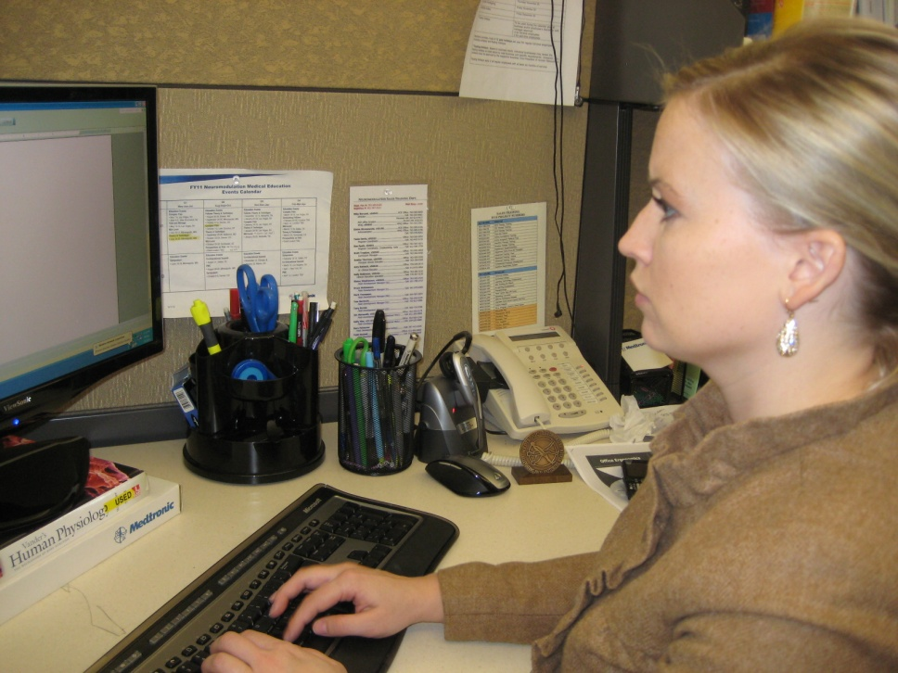
WorkWell and ErgoSystems Present:
Office Ergonomics: Introduction for Health Care Professionals (Online)
WorkWell Systems, Inc.
ErgoSystems Consulting Group, Inc.

Slide 2
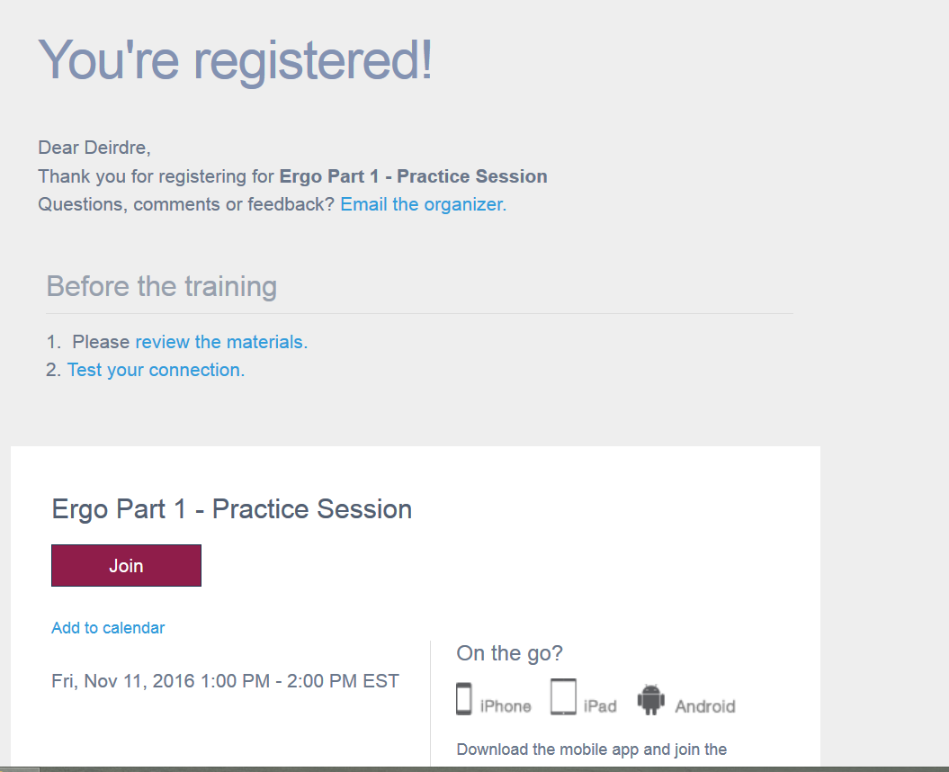
Click this link to download important files.
Test your connection if you are new to online training

Slide 3
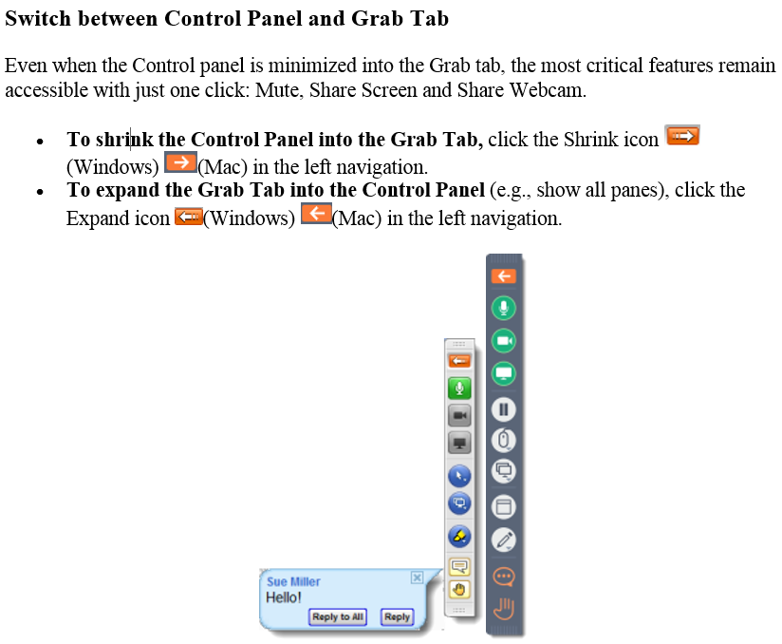
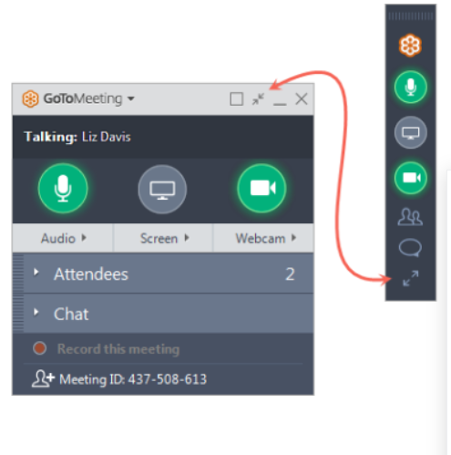
GoToTraining - Continued
Open/Close the Control Panel or Grab Bar

Slide 4

Course Logistics
GoToTraining with Call In
Manual/Downloads via email
Attendance Log
Course Schedule
  Starting/ending times
  Breaks
  Online Test
Group Overview
Telephones- Use MUTE, not hold

Slide 5
Schedule

Slide 6
Learning Objectives
Explain the relationships between office users and common office components related to providing support to the body, completion of work and common work organizational strategies.
Apply data collection elements to case information using a work station evaluation form, including breakdown of work activity, related measurements and identification of risk factors.
Determine appropriate office set up/modifications by participating in a video case study
Complete a post-test with a score of 80% or more based on the principles and practical application of office ergonomics presented in the course.

Slide 7
Faculty- Kristen Cederlind, OTR/L
Kristen Cederlind, OTR/L joined the WorkWell team in 2013, first serving as a Manager of On-Site Services and, more recently, assuming the role of Director of the WorkWell Quality Provider Network. With over 25 years of experience as an Occupational Therapist, she has consulted with manufacturing employers across the country to develop customized On-Site therapy and wellness programs to improve employee health and safety, while collaborating with the rest of the On-Site team in service implementation, provider training, customer and provider relations and metrics reporting. Her background includes program development and management of a hospital acute care and outpatient rehabilitation department. Her partnership with WorkWell began in 2003, when the hospital joined the WQP network and received training in FCE, FJA and PWS programs. While working in the hospital setting, she championed ergonomics initiatives such as safe patient handling and office ergonomics, and was able to utilize job analysis and prework screening skills both within the hospital and in her local community.
Kristen is a graduate of the University of Southern California and is a member of both the California and American Occupational Therapy Associations

Slide 8
Faculty - Deirdre “Dee” Daley, PT, DPT
Dee Daley, PT, DPT is a graduate of the University of North Carolina- Chapel Hill and Quinnipiac College physical therapy programs. Dee is currently employed by WorkWell in New Ipswich, NH as Director of Clinical Practice. Dee has been a member of the WorkWell faculty since 2003, and intermittently teaches as a guest lecturer for PT and PTA schools on topics related to Work Injury Prevention and Management. Dee also holds a degree in Health Professions Education from North Carolina State University.
In addition to clinical practice, Dee has been active in the New Hampshire and North Carolina Chapters of the American Physical Therapy Association (APTA) as President and other roles in the area of Education and Policy. In addition to helping develop training materials for WorkWell, she has coauthored several publications on the Role of PT in Occupational Health and Wellness, and Safety in Functional testing. She has also served as a member of the APTA as a working member of the Occupational Health Special Interest Group and Work Rehab Clinical Practice Guideline group.

Slide 9
Faculty - Robin Peterson, PT
Robin Peterson PT is a graduate of the University of Minnesota Physical Therapy Program. Robin is currently employed by Regions Hospital in St. Paul MN as Physical Therapist and Supervisor. Robin has been a faculty member and consultant for WorkWell since 2008. Robin also holds a Bachelor of Arts degree in Distributive Sciences and Psychology from Gustavus Adolphus College in St. Peter MN.
In addition to clinical practice and consulting, Robin Peterson has been an active member in the MN chapter of the APTA since 1987, and has served as the physical therapy alternate member for the MN Medical Services Review Board with the Department of Labor and Industry since 2002. Robin Peterson is also a member of the National Association of Occupational Health Providers and Human Factor Society. She co-authored Smart Tracks patient management system, Volumes I and II.

Slide 10
Faculty - Marc Yeager, PT, MPT
Marc Yeager, MPT, is a graduate of Loma Linda University, where he received a bachelor’s degree in Life Sciences and a Master of Physical Therapy degree in June 1993. Marc is the Managing Principal of Injury Prevention & Management Consulting.
Marc has been a member of the American Physical Therapy Association since 1994 and the Georgia Physical Therapy Association since 1997. He has been a faculty member for WorkWell Systems since 2006. He achieved the distinction of WorkWell Master Clinician in 2001 with certifications in Functional Capacity Evaluations, Functional Job Analysis, Return to Work Clinical Pathways, Functional and Office Ergonomics.
Marc founded Highland Park Physical Therapy in 2001, shortly before joining WorkWell Systems as an Occupational Health Specialist developing injury prevention and management programs, including Rapid Return to Work, Stress Factor Analysis, and supportive training materials, in addition to implementing internet-based injury prevention and management programs for industrial clients. Marc has assisted in the development and implementation of on-site ergonomic programs for a Silicon Valley-based high-tech Fortune 100 Company, and served as a member on their ergonomic safety committee as an external consultant.

Slide 11
Disclosure
WorkWell has some degree of financial and non-financial relationships with providers through our business model.
WorkWell focuses sales of services predominantly at a national level, contracting with provider groups instead of operating a brick and mortar operation business model.
WorkWell has a commercial interest in both delivering educational programs and delivering prevention and work disability rehabilitation/management programs (generally to employers).
There is no exclusivity requirement against sites participating in training from other vendors, nor any requirement to accept work on individual contract/s offered by WorkWell.
Clinics who foster local employer contracts and seek to expand the footprint of those contracts may negotiate with WorkWell to help leverage resources and/or partner to expand.
There is not an implied or specific promise of additional contracting or business opportunities related to participant attending educational programs.

Slide 12
Learning Environment and Non Discrimination
WorkWell is committed to a supportive learning environment, and seeks to provide professional development opportunities which are accessible and free from discrimination.
WorkWell does not discriminate on the basis of race, color, national origin, religious affiliation, sex, gender, disability, military status, sexual orientation or age and expects course participants to adhere to those principles.
Special Needs
Participants who have special needs are encouraged to contact WorkWell so that reasonable efforts to accommodate these needs can be made.

Slide 13
Participation Attendance Policy
WorkWell wants to ensure a suitable learning environment and conditions free from distraction to optimize participation.
Participation in the entire training is Mandatory.
Registrants who arrive late or miss portions of the workshop will NOT be eligible for certificate or refund.
Attendance Sheets (on-line courses)
Faculty will complete an Attendance log at program initiation and completion as well as following break/s.
Online platforms allow faculty to monitor attendee engagement

Slide 14
Certificates of Completion
Certificates of completion will only be provided to individuals who meet the course requirements and attend all training sessions.
Individuals who do not complete the training sessions will not be eligible for certificates of completion (a letter of attendance documenting time attended may be provided)
Course Evaluation
A course evaluation must be completed by each participant, prior to issuing a certificate of completion or certificate of attendance.
Course evaluations will be distributed electronically
Copyright
Reminder - As part of your registration and accessing the course materials, you agreed “to adhere to the WWPC copyright policy which can be viewed at http://www.workwell.com/general-course-information/.”

Slide 15
WorkWell and ErgoSystems Present:
Office Ergonomics: Introduction for Health Care Professionals (Online)
WorkWell Systems, Inc.
ErgoSystems Consulting Group, Inc.

Slide 16
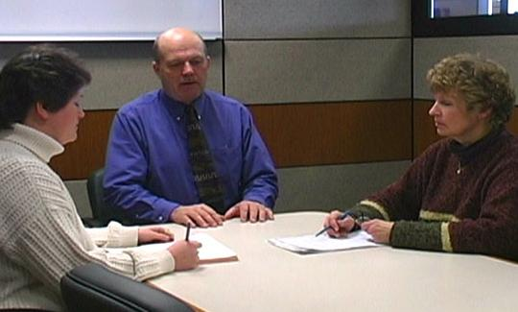
It’s all about relationships!
The relationships we form are one very important part of life
In office ergonomics, relationships between the user and the chair, workstation and equipment are also a critical component
Polls

Slide 17
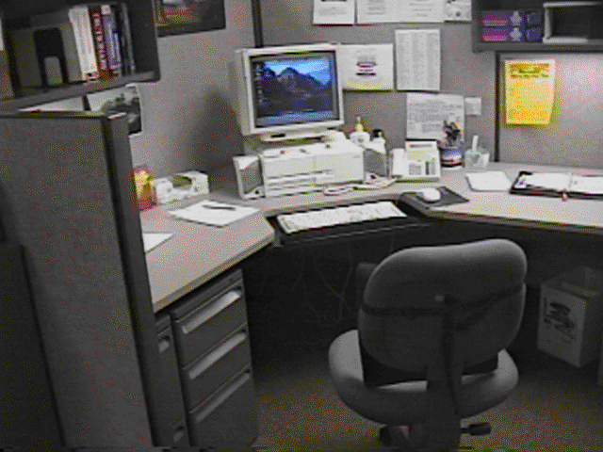
Relationships
What do you see as potentials problems in this example?
You really can’t tell a whole lot until you see the workspace in use!

Slide 18

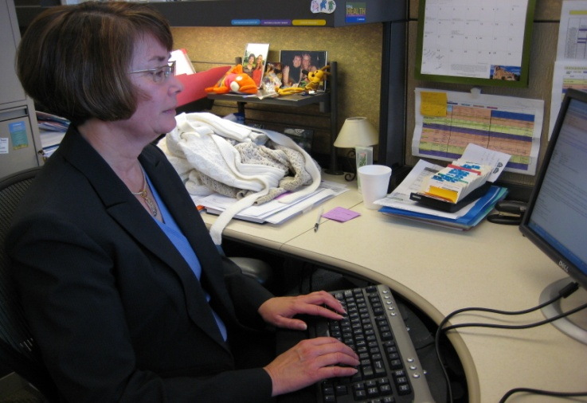
Office Ergonomics Applications
Typewriters to computers!
Where do we use computers?
EVERYWHERE!

Slide 19
Typical office components
User population profile
User – Single/Multi
Tasks – Single /Multi
Floor space
Seating system
Worksurface
Floor surface
Computer equipment
Telephone
Office equipment
Storage
Conference tables/chairs
Light
Noise
Temperature

Slide 20
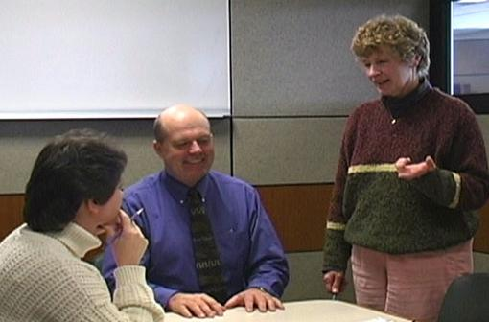
User population profile
Very important first step - accurately define user population
  Age
  Gender
  Stature
  Vision
  Hand dominance
  Other
Defining user profile lays the foundation for remainder of process

Slide 21
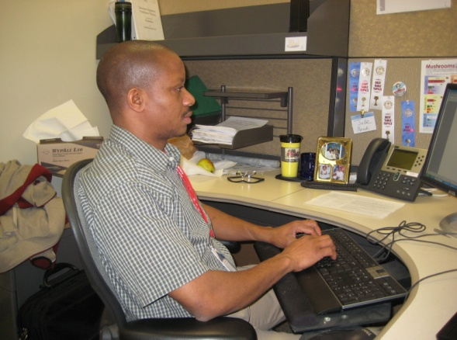
Single user
Less influenced by need for adjustability of workstation itself
Once determine proper height of worksurface
  Use fixed height or adjustable/fixed worksurface
  Worksurface can be height adjusted but once adjusted is not readily changed

Slide 22
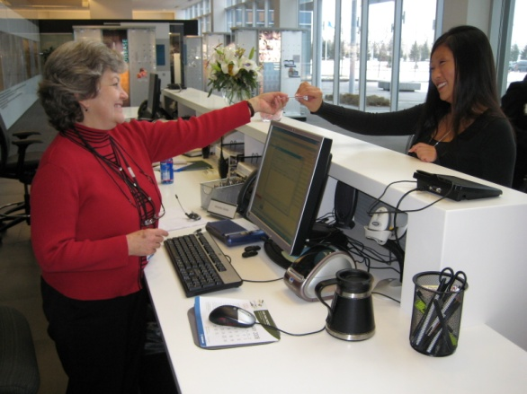
Multi user
Multi-user workstations require significantly greater degree of adjustability
Critical that changeover from one user to next accomplished quickly and easily
Adjustable/adjustable worksurface
  Through spring balanced manual system/powered system worksurface height readjusted within seconds

Slide 23
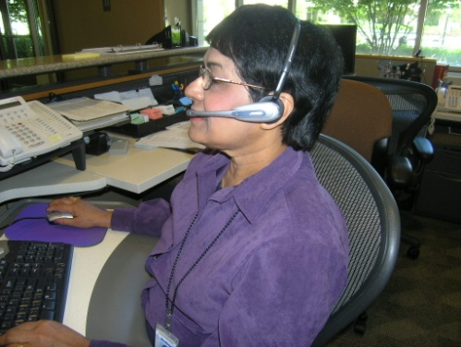
Single-task
Majority of work time accomplishing specific focused task
For example, customer service representative majority of day on computer and telephone performing computer lookup activities
Physically job demands are concentrated in single area
Efficient set up is critical because user tends to maintain sustained position to perform activities

Slide 24
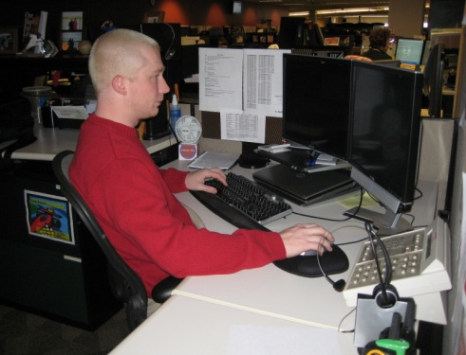
Multi-task
Number of different tasks need to be accomplished
  Computer
  Telephone
  Writing workstation
  Attending meetings
  And so on
Poll

Slide 25
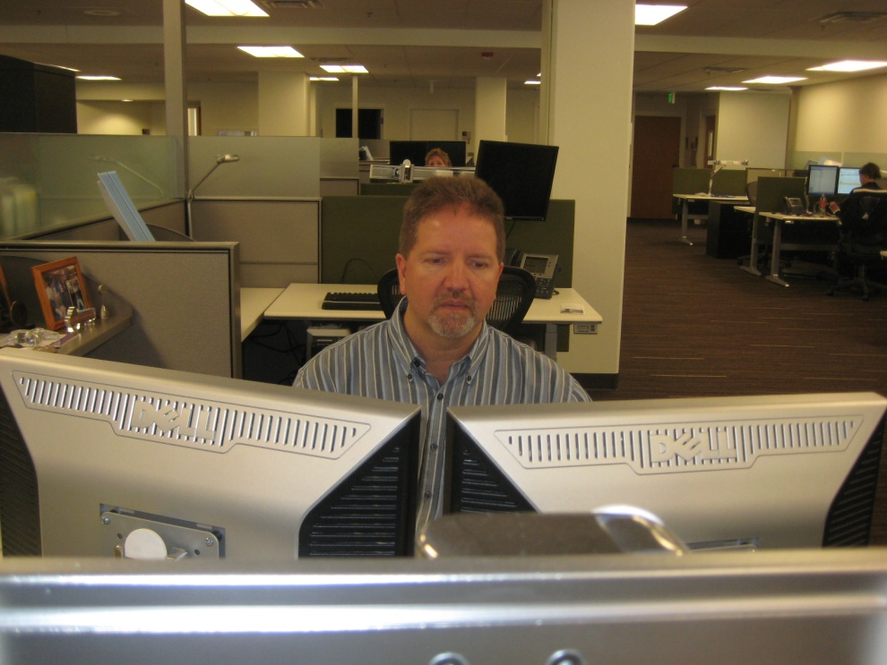
Work Activity
(percentage breakdown)
Computer
Telephone
Read
Write
Meetings
Misc
Other

Slide 26
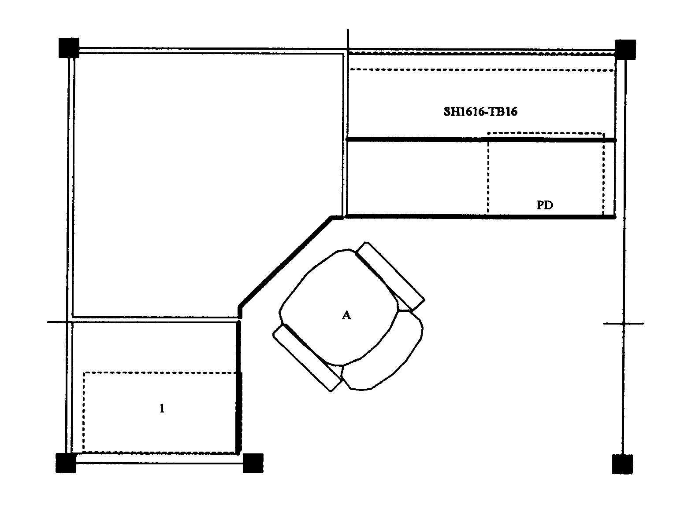
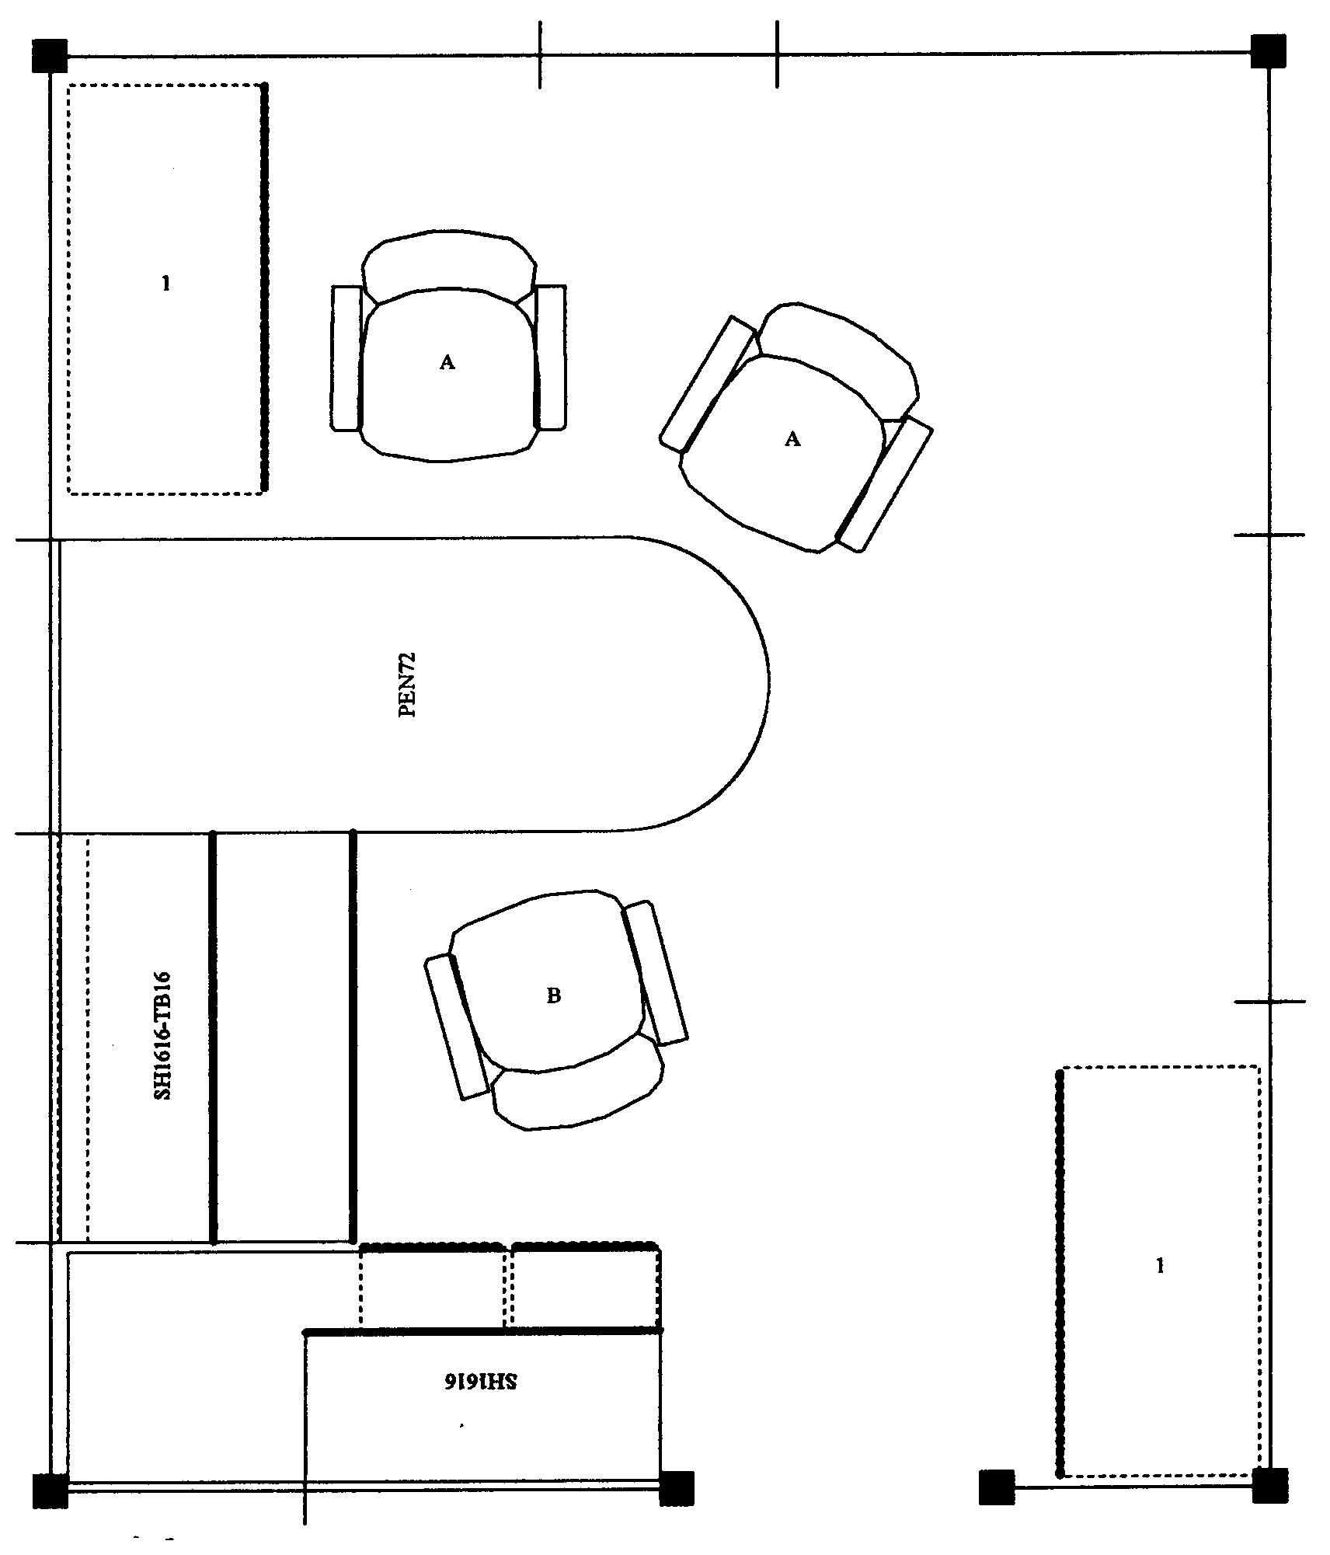
Floor space
In ideal world, dimensions of office workstation are determined exclusively by job tasks
  Some very focused single-task workstations 48 sq ft
  Multitask workstation 120 sq ft or even more

Slide 27
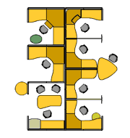
We do not live in an ideal world
Floor space may be determined by host of factors not relative to job task
Does not negate need to perform an effective job analysis to make recommendations
Does cause us in many cases to be quite creative!

Slide 28
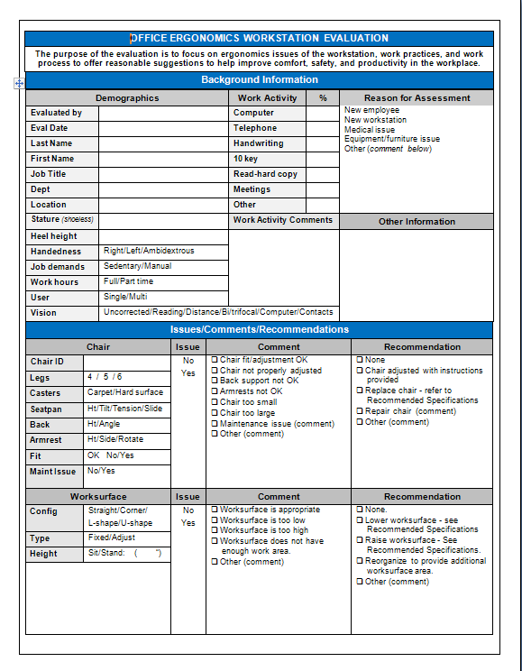
Office Ergonomics
Workstation Evaluation Forms
Downloads include Office Ergo Workstation Evaluation and Short Assessment

Slide 29
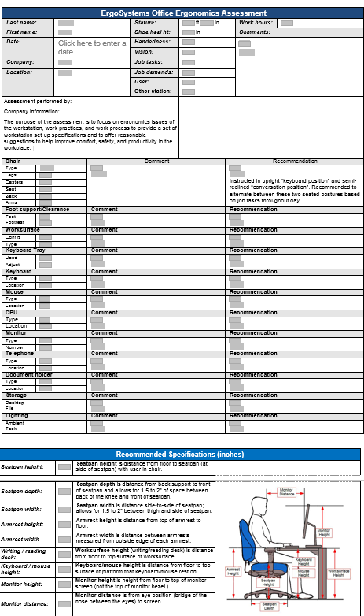
Short Evaluation Form
Longer form has more detail in each area

Slide 30
Office Ergonomics
Workstation Forms
Background Information
Demographics
Work Activity
Reason for assessment

Slide 31
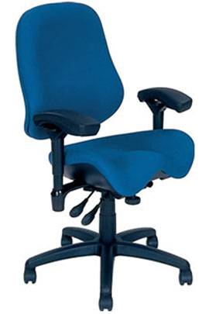
Chair
Objectives of chair
  Support body and limbs to provide relief from weight bearing
  Provide stable base or platform for body and limbs
  Position user at correct height and reach relationship to worksurface and tasks at hand
  Allow for easy change in position/movement of user
Poll

Slide 32
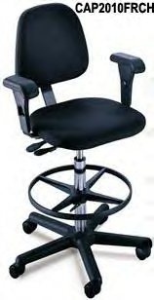
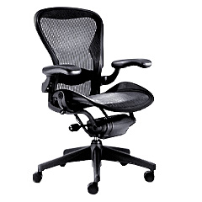
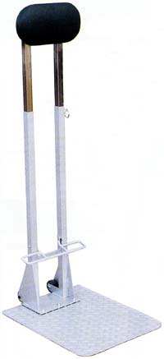
Types of seating systems
Number of seating systems available in workplace
  Office chairs
  Stools
  Lean platforms
  Other miscellaneous seating

Slide 33
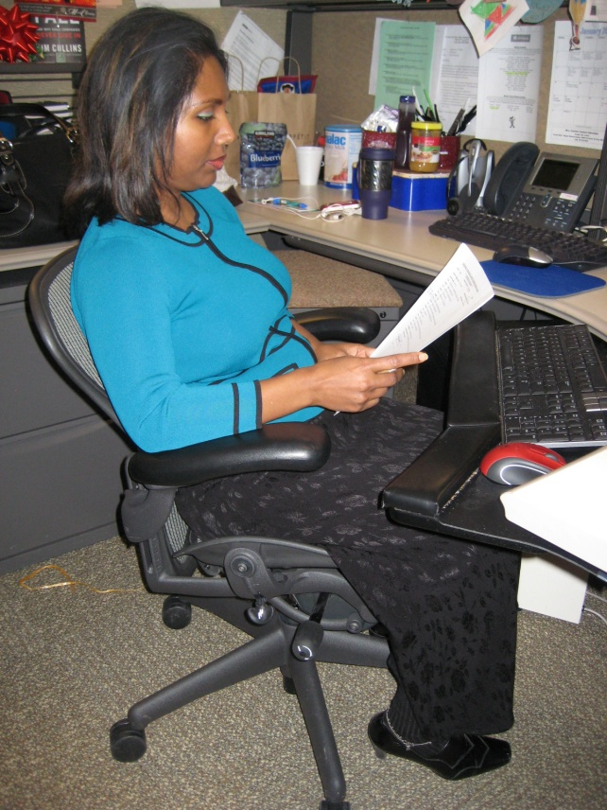
Chair criteria
Type, use and efficiency of chair are critical elements
Acceptable chair criteria determined by:
  Type of job activities performed
  Size and shape of user
  Duration of time spent in chair

Slide 34
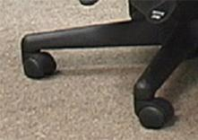
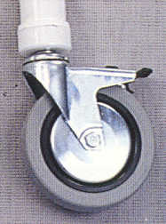
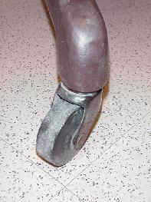
Legs and Casters
Does the chair have at least 5 legs?
Does the chair roll easily on the floor surface?
  Hard caster on soft floor
  Soft caster on hard floor

Slide 35
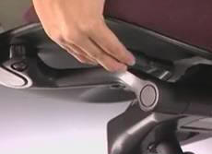
Seatpan Height
Does the chair’s seatpan height adjust up and down?

Slide 36
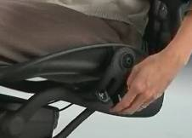
Seatpan Tilt
Does the chair’s seatpan tilt up and down?

Slide 37
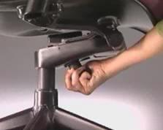
Seatpan Tension
Can you adjust the seatpan tension?

Slide 38
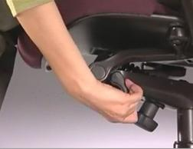
Seatpan Depth
Does the chair’s seat move forward or backward?

Slide 39
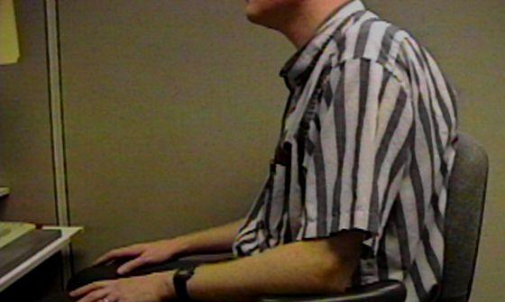
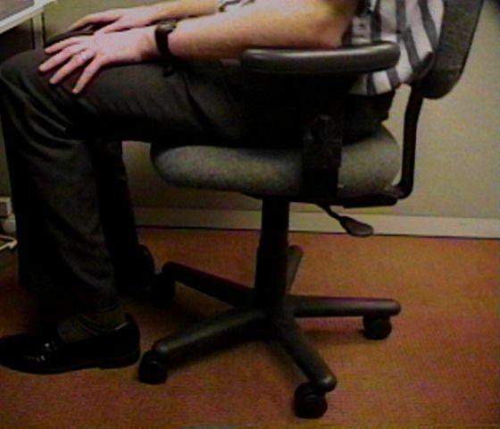
Relationships
Does the chair fit the individual?
  This gentleman is 7’ tall!
  Arrows point to back of knee and front edge of seatpan

Slide 40
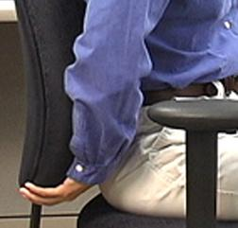
Back Support Height
Does chair’s back support move up and down?

Slide 41
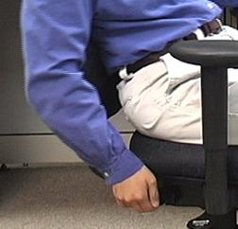
Back Support Angle
Does chair’s back rest angle forward or backward?

Slide 42
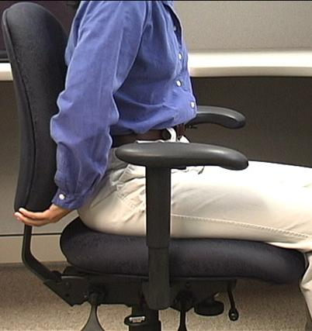
Cushion
Suitable cushion
  Foam density
  Wearability
  Breathability
  Type of material (fabric or rubberized)

Slide 43
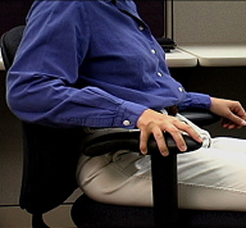
Armrests Adjust
Do chair’s armrests adjust up and down and/or side-to-side?

Slide 44
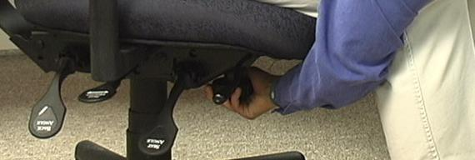
Adjustment levers/knobs/controls
Easy to reach
Easy to manipulate
Should not intimidate

Slide 45
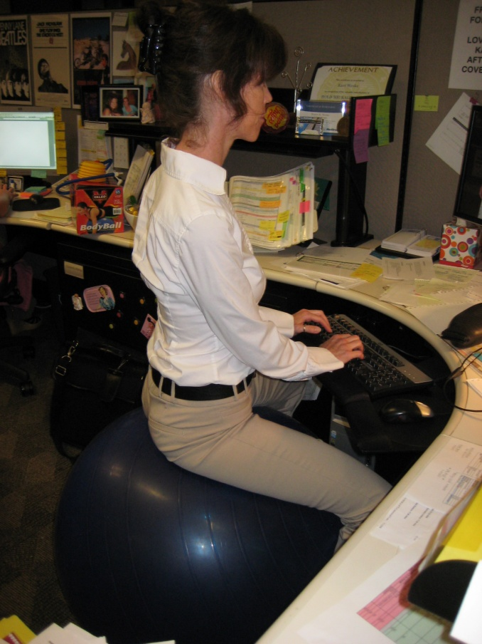
Ball Chairs?
Therapeutically, exercise balls used in clinical settings as treatment modalities
  Improve spinal stability
Over past several years, use of exercise balls in place of or in addition to task chairs
  Currently only anecdotal evidence exists to support full-time use
Most ergonomists advocate for properly sized/properly adjusted office task chairs rather than use of ball chairs

Slide 46
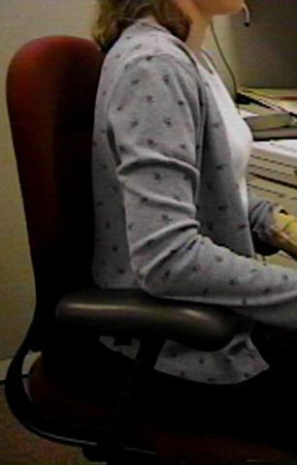
Art of Sitting
Body not designed to sit
  Particularly for long periods
  Studies determined even when seated in well-supported postures . . .
  How soon do we want to move?
  About every 20 to 30 minutes!

Slide 47
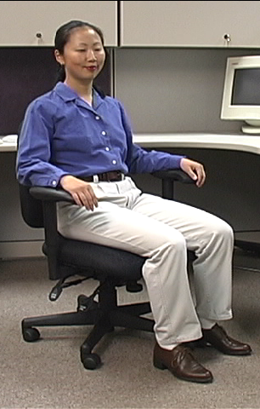
The Art of Sitting
Three point contact
  Sacrum/Trunk
  Hips/Thighs
  Feet/Floor

Slide 48
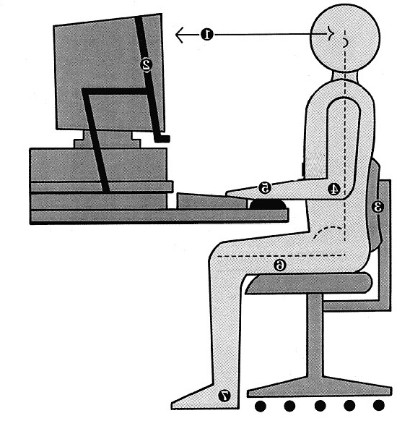
The Art of Sitting
90/90 seated posture?
  Only in drawings!
  Most people will sit at 95 to 110 degrees at hips and knees

Slide 49
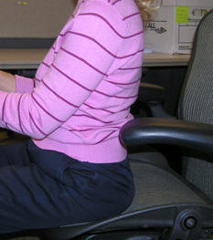
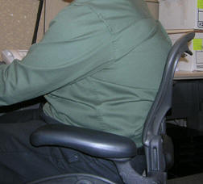
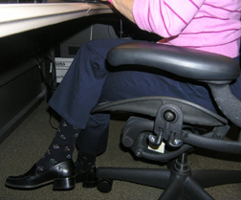
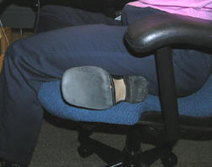
Sitting styles
Sitting styles quite varied from person to person:
  Percher
  Slouch
  Sit crossed leg
  Sit on leg

Slide 50
Sitting styles
Particular sitting style needs to be assessed
  Habit developed over time
  Response to poor workstation setup
  Combination of both
  What drives problem is frequency and duration of seated position

Slide 51
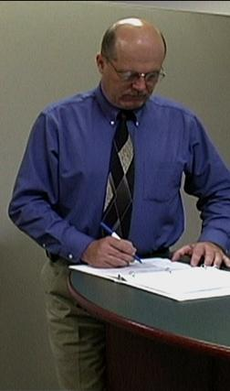
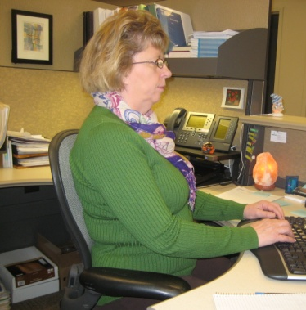
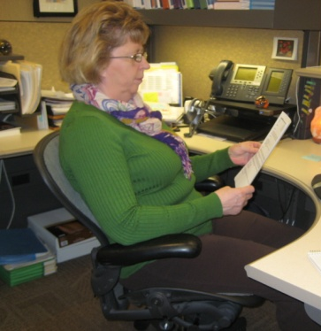
Functional seated positions
Provide for several different acceptable postures
Rotate throughout day on regular basis:
  Upright “keyboard” position
  Semi-reclined/rocking “conversation” position
  Standing

Slide 52
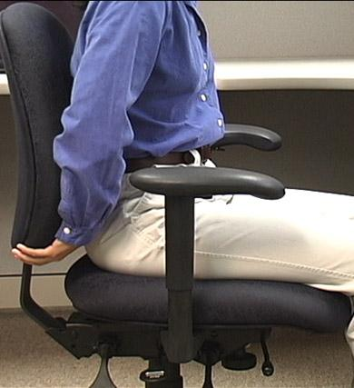
Adjustment anxiety
Chairs can be pretty expensive
  All kinds of bells and whistles
  Chair only as good as how it is adjusted
Some people have never adjusted their chair
  Just sit down and go to work!
Bottom line
  Need to initially be able to adjust chair to fit
  As well as throughout day

Slide 53
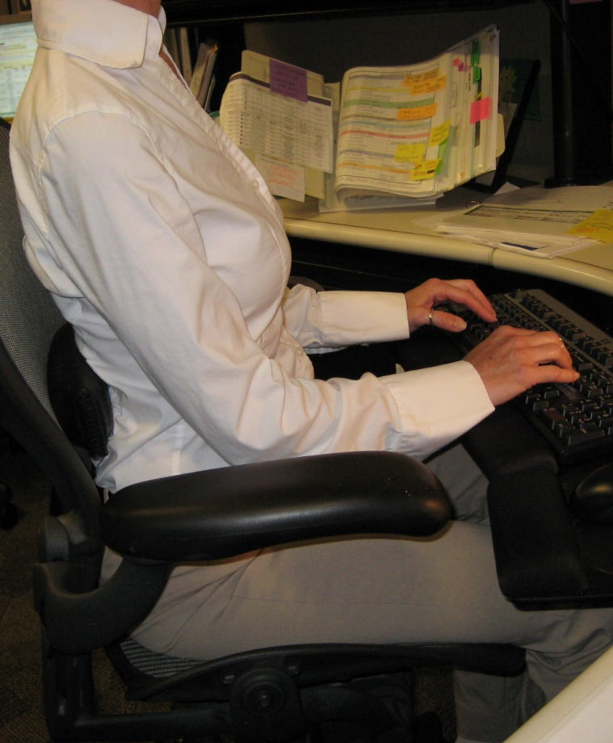
Chair solutions
Manual
  Find and read it!
Position and support body in neutral
  Adjust seat pan/back support tension to hold body in neutral position
  Adjust seatpan height to get feet on floor with even pressure on hips and thighs
  Adjust height and angle of back support to fill in low back curve

Slide 54

Maintenance
Is chair functioning properly?
No maintenance problems?

Slide 55


Chair

Slide 56

MOVE!
Remember, no matter how perfectly adjust chair to fit
  Still comes down to fact that need to move on regular basis to keep body healthy and safe
Movement is critical to the health of the body!

Slide 57

Worksurface
Worksurface objectives
  Provide functional workspace (depth, width)
  Support and position equipment
  Provide access to work materials
  Achieve desired relationship match between user/work

Slide 58
Straight line (desk/table)
The straight in-line configuration is suited for single task activities with minimal reach requirements for other office equipment and materials

Slide 59
L-shape (two worksurfaces)
L-shaped configuration is suited for single to multitask activities that require two or more separate workspaces
One workspace may be used as computer workstation and another as writing or collating workstation

Slide 60
Corner/U-shaped
Corner/U-shaped configuration well suited for multitask activities in same workspace with significant requirements to frequently reach other office equipment and materials
Allows for greatest degree of adjustability and accommodation for user

Slide 61

Worksurface Fixed
Traditional desk at fixed worksurface height of 29 inches - Millions of these!
Not designed to be changed in height or angle
Generally possible to raise fixed height worksurface on supports but also generally very difficult to lower it

Slide 62

Worksurface Fixed/Adjustable
Wall panel mounted worksurface or worksurface on legs
Can be adjusted within given range but once adjusted fixed in that position on fairly permanent basis

Slide 63


Adjustable/adjustable
Sit/stand workstations
  Controlled by mechanical springs or powered mechanisms
Keyboard trays
  User can readily and easily adjust worksurface

Slide 64



Wrong Desk height
If work height is adjustable, adjust it as needed
  Raise height of work surface by putting it up on blocks
  Make sure desk or work surface is solidly placed on blocks and won’t fall off!
Adjust chair height
  Make sure feet are supported either on floor or with footrest
Add height/angle adjustable keyboard tray
  Mounted underneath work surface

Slide 65

Not enough layout space
House cleaning
Other worksurfaces available for use
  File cabinet at standing height to review documents
Relocate some of equipment on desk
Pullout drawers already in desk

Slide 66


Sit/Stand Workstations
Worksurface at standing height
Stool
Foot rest

Slide 67

Sit/Stand Workstations
Portable system placed on desk
  Adjustable keyboard/mouse and monitors
  Use chair when seated

Slide 68


Sit/Stand Workstations
Height adjustable sit/stand workstation

Slide 69


Tips for Sit/Stand Workstations
Correct worksurface heights
  Seated and standing
Good footwear
  Good walking shoes make for good standing shoes
Anti-fatigue foot mat
  May be beneficial
  Difficult to roll chairs on mats
Foot rest/shift weight
  Allows for alternating posture with one foot up and then the other and shifts weight on the feet
Accommodation to sit/stand routine
  Start with specific schedule for first week
  (e.g. 30 minute stand – 30 to 60 second walk – 30 minute seated - 30 to 60 second walk and repeat)
  Modify based on unique response.
  Remember the mantra: “Don’t wait until it’s too late!”

Slide 70

Worksurface

Slide 71


Foot Support
In an ideal world the best foot support when seated in a chair is the floor . . .
However if needed use proper sized foot rest

Slide 72


Knee/foot clearance
Move what is not needed to some other storage position or get rid of it
Survey work area and determine what is blocking access

Slide 73

Foot Support/Clearance

Slide 74


Sharp edges
Proper work height in relation to worksurface edge
  Many times will eliminate the issue
Pad sharp edge
  If cannot eliminate pad the edge

Slide 75

Work organization
Includes organization and structure of tasks/activities performed throughout workday
  e.g. Do not store file boxes on the floor

Slide 76

Work organization solutions
Space in most companies is premium
  Store infrequently used items outside of immediate work environment
Pick up at end of day

Slide 77


Floor surface
Providing ease of rolling chair on floor surface
Nonskid surface to prevent slips and falls
Non glare surface to reduce overall glare in workstation

Slide 78

Computer equipment

Slide 79



Keyboards
Keyboard configurations
  Straight-line
  Curved
  Articulated
Keyboard surface finish
Keyboard size
Keyboard activation pressure
Layout
Wireless

Slide 80


Keyboard Technique
Free float piano playing style
Use of worksurface for forearm support

Slide 81




Non-neutral Keyboard Positions

Slide 82
Keyboard Solutions
Based on technique obtain correct height, reach and angle of keyboard
Adjust keyboard height and position
  Adjust worksurface height
  Keyboard tray
If cannot adjust keyboard height, position chair height to place hands in neutral posture in relation to keyboard
  May require support for feet if no longer touch floor

Slide 83

Wrist rests
To use or not to use . . .
That is the question!

Slide 84



Poor Technique
If technique needs improvement
Training programs that teach improved technique

Slide 85

Take break
Add stretching to day
  A little post it note put on computer monitor
  Software that reminds you to stretch
  Old-fashioned as egg timer
  Team up with someone else in office
  Take advantage of natural breaks between activities
Remember to Stretch!

Slide 86



Keyboard Trays
Keyboard tray configurations
Keyboard tray size
Height adjustment
Angle adjustment
Knee clearance

Slide 87

Keyboard Tray

Slide 88

Keyboard

Slide 89

Pointing device
No not that kind of mouse!
Use mouse as little as possible
  Keyboard shortcuts

Slide 90

Poll

Slide 91

Pointing device technique
Neutral positions
  Same plane as keyboard
Mousing style or technique
  Free float piano playing style
  Use of worksurface for forearm support

Slide 92




Pointing Device Non-neutral Positions

Slide 93


Pointing Device Solutions
Based on technique
  Adjust worksurface height
  Mouse tray
Cannot adjust mouse height and position
  Position chair height
  May require foot support
Keyboard shortcuts
Zoom with CTRL/SCROLL WHEEL

Slide 94


Mouse Wrist Rests
In most cases, mouse wrist rest is not recommended
  Wrist rest tends to “anchor” wrist
  Excessive side-to-side deviation of hand
Straight in access
  Allow forearm, wrist and hand moving as unit to manipulate mouse
  Think of mouse as extension of arm NOT just extension of wrist

Slide 95









Choosing Correct Pointing Device
p26-27

Slide 96

Mouse Setup
Buttons
Pointers
Pointer Options
Wheel
Hardware

Slide 97

Mouse

Slide 98


Computer
Where?
  Computer underneath monitor
  May or may not be appropriate
  Don’t block ventilation
  On/off and disc drives access

Slide 99

Computer

Slide 100


Monitor
Everything need access to may be viewed through monitor
Watch people looking at their monitors
  Almost like monitor is a vacuum cleaner
  They turn it on . . . and it sucks their head right in!

Slide 101

Monitors
LCD
Factors
  Physical size
  Resolution
  Display size
  Colors
  Brightness
  Viewing angle

Slide 102


Monitor Resolution
Pixel (picture element)
  640 by 480
  800 by 600
  1024 by 768
  1600 by 1800
Guideline
  Set LCD monitor resolution to the native resolution
  Typically the highest it will go

Slide 103


Monitor Alignment
Directly face primary work task
  Primarily data creation or manipulation
    Monitor directly in front
  Primarily data entry - main focus on paper documents
    Monitor slightly off to side
    Copy stand to place paper documents directly in front

Slide 104

Glare
Unwanted light directed or reflected into eyes
Sources
  Overhead lights
  Task lights
  Outside light
  Any shiny surface
  Any white/bright object

Slide 105


Control Glare
First step
  Identify glare source
Control
  Control source
  Control path

Slide 106


Use glare screen
Get what you pay for
  Inexpensive glare screen is generally just wire mesh
  Will cut glare at expense of character quality
  Good quality optical glass glare screen
Don’t have light source such as window directly behind monitor
  Reposition monitor
  Shade window

Slide 107

Adjust monitor screen brightness and contrast

Slide 108

Monitor Height
Where do we naturally read?
We read looking out and down

Slide 109

Monitor Height
Top of screen no higher than eye level
Look out and use downward eye movement to look at lower part of screen

Slide 110

Monitor too high
If screen too high
  Forces eyes wider open than usual
  Less tearing - eyes become more dry
  Tip head back putting additional strain into neck and shoulders
  Solutions
  Tip monitor slightly forward
  Raise chair slightly
  Lower worksurface

Slide 111



Monitor too low
If screen too low
  Head forward
Solutions
  Adjust monitor stand – if adjustable
  Monitor arms
  Monitor stands/Risers

Slide 112


Monitor Distance
Eyes
  Accommodation Convergence
Guideline
  Get screen as far away from user as possible
    At least arm’s length
    Still be able to read it clearly with good posture

Slide 113

Monitor too far away
Slide screen towards user

Slide 114



Monitor too close
Reconfigure monitor placement on desk
Add keyboard tray
At minimum push chair back from worksurface to give eyes a break

Slide 115

Dirty monitor screens
On regular basis clean monitor screen
Only use approved cleaning measures

Slide 116


Dual Monitors
Primary/Primary
Primary/Primary

Slide 117


Dual Monitors
Primary/Secondary
Primary/Secondary
Poll

Slide 118

Eye Examinations
Regular eye examinations
Eyewear prescriptions changes
Eye health in general
Based on job task

Slide 119


Presbyopia
Age-related process
Slow loss of flexibility within lens inside eye
Solutions
  Bifocals
  Computer glasses
  Lower monitor

Slide 120

Monitor

Slide 121



Document holder
Horizontal vs. inclined

Slide 122



Document holders
Landscape
Portrait
Read Write Stand

Slide 123

Document Holder

Slide 124

Laptops
Design violates basic ergonomic principles
Fixed position keyboard and monitor
Poll

Slide 125


Occasional Laptop User
Occasional Users
  Better off sacrificing neck posture rather than wrist posture
Find comfortable chair
  Position in lap or on table for most neutral wrist posture that you can achieve
  Angle laptop screen so can see with least amount of neck deviation

Slide 126


Full-time Laptop User
Use separate keyboard/mouse
Port replicator/docking station
Position on desk/worksurface to see screen without bending neck
Elevate off desk surface using stable support surface, such as computer monitor pedestal
Follow postural guidelines for working at computer workstation
Transport with bag or wheeled cart

Slide 127

Telephone
Frequency and duration
  More than 1 to 2 hours/day
  More than 1 to 2 minute calls
  Should have hands free to operate equipment

Slide 128


Telephone Types
Handsets
  Awkward head, neck and arm position
Shoulder cradle
  Still have awkward head, neck and arm position

Slide 129


Telephone Types
Headsets
  Wireless
  Bluetooth

Slide 130

Telephone

Slide 131

Handwriting/Reading
Use good old pen and paper
The paperless office?

Slide 132


Solutions
Inclined
  Document stand or podium
Gripping
  Is it really true, harder you squeeze more ink will come out?

Slide 133

Office equipment
Make use of principles to position office equipment
  Calculator
  Printer
  Fax
  Writing utensils
  Scissors
  Paper clips
  Stapler
  Stuff

Slide 134

Relationships

Slide 135



Storage/Reach zone
Primary
  Frequently accessed from seating system
  Within easy reach
Secondary
  Occasionally accessed
  Located in gray zone
  Danger Zone!
Tertiary
  Very occasionally accessed
  Have to get up and move to access

Slide 136




Storage
Storage types
  Vertical storage racks
  Horizontal storage bin
  Wall hanging storage
File cabinet types
  Vertical
  Lateral
  Rolling
Don’t overfill
  50 files in cabinet that holds 30!

Slide 137

Storage

Slide 138

Conference rooms
How to enhance audience reception of information
Lack of physical movement
138

Slide 139


Conference Rooms
Look for as many opportunities as possible to move as part of meeting
  Standing mixed in with sitting
Bring in small footrest or back cushion
139

Slide 140




Lighting – General and Task

Slide 141


Light solutions
Too much
  Turn out lights
Too little
  Add overhead lights
    Add indirect lights
    Bounce light off of ceiling and walls
  Add task light
    Desktop or wall panel lamp
    Position light carefully
Lighting Design

Slide 142

Illumination

Slide 143

Noise
Office can be noisy place
Contributing factor to fatigue and general stress
Noise level
  Too much noise
  Too little noise
Noise source
  Figure out where noise is coming from

Slide 144


Control Noise
People noise
  Limit volume and length of conversations
  Make good use of more public areas or conference rooms
Equipment noise
  Move equipment
  Noise enclosures
  White noise

Slide 145



Temperature solutions
Survey group
  General consensus
Controls
  Window shade
  Sweater
  Personal fan

Slide 146


Recommended Specifications

Slide 147
Office
Ergonomics
Assessment
Guidelines

Slide 148

Assessment Steps
Background Information
Job Tasks
Chair
Worksurface
Computer and Office Equipment
Environmental Factors
Recommended Workstation Setup and Specifications
Summarize Issues and Recommendations
Follow-up

Slide 149

Sample Ergo Report

Slide 150
Ergonomics – A Potent Tool!
Great number of factors enter into the office ergonomics workplace
Use the principles and ergonomics analysis process to offer solutions that are practical and effective!

Slide 151
Post Course Test
-Test link sent via email 6-12 hours after training- 20 questions
- Complete test with 80% and complete course eval for certificate
THANKS!

Slide 152
WorkWell and ErgoSystems Present:
Office Ergonomics
for Health Care Professionals
WorkWell Systems, Inc.
ErgoSystems Consulting Group, Inc.

