Slide 1
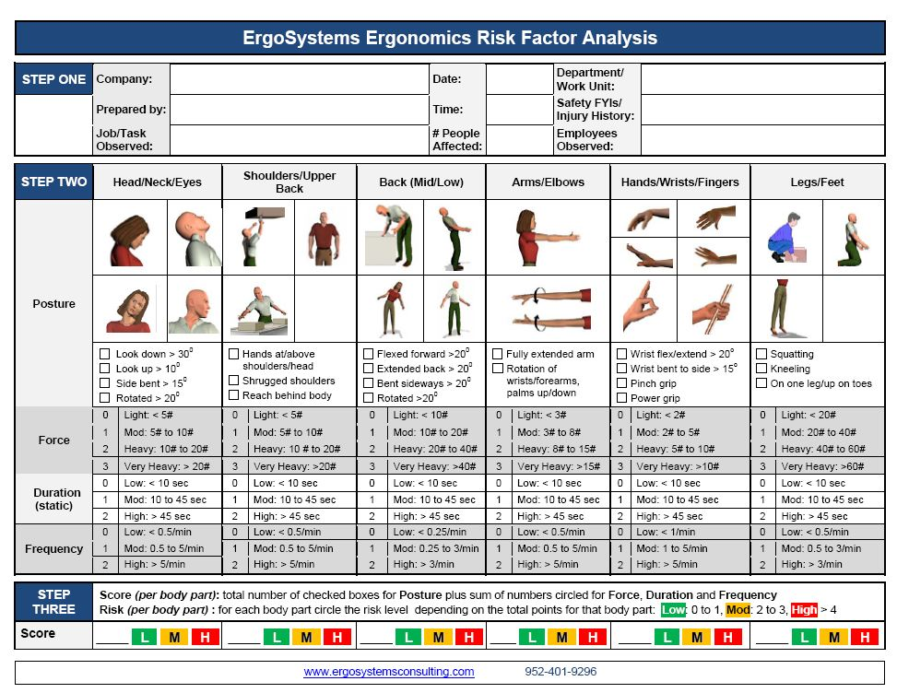
WorkWell and ErgoSystems Present:
Manufacturing Ergonomics: Introduction for Health Care Professionals (Online)
WorkWell Systems, Inc.
ErgoSystems Consulting Group, Inc.

Slide 2
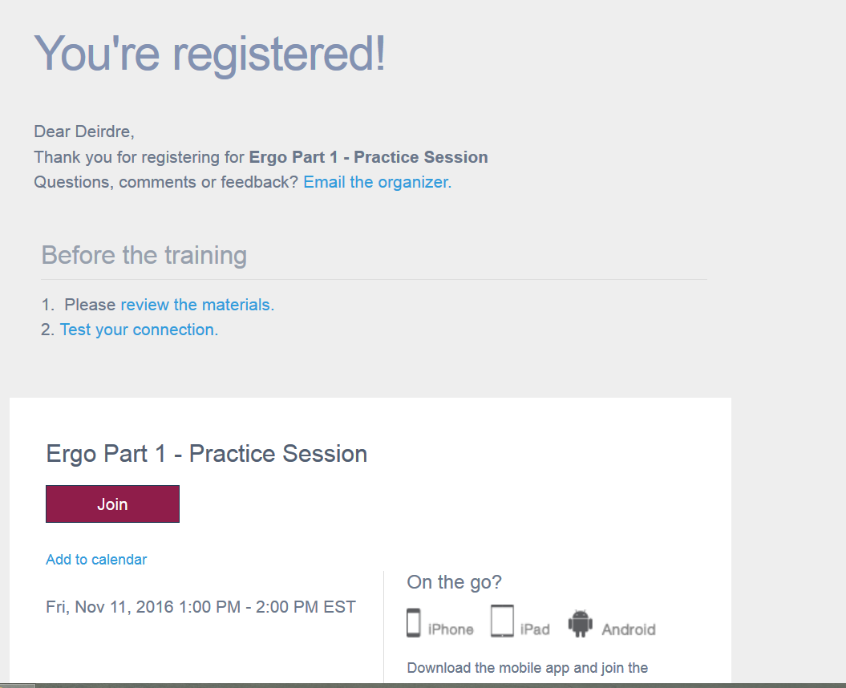
Welcome!
Thanks for registering and accessing the program.
Did you download the course materials?
Click this link to download important files.

Slide 3
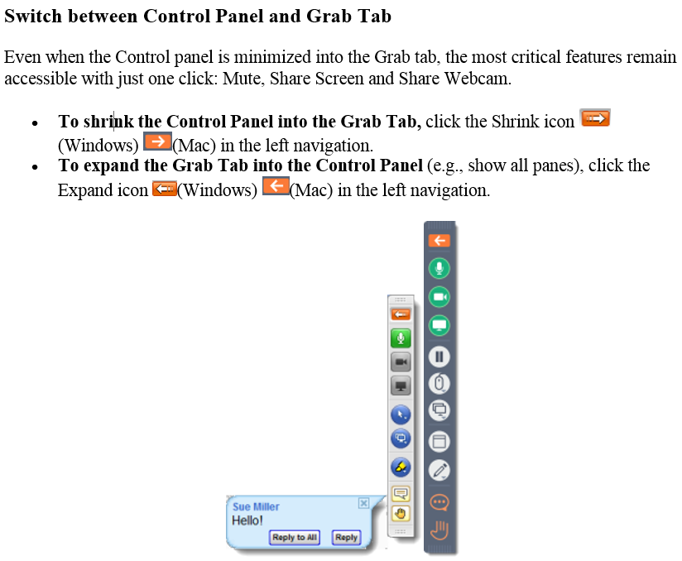
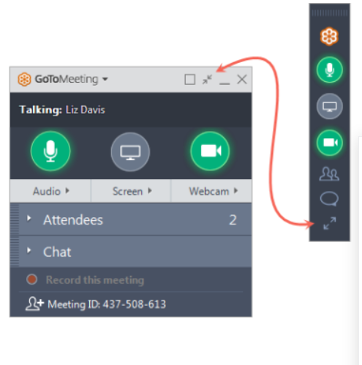
Opening/Closing the Go To Training Control Panel

Slide 4

Program Delivery
GoToTraining with Call In
Manual/Downloads via email
Attendance Log
Course Schedule
  Starting/ending times
  Breaks
  Worksheets and Homework
Telephones- Use MUTE, not hold
Group Overview

Slide 5
Schedule

Slide 6
Learning Objectives
Discuss elements of a systems design approach to ergonomics, including foundation principles of biomechanics, epidemiology, physiology, anthropometry, engineering psychology, and biomechanics
Summarize a set of ergonomics principles categorized into work force, workstation, and work process factors through review of basic ergonomics tools and checklists.
Explain how ergonomics principles can be used at both a group and individual level for injury prevention and post injury return specific to the manufacturing environment
Discuss a framework for problem solving and organizing data relating to job tasks, risk areas, and recommendations through review of simple and detailed risk analysis tools.
Apply problem solving principles using “tool box” components to analyze case studies in a progressive manner, generating reasonable/feasible recommendations based on short case videos.
Discuss strategies to decrease resistance and promote change during ergonomics initiatives, identifying barriers/facilitators and corresponding positive change strategies.
Complete a post-test with a score of 80% or more based on practical application of the manufacturing ergonomics material presented in the course, use of case information and guided worksheets.

Slide 7
Faculty
Kristen Cederlind, OTR/L
Kristen Cederlind, OTR/L joined the WorkWell team in 2013, first serving as a Manager of On-Site Services and more recently, assuming the role of Director of the WorkWell Quality Provider Network.
With over 25 years of experience as an Occupational Therapist, she has consulted with manufacturing employers across the country to develop customized On-Site therapy and wellness programs to improve employee health and safety, while collaborating with the rest of the On-Site team in service implementation, provider training, customer and provider relations and metrics reporting.
Her background includes program development and management of a hospital acute care and outpatient rehabilitation department. Her partnership with WorkWell began in 2003, when the hospital joined the WQP network and received training in FCE, FJA and PWS programs.
While working in the hospital setting, she championed ergonomics initiatives such as safe patient handling and office ergonomics and was able to utilize job analysis and prework screening skills both within the hospital and in her local community.
Kristen is a graduate of the University of Southern California and is a member of both the California and American Occupational Therapy Associations.

Slide 8
Faculty
Deirdre “Dee” Daley, PT, DPT
Dee Daley, PT, DPT is a graduate of the University of North Carolina- Chapel Hill and Quinnipiac College physical therapy programs. Dee is currently employed by WorkWell in New Ipswich, NH as Director of Clinical Practice.
Dee has been a member of the WorkWell faculty since 2003, and intermittently teaches as a guest lecturer for PT and PTA schools on topics related to Work Injury Prevention and Management. Dee also holds a degree in Health Professions Education from North Carolina State University.
In addition to clinical practice, Dee has been active in the New Hampshire and North Carolina Chapters of the American Physical Therapy Association (APTA) as President and other roles in the area of Education and Policy.
In addition to helping develop training materials for WorkWell, she has coauthored several publications on the Role of PT in Occupational Health and Wellness, and Safety in Functional testing.
She has also served as a member of the APTA as a working member of the Occupational Health Special Interest Group and Work Rehab Clinical Practice Guideline group.

Slide 9
Faculty
Robin Peterson, PT
Robin Peterson PT is a graduate of the University of Minnesota Physical Therapy Program. Robin is currently employed by Regions Hospital in St. Paul MN as Physical Therapist and Supervisor.
Robin has been a faculty member and consultant for WorkWell since 2008. Robin also holds a Bachelor of Arts degree in Distributive Sciences and Psychology from Gustavus Adolphus College in St. Peter MN.
In addition to clinical practice and consulting, Robin Peterson has been an active member in the MN chapter of the APTA since 1987 and has served as the physical therapy alternate member for the MN Medical Services Review Board with the Department of Labor and Industry since 2002.
Robin Peterson is also a member of the National Association of Occupational Health Providers and Human Factor Society.
She co-authored Smart Tracks patient management system, Volumes I and II.

Slide 10
Faculty
Marc Yeager, PT, MPT
Marc Yeager, MPT, is a graduate of Loma Linda University, where he received a bachelor’s degree in Life Sciences and a Master of Physical Therapy degree in June 1993. Marc is the Managing Principal of Injury Prevention & Management Consulting.
Marc has been a member of the American Physical Therapy Association since 1994 and the Georgia Physical Therapy Association since 1997. He has been a faculty member for WorkWell Systems since 2006. He achieved the distinction of WorkWell Master Clinician in 2001 with certifications in Functional Capacity Evaluations, Functional Job Analysis, Return to Work Clinical Pathways, Functional and Office Ergonomics.
Marc founded Highland Park Physical Therapy in 2001, shortly before joining WorkWell Systems as an Occupational Health Specialist developing injury prevention and management programs, including Rapid Return to Work, Stress Factor Analysis, and supportive training materials, in addition to implementing internet-based injury prevention and management programs for industrial clients.
Marc has assisted in the development and implementation of on-site ergonomic programs for a Silicon Valley-based high-tech Fortune 100 Company, and served as a member on their ergonomic safety committee as an external consultant.

Slide 11
Disclosure
WorkWell has some degree of financial and non-financial relationships with providers through our business model.
WorkWell focuses sales of services predominantly at a national level, contracting with provider groups instead of operating a brick and mortar operation business model.
WorkWell has a commercial interest in both delivering educational programs and delivering prevention and work disability rehabilitation/management programs (generally to employers).
There is no exclusivity requirement against sites participating in training from other vendors, nor any requirement to accept work on individual contract/s offered by WorkWell.
Clinics who foster local employer contracts and seek to expand the footprint of those contracts may negotiate with WorkWell to help leverage resources and/or partner to expand.
There is not an implied or specific promise of additional contracting or business opportunities related to participant attending educational programs.

Slide 12
Learning Environment and Non-Discrimination
WorkWell is committed to a supportive learning environment, and seeks to provide professional development opportunities which are accessible and free from discrimination.
WorkWell does not discriminate on the basis of race, color, national origin, religious affiliation, sex, gender, disability, military status, sexual orientation or age and expects course participants to adhere to those principles.
Special Needs
Participants who have special needs are encouraged to contact WorkWell so that reasonable efforts to accommodate these needs can be made.

Slide 13
Participation Attendance Policy
WorkWell wants to ensure a suitable learning environment and conditions free from distraction to optimize participation.
Participation in the entire training is Mandatory.
Registrants who arrive late or miss portions of the workshop will NOT be eligible for certificate or refund.
Attendance Sheets (on-line courses)
  Faculty will complete an Attendance log at program initiation and completion as well as following break/s.
  Online platforms allow faculty to monitor attendee engagement

Slide 14
Certificates of Completion
Certificates of completion will only be provided to individuals who meet the course requirements and attend all training sessions.
Individuals who do not complete the training sessions will not be eligible for certificates of completion (a letter of attendance documenting time attended may be provided)
Course Evaluation
A course evaluation must be completed by each participant, prior to issuing a certificate of completion or certificate of attendance.
Course evaluations will be distributed electronically
Copyright
Reminder - As part of your registration and accessing the course materials, you agreed “to adhere to the WWPC copyright policy which can be viewed at http://www.workwell.com/general-course-information/

Slide 15

Reminder –
If things get loud/busy or you need to respond to something in the area where you are located…
Please MUTE Us!!!
Don’t use HOLD!!!
Many locations have hold music or infomercials that will disrupt the class

Slide 16
WorkWell and ErgoSystems Present:
Manufacturing Ergonomics: Introduction for Health Care Professionals (Online)
WorkWell Systems, Inc.
ErgoSystems Consulting Group, Inc.

Slide 17
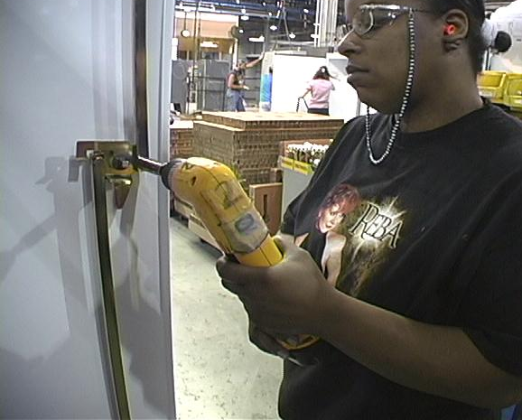
Welcome!
Advantages?
  Focusing patient’s treatment plan
  Identifying potential job modifications
  Preventing potential injuries
  Enhancing bottom line
  Other
Polls

Slide 18
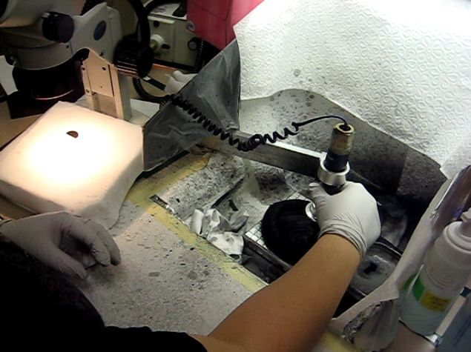
Course Content
Ergonomics Analysis
  Frame work to perform ergonomics analysis
  Generate reasonable and feasible recommendations
  Fundamental knowledge of ergonomics
Ergonomics Principles and Foundations
  Apply principles to ergonomics analysis
  Provide rationale to support ergonomics principles
Polls

Slide 19
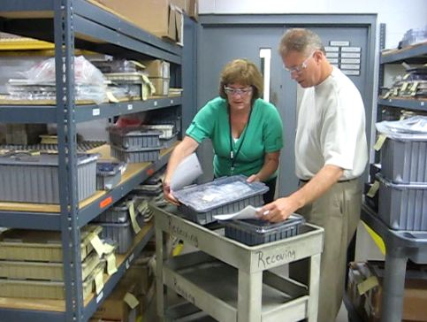
Ergonomics - Defined
Word “ergonomics” comes from the Greek
  “ergon” means work
  “nomos” means the laws or study of
So, ergonomics is literally the “laws or study of work”

Slide 20
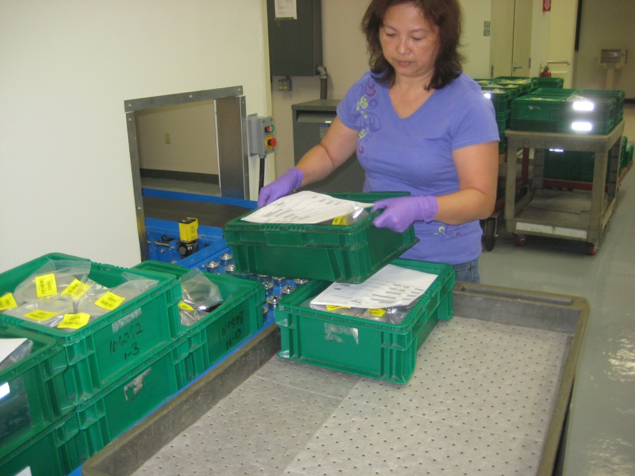
Ergonomics – What is the goal?
Eliminate?
  Physical stress
    Too much?
    Too little?
  Mental stress
    Too much?
    Too little?!

Slide 21
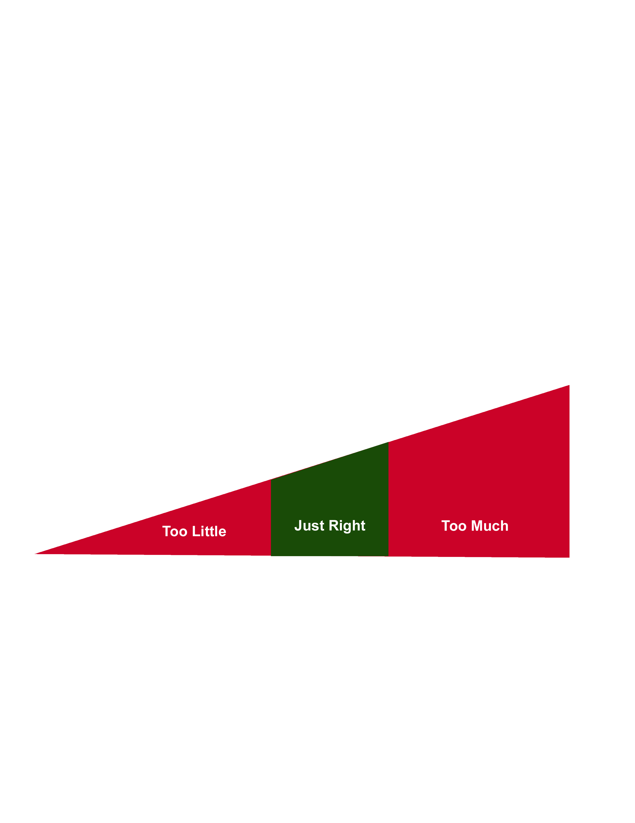
Ergonomics – What is the goal?
Optimize!
  “Just Right Window”
  That is the challenge!

Slide 22

Ergonomics and Gravity
Ergonomics is like throwing ball into air
What happens?
  Correct!
  The ball comes back down!
Why?
  Because GRAVITY works!
What if we don’t want the ball to come down?
  Tell it . . . BALL - TO STAY UP!

Slide 23
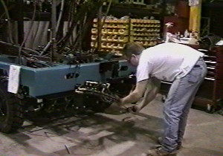
In our workspace . . .
given a certain set of circumstances . . .
we will respond in a fairly predictable way!

Slide 24
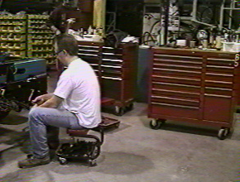
If we want to change the response . . .
We need to
change the circumstances!

Slide 25
Ergonomics . . .
Optimizing all aspects of job performance – safety, quality and productivity – accomplished through the appropriate design and use of workstations, work processes and the overall organization of work.

Slide 26
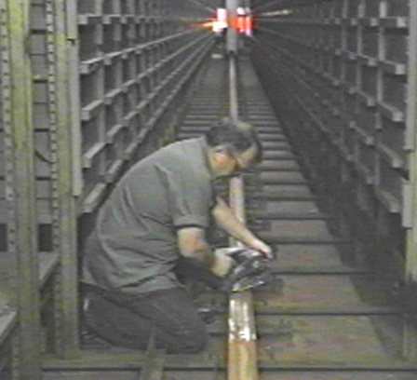
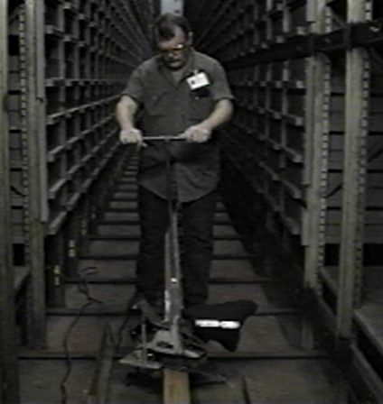
Why does ergonomics work?
Strategies to identify and solve problems
Design based; it addresses true root cause not just symptoms
Cost-effective; it incorporates an incremental
Makes use of best ergonomists in world . . . people who do work!

Slide 27
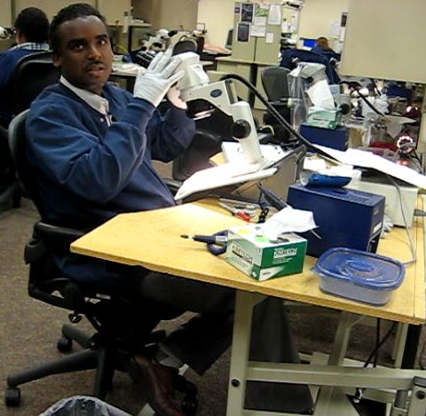
Systems Design Approach

Slide 28

A little mind reading!?
Choose number between one and nine.
Multiply that number by nine.
Add together digits of result of Step Two.
Subtract five from result of Step Three.
Choose letter of alphabet that corresponds to result of Step Four, e.g., A=1, B=2, C3, etc.
Choose a country that begins with that letter.
Choose an animal that begins with last letter of that country.
Choose a color that begins with last letter of animal.
Poll

Slide 29
Definition of Systems Design
Human Factors Design Handbook defines a system as:
  System is a mission-oriented grouping of elements into an integrated, functional whole
  System typically includes facility, equipment, furnishings, and fixtures and involves variety of people who use, operate, or maintain it
  System must perform mission or function and must work in an environment

Slide 30

The Country-Animal-Color Exercise
A system . . .
  Yields consistent response based on set of principles that make up system
  We want a work system that yields a consistent response

Slide 31
General Principles - Systems Design
Adapted to the human
Facilitates optimal level of performance to which user is capable
Optimizes physical and mental stress imposed on user
Provides personal satisfaction for user
Recognizes individual variation in human capabilities and limitations
Influences human behavior either positively or adversely
Does not exist in isolation

Slide 32
Set of Ergonomics Principles
Develop a set of principles to guide the design process

Slide 33
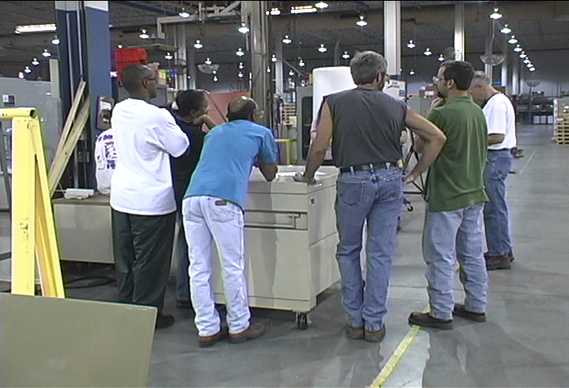
Systems Design: Foundations
Epidemiology
Work Physiology
Engineering Psychology
Anthropometry
Occupational Biomechanics

Slide 34
Ergonomics Principles
PROCESS – Promote effective work processes
POSITION/SUPPORT – Promote neutral body and limb position/support
MOVEMENT – Promote regular physical movement
MATERIAL HANDLING – Control manual material handling
REACH – Promote work in reach zone
WORKSTATION/TOOLS/EQUIPMENT – Correct workstation, tools, equipment
TRAINING – Provide competency-based training
ENVIRONMENT – Control exposure to work environment
HEALTH/WELLNESS – Promote personal health and wellness
FEEDBACK – Provide on-going feedback for continuous improvement

Slide 35
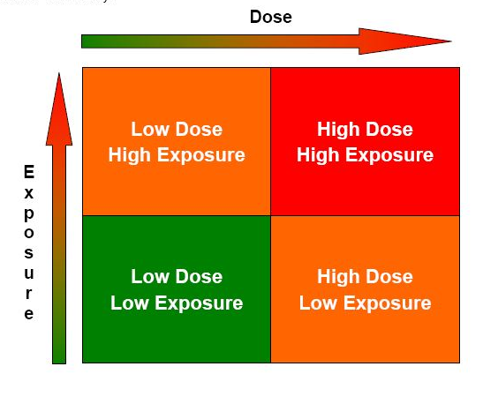
Risk Level Index
LOW: low risk, low priority to change
MOD: moderate risk, recommend modification as feasible
HIGH: high risk, recommend concerted effort to modify

Slide 36
Ergonomics Principles
PROCESS – Promote effective work processes
POSITION/SUPPORT – Promote neutral body and limb position/support
MOVEMENT – Promote regular physical movement
MATERIAL HANDLING – Control manual material handling
REACH – Promote work in reach zone
WORKSTATION/TOOLS/EQUIPMENT – Correct workstation, tools, equipment
TRAINING – Provide competency-based training
ENVIRONMENT – Control exposure to work environment
HEALTH/WELLNESS – Promote personal health and wellness
FEEDBACK – Provide on-going feedback for continuous improvement

Slide 37
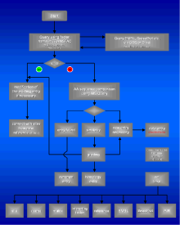
Promote effective work processes
Take step back and really examine why something is done as it is
If answer is. . .
“Because it has always been done that way!”
Take fresh look
Is there better way to get it done?

Slide 38
Ergonomics . . .
Optimizing all aspects of job performance – safety, quality and productivity – through the appropriate design and use of workstations, work processes and the overall organization of work.

Slide 39
Promote effective work processes
Lean Manufacturing
Continuous Process Improvement
Value Sream Mapping
Kaizen Events
Six Sigma
5S + 1
Poll

Slide 40
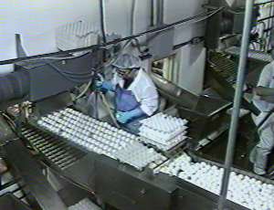
Work Process: Look at Whole Picture
Goal is to:
  Design work to take into account basic predictable human behavior
  Provide adequate level of job complexity and challenge
  Involve worker in design process
  Implement engineering, work practice and administrative control as appropriate

Slide 41
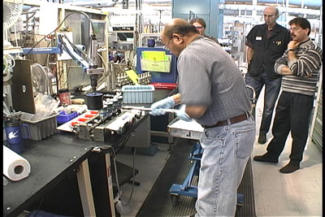
Management and Supervision
With out appropriate management:
  Ergonomics interventions will not be effective
Factors include:
  Labor/management relationships
  Supervision given and received
  Peer interaction

Slide 42
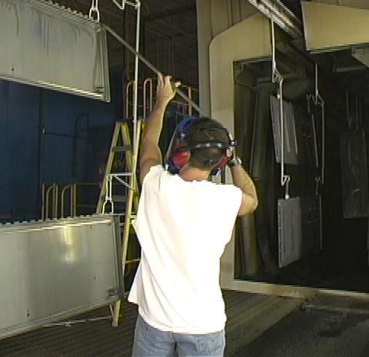
Work Force
Work force component is critical
Essence of ergonomics focuses on enhancing health, safety and productivity of workforce

Slide 43
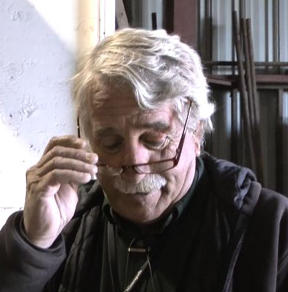
Age
Strength and flexibility may significantly decrease
Aerobic capacity and endurance decrease
Visual acuity may deteriorate
Reflexes and hand-eye coordination may deteriorate
Changes also take place in psycho-social aspects

Slide 44

Gender
Fit and use of workstations, tools, equipment and clothing
Match between physical demands of the job and functional capacity levels of the worker

Slide 45
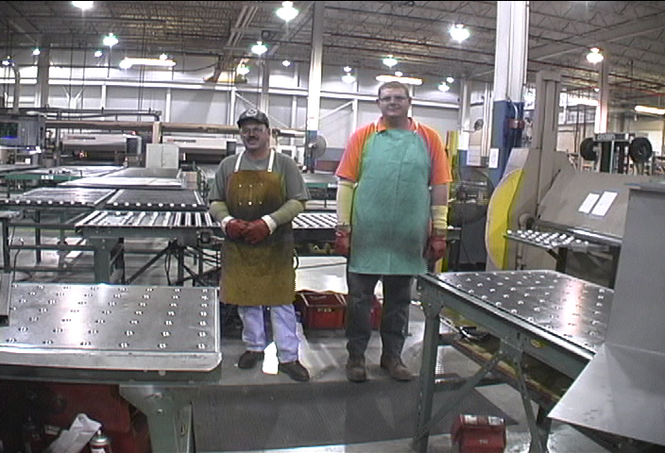
Stature and morphology
Anthropometry - the study of the size and shape of the body plays an important role
In other words, how tall? how short? how big? how small?

Slide 46
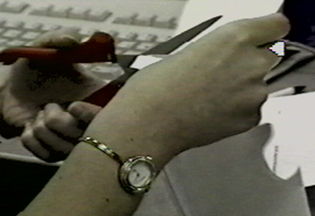
Hand dominance
Most workstations, tools and equipment are designed and set up to accommodate right hand dominance
May present a problem for left hand dominant workers

Slide 47
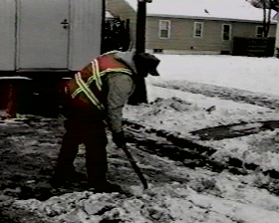
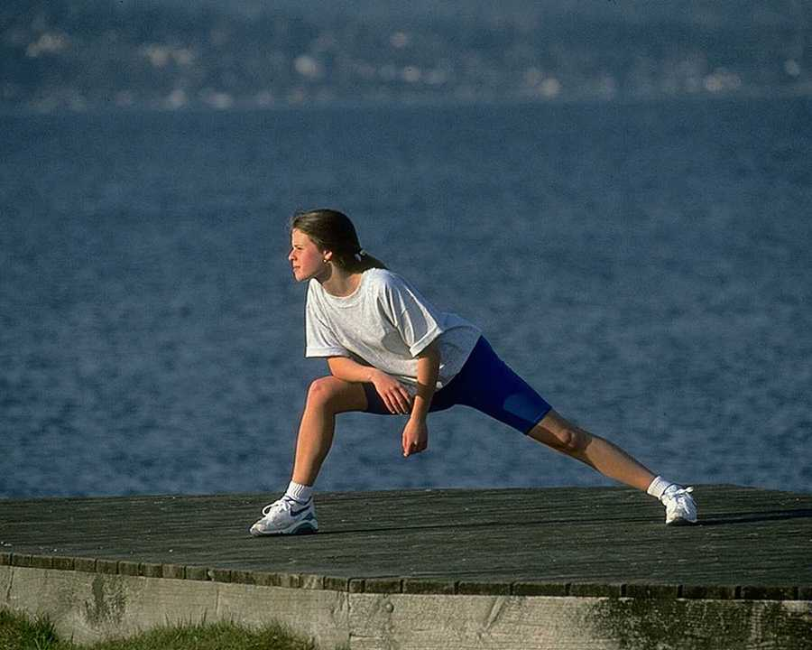
Fitness Level
Job Match
Health and Wellness

Slide 48
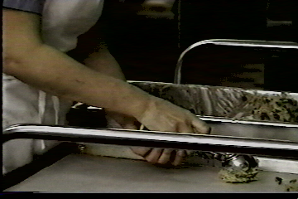
Training
Appropriate workstation design is only part of issue
Very best ergonomics design is worthless if the worker is poorly trained
  Technical
  Safety

Slide 49
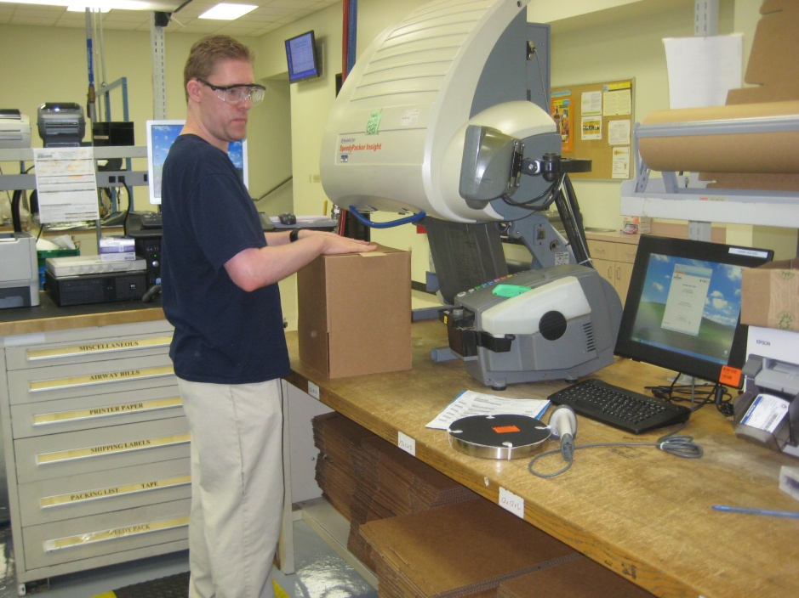
Work Experience
Level
  General work experience level of the workforce or worker?
Scope
  Cross-trained in other job demands, are they able to deal with emergency situations, etc.?

Slide 50

Effective Work Process Metrics
Establish injury and illness baseline against which future interventions can be measured
Provide guidance for allocation of resources
Compare particular company to industry wide statistics
Provide work force input and enhance communication

Slide 51

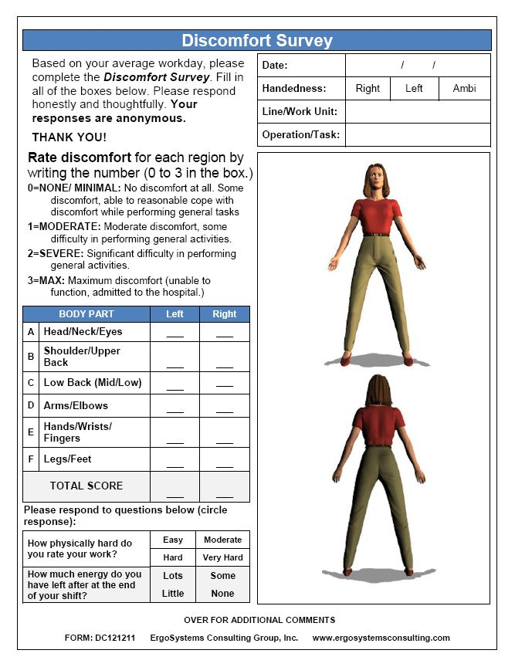
Effective Work Process Metrics
Reactive records review
Proactive data collection

Slide 52
Discomfort
Survey
Poll

Slide 53
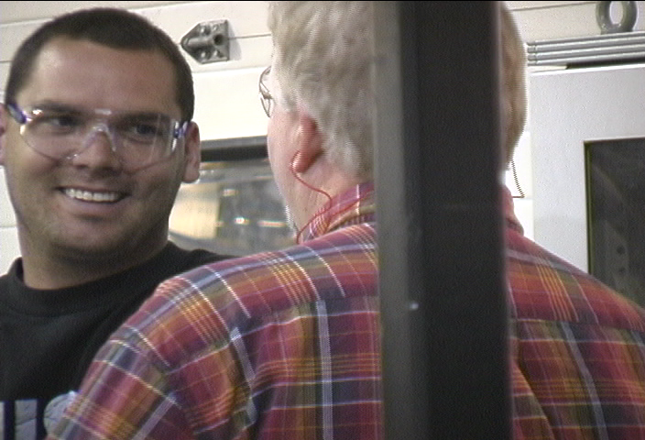
Designing Effective Work Processes
Common sense?
Population Stereotypes

Slide 54
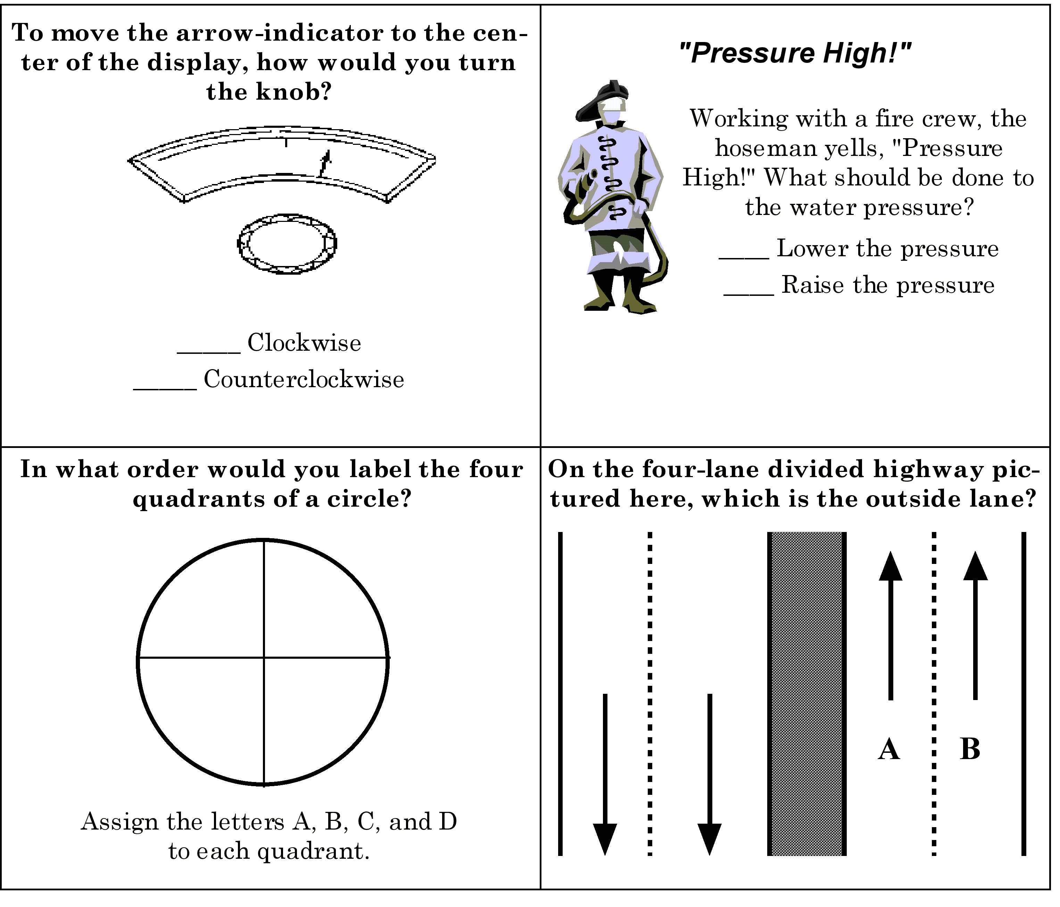
To move the arrow-indicator to the center of the display, how would you turn the knob?
_____ Clockwise
_____ Counterclockwise

Slide 55
    On the four lane divided highway
    pictured here, which is the outside lane, A or B?
A
B

Slide 56

Design Conventions and Human Behavior
Information Overload
  Jet fighter pilots shut down displays
  Typical 10 digit telephone number too long to remember
Information Underload
  Too boring
Design systems with information processing capabilities and limitations in mind.

Slide 57
Work Process Design Synopsis
Design conventions
  Avoid operator overload (as well as underload)
  Previous experience influences future performance
Design Principles
  Visibility – design for good visibility for operation
  Mapping – make sure the relationship is clear
  Feedback – provide to user regarding outcome

Slide 58
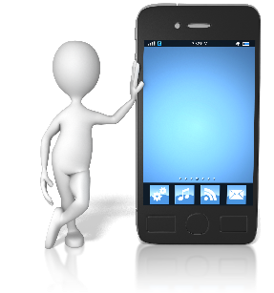
Donald Norman
“The Psychology of Everyday Things”
Design for good visibility
  Make it visually apparent what control on a piece of equipment does
  Many people never fully use full features of cell phones or computer software
    Controls, by themselves, may not be visually apparent

Slide 59
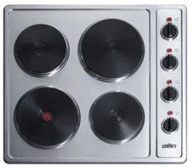
Donald Norman
“The Psychology of Everyday Things”
Apply the PRINCIPLES OF MAPPING
  Turning wheel RIGHT . . . . Steer to RIGHT
  Move indicator UP . . . . Turn volume UP
  Move indicator RIGHT . . . . Turn volume UP
  Stove burners . . . . ????

Slide 60
Donald Norman
“The Design of Everyday Things”
Provide FEEDBACK
  Return to user outcome information
  "Is the alarm really on?"

Slide 61
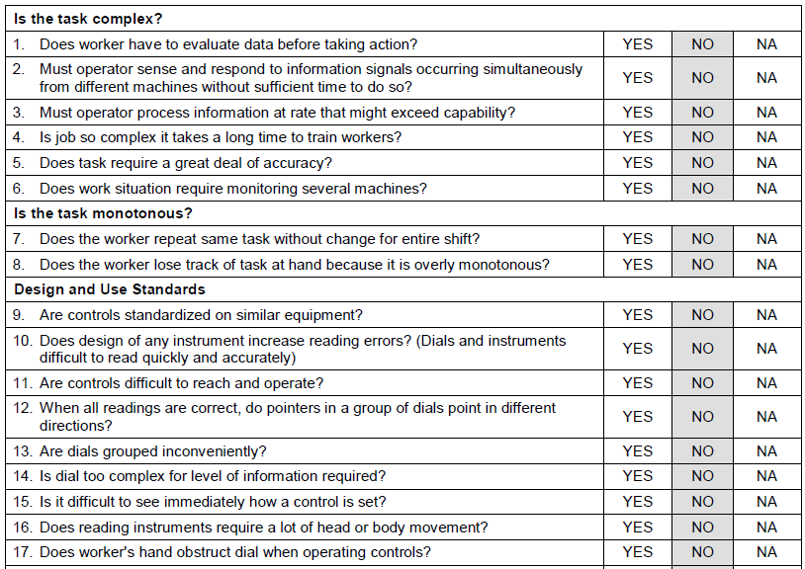
Work Process Design Checklist
(sample)

Slide 62
Ergonomics Principles
PROCESS – Promote effective work processes
POSITION/SUPPORT – Promote neutral body and limb position/support
MOVEMENT – Promote regular physical movement
MATERIAL HANDLING – Control manual material handling
REACH – Promote work in reach zone
WORKSTATION/TOOLS/EQUIPMENT – Correct workstation, tools, equipment
TRAINING – Provide competency-based training
ENVIRONMENT – Control exposure to work environment
HEALTH/WELLNESS – Promote personal health and wellness
FEEDBACK – Provide on-going feedback for continuous improvement

Slide 63

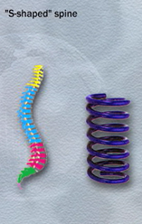
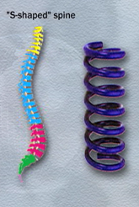
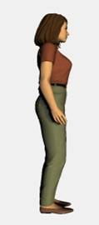
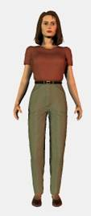
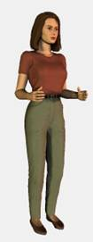
Position in Neutral
Neutral spine
  S-Shape
  Spring like
Arm/hand neutral position

Slide 64
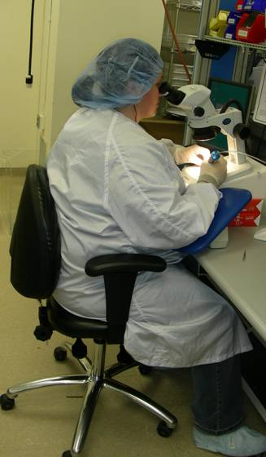
Seated
  Compression of soft tissues
  Decrease in blood flow and circulation
  Proper seated support is critical
Limbs
  Proper support for limbs
  Removes strain of weight bearing
  Unloads neck, shoulders and back

Slide 65
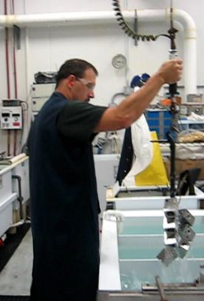
Provide support for body/limbs
Standing
  Unsupported standing for extended periods is not desired
  Joint compression occurs decreasing joint space
  Inadequate joint lubrication
  Fluid tends to pool in lower extremities
The bottom line . . . it is tiring!

Slide 66
Ergonomics Principles
PROCESS – Promote effective work processes
POSITION/SUPPORT – Promote neutral body and limb position/support
MOVEMENT – Promote regular physical movement
MATERIAL HANDLING – Control manual material handling
REACH – Promote work in reach zone
WORKSTATION/TOOLS/EQUIPMENT – Correct workstation, tools, equipment
TRAINING – Provide competency-based training
ENVIRONMENT – Control exposure to work environment
HEALTH/WELLNESS – Promote personal health and wellness
FEEDBACK – Provide on-going feedback for continuous improvement

Slide 67

Dynamic Physical Movement
What would you rather do?
  Stand in one place with 30 pounds of equipment
  Two-mile hike with
  30 pounds of equipment

Slide 68
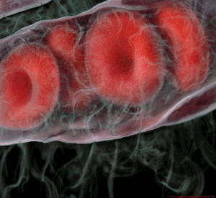
Metabolic Factors
Blood Flow
  Glucose and oxygen stored in small quantities in muscle tissue
  To sustain performance:
    Provide additional quantities
    Remove metabolites

Slide 69
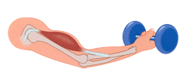
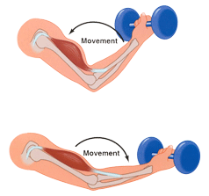
Metabolic Factors
STATIC
  Blood vessel compression
  Essentially occluded at 60% of MVIC
  Force levels
    Maximal < 10 seconds
    Moderate < 60 seconds
    Slight < 240 seconds
DYNAMIC
  Muscle contracts and relaxes
  Preferred

Slide 70
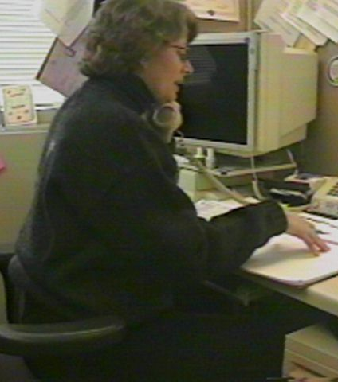
Metabolic Fatigue
Sustained Position
  blood flow decreases
  pooling of fluids
Awkward Position
  muscular contractions

Slide 71
Physiology Principles
Movement/activity
  Promote dynamic not static muscle contractions
  Build-in adequate physical recovery times
  Incorporate movement into the work process
Position and support
  Design for neutral positions
  Design for body/limb support at work stations

Slide 72
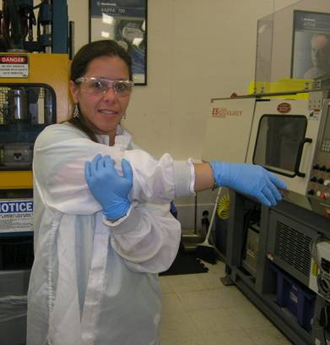
Promote Physical Movement
Build in purposeful movement into the work process
Dynamic vs. static muscle contraction
Promote circulation
30/30 Rule

Slide 73
Ergonomics Principles
PROCESS – Promote effective work processes
POSITION/SUPPORT – Promote neutral body and limb position/support
MOVEMENT – Promote regular physical movement
MATERIAL HANDLING – Control manual material handling
REACH – Promote work in reach zone
WORKSTATION/TOOLS/EQUIPMENT – Correct workstation, tools, equipment
TRAINING – Provide competency-based training
ENVIRONMENT – Control exposure to work environment
HEALTH/WELLNESS – Promote personal health and wellness
FEEDBACK – Provide on-going feedback for continuous improvement

Slide 74
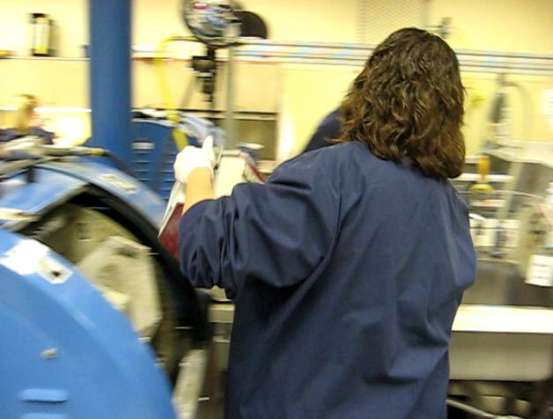
Control Manual Material Handling
How much can a person lift?

Slide 75
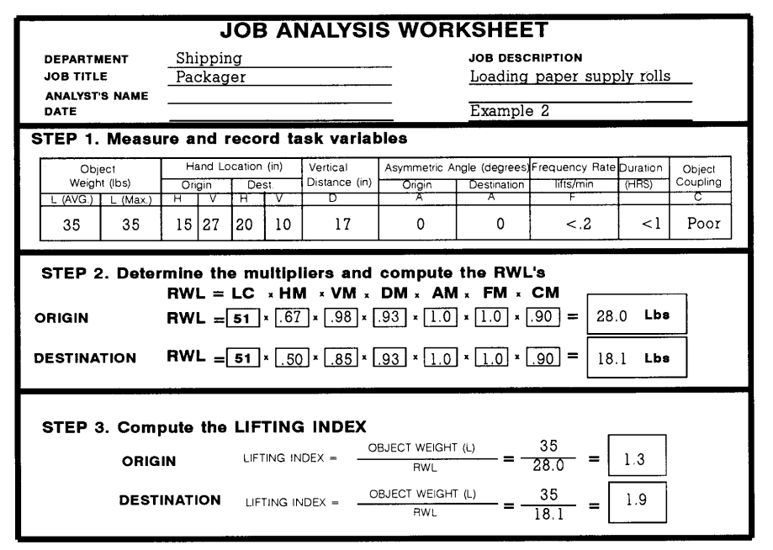
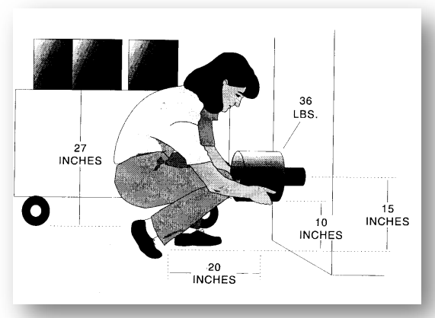
Occupational Biomechanics
NIOSH Work Practices Guide for Manual Lifting

Slide 76
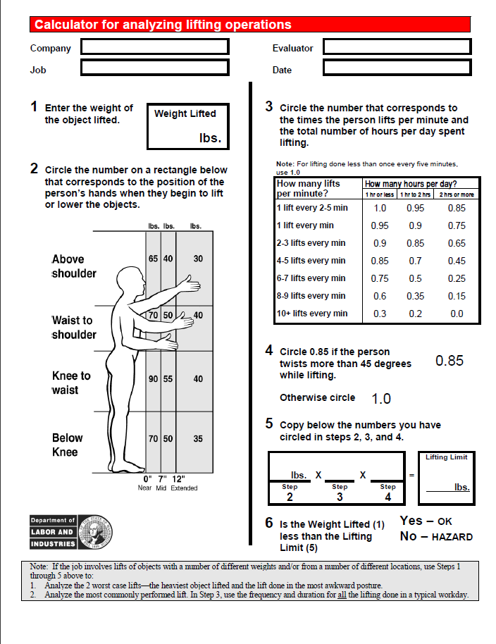
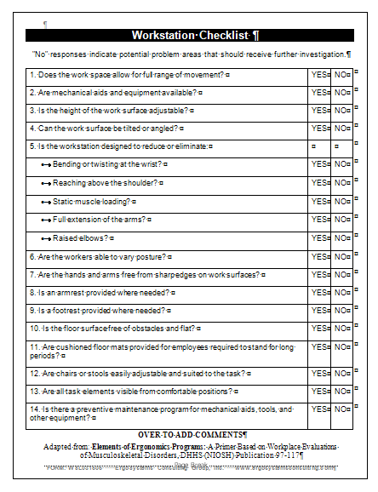
Control Manual Material Handling
Lifting Calculator
Manual Material Handling Checklist

Slide 77

LNI Lift Calculator
Note: If the job involves lifts of objects with a number of different weights and/or from a number of different locations, use Steps 1
through 5 above to:
1. Analyze the 2 worst case lifts—the heaviest object lifted and the lift done in the most awkward posture.
2. Analyze the most commonly performed lift. In Step 3, use the frequency and duration for all the lifting done in a typical workday.

Slide 78

Manual Material Handling
Checklist
(sample)
Poll

Slide 79
Ergonomics Principles
PROCESS – Promote effective work processes
POSITION/SUPPORT – Promote neutral body and limb position/support
MOVEMENT – Promote regular physical movement
MATERIAL HANDLING – Control manual material handling
REACH – Promote work in reach zone
WORKSTATION/TOOLS/EQUIPMENT – Correct workstation, tools, equipment
TRAINING – Provide competency-based training
ENVIRONMENT – Control exposure to work environment
HEALTH/WELLNESS – Promote personal health and wellness
FEEDBACK – Provide on-going feedback for continuous improvement

Slide 80

Work in Reach Zone
How much do you use your hands?
Where do you use them?
Comfort Reach Zone
Functional Reach Zone

Slide 81

Work in Reach Zone
Stature and arm’s length determine reach zones
  Comfort Reach
  Functional Reach
Determine individual reach zone and set up workstation to promote reach in that zone

Slide 82
Anthropometry
Door Heights, Kitchen Counters and Stairs
anthrōpos – human being
metry – to measure
Anthropometry is study of physical dimensions of human body - size, shape and weight

Slide 83

Anthropometry
Design standards
Machine guards
Reaches
Heights
Handle configuration
General work station design

Slide 84
Data Tables
Access tables
Design for whom?
  5th percentile
  50th percentile
  95th percentile

Slide 85



Slide 86



Slide 87


Slide 88


Slide 89


Anthropometry Principles
Help tall person fit
Help short person reach

Slide 90

Online Ergonomics – Session 1 Homework
Video Download and Sheets
(Homework must be successfully completed for course credit)

Slide 91

Issues Cheat Sheet

Slide 92

Online Ergonomics – Session 1 Homework Sheets
Polls

Slide 93
Ergonomics Principles
PROCESS – Promote effective work processes
POSITION/SUPPORT – Promote neutral body and limb position/support
MOVEMENT – Promote regular physical movement
MATERIAL HANDLING – Control manual material handling
REACH – Promote work in reach zone
WORKSTATION/TOOLS/EQUIPMENT – Correct workstation, tools, equipment
TRAINING – Provide competency-based training
ENVIRONMENT – Control exposure to work environment
HEALTH/WELLNESS – Promote personal health and wellness
FEEDBACK – Provide on-going feedback for continuous improvement
93

Slide 94

Work Station
General design and set-up of the workstation is important factor
Examine factors to adequately assess workstation

Slide 95


Stationary or mobile workstation
Is workstation stationary - used primarily in one position?
Is workstation mobile - taken from job site to job site?

Slide 96

Adjustable features
Work height
Work reach
Chair/stool
Equipment controls
Worker movement
Space and clearance

Slide 97


Tool Use

Slide 98


Manual to Power
Switch from manual hand tools to power tools can reduce force levels
Power tools create their own set of issues, including vibration and torque reaction force
Checklist

Slide 99

Torque reaction forces
Cause: fastener reaches the end of travel, transferring torque to the tool and operator
Solution: clutches, torque reaction bars, newer tools

Slide 100

Handle size
Provide optimum power grasps
Trigger configuration to spread the required triggering force over a large area

Slide 101

Machinery/Equipment
Pedals
  Are foot/knee control pedals used?
  Does the operator have to operate foot/knee pedals while standing?
  To operate foot pedals or knee switches, must worker assume unnatural or uncomfortable posture?
  Are pedals limited to two?
  Are pedals too small to allow operator to alter the position of foot/knee?
  Are pedals triggered at a high repetition rate?

Slide 102

Machinery/Equipment
Hand controls
  Are hand controls used?
  Placed to allow neutral hand/arm/body position?
  Difficult (require excessive force) to operate?
  Designed (shape and configuration) to take into account the amount and types of force required for operation?

Slide 103

Personal Protective Equipment (PPE)
Mandatory
  Conditions that require personal protective clothing or equipment?
  What conditions exist?
  What PPE is used?
Monitoring and Enforcement
  How is PPE use monitored?
  Are PPE policies enforced?

Slide 104
Physical Demand Questions:
Does the job involve peak loads of muscular effort?
How often do peak loads occur and how long do they last?
Are there signs of unacceptable fatigue on worker's part? (i.e. profuse sweating, red flushed face, heavy and labored breathing, poor coordination, etc.)
Is there frequent daily stair or ladder climbing?
Is recovery time figured into work process?

Slide 105

Force

Slide 106

Force - Component Fit
Poor fit may force assembler to "bang in" component using hand
  Ensure needed fit quality
Type of fastener
  Riveting
  Spot welding
  Specialized fastening systems

Slide 107

Intervention Strategies

Slide 108

Can the job be designed to reduce static muscle loading? (Provide jigs, fixtures, clamps, spot welds, etc. to hold work object)

Slide 109

Can the worker learn how to better control static muscle loading?
Body mechanics, stretching, etc.

Slide 110

Make use of mechanical devices, hoists, lifts, etc. to eliminate manual lifting

Slide 111

Eliminate the effect of gravity by counter-balancing weight
Method commonly used with tools

Slide 112

Remove physical barriers, thereby reducing horizontal distance (long lever arm)

Slide 113

Relocate storage heights with heavier objects stored between mid- thigh and waist height

Slide 114


Work with vendors to provide material either in smaller unit weights (e.g., 50 pounds, rather than 100 pounds)
Bulk that requires handling with mechanical means
Remove from “GRAY ZONE”

Slide 115

Provide adjustable height surfaces (e.g., scissors tables) to maintain desired height of material

Slide 116

Reposition the worker

Slide 117

Reposition the work material; e.g., bring parts and tools within reach envelope

Slide 118

The safest lift?
  One that does not occur!
Whenever possible slide objects rather than lift them
  Friction between surface and object may be a problem

Slide 119
Friction can by decreased by:
  Line storage shelves with decreased friction liners (e.g., Teflon sheets)
  Spray-on products will reduce friction (may cause a toxic substance problem)
  Use roller conveyor systems to transport materials
  Maintain quality of floor conditions to eliminate cracks and general deterioration
  Use appropriate type and size of casters or wheels as original equipment or retrofit, depending on floor type

Slide 120

Force - Workflow and Rate
Contribute to effect of force
Duty cycle of job demand determines force dose-exposure

Slide 121


Force - Grip
Using tools or handling boxes, grip has a major influence on controlling force levels
  Power grip makes use of larger, more powerful muscles than does a pinch grasp
  Maximal pinch is only 20% of maximal power grasp
  Grip spans of 1 1/2 to 2 inches are ideal

Slide 122

Coefficient of Friction
Friction between the hand and object can be increased by:
  Use rubberized coating on the object; e.g., tool handle
  Clean the object of lubricants
  Provide appropriate non-slip gloves
  Maintain normal skin moisture

Slide 123

Glove use
Commonly seen in work environments
The type and fit of glove should reflect the purpose of glove
Determine if glove is truly necessary
Generally, a gloved hand produces 25% to 30% less force than ungloved hand

Slide 124


Position

Slide 125
Neutral Position
Neutral posture as much as possible
Evaluate jobs or activities with worker out of ergonomic neutral positions or in awkward or sustained positions

Slide 126


Wrist deviations greater than 15 degrees from neutral

Slide 127
Forearm rotation

Slide 128

Elbows sustained above mid-chest height

Slide 129

Reaching frequently behind body or above shoulders

Slide 130

Optimize Work Positions

Slide 131
Standing work position
Frequent or relatively heavy lifting is required
Significant downward forces are required

Slide 132

Seated work position
Use seated workstations when light assembly or precision work is performed

Slide 133

Sit/Stand work positions
In some cases sit/stand workstations may provide a viable option
Provide for postural variability

Slide 134

Adjustable height work stations
Allows for increased postural variety for workers
Allows for accommodation for variation in body stature between workers

Slide 135

Turntables
Bring parts closer to the worker
Worker needs to access the other side of the pallet

Slide 136

Movement

Slide 137


Tool use and postures
Pistol grip
In-line grip

Slide 138

Rapid machine pacing in assembly task
Work ahead of the to create a buffer
Work behind the line because they can not keep pace
138

Slide 139

Reach envelope
Desirable reach envelope is laid out horizontally within a 45⁰ arc from midline to each side of body
Examine work station layout regarding placement of
  Tools
  Parts
  Materials

Slide 140


Storage locations
Place most frequently used materials, tools and controls at optimal positions within reach envelope
Use rotating jigs and turntables to bring parts or materials close to person when required

Slide 141

Repetition
Reduce repetition rates through:
  Mechanical Aids
  Worker Rotation
  Pay System
  Add Staff
  Reduce Line Speed

Slide 142

Vibration
Whole body
  Truck and forklift drivers
  Encounter whole body vibration
  Weakening and disrupting soft tissue structures such as tendons and ligaments

Slide 143


Vibration
Segmental vibration
  Assess duration of exposure
Fastener types
  Hex head screws drive faster and with less effort than Phillips screws and Phillips screws less so than slotted screws
  In some cases, rivets, welding, or adhesives may replace the need for screw fasteners

Slide 144

Control vibration
Source control
  Maintain and balance power tools on a regular basis
  Evaluate floor quality
  Repair work, or even replacing vehicle seats, may be necessary to reduce exposure to whole body vibration

Slide 145

Path control
  Vibration attenuation covers that attach directly to tools
  Wear gloves with padded palms
  Effective handle diameter increases
    Tool control and grip strength may be adversely effected
  Increase speed (RPM) at which tool turns
    Frequently helps to reduce amplitude of vibration
  Quick-cutting abrasives in grinding and sanding operations

Slide 146

Contact Stress - Sharp edge
Examine tool handle size and shape for prominences that promote increased pressure
Evaluate localized pressure tools produce in palm of hand
Finger contours on handles or triggering devices of tools may also produce unnecessary stress on digits
Examine size and shape of any machine guards for potential contact stress

Slide 147


Control strategies
Round work surface edges that come in contact with worker
Rounded contours on tool handles and trigger switches
Avoid use of tools that require
  Continuous or intermittent pressure on fingers, palm, base of wrist, forearm, and elbow
When possible, use self-opening tools
  Such as pliers and scissors that are spring loaded
Goal is to distribute pressure over as large an area as possible
  By increasing contact surface area

Slide 148


Contact Stress – Standing and Sitting

Slide 149

Mental Demands
The mental demands of work can be just as demanding and stressful as the physical demands

Slide 150
Is the task complex?
Does worker have to evaluate data before taking action?
Must operator sense and respond to information signals occurring simultaneously from different machines without sufficient time to do so?
Must operator process information at a rate, which might exceed capability?
Is job so complex it takes a long time to train workers?
Does task require a great deal of accuracy?

Slide 151
Is the task monotonous?
Does worker repeat same task without change for entire shift?
Does worker lose track of task at hand because it is overly monotonous?

Slide 152

Perceptual Demands
Ability to properly perceive perceptual demands exerts major influence
Illumination, auditory, touch and visual acuity fall into realm of perceptual demand

Slide 153

Illumination – General and Task
General work area including egress/ingress adequately illuminated?
Are controls, instruments and equipment poorly lit?
Is illumination not satisfactory for task?

Slide 154

Illumination - Contrast
Is contrast poor between workspace and its surroundings?
Is workplace so poorly lit that there are great differences between brightness levels in panels, dials and surroundings?

Slide 155

Illumination - Glare
Is glare present in workplace?
What is source of glare?
Is glare from displays a problem?

Slide 156

Auditory
Does noise level prevent or impair verbal communication?
Are there auditory signals?
Are some auditory signals hard to hear in general?
Are auditory signals difficult to distinguish from one another?

Slide 157

Touch
Is there a need to tell difference between parts by touch?
Is it difficult to recognize controls and tools by touch and/or position?

Slide 158

Visual Acuity
Does task require fine visual judgments?
  (This includes need to detect small defects, judging distances accurately, etc.)
Are dials and instruments difficult to read quickly and accurately?

Slide 159



Preventive Maintenance
Preventive maintenance of tools, equipment, workstations and facility itself have a major impact on workforce

Slide 160

Housekeeping
General
  Is workplace floor clear of clutter and obstructions?
  Could create risk of slips, trips or falls?
  Are floors slippery?
Workstation
  Too much clutter in workstation?
  Is housekeeping at workstation poor?

Slide 161
Provide Correct Tools, Equipment and Facilities
Checklists
  Work Station
  Tools
  Equipment

Slide 162

Workstation Checklist
(sample)

Slide 163

Tool
Checklist
(sample)

Slide 164

Equipment
Checklist
(sample)

Slide 165
Ergonomics Principles
PROCESS – Promote effective work processes
POSITION/SUPPORT – Promote neutral body and limb position/support
MOVEMENT – Promote regular physical movement
MATERIAL HANDLING – Control manual material handling
REACH – Promote work in reach zone
WORKSTATION/TOOLS/EQUIPMENT – Correct workstation, tools, equipment
TRAINING – Provide competency-based training
ENVIRONMENT – Control exposure to work environment
HEALTH/WELLNESS – Promote personal health and wellness
FEEDBACK – Provide on-going feedback for continuous improvement

Slide 166

Competency based training
Results not achieved?
  Spend thousands of $ on ergonomically designed tools, equipment and facility
  Workforce doesn't know how to make most of tool or equipment or furniture
Acquire new skills
  Need to correctly practice new technique to acquire skill level to advance

Slide 167
Ergonomics Principles
PROCESS – Promote effective work processes
POSITION/SUPPORT – Promote neutral body and limb position/support
MOVEMENT – Promote regular physical movement
MATERIAL HANDLING – Control manual material handling
REACH – Promote work in reach zone
WORKSTATION/TOOLS/EQUIPMENT – Correct workstation, tools, equipment
TRAINING – Provide competency-based training
ENVIRONMENT – Control exposure to work environment
HEALTH/WELLNESS – Promote personal health and wellness
FEEDBACK – Provide on-going feedback for continuous improvement

Slide 168

Control exposure to environment
Light
Noise
Temperature
Ventilation
Checklist

Slide 169

Cold
Cold environments, tools, or pneumatic tool exhaust
Reduction in tissue sensitivity, manual dexterity, and grip strength
Adequate personal protective equipment and appropriate worker rotation (in and out of cold environment) are also effective
Directing tool exhaust away from user

Slide 170

Heat
Increase metabolic demand
Affect ability to grasp tools and parts and to manipulate controls due to effect of perspiration on grasp
Fogging eye protection
Adequate ventilation and clothing as well as worker rotation are effective ergonomic interventions

Slide 171

Air
Temperature
Quality
Flow
Humidity

Slide 172

Noise
Noise is any unwanted sound
  High noise levels can drastically impede effective communication in the workplace
  Concentration is affected, negatively influencing productivity
  Noise has also been blamed for excessive fatigue

Slide 173

Noise Abatement
Controlling noise at its source is always best possible solution
If not possible to control source of noise, changing its path can also control it
  Use acoustical sound barriers, enclosures, and sound absorbing tiles and carpet

Slide 174

Environment
Checklist
(sample)

Slide 175
Ergonomics Principles
PROCESS – Promote effective work processes
POSITION/SUPPORT – Promote neutral body and limb position/support
MOVEMENT – Promote regular physical movement
MATERIAL HANDLING – Control manual material handling
REACH – Promote work in reach zone
WORKSTATION/TOOLS/EQUIPMENT – Correct workstation, tools, equipment
TRAINING – Provide competency-based training
ENVIRONMENT – Control exposure to work environment
HEALTH/WELLNESS – Promote personal health and wellness
FEEDBACK – Provide on-going feedback for continuous improvement

Slide 176


Health and Wellness!
Health and wellness
  Diet and nutrition
  Body weight control
  Stress management
  Smoking cessation
  Blood pressure control
  Fluid intake - don’t get dehydrated
  Adequate rest/sleep
For example movement helps to control fatigue
Poll

Slide 177
Ergonomics Principles
PROCESS – Promote effective work processes
POSITION/SUPPORT – Promote neutral body and limb position/support
MOVEMENT – Promote regular physical movement
MATERIAL HANDLING – Control manual material handling
REACH – Promote work in reach zone
WORKSTATION/TOOLS/EQUIPMENT – Correct workstation, tools, equipment
TRAINING – Provide competency-based training
ENVIRONMENT – Control exposure to work environment
HEALTH/WELLNESS – Promote personal health and wellness
FEEDBACK – Provide on-going feedback for continuous improvement

Slide 178

Provide on-going feedback
100% Correct the First Time?
  Does any new process work 100% correctly out of gate?
    Unintended consequences
  Schedule formal follow-up sessions
    Document outcome of follow-up
    Alleviate issues identified in timely manner
Continuous Process Improvement and Ergonomics
  Continuous process improvement strategies have tremendous benefit
    Waste is reduced
    Productivity is enhanced
Applying ergonomics principles to overall continuous process improvement effort is integral to success of process!

Slide 179
Ergonomics Principles
PROCESS – Promote effective work processes
POSITION/SUPPORT – Promote neutral body and limb position/support
MOVEMENT – Promote regular physical movement
MATERIAL HANDLING – Control manual material handling
REACH – Promote work in reach zone
WORKSTATION/TOOLS/EQUIPMENT – Correct workstation, tools, equipment
TRAINING – Provide competency-based training
ENVIRONMENT – Control exposure to work environment
HEALTH/WELLNESS – Promote personal health and wellness
FEEDBACK – Provide on-going feedback for continuous improvement

Slide 180

Problem Solving Principles

Slide 181
Design dictates performance
Recall toolbox on floor scenario
  Placing toolbox on floor promotes poor technique to remove tools
  Body mechanics training may be ineffective
Successful response
  Repositioning toolbox to waist height to promote desired technique
Apply this concept in any workplace for any ergonomics problem

Slide 182
Understand and make productive use of human behavior
The study of human behavior is one of the most fascinating fields of study that exists
The study of human behavior is one of the most frustrating fields of study that exists

Slide 183


There are reasons why we do what we do; sometimes we just can’t figure out what they are!
However it is possible to understand human behavior at some level and use this knowledge in a productive way.

Slide 184
Do not fix without adequate analysis!
Many novice analysts (and sometimes some experienced ones) cause themselves and others problems
They try to “fix stuff” without knowing why or what or when or who

Slide 185
Always ask why!
Sometimes when we look at work, all we see is what is in front of us
It is imperative that we look both up and down stream to see what truly is going on

Slide 186
Don’t generalize from a sample of one
Common assumption:
  Works for me . . .
  Must then work for everyone!
Be wary of population stereotypes
  Recognize individual uniqueness

Slide 187
Scope of Influence
Have to know scope of influence and not violate boundaries
If offer solution that is not within scope of influence of individual . . . solution will not work!

Slide 188


Resistance to change
Most people do not like change
Introduce change in a very careful manner
Other wise the solution will not work
Poll

Slide 189
What can you do to facilitate change?
Wasn’t their idea!
  Involve them!
Fear!
  Knowledge/Training!
Habit!
  Practice the right way!
No one else is changing!
  Group as a whole involved!

Slide 190
Tool Box
Personal Protective Equipment
Measurement devices
Background materials
Objectives

Slide 191
Tool Box
Personal Protective Equipment
  Eye
  Foot
  Hearing
  Clothing
  Head

Slide 192
Tool Box
Measurement
  “eyeball”
  Stop watch
  Tape Measure
  Force Gauge
  Cameras
  Other

Slide 193
Tool Box
Back ground Materials
  Job Description
  Sketch of Layout
  Organizational Chart
  Check List
  Clip Board
  Dictaphone

Slide 194
Tool Box
Set of Objectives
  Open Mind
  Credibility
  “New set of eyes”

Slide 195
Videotaping for Ergonomics Analysis
Moving pictures
Don’t’ make home videotapes
Videotaping sequence

Slide 196


General Ergonomic Analysis

Slide 197

Ergonomics Case Studies

Slide 198


Slide 199


Slide 200
Ergonomics – A Potent Tool!
Great number of factors enter into ergonomics workplace equation
Goal is to recognize what factors are impacting the job or task
Determine true cause and work to offer solutions that are practical and effective!

Slide 201
THANKS!

