Slide 1
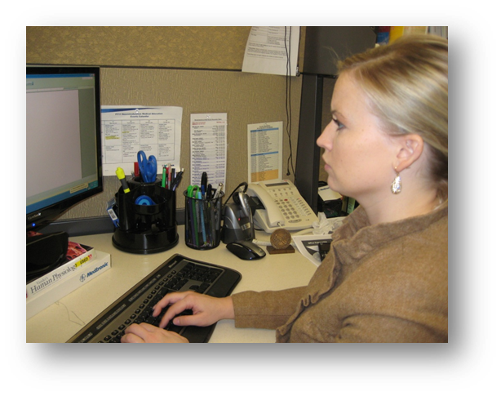
WorkWell Prevention and Care and ErgoSystems Present
Office Ergonomics: Introduction for Health Care Professionals (Online)
WorkWell Prevention and Care
ErgoSystems Consulting Group, Inc.
MENU

Slide 2
Welcome
Office Ergonomics: Introduction for Health Care Professionals
Critical Ergonomics tool to enhance
Safety
Productivity
Detailed framework
Conduct office ergonomics assessment
Generate reasonable and feasible recommendations

Slide 3
Workshop Logistics
Manual/Handouts
Workshop Schedule
Starting/ending times
Breaks
Rest rooms
Fire exits
Telephones
Messages
3

Slide 4
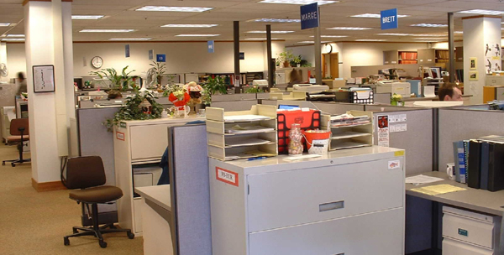
What do you want to accomplish?
Describe successful office workspace . . .

Slide 5
A careful examination
Look carefully at the words
Do you see any pattern or trend?
Is there a predominant theme?

Slide 6
A careful examination
Look carefully at the words
Do you see any pattern or trend?
Is there a predominant theme?

Slide 7
In other words . . .
Words like comfort or comfortable mixed in with:
Productive
Efficient
Satisfying
Effective
Safe and so on
Comfort . . . direct positive relationship to other descriptors
Comfortable
Productive
Efficient
Satisfying
Effective
Safe

Slide 8
Maximize comfort?
The answer is NO!
Maximizing comfort can be very dangerous thing to do
Optimize comfort the in office workplace!

Slide 9
Health Care Professionals (HCP) Advantages
Focusing patient’s treatment plan
Ergonomics analysis of patient’s work and/or home demands
Identifying potential job modifications
Assist patient in Return to Work (or other activity) process
Preventing potential injuries to employees
Proactive ergonomics analysis and intervention
Enhancing company’s bottom line
Ergonomics related improvements in quality and productivity that also complement health and safety
Other?

Slide 10
Workshop Objectives
Discover what Office Ergonomics is all about
Identify components that make up the successful office workspace
Learn how to analyze and setup the office workplace
Acquire confidence in using system through practice

Slide 11
Learning Objectives
At the end of training, participants will be able to
Describe physical relationship between office workers and common office components that minimize ergonomics risk, including work surface, chair, and computing devices/peripherals
Distinguish 3 office ergonomics musculoskeletal risk factors relevant to work set up and frequently performed work tasks in a case study scenario
Propose 2 office ergonomics interventions to reduce risks identified during ergonomic analysis

Slide 12
Workshop Guidelines
Follow along with demonstrations unless you think they may cause you a problem
Do not go against doctor's orders or do anything that you feel you should not do
If you are uncomfortable sitting during training, feel move to move
Use your good judgment when trying new techniques or exercises once you complete the training

Slide 13
Participant Background/Experience
Let’s continue by learning a bit more about you
Poll – Practice Setting
Poll – Assessment Experience
Poll – Ergonomics Consultation

Slide 14
Workstation Assessment Worksheets
Printed Worksheet and PDF Fillable Worksheets
Printed form completed by filling out form by checking pertinent boxes and writing in comments in each section
PDF fillable document contains checkboxes and comment fields for each section with option to include pictures

Slide 15
Quick Reference Guide
Assist in step-by-step process to conduct office ergonomics assessment
Take Quick Reference Guide with you for first several assessments to help speed up process
Guide offers tips and techniques to enhance assessment effectiveness

Slide 16
A Word about Pictures
Pertinent pictures may be included in report
“A picture is worth a thousand words!”
Valuable teaching tool
Help individual “see” issues
Show “before” and “after” pictures
Help supervisor/manager better understand issues/recommendations
Must get approval for pictures
Person being assessed
Supervisors, managers, etc.
Written release may be needed
In some cases, due to proprietary nature of workspace, pictures may not be allowed

Slide 17
Workshop Case Study
Introducing Michael Wilson
Works for XYZ Company in Human Resources
Recently moved into current office
Would like to ensure appropriate ergonomics set-up and use of workstation

Slide 18
Workshop Case Study - Logistics
Assessment notification and scheduling
Notified of need for assessment
Contact individual to schedule.
Typical assessment takes approximately 30 to 45 minutes
Assessment worksheet and equipment
Assessment worksheets and other equipment (tape measure, camera, sample equipment, etc.) available

Slide 19
Workshop Case Study – Conduct Assessment
Introduction
If needed, introduce yourself to person being assessed
Provide background that you are member of Ergonomics Assessment Team
If person is seated, obtain chair so you can sit with person as you conduct interview and assessment

Slide 20
Workshop Case Study – Conduct Assessment
Outline assessment objectives:
Understand pertinent ergonomics related issues
Conduct step-by-step ergonomics assessment to determine ergonomics issues
Work with them to "fix" whatever is possible at time of assessment.
Follow-up available as needed
Discuss pictures and obtain permission as needed.
Let them know you will obtain set of measurements
Ask if they have any questions as you get started with assessment.

Slide 21
Workshop Case Study – Conduct Assessment
Background information
Talk with person to complete Background Information section
Refer to Worksheet
Fill out form by hand
PDF fillable form
Respect confidentiality of information
Only requesting information specific to ergonomics assessment

Slide 22
Workshop Case Study – Conduct Assessment
Purpose
Review with the person the purpose of the assessment
Improve comfort, safety, and productivity of person in the workplace
Emphasize 30/30/30 guideline for physical movement

Slide 23
Workshop Case Study – Conduct Assessment
Observe typical work routine
Perform typical work tasks
Perform purposeful work
Watch for a few minutes
Perform specific activities they expressed concern about or that you have additional questions about
Take pictures as appropriate
Ask them to "freeze" position so you can obtain the desired pictures
Next step
Go through step-by-step assessment
Fill out worksheet

Slide 24
Workshop Case Study – Observations

Slide 25
Workshop Case Study – Observations

Slide 26
Workshop Case Study – Observations

Slide 27
Typewriters to computers!
Anybody remember typewriters?
Still see one every once in a while
Where do we use computers?
EVERYWHERE!

Slide 28
Office Components
User – Single/Multi
Tasks – Single /Multi
Floor space
Chair
Worksurface
Floor surface
Computer equipment
Telephone
Office equipment
Storage
Conference tables/chairs
Light

Slide 29
Single-user
Less influenced by need for adjustability of workstation itself
Once determine proper height of worksurface
Use fixed height or adjustable/fixed worksurface
Worksurface may be height adjustable
But once adjusted not readily changed

Slide 30
Multi-user
Multi-user workstations require significantly greater degree of adjustability
Critical that changeover from one user to next accomplished quickly and easily
Adjustable/adjustable worksurface
Through spring balanced manual system/powered system worksurface height readjusted within seconds

Slide 31
Single-task
Majority of work time accomplishing specific focused task
For example, customer service representative majority of day on computer and telephone performing computer lookup activities
Physically job demands are concentrated in single area
Efficient set up is critical because user tends to maintain sustained position to perform activities

Slide 32
Multi-task
Number of different tasks need to be accomplished
Computer
Telephone
Writing workstation
Attending meetings
And so on
Does not stay in a sustained position for long periods

Slide 33
Work Activity
Get general sense of work activity in terms of exposure
Computer
Telephone
Read
Write
Meetings
Misc
Other
Guides assessment
What activities to focus on

Slide 34
Floor Space
In ideal world, dimensions of office workstation
Determined exclusively by job tasks
Some very focused single-task workstations may be 36 sq ft
Multitask workstation 120 sq ft or even more

Slide 35
We do not Live in an Ideal World
Floor space may be determined by host of factors not relative to job task
Does not negate need to perform an effective job analysis to make recommendations
Does cause us in many cases to be quite creative!

Slide 36
Chair
Objectives of chair
Support body and limbs to provide relief from weight bearing
Provide stable base or platform for body and limbs
Position user at correct height and reach relationship to worksurface and tasks at hand
Allow for easy change in position/movement of user

Slide 37
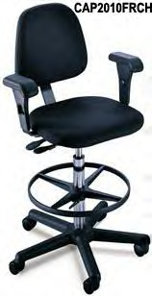
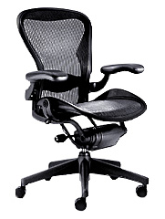
Types of Seating Systems
Number of seating systems available in workplace
Office chairs
Stools
Lean platforms
Other miscellaneous seating

Slide 38
Chair Criteria
Type, use and efficiency of chair are critical elements
Acceptable chair criteria determined by:
Type of job activities performed
Size and shape of user
Duration of time spent in chair

Slide 39
Legs and Casters
Does the chair have at least 5 legs?
Does the chair roll easily on the floor surface?
Hard caster on soft floor
Soft caster on hard floor

Slide 40
Seatpan – Height
Does the chair’s seatpan height adjust up and down?

Slide 41
Seatpan – Tilt
Does the chair’s seatpan tilt up and down?

Slide 42
Seatpan – Tension
Can you adjust the seatpan tension?

Slide 43
Seatpan – Depth
Does the chair’s seat slide/move forward or backward?

Slide 44
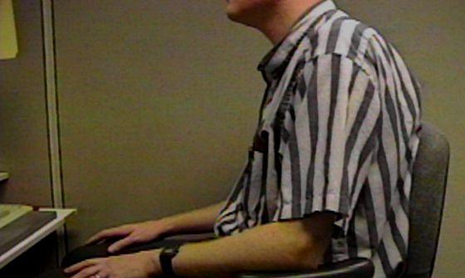
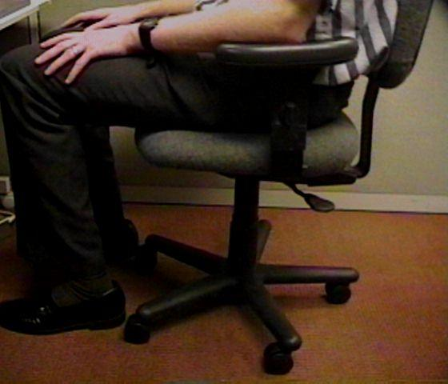
Relationships
Does the chair fit the individual?
This gentleman is 7’ tall!
Arrows point to back of knee and front edge of seatpan

Slide 45
Back Support – Height
Does chair’s back support move up and down?

Slide 46
Back Support – Angle
Does chair’s back support angle forward or backward?

Slide 47
Cushion
Suitable cushion
Foam density
Wearability
Breathability
Type of material (fabric or rubberized)

Slide 48
Armrests Adjust
Do chair’s armrests adjust
Up and down
Side-to-side
Rotate

Slide 49
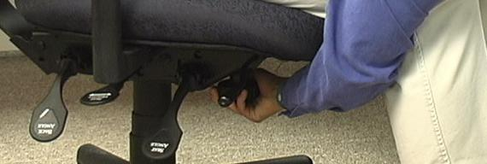
Adjustment levers/knobs/controls
Easy to reach
Easy to manipulate
Should not intimidate

Slide 50
Ball Chairs?
Therapeutically, exercise balls used in clinical settings as treatment modalities
Improve spinal stability
Over past several years, use of exercise balls in place of or in addition to task chairs
Currently only anecdotal evidence exists to support full-time use
Most ergonomists advocate for properly sized/properly adjusted office task chairs rather than use of fulltime ball chairs

Slide 51
Micro-breaks
30/30/30 Rule of Physical Movement
Physically active micro-breaks 30 seconds in length
Taken about every 30 minutes
Practiced for next 30 days to make it a habit
Benefits
Reduce tissue compression and joint stiffness
Enhance circulation
Improve overall comfort levels
Encourage person to figure out reminders that work for them
Post-it notes
Buddy approach
Drink a lot of water
Set reminders on their calendar

Slide 52
Art of Sitting
Body not designed to sit
Particularly for long periods
Studies determined even when seated in well-supported postures
How soon do we want to move?
About every 20 to 30 minutes!

Slide 53
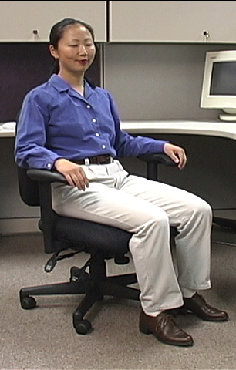
The Art of Sitting
Three-point contact
Sacrum/Trunk
Hips/Thighs
Feet/Floor

Slide 54
The Art of Sitting
90/90 seated posture?
Only in drawings!
Most people will sit at 95 to 110 degrees at hips and knees

Slide 55
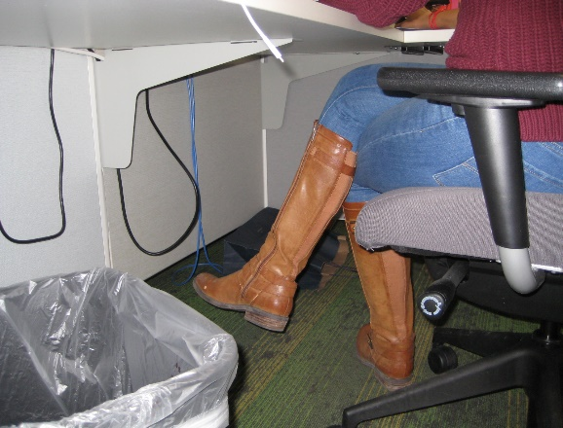
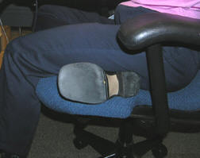
Sitting styles
Sitting styles quite varied from person to person:
Percher
Slouch
Sit crossed leg
Sit on leg

Slide 56
Sitting styles
Particular sitting style needs to be assessed
Habit developed over time
Response to poor workstation setup
Combination of both
What drives problem is frequency and duration of seated position

Slide 57
Functional seated positions
Provide for several different acceptable postures
Rotate throughout day on regular basis
Upright “keyboard” position
Semi-reclined/rocking “conversation” position
Standing

Slide 58
Adjustment anxiety
Chairs can be pretty expensive
All kinds of bells and whistles
Chair only as good as how it is adjusted
Some people have never adjusted their chair
Just sit down and go to work!
Bottom line
Need to initially be able to adjust chair to fit
As well as throughout day

Slide 59
Maintenance
Is chair functioning properly?
No maintenance problems?

Slide 60
Chair Adjustment
Manual (hardcopy/online)
Find and read it!
Position and support body/limbs in neutral
Adjust seat pan/back support tension to hold body in neutral position
Adjust seatpan height to get feet on floor with even pressure on hips and thighs
Adjust height and angle of back support to fill in low back curve
Adjust armrests to provide arm support

Slide 61
Chair – Case Study

Slide 62
Chair – Case Study
Chair adjusted with instructions in
Upright “keyboard position”
Semi-reclined “conversation position”

Slide 63
MOVE!
Remember, no matter how perfectly adjust chair to fit
Still comes down to fact that need to move on regular basis to keep body healthy and safe
Movement is critical to the health of the body!

Slide 64
Worksurface
Worksurface objectives
Provide functional workspace (depth, width)
Support and position equipment
Provide access to work materials
Achieve desired relationship match between user/work

Slide 65
Straight line (desk/table)
Straight in-line configuration
Suited for single task activities
Minimal reach requirements for other office equipment and materials

Slide 66
L/U-shape (two/three worksurfaces)
L-shaped configuration
Suited for single to multitask activities
Require two or more separate workspaces
One workspace may be used as computer workstation
Another as writing or collating workstation

Slide 67
Corner/cockpit
Corner/cockpit configuration
Suited for multitask activities in same workspace
Significant requirements to frequently reach other office equipment and materials
Allows for greatest degree of adjustability and accommodation for user

Slide 68
Worksurface Fixed
Traditional desk at fixed worksurface height of 29 inches
Millions of these!
Not designed to be changed in height or angle
Generally possible to raise fixed height worksurface on supports
Generally, very difficult to lower it

Slide 69
Worksurface Fixed/Adjustable
Wall panel mounted worksurface or worksurface on legs
Can be adjusted within given range
Once adjusted fixed in that position on fairly permanent basis

Slide 70
Adjustable/adjustable
Sit/stand workstations
Controlled by mechanical springs or powered mechanisms
Keyboard trays
User can readily and easily adjust worksurface

Slide 71
Sharp Edges
Proper work height in relation to worksurface edge
Many times, will eliminate the issue
Pad sharp edge
If cannot eliminate pad the edge

Slide 72
Work Organization
Includes organization and structure of tasks/activities performed throughout workday
Do not store file boxes on the floor!

Slide 73
Not Enough Layout Space
House cleaning
Other worksurfaces available for use
File cabinet at standing height to review documents
Relocate some of equipment on desk
Pullout drawers already in desk

Slide 74
Work Organization Solutions
Space in most companies is premium
Store infrequently used items outside of immediate work environment
Pick up at end of day

Slide 75
Worksurface Height Solutions
If work height is adjustable, adjust it as needed
Raise height of work surface by putting it up on blocks
Make sure desk or work surface is solidly placed on blocks and won’t fall off!
Adjust chair height
Make sure feet are supported either on floor or with footrest
Add height/angle adjustable keyboard tray
Mounted underneath work surface

Slide 76
Sit/Stand Workstations
Worksurface at standing height
Stool
Footrest

Slide 77
Sit/Stand Workstations
Portable system placed on desk
Adjustable keyboard/ mouse and monitors
Use chair when seated

Slide 78
Sit/Stand Workstations
Height adjustable sit/stand workstation

Slide 79
Tips for Sit/Stand Workstations
Correct worksurface heights
Seated and standing
Good footwear
Good walking shoes make for good standing shoes
Anti-fatigue foot mat
May be beneficial
Difficult to roll chairs on mats
Footrest/shift weight
Allows for alternating posture with one foot up and then the other and shifts weight on the feet
Accommodation to sit/stand routine
Start with specific schedule for first week
30-minute stand – 30 to 60 second walk – 30 minute seated - 30 to 60 second walk and repeat
Modify based on unique response
Remember the mantra: “Don’t wait until it’s too late!”

Slide 80
Conference Rooms
How to enhance audience reception of information
Lack of physical movement is a concern
80

Slide 81
Conference Rooms
Look for as many opportunities as possible to move as part of meeting
Standing mixed in with sitting
Bring in small footrest or back cushion
Get rid of seated desks
Meetings will get shorter and perhaps more productive!

Slide 82
Worksurface – Case Study

Slide 83
Foot Support
In an ideal world the best foot support when seated in a chair is the floor . . .
Never OK to have feet dangling for extended time!
However, if needed use proper sized footrest

Slide 84
Knee/Foot Clearance
Move what is not needed to some other storage position or get rid of it
Survey work area and determine what is blocking access
Pencil drawer
Other

Slide 85
Foot Support/Clearance

Slide 86
Computer equipment

Slide 87
Keyboards
Keyboard configurations
Straight-line
Curved
Articulated
Features
Keyboard surface finish
Keyboard size
Keyboard activation pressure
Layout
Wireless

Slide 88
Keyboard Wrist Rests
To use or not to use . . .
That is the question!
Can be a good addition to a keyboard
Called a wrist ‘rest’ not wrist ‘anchor’
Provide some weight-bearing supports for arms to provide opportunity for rest
Wrists should NOT be anchored to rest when keying
Move hands and fingers side to side when keying

Slide 89
Keyboard Shortcuts
Keyboard shortcut challenge
Identify common uses for mouse
Learn keyboard shortcuts instead
Improve efficiency

Slide 90
Keyboard Technique
Free float piano playing style
Worksurface forearm support

Slide 91
Worksurface Height Strategy
Fixed worksurface height
Use chair seatpan height adjustment to position hands at appropriate position
Based on technique
“Piano Player”
“Forearm Supporter”
Evaluate foot placement
Determine if footrest required
With taller individuals, may need to determine if worksurface can be raised

Slide 92
Worksurface Height Strategy
Adjustable worksurface height
Adjust chair’s seatpan height so hips slightly higher or equal to knees and feet supported on floor
“Piano Player” keyboard user
Position hands where they would be when using keyboard
Adjust worksurface height to match hand position
“Forearm Supporter” keyboard user
Position hands and forearms where they would be when using keyboard
Adjust worksurface height to match this position

Slide 93
Worksurface Height Strategy
Fixed/Adjustable worksurface height
No access to adjustable sit/stand workstation
Adjust chair appropriately with feet on floor
Locate specific point on chair and take vertical measurement from that point to floor
Have person adjust chair seatpan height to place hands on fixed height keyboard using identified keyboard technique
Using same point on chair take second measurement to floor
Difference between two measurements is how much current worksurface height needs to be changed
Example: initial worksurface height is 29”, difference in two chair measurements was 2”, current worksurface lowered by 2” to 27”

Slide 94
Worksurface Height Strategy
Fixed/Adjustable worksurface height
Access to adjustable sit/stand workstation
Use workstation to figure out recommended heights
With chair properly adjusted
Set demo worksurface height
Take measurements from floor to top of worksurface
Set actual worksurface to this height

Slide 95
Standing Worksurface Height Strategy
Stand comfortably tall
Not forced erect tall but not slumped either
“Piano Player”
Position hands as if using keyboard
Adjust worksurface height
“Forearm Supporter”
Position hands and forearms appropriately
Adjust worksurface height

Slide 96
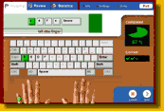
Poor Technique
If technique needs improvement
Back space and delete most commonly used keys?
Training programs teach improved technique
Going from 20 words/minute to 40 words/minute
100% improvement
Makes a huge difference in productivity

Slide 97
Take break
Add stretching to day
A little post it note put on computer monitor
Software that reminds you to stretch
Old-fashioned egg timer
New-fashioned FitBit
Team up with someone else in office
Take advantage of natural breaks between activities
Drink lots of water!
Remember to Stretch!

Slide 98
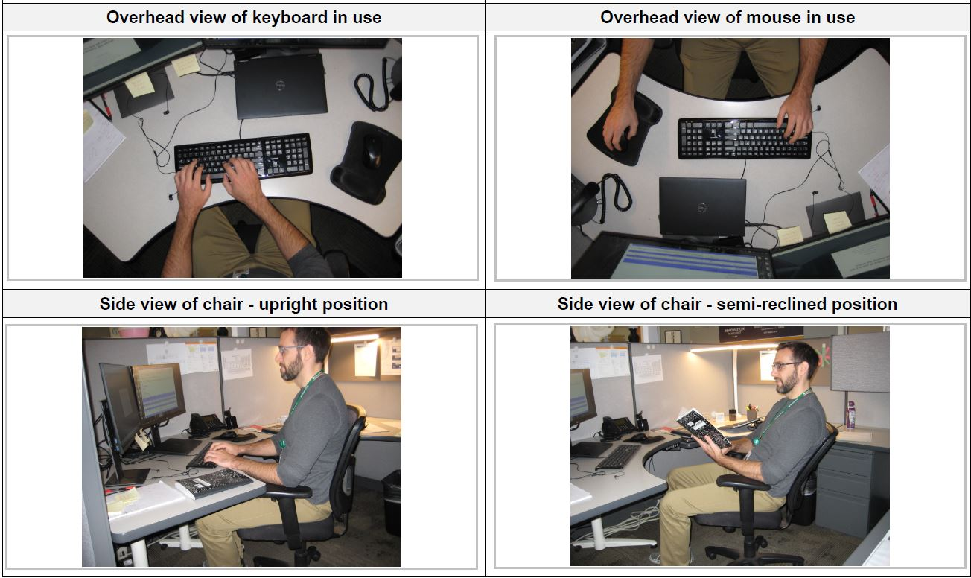
Keyboard – Case Study

Slide 99
Keyboard Trays
Response to first personal computers
Keyboard tray configurations
Keyboard tray size
Keyboard/mouse
Height/angle adjustment
Knee clearance

Slide 100
Keyboard Tray – Case Study

Slide 101
Mouse
No not that kind of mouse!
Use mouse as little as possible
Keyboard shortcuts
Productivity improvement
Less need to reposition hand on mouse from keyboard

Slide 102
Mouse technique
Neutral positions
Same plane as keyboard
Mouse placement
Free float piano playing style
Use of worksurface for forearm support
Right or left-hand use
May consider switch from one hand to the other
Reduce exposure of only one hand using mouse
Works for some not for all people

Slide 103
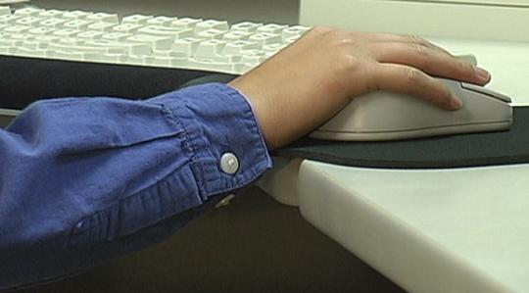
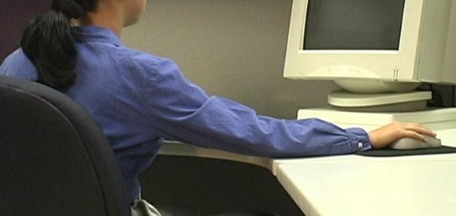
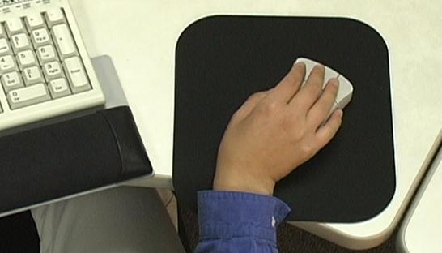
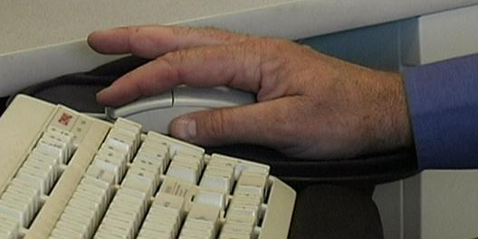
Pointing Device Non-neutral Positions

Slide 104
Mouse Set-up
Mouse Setup
Buttons
Swap sides
Pointers
Pointer Options
Pointer speed
Snap To
Show location with CTRL key
Wheel
Change scroll rate
Hardware

Slide 105
Mouse Wrist Rests
In most cases, mouse wrist rest is not recommended
Wrist rest tends to “anchor” wrist
Excessive side-to-side deviation of hand
Straight in access
Allow forearm, wrist and hand moving as unit to manipulate mouse
Think of mouse as extension of arm NOT just extension of wrist

Slide 106
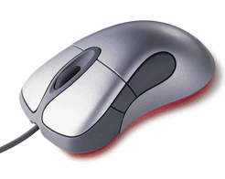
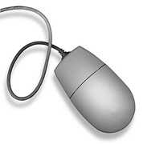
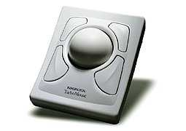
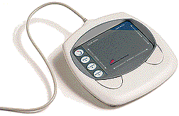
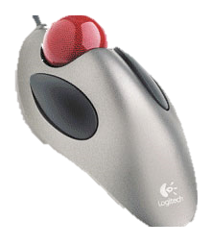
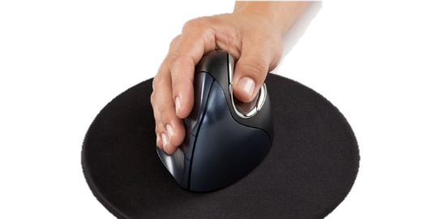
Mouse Types

Slide 107
Mouse – Case Study

Slide 108
Laptop/Desktop
Where?
Computer underneath monitor
May or may not be appropriate
Don’t block ventilation
On/off and disc drives access

Slide 109
Laptops
Design violates basic ergonomic principles
Fixed position keyboard and monitor

Slide 110
Occasional Laptop User
Occasional Users
Better off sacrificing neck posture rather than wrist posture
Find comfortable chair
Position in lap or on table for most neutral wrist posture that you can achieve
Angle laptop screen so can see with least amount of neck deviation

Slide 111
Full-time Laptop User
Use separate keyboard/mouse
Port replicator/docking station
Position on desk/worksurface to see screen without bending neck
Elevate off desk surface using stable support surface, such as computer monitor pedestal
Follow postural guidelines for working at computer workstation
Transport with bag or wheeled cart

Slide 112
Laptop/Decktop – Case Study

Slide 113
Monitor
Everything need access to may be viewed through monitor
Watch people looking at their monitors
Almost like monitor is a vacuum cleaner
They turn it on . . . and it sucks their head right in!
The “Thinker” Pose!

Slide 114
Monitor Height
Where do we naturally read?
We read by looking out and down

Slide 115
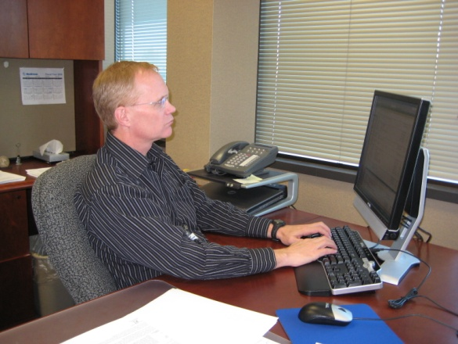
Monitor Height
Top of screen no higher than eye level
Look out and use downward eye movement to look at lower part of screen

Slide 116
Monitor Too High
If screen too high
Forces eyes wider open than usual
Less tearing - eyes become more dry
Tip head back putting additional strain into neck and shoulders
Solutions
Lower monitor
Tip monitor slightly forward
Raise chair slightly
Lower worksurface slightly

Slide 117
Monitor Too Low
If screen too low
Head forward
Solutions
Adjust monitor stand – if adjustable
Monitor arms
Monitor stands/Risers

Slide 118
Monitor Distance
Eyes
Accommodation
Convergence
Guideline
Get screen as far away from user as possible
At least arm’s length
Still be able to read it clearly with good posture

Slide 119
Monitor Too Far Away
Slide screen towards user
On worksurface
Monitor arm

Slide 120
Monitor Too Close
Reconfigure monitor placement on desk
Add keyboard tray
At minimum push chair back from worksurface to give eyes a break

Slide 121
Monitor Alignment
Directly face primary work task
Primarily data creation or manipulation
Monitor directly in front
Primarily data entry - main focus on paper documents
Monitor slightly off to side
Copy stand to place paper documents directly in front

Slide 122
Dual Monitors
Primary/Primary
About 50% each monitor
Middle of two monitors
Centered on user’s nose
Equal head rotation from side-to-side

Slide 123
Dual Monitors
Primary/Secondary
Primary monitor viewed primarily
60 to 90% of the time
User centered on Primary
Secondary monitor viewed occasionally
10 to 40 % of the time
Limit asymmetrical head/neck position

Slide 124
Monitor Resolution
Pixel (picture element)
640 by 480
800 by 600
1024 by 768
1600 by 1800
Guideline
Set LCD monitor resolution to native resolution
Typically, the highest it will go
Consult with IT if needed

Slide 125
Functional Monitor Placement Test
Close eyes and position head in balanced neutral position on neck
Open eyes
With proper monitor height
View top third of screen without any head movement
View bottom third of screen
Look for downward eye movement of up to 30 to 40 degrees and perhaps a small amount of head down tip
Make any monitor position changes indicated

Slide 126
Glare
Unwanted light directed or reflected into eyes
Sources
Overhead lights
Task lights
Outside light
Any shiny surface
Any white/bright object

Slide 127
Control Glare
First step
Identify glare source
Windows
Lights
Floor
Etc.
Control
Control source
Window shades
Light direction
Control path
Repostion monitor

Slide 128
Use glare screen
Get what you pay for
Inexpensive glare screen is generally just wire mesh
Will cut glare at expense of character quality
Good quality optical glass glare screen
Don’t have light source such as window directly behind monitor
Reposition monitor
Shade window

Slide 129
Adjust Monitor Screen Brightness/ Contrast
Check if brightness and contrast can be adjusted
Adjust based on user’s perception of overall quantity and quality of light

Slide 130
Clean Monitor
On regular basis clean monitor screen
Only use approved cleaning measures

Slide 131
Eye Examinations
Regular eye examinations
Eyewear prescriptions changes
Eye health in general
Based on job task

Slide 132
Presbyopia
Age-related process
Slow loss of flexibility within lens inside eye
Inability to focus at closer distances
With bifocals may result in head tip
Solutions
Computer glasses
Lower monitor

Slide 133
Monitor – Case Study

Slide 134
Document Holder
Head position
Horizontal vs. inclined
What does your head weigh?
Out-of-neutral head position increases neck and shoulder strain

Slide 135
Document Holders
Landscape
Portrait
Read Write Stand

Slide 136
Document Holder

Slide 137
Telephone
Frequency and duration
More than 1 to 2 hours/day
More than 1 to 2 minute calls
Should consider use of hands free to operate equipment

Slide 138
Telephone Types
Handsets
Awkward head, neck and arm position
Shoulder cradle
Still have awkward head, neck and arm position

Slide 139
Telephone Types
Headsets
Wireless
Bluetooth

Slide 140
Telephone

Slide 141
Office Equipment
Make use of principles to position office equipment
Calculator
Printer
Fax
Writing utensils
Scissors
Paper clips
Stapler
Stuff

Slide 142
Relationships

Slide 143
Storage
Primary
Frequently accessed from seating system
Within easy reach
Secondary
Occasionally accessed
Located in gray zone
Danger Zone!
Tertiary
Very occasionally accessed
Have to get up and move to access

Slide 144
Storage
Storage types
Vertical storage racks
Horizontal storage bin
Wall hanging storage
File cabinet types
Vertical
Lateral
Rolling
Don’t overfill
50 files in cabinet that holds 30!

Slide 145
Storage

Slide 146
Illumination – Ambient and Task

Slide 147
Ambient Light Solutions
Too much
Turn out lights
Too little
Add overhead lights
Add indirect lights
Bounce light off of ceiling and walls
Add task light
Desktop or wall panel lamp
Position light carefully
Lighting Design
Consult with the building Facilities group

Slide 148
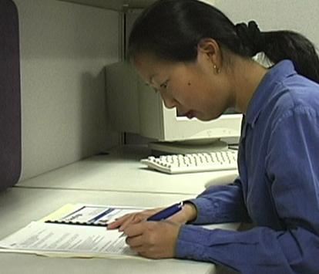
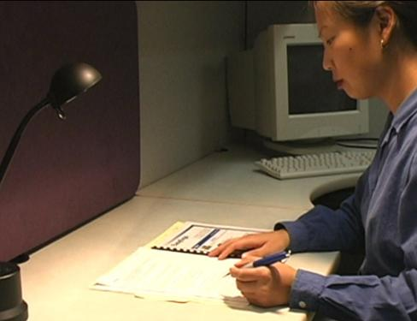
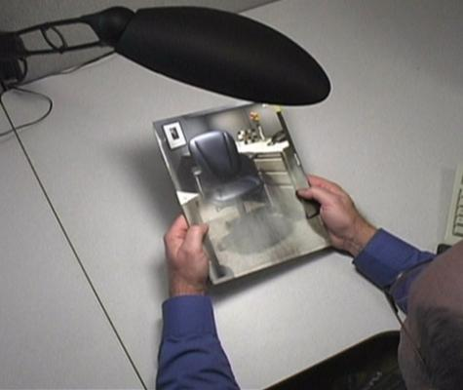
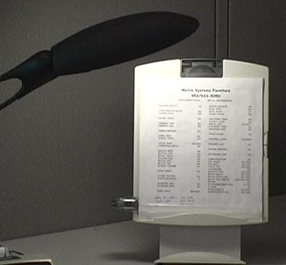
Task Light Solutions
Task lights
Desktop or wall panel lamp
Position light carefully
Reading material

Slide 149
Illumination

Slide 150
Recommended Specifications – Case Study

Slide 151
Assessment Follow-up – Case Study

Slide 152
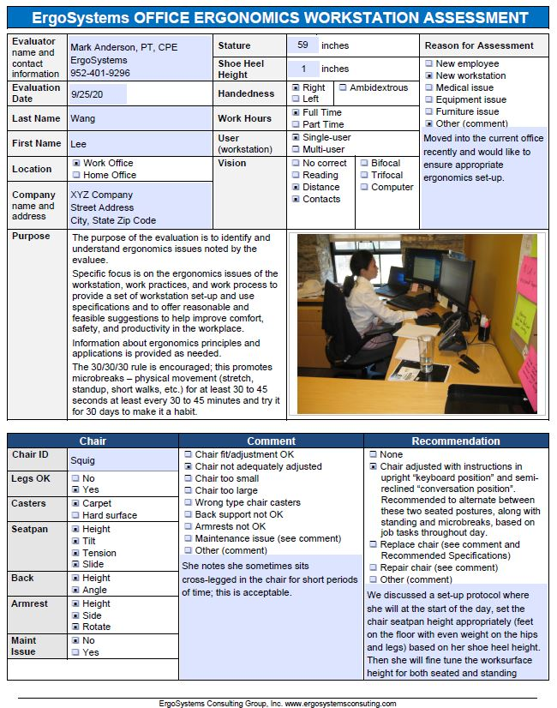
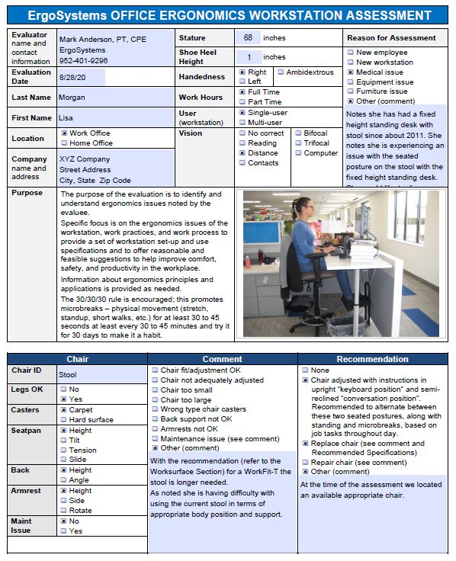
Sample Assessnent Reports

Slide 153
Ergonomics – A Potent Tool!
Great number of factors enter into the office ergonomics workplace
Use the principles and ergonomics analysis process to offer solutions that are practical and effective!

Slide 154
Thanks for your Time and Attention!

Slide 155
WorkWell Prevention and Care and ErgoSystems Present
Office Ergonomics: Introduction for Health Care Professionals (Online)
WorkWell Prevention and Care
ErgoSystems Consulting Group, Inc.
MENU

Slide 156
Course Developer
Mark A. Anderson, MA, PT, CPE
Mark Anderson, MA, PT, CPE is the president and founder of Minneapolis, Minnesota based ErgoSystems Consulting Group, Inc. Anderson started working clinically in the Industrial Rehabilitation arena in the mid 1980’s; this led to his interest in ergonomics. Since 1993, he has been certified by the Board of Certification in Professional Ergonomics as a Certified Professional Ergonomist (www.bcpe.com).
Anderson is a graduate of the University of North Dakota Physical Therapy program and holds a Master of Arts degree in Physical Therapy from the University of Iowa. He has consulted in ergonomics for over 30 years.
Anderson has worked with WorkWell since 2005 developing the current Office and Manufacturing Ergonomics training courses. An experienced consultant and instructor, he has developed and implemented ergonomics consultation and training strategies for a wide range of companies, organizations and local, state and federal government agencies. Including Emerson Process Management, Tescom, Tennant Company, General Electric, Alliant Techsystems, Boston Scientific Corporation, Quaker Oats, Pepsi-Cola, General Mills, Medtronic, Fingerhut, Panama Canal Commission, United States Navy and Marine Corps, United States Customs Service, Social Security Administration, USDA Animal and Plant Health Inspection Service and state and local governments.
Anderson has written a number of publications and spoken nationally and internationally on ergonomics. He has been active in the Upper Midwest Chapter of the Human Factors and Ergonomics Society serving as the past secretary and co-program chair.

Slide 157
Faculty
Kristen Cederlind, OTR/L
Kristen Cederlind, OTR/L joined the WorkWell team in 2013, first serving as a Manager of On-Site Services and more recently, assuming the role of Director of the WorkWell Quality Provider Network.
With over 25 years of experience as an Occupational Therapist, she has consulted with manufacturing employers across the country to develop customized On-Site therapy and wellness programs to improve employee health and safety, while collaborating with the rest of the On-Site team in service implementation, provider training, customer and provider relations and metrics reporting.
Her background includes program development and management of a hospital acute care and outpatient rehabilitation department. Her partnership with WorkWell began in 2003, when the hospital joined the WQP network and received training in FCE, FJA and PWS programs.
While working in the hospital setting, she championed ergonomics initiatives such as safe patient handling and office ergonomics and was able to utilize job analysis and prework screening skills both within the hospital and in her local community.
Kristen is a graduate of the University of Southern California and is a member of both the California and American Occupational Therapy Associations.

Slide 158
Faculty
Dee Daley, PT, DPT
Dee Daley, PT, DPT is a graduate of the University of North Carolina- Chapel Hill and Quinnipiac College physical therapy programs. Dee is currently employed by WorkWell in New Ipswich, NH as Director of Clinical Practice.
Dee has been a member of the WorkWell faculty since 2003, and intermittently teaches as a guest lecturer for PT and PTA schools on topics related to Work Injury Prevention and Management. Dee also holds a degree in Health Professions Education from North Carolina State University.
In addition to clinical practice, Dee has been active in the New Hampshire and North Carolina Chapters of the American Physical Therapy Association (APTA) as President and other roles in the area of Education and Policy.
In addition to helping develop training materials for WorkWell, she has coauthored several publications on the Role of PT in Occupational Health and Wellness, and Safety in Functional testing.
She has also served as a member of the APTA as a working member of the Occupational Health Special Interest Group and Work Rehab Clinical Practice Guideline group

Slide 159
Faculty
Robin Peterson, PT
Robin Peterson PT is a graduate of the University of Minnesota Physical Therapy Program. Robin is currently employed by Regions Hospital in St. Paul MN as Physical Therapist and Supervisor.
Robin has been a faculty member and consultant for WorkWell since 2008. Robin also holds a Bachelor of Arts degree in Distributive Sciences and Psychology from Gustavus Adolphus College in St. Peter MN.
In addition to clinical practice and consulting, Robin Peterson has been an active member in the MN chapter of the APTA since 1987 and has served as the physical therapy alternate member for the MN Medical Services Review Board with the Department of Labor and Industry since 2002.
Robin Peterson is also a member of the National Association of Occupational Health Providers and Human Factor Society.
She co-authored Smart Tracks patient management system, Volumes I and II.

Slide 160
Faculty
Marc Yeager, PT, MPT
Marc Yeager, MPT, is a graduate of Loma Linda University, where he received a bachelor’s degree in Life Sciences and a Master of Physical Therapy degree in June 1993. Marc is the Managing Principal of Injury Prevention & Management Consulting.
Marc has been a member of the American Physical Therapy Association since 1994 and the Georgia Physical Therapy Association since 1997. He has been a faculty member for WorkWell Systems since 2006. He achieved the distinction of WorkWell Master Clinician in 2001 with certifications in Functional Capacity Evaluations, Functional Job Analysis, Return to Work Clinical Pathways, Functional and Office Ergonomics.
Marc founded Highland Park Physical Therapy in 2001, shortly before joining WorkWell Systems as an Occupational Health Specialist developing injury prevention and management programs, including Rapid Return to Work, Stress Factor Analysis, and supportive training materials, in addition to implementing internet-based injury prevention and management programs for industrial clients.
Marc has assisted in the development and implementation of on-site ergonomic programs for a Silicon Valley-based high-tech Fortune 100 Company and served as a member on their ergonomic safety committee as an external consultant.

Slide 161
Menu
Title Slide
Welcome
Objectives/Guidelines
Worksheet/Reference Guide
Case Study – Introduction
Office Components
Chair
Worksurface
Sit/Stand Workstation
Foot Support/Clearance
Keyboards
Trays
Mouse
Laptop/Desktop
Monitors
Document Holder
Telephone
Storage
Illumination
Recommended Specifications
Sample Reports
Summary/Close
Resources
Faculty
Menu

Slide 162
Schedule 10 min. break mid way through class - at faculty discretion
Topics
Successful office workplace
Office Ergonomics Evaluation Worksheets – Introduction
Office Ergonomics – Case Study Introduction
Typical office components - review
Office ergonomics evaluation (worksheet review)
Recommended Specifications
Sample Office Ergonomics Assessments
Summary and Close
Downloadable Handouts and Forms
Workstation Evaluation Worksheets (fillable pdf)
Office Ergonomics Quick Reference Guide (pdf)
Common Keyboard Shortcuts
Post Course Online Assessment (link sent following training)

Slide 163
Resources
Evaluation Worksheets
Office Ergonomics Workstation Assessment Worksheet PDF Fillable Template with Pictures
Office Ergonomics Workstation Assessment Worksheet PDF Fillable Template without Pictures
Office Ergonomics Workstation Assessment Worksheet PDF Manual Entry
Quick Reference Guide
Office Ergonomics Assessment Quick Reference Guide (PDF)
Manual
Office Ergonomics Training Manual (PDF)
Case Study – Example Reports
Ergonomics Workstation Assessment Worksheet Example 1
Ergonomics Workstation Assessment Worksheet Example 2
Ergonomics Workstation Assessment Worksheet Example 3

